Slide 1

Advertising

Slide 2
Advertising is providing information, calling attention to, and making known something that you want to sell or promote.

Slide 3


More Detail - Advertising is a message designed to promote or sell a product, a service, or an idea.

Slide 4
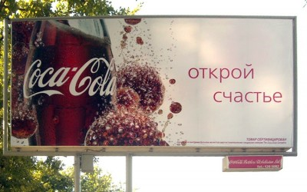
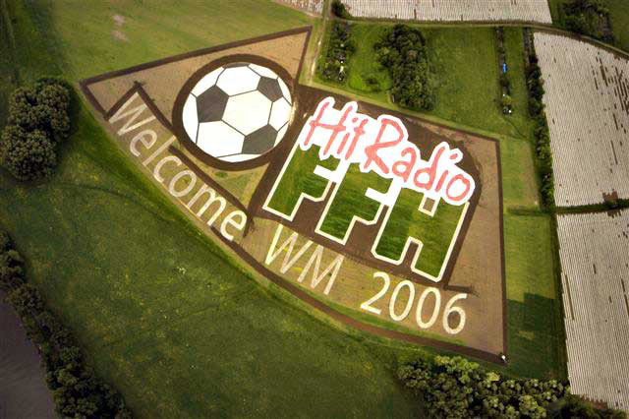
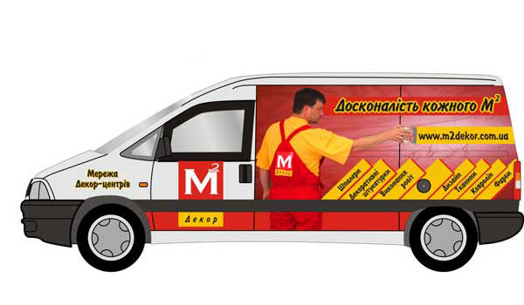
Advertising reaches people through varied types of mass communication.
In everyday life, people come into contact with many different kinds of advertising.

Slide 5

For example:

Slide 6
My favourite TV advertising.
I love all advertising. But my favourite advertising is about chocolate such as “Korona” and “Roshen” and “Rafaello” because it`s very romantic, tempting, bright, harmonic, with good and romantic music by favorite singers.

Slide 7
Please, enjoy the following advertising

Slide 8


Slide 9



Slide 10


Slide 11


Slide 12


Slide 13


Slide 14
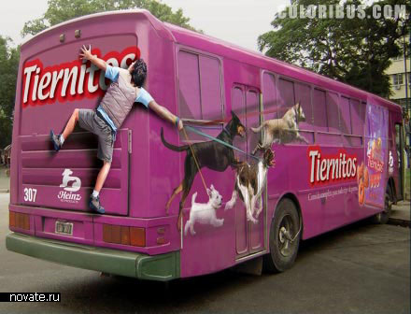
Printed ads are found in newspapers and magazines. Poster ads are placed in buses, subways, and trains.

Slide 15
Neon signs are scattered along downtown streets.
Billboards dot the landscape along our highways. Commercials interrupt radio and television programming.

Slide 16
For example:

Slide 17
My favorite billboards advertising!
I like various billboards. But my favorite billboards advertising is about correction of child`s sticking out ear. Cheburashka is painted there.

Slide 18


It is very funny and original advertising.

Slide 19

Advertising is a multibillion dollar industry (more than $100 billion a year) in the U.S.

Slide 20
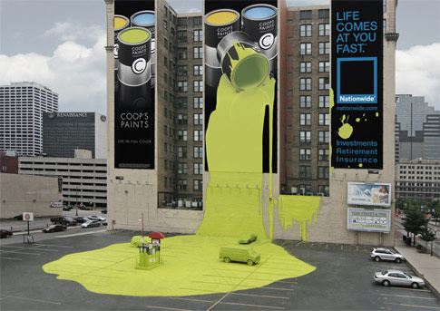
In many businesses, sales volume depends on the amount of advertising done.

Slide 21
Manufacturers try to persuade people to buy their products. Business firms use advertising to promote an "image" for their company.

Slide 22
Businesses use advertising to gain new customers and increase sales.

