Slide 1
Ukrainian cuisine
by Olga Butryk

Slide 2
Plan
Foreword;
Briefly about the history;
Features of Ukrainian cuisine;
The most popular Ukrainian dishes:
Soup: Borshch, Kapusniak, Rosolnyk, Sorrel soup;
Varenyky;
Bread;
Salo;
Kvass;
Mead;
Cabbage roll;
Holodets.
Sayings about food;
Conclusion.

Slide 3
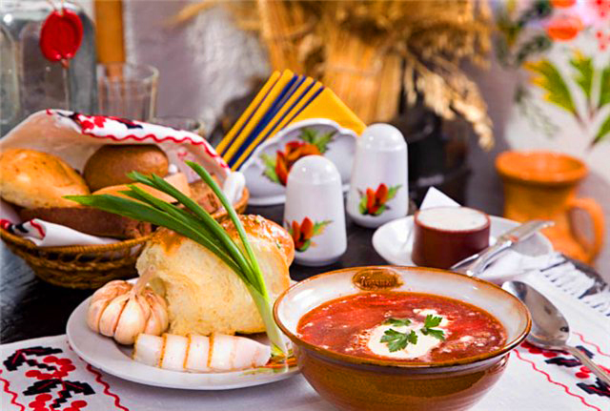
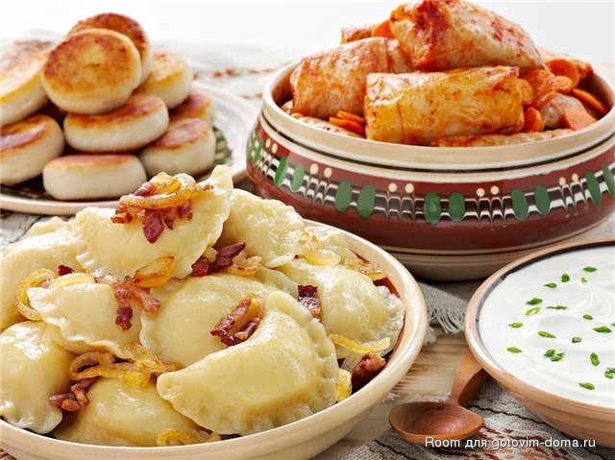
Foreword
Ukrainian cuisine has a rich history and offers a wide variety of dishes.
Ukrainian cuisine is rich in taste and nutritional value.
Ukrainian cuisine has dozens thousands of food recipes, which are characterized with high taste qualities.
The modern national culinary art preserved and enriched the old good traditions.
The Ukrainian food is characterized with large number of components.
For example the traditional Ukrainian food – borsch – contains 20 components.
Popular ingredients in the cuisine of Ukraine are meat, mushrooms, vegetables, berries, fruit and herbs.

Slide 4

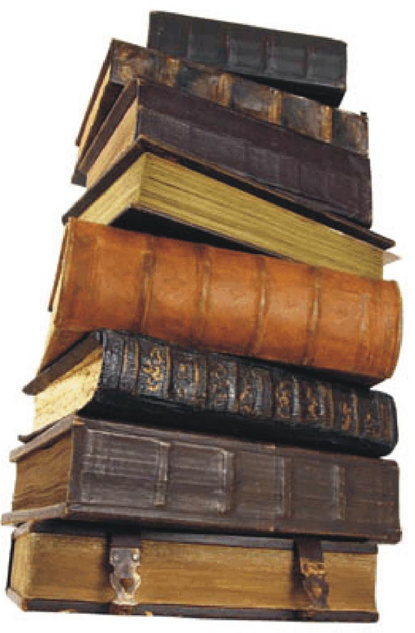

Briefly about the history
Ukrainian cuisine has developed quite late, mostly to early - mid XVIII century., And finally - the beginning of XIX century. Until then, it was difficult to separate from her family of Polish and Belarusian cuisine. This is explained by the duration and complexity of the process of formation of the Ukrainian nation and the Ukrainian state. Indeed, the formation of the Ukrainian nation began only in the XVII century. and completed 100 years later.
Ukrainian cuisine was created for centuries, so it is to a certain extent reflects not only the historical development of the Ukrainian nation, its customs and tastes, but also social conditions, natural and climatic features, which was the Ukrainian people in the process of historical development.

Slide 5
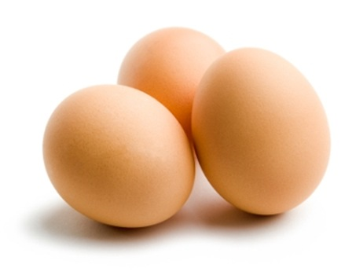
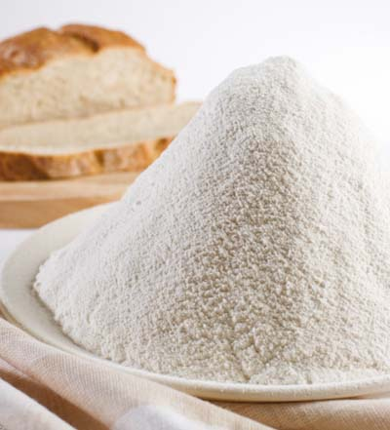
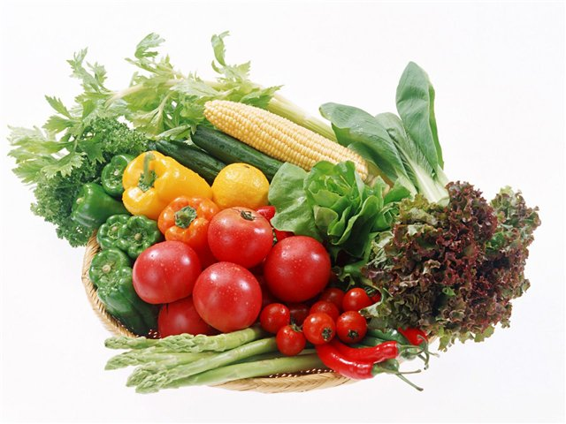
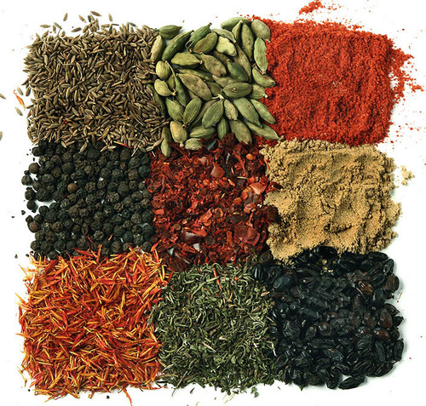
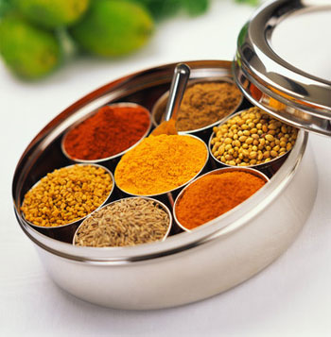
Features of Ukrainian cuisine;
For ukrainian cuisine is acceptable frequent use of eggs, flour and vegetables. The most popular vegetables - beets, beans, carrots, pumpkin, corn and tomatoes.
Of condiments and seasonings national Ukrainian cuisine recipes actively use garlic, onion, cumin, mint, angelica, red pepper, savory, cinnamon and bay leaf.
In Ukrainian cuisine tens of thousands of recipes that distinguishes simple preparation and high palatability. Modern national culinary arts preserved and enriched the long-standing good tradition.

Slide 6
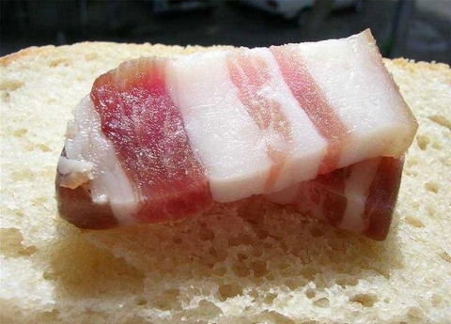
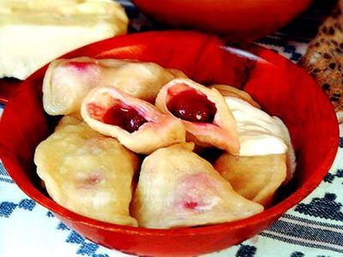
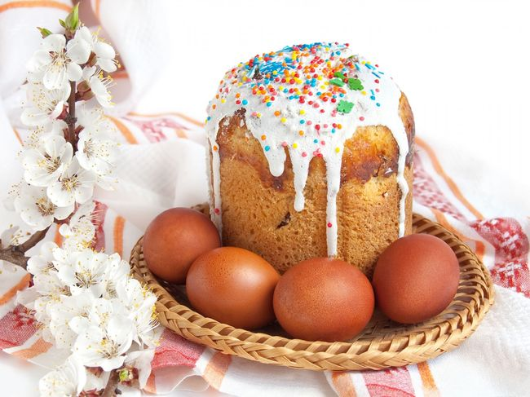
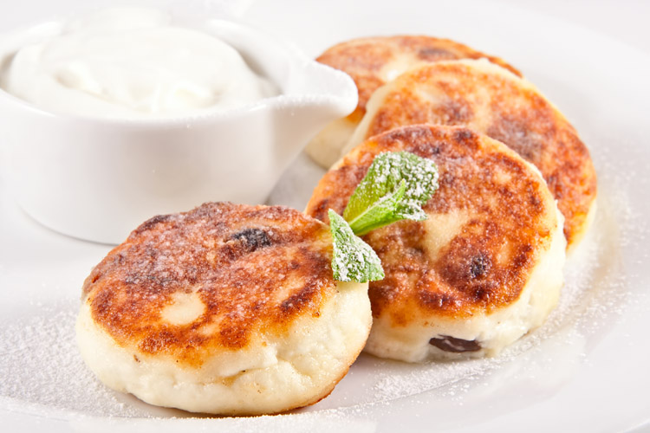
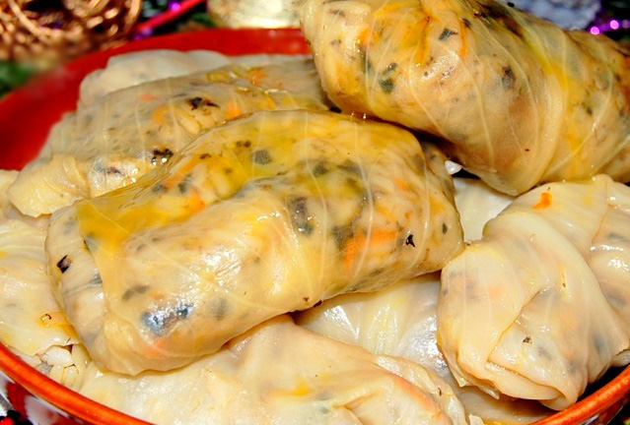
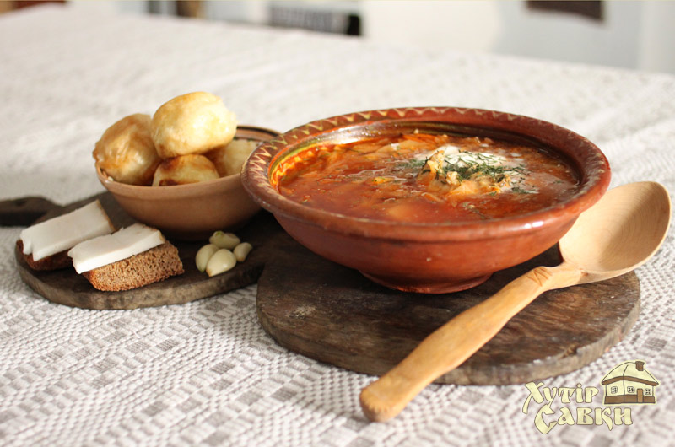
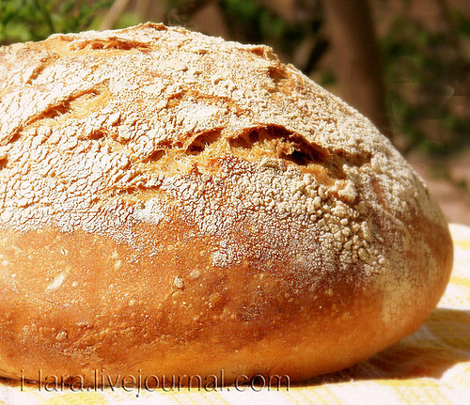
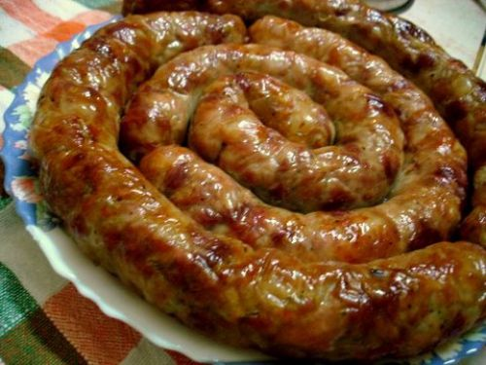
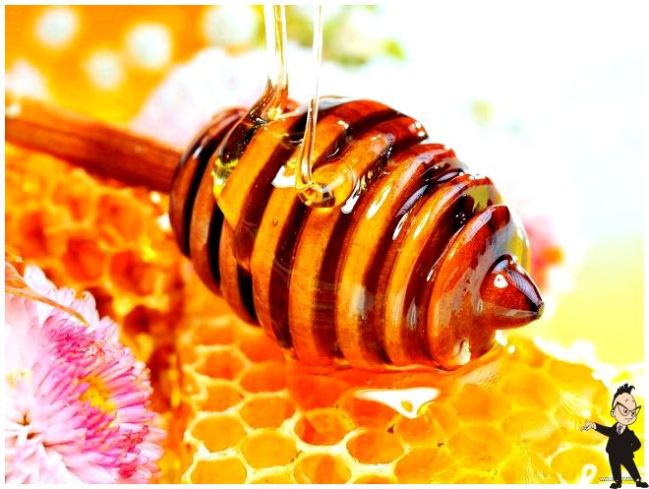
The most popular Ukrainian dishes

Slide 7
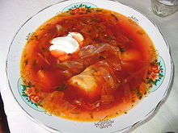
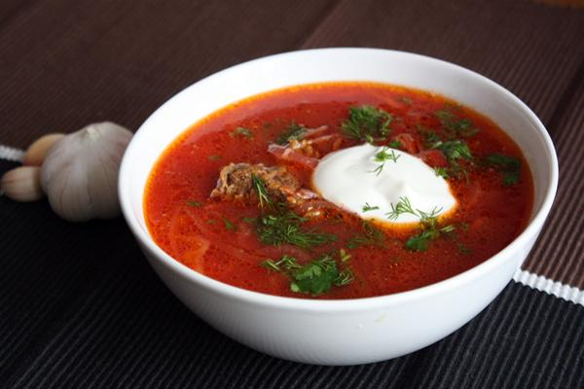
Soup:
Borshch (borshch) is a vegetable soup made out of beets, cabbage, potatoes, tomatoes, carrots, onions, garlic, dill. There are about 30 varieties of Ukrainian borscht soup, and the dish often includes meat. In Ukrainian cuisine, it can be a vegetable soup or based on either chicken or other meat bouillon. Traditionally borshch is served with pampushki and smetana. Main ingredients include specially prepared red beets, potatoes, carrots, beans (e.g. broad beans, green runner beans, butter beans or other varieties), celery, fresh or dried mushrooms (optional), herbs (e.g. fresh dill and/ or parsley), chopped cabbage, chopped fresh tomatoes or tomato sauce.

Slide 8
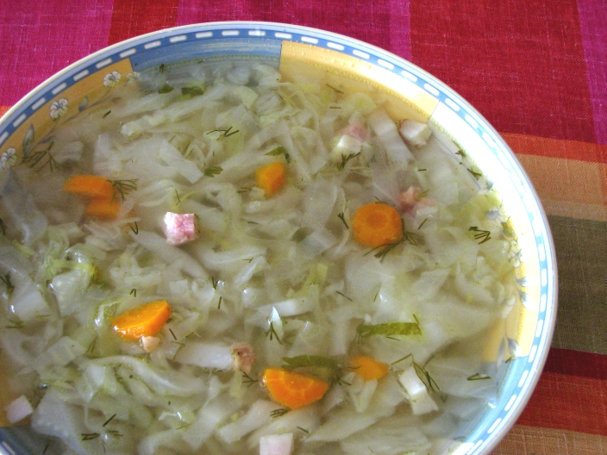
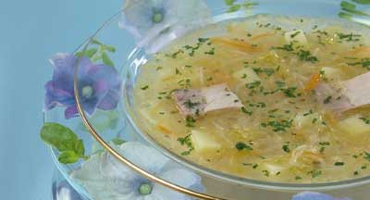
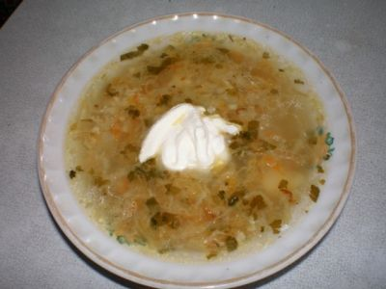
Kapusniak - Cabbage soup is a filling vegetable soup of sauerkraut and/or white cabbage(s). There are different types of cabbage soup, prepared with different ingredients. Vegetarian cabbage soup uses mushroom stock and there is another variety using a fish stock. Traditional cabbage soup is prepared using a pork stock. Kapusniak is served hot, in some regions with sour cream and sprinkled with chopped parsley and dill. In Ukraine kapusniak is served at weddings, wakes and funerals as a main dish.

Slide 9
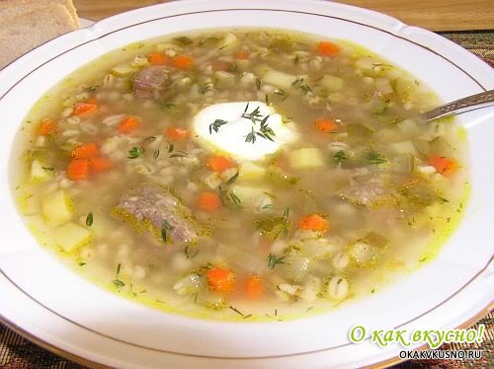
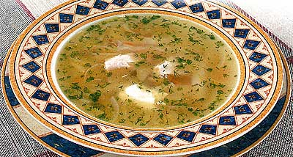
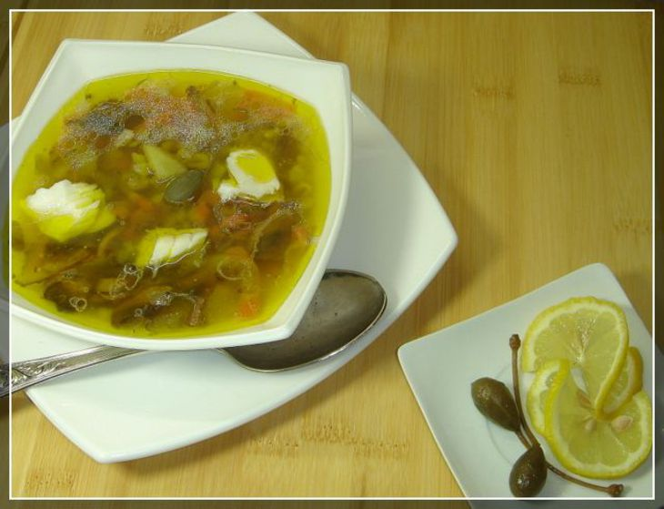
Rosolnyk — the first liquid food, an essential element of which is salty cucumbers. The structure may also include meat, pluck, different cereals (rice, buckwheat, barleys), vegetables (potato, carrot, onion, roots parsley,saler or parsnips), spices and greens. Serves with cream.

Slide 10
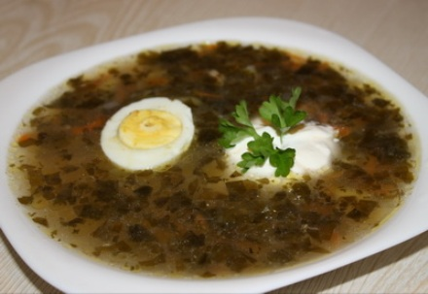
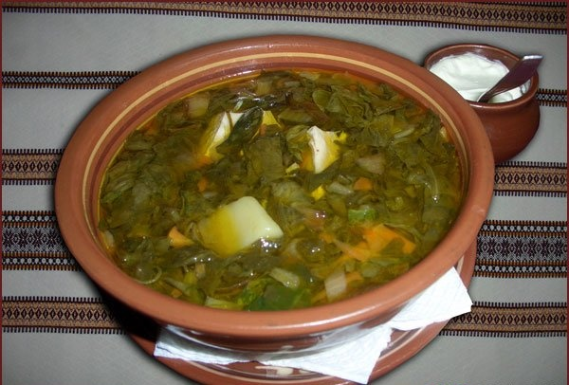
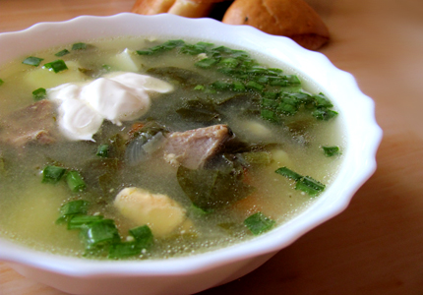
Sorrel soup (Green borsch) - is a soup made from water or broth, sorrel leaves, and salt. Other possible ingredients are egg yolks or whole eggs (hard boiled or scrambled), potatoes, carrots, parsley root, and rice. It can be served hot or cold, and is usually garnished with sour cream. It is known in Russian, Polish, Ukrainian, Lithuanian, Latvian, and Eastern European Jewish cuisines

Slide 11
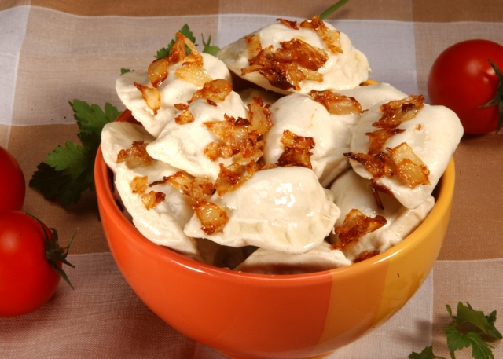
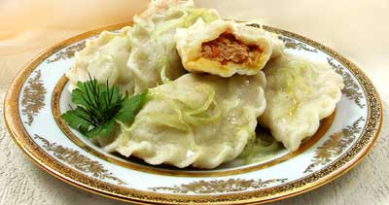
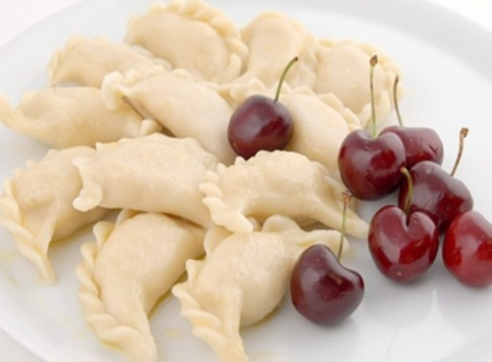
Varenyky
No less typical Ukrainian dish is varenyky. In some ways similar to their preparation Siberian pelmeni or Caucasian manta rays, but the fundamental difference is that instead of stuffing dumplings in commonly used vegetative, vegetable or berry stuffing. For example, there are varenyky with cherries, potatoes, cabbage or curd.

Slide 12
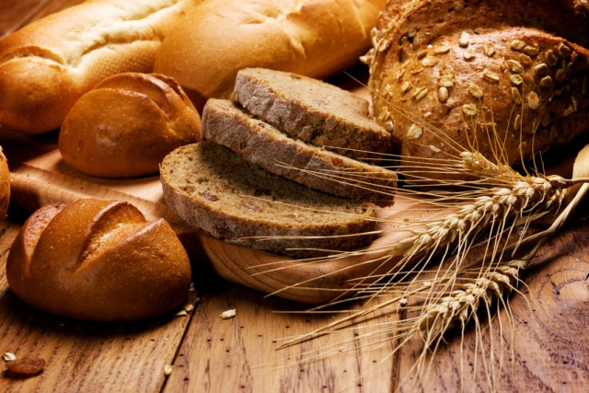
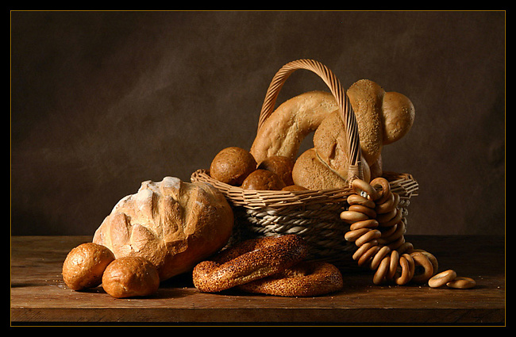
Bread
The centerpiece of Ukrainian ration takes the bread that is baked from rye and wheat flour. All this prepared using sour sourdough and baked in a traditional oven. Also sour, there is unleavened bread, which in Ukrainian cuisine are several types. From unleavened dough, for example, make galushki. In confectionery products often use shortcrust pastry.

Slide 13
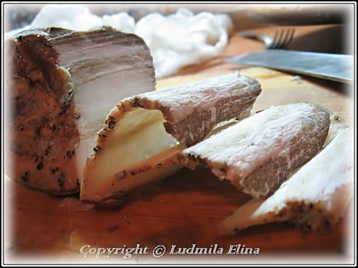
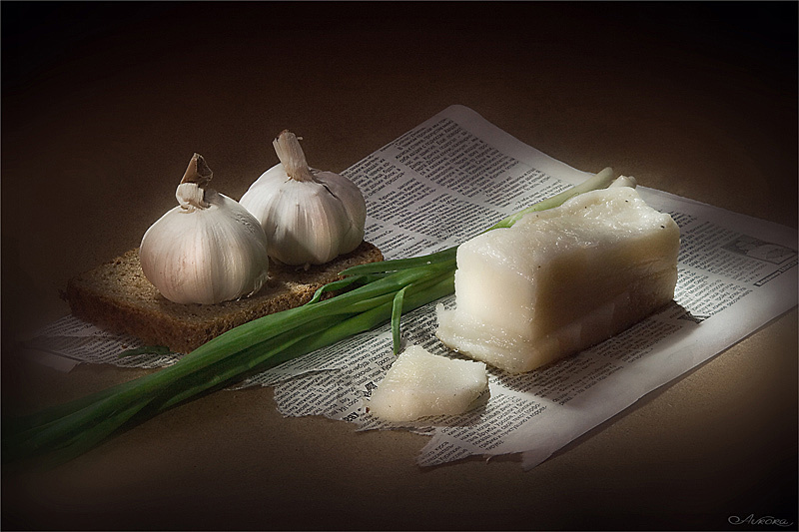
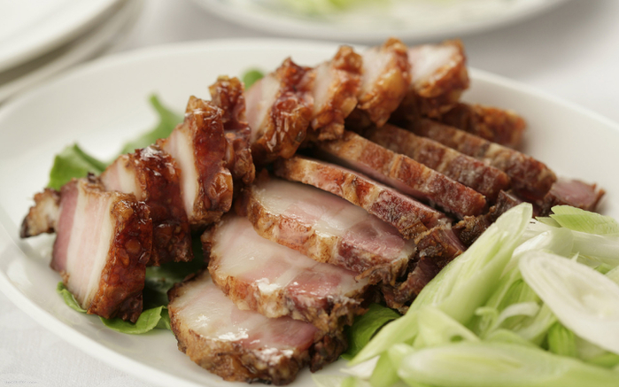
Salo
When it comes to the Ukrainian Salo is something of unsurpassed. They really eat it in all imaginable kinds. It comes almost to chocolate. Fat is salty, fried, raw and cooked, boil and smoked, it prepared almost all the rest of the food, they spy on meat less of selected breeds of animals, it is paired with molasses and honey. Even desserts fry! Well the fat of the fact that this product is totally некапризный. It is stored for a long time it easy to handle and almost impossible to spoil.

Slide 14
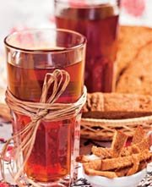
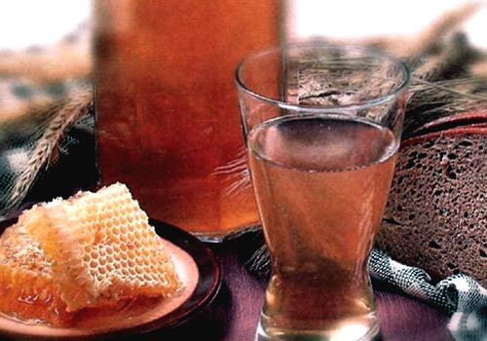
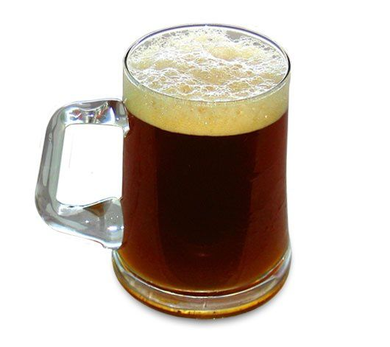
Kvass
The main Ukrainian drinks for a long time were meads, kvass, beer, grape wine, gorilka (vodka) and various liqueurs. Kvass - the most popular drink that is good thirst quencher, contains vitamins B1 and E the set of enzymes and quite easy to cook. Usually kvass required grain crackers and kvass wort, which every woman saves for subsequent preparation of the beverage. Not only does a brew of bread. It can be made from berries or vegetables, however, and in the usual kvass is often added for taste horseradish, berries, apples, pears, mint or sea buckthorn.

Slide 15
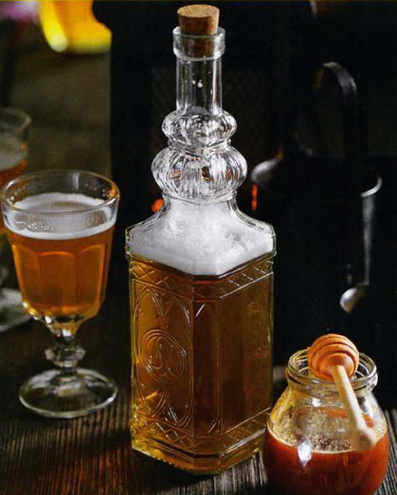
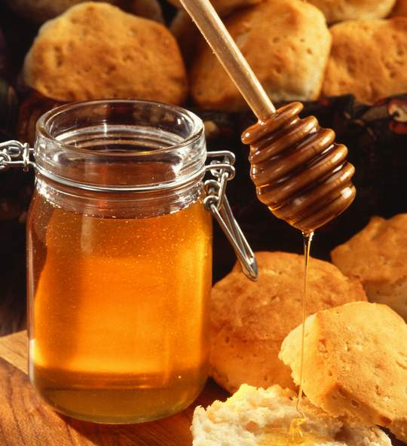
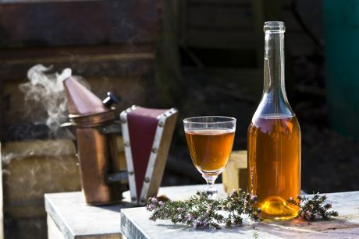
Mead
Another, no less ancient and legendary drink - honey or mead. This single Slavonic drink appeared in pre-Christian period, originally was used for ritual purposes. Honey predates Scotch whiskey, Mexican tequila or Japanese sake. Extremely useful to have healing properties of honey preparing yeast and honey with the addition of pollen, hops, spices, roots and berries. Drinking mead taken before a meal, this drink is an aperitif, appetizing.

Slide 16
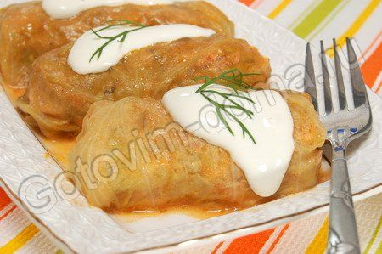
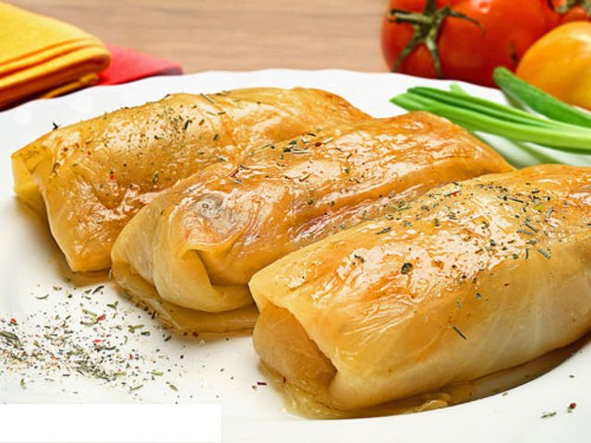
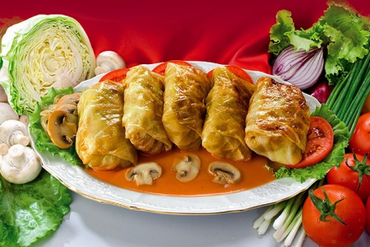
Cabbage roll
A cabbage roll (also stuffed cabbage or pigs in a blanket) is a dish consisting of cooked cabbage leaves wrapped around a variety of fillings. It is common to the ethnic cuisines of the Balkans, as well as other parts of Europe such as Finland and Sweden, and the Middle East. The name of this ancient cuisine, derived from the word "dove", which indicates that its symbolism. Live pigeons are considered symbols of spiritual beings and creative forces in the birth of the world.

Slide 17
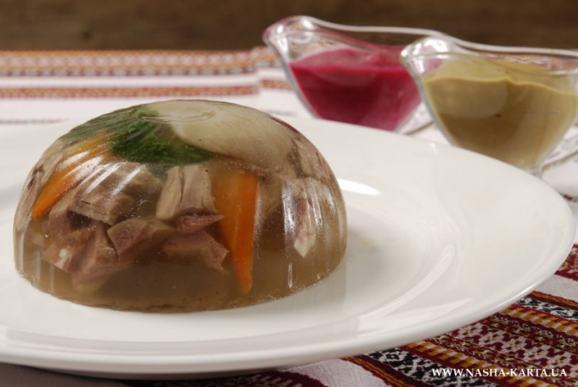
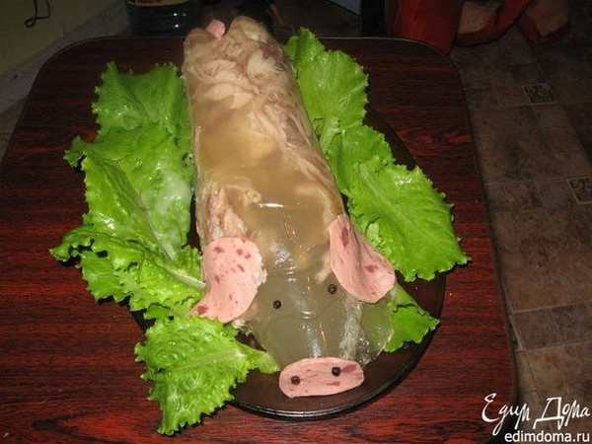
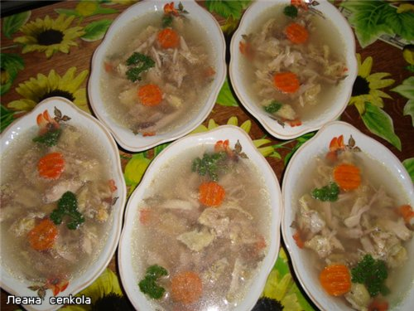
Holodets
Dish of thickened to a gelatinous mass on cooling beef broth with chunks of meat. Aspic is not a form filler, as jelly-like consistency of jellied dishes is a consequence of the use of gelling agents, such as gelatin and agar-agar, a holodets dish is an independent, not requiring supplementation.

Slide 19
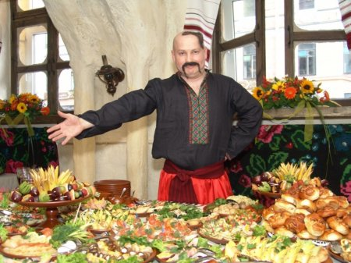
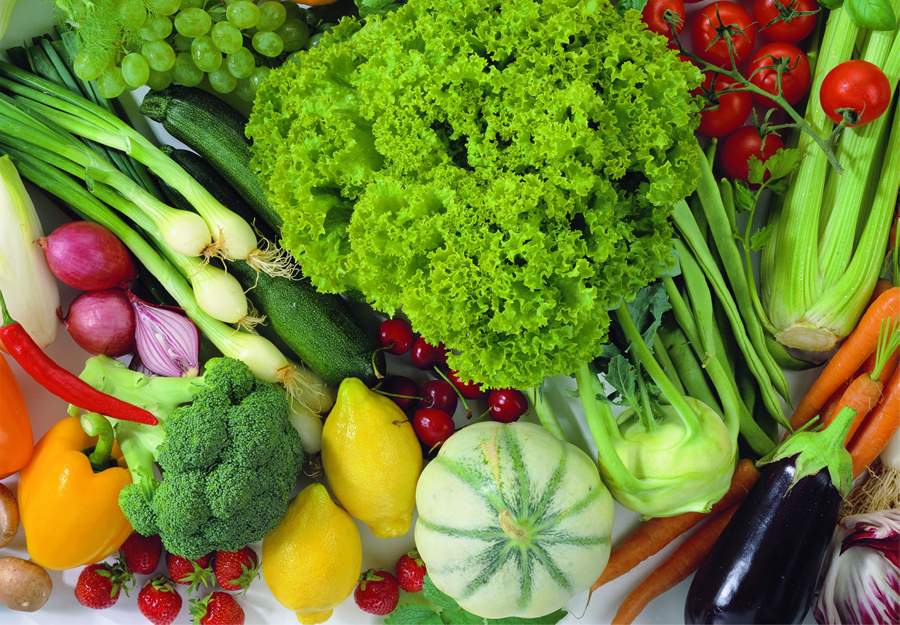


Conclusion
Ukrainian cuisine has its own uniqueness and originality. Unlike other cuisines dishes, most celebrated dishes of Ukrainian cuisine recipes difficult and complex combined methods of preparation. Every meal should be not only nutritious, but also delicious. Ukrainian peasants had a lot and work hard, and perhaps that is why, during the last millennium, our hostess created recipes are not complicated but surprisingly delicious.

Slide 20









Thanks for your attention!!!

