Slide 1
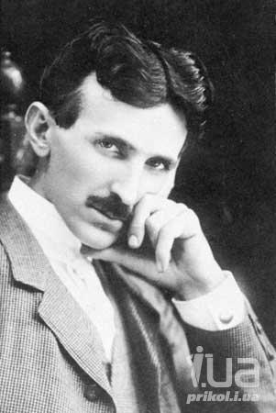
O. HENRY

Slide 2
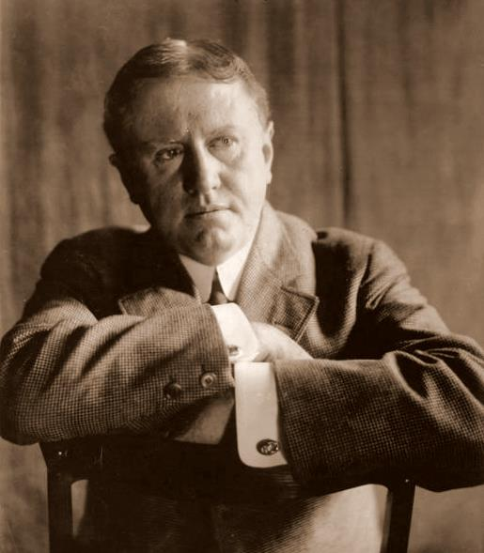
Born William Sidney Porter
September 11, 1862
Greensboro, North
Carolina
Died June 5, 1910 (aged 47)
New York City
Pen name O. Henry,
Olivier Henry,
Oliver Henry
Occupation Writer
Nationality American
Portrait of O. Henry, by W. M. Vanderweyde, 1909

Slide 3
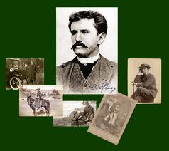
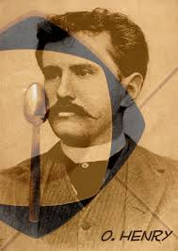

William Sydney Porter (O. Henry) was born in Greensboro, North Carolina. His father was a physician. When William was three, his mother died, and he was raised by his paternal grandmother and aunt. William was an avid reader, but at the age of fifteen he left school, and then worked in a drug store and on a Texas ranch. He moved to Houston, where he had a number of jobs, including that of bank clerk. After moving to Austin, Texas, in 1882, he married.

Slide 4
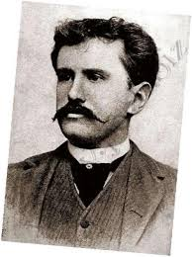
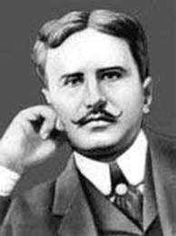
In 1884 he started a humorous weekly ”The Rolling Stone.” When the weekly failed, he joined the “Houston Post” as a reporter and columnist.
While in prison O. Henry started to write short stories to earn money to support his daughter Margaret. His first work, "Whistling Dick's Christmas Stocking" (1899), appeared in McClure's Magazine. Porter emerged from the prison in 1901 and changed his name to O. Henry.

Slide 5

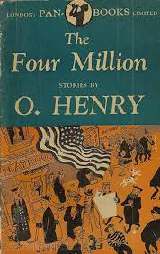
O. Henry moved to New York City in 1902 and from December 1903 to January 1906 he wrote a story a week for the New York World, also publishing in other magazines.
Henry's first collection,
”Cabbages And Kings”
appeared in 1904. The
second, ”The Four Million”, was published two years later and included his well-known stories "The Gift of the Magi" and "The Furnished Room". The Trimmed Lamp (1907) included "The Last Leaf". Henry's best known work is perhaps the much anthologized "The Ransom of Red Chief", included in the collection ”Whirligigs” (1910). ”The Heart Of The West” (1907) presented tales of the Texas range. O. Henry published 10 collections and over 600 short stories during his lifetime.

Slide 6



Slide 7
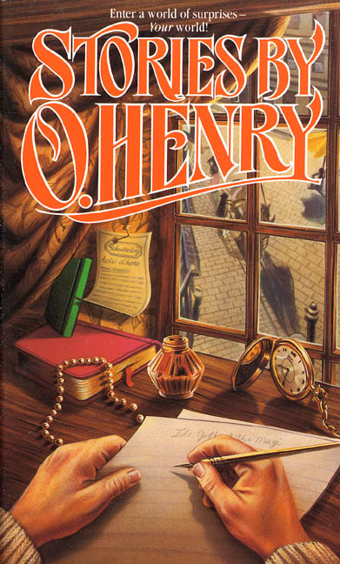

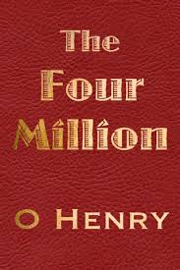
O. Henry published 10 collections and over 600 short stories during his lifetime.

Slide 8
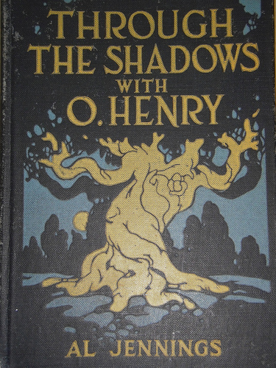
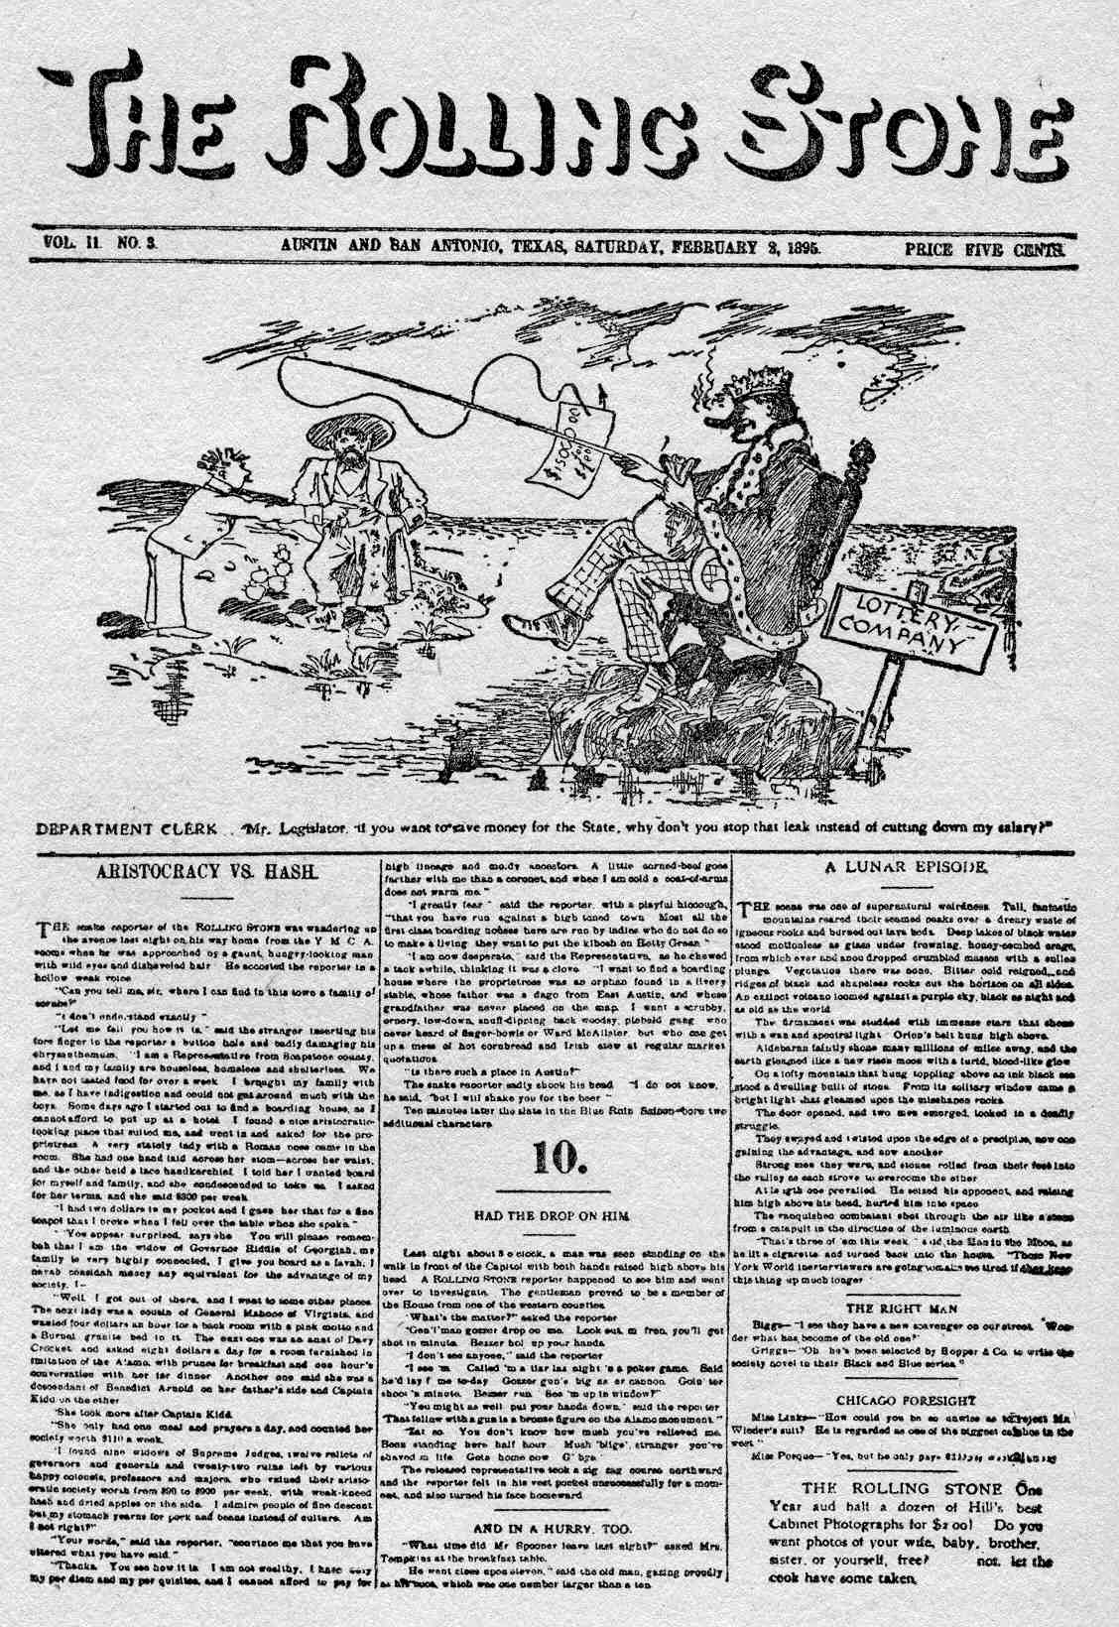
O. Henry's last years were shadowed by alcoholism, ill health, and financial problems.
He married Sara Lindsay Coleman in 1907, but the marriage was not happy, and they separated a year later.
O. Henry died in 1910, in New York. Three more collections, ”Sixes And Sevens” (1911), ”Rolling Stones” (1912) and ”Waifs And Strays” (1917), appeared posthumously.

Slide 9
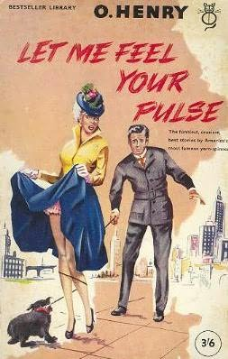
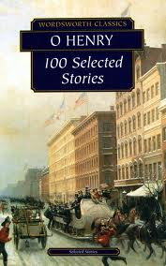
Collections:
«The Four Million» 1906
«The Trimmed Lamp» 1907
«Heart Of The West» 1907
«The Gentle Grafter» 1908
«The Voice Of The City» 1908
«Roads Of Destiny» 1909
«Options» 1909
«Whirligigs» 1910
«Strictly Business» 1910
«Sixes And Sevens» 1911
«Rolling Stones» 1912
«Waifs And Strays» 1917

