Slide 1
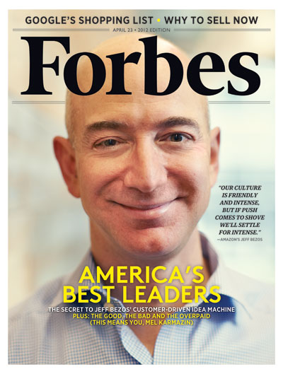
JEFF BEZOS

Slide 2
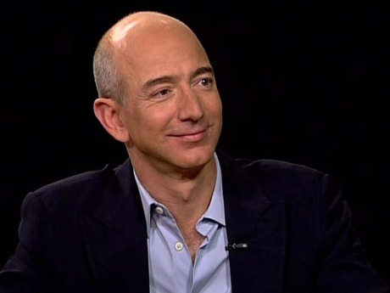
JEFF JORGENSEN (BEZOS)
Bezos, was born 1964 in Albuquerque, New Mexico. Jeff, born of a mother under 18 years, as soon as he was born and his father escaped. Jeff Bezos, education has shown a very successful life. After graduating from River Oaks Elemantary School, graduated from high school gifted children and graduated first in his class in the Faculty of Computer Science at Princeton University.

Slide 3
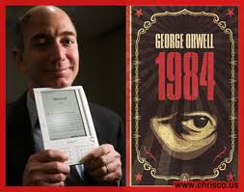
Business Life
In 1986,company started to work in Fitel after receiving the bachelor’s degree. In December 1990, was hired as vice president of DE Shaw hedge fund company. DE Shaw, the company is a result of the company's research suggested that the internet has to buy books in the first step, not acceptance resign and he embarked on this work.

Slide 4
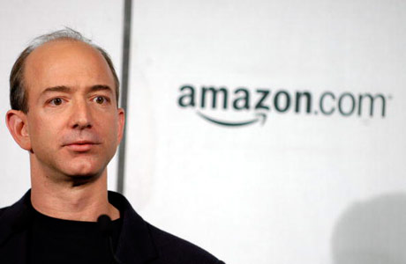
Amazon.com
Jeff Jorgensen (Bezos) founded “amazon.com” something never seen before in the world. Internet has created the most recognized brand, was one of the richest men in the world. Jeff Bezos, which is one of the most popular internet shopping websites are made, which was founded on July 16, 1995 "amazon.com" the founder and owner.

Slide 5
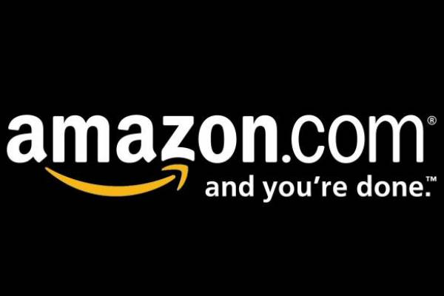
This is a great brand's founder Jeff Bezos, the brand found by searching the dictionary. The brand's first letter "A" wants to be, especially Jeff, move up one rank in alphabetical thought can make a difference. Dictionary "A" investigating things that begin with the letter, which is considered the world's largest river, the Amazon river ended and has made the decision that name. As the reason for choosing the name of the Amazon, lies one day wants to be such a big company.

Slide 6
Now,
"Kindle Fire" (read Amazon's tablet computer) has created a new revolution in book publishing. This pocket book is a book-sized tablet for half the price of a book printed at any time and anywhere to download and read the book possible. The book is possible to make out the payment in the same computer. A lot of free dictionaries and classics, the computer can be installed without payment.

