Slide 1
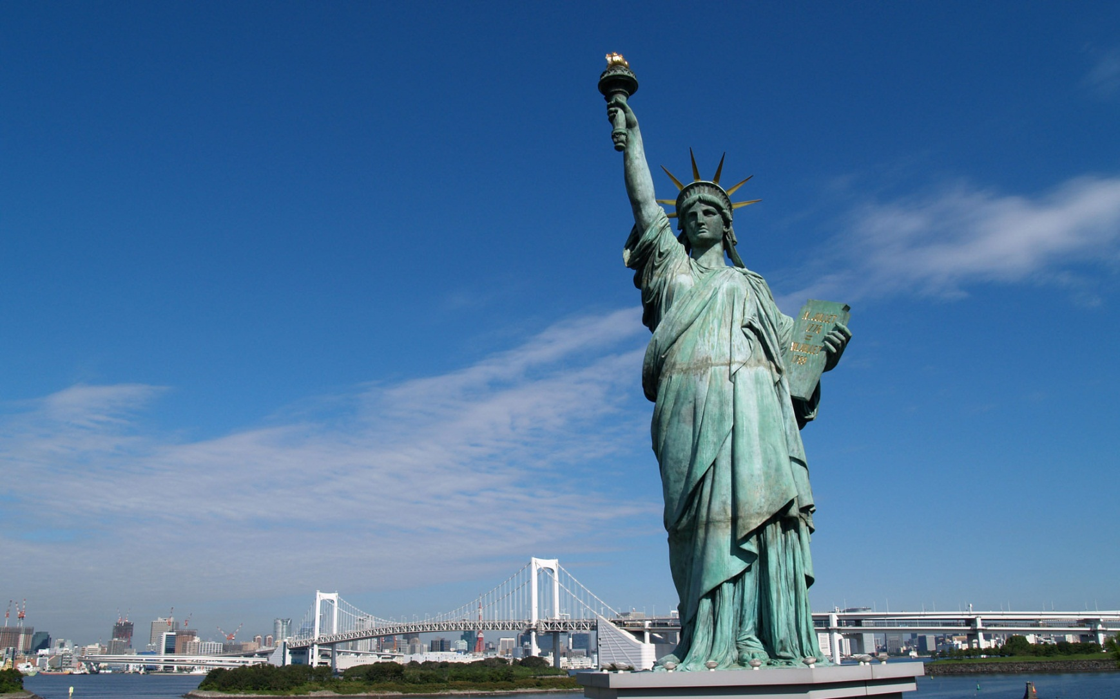
The history of the USA

Slide 2
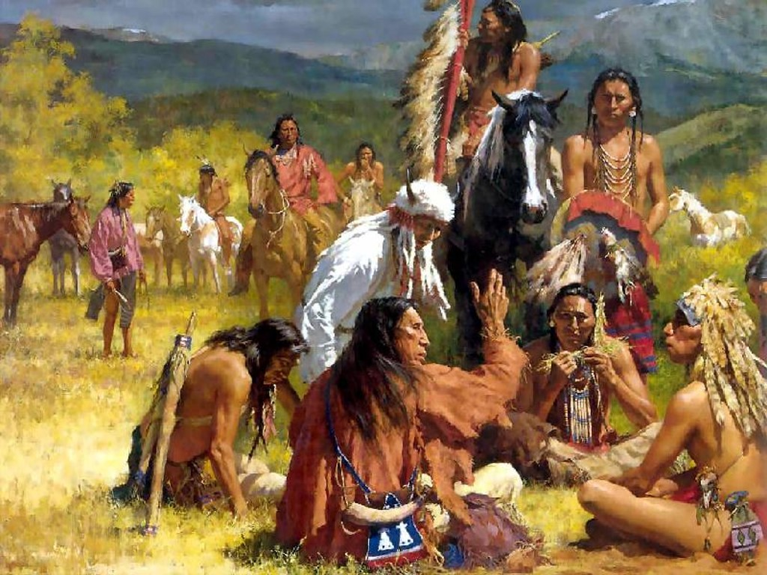
American Indians

Slide 3
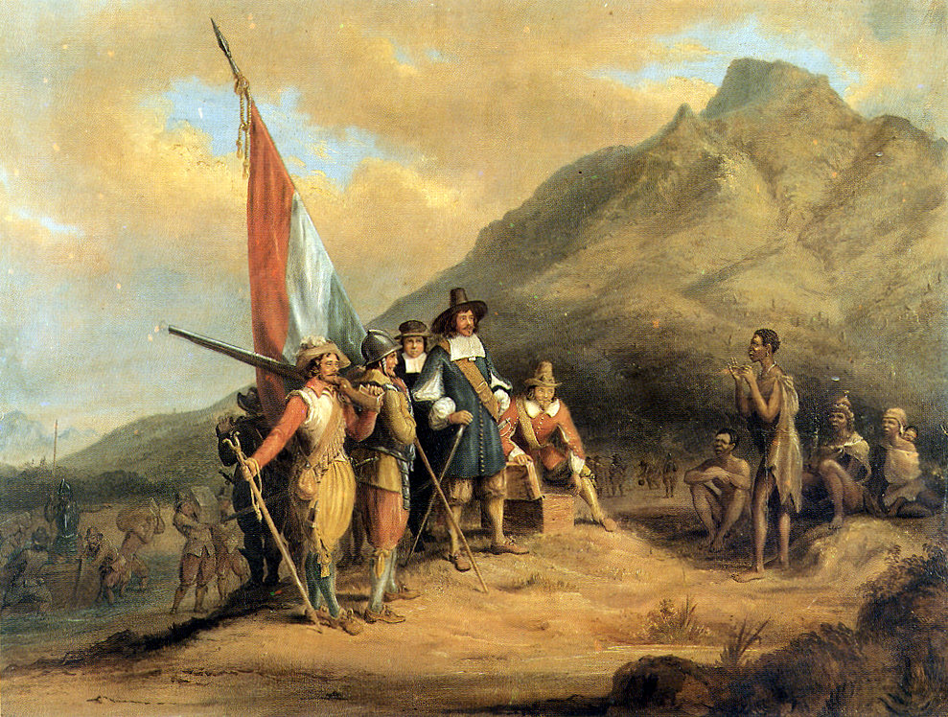
Modern America was created by European settlers

Slide 4
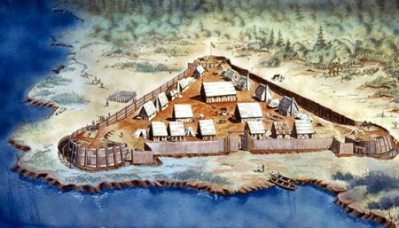
The first colony in North America was founded in 1607 in Jamestown

Slide 5
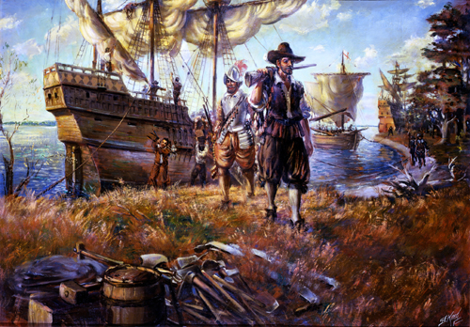
The Pilgrims arrived in Mausachusets in 1620

Slide 6
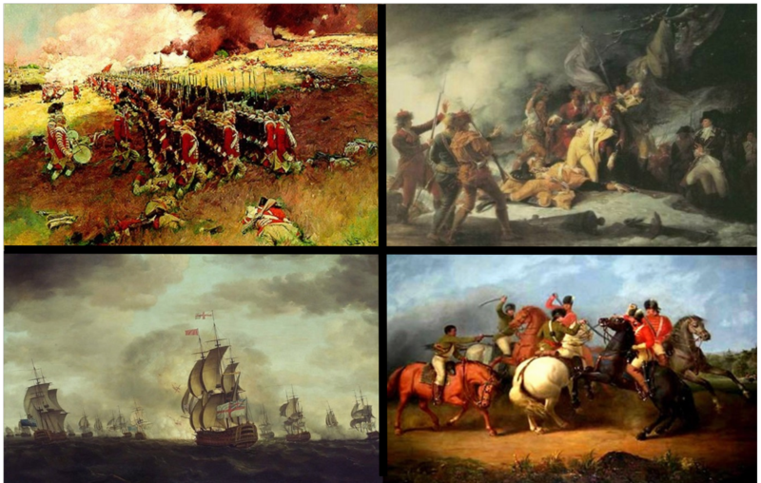
The War of Revolution

Slide 7
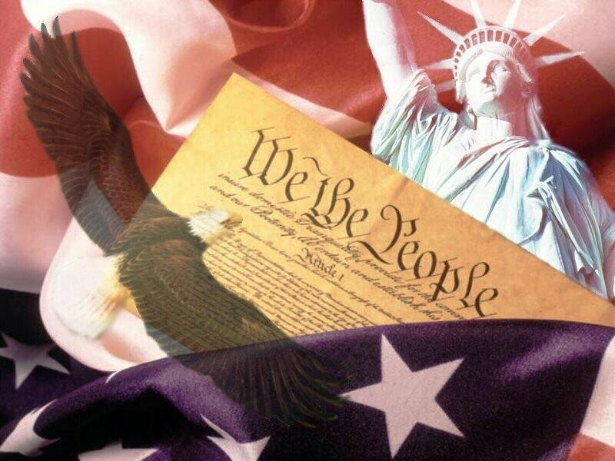
Constitution of the USA. 1787

Slide 8
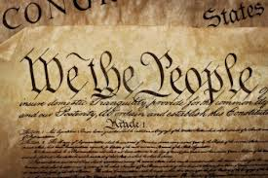
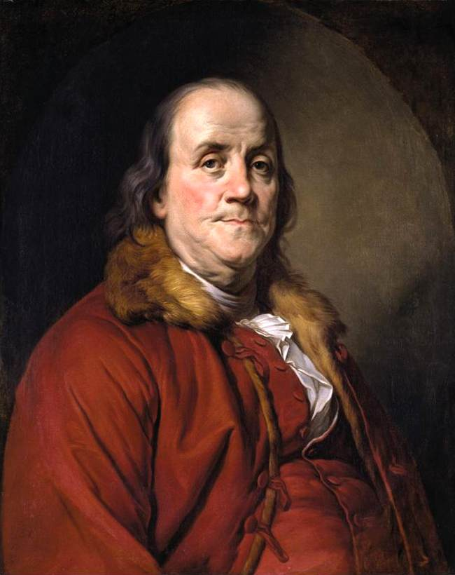
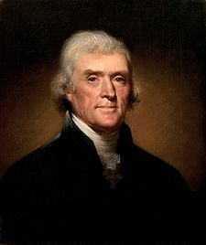
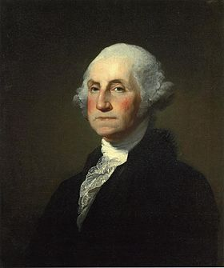
Thomas Jefferson. George Washington. Benjamin Franklin.

Slide 9
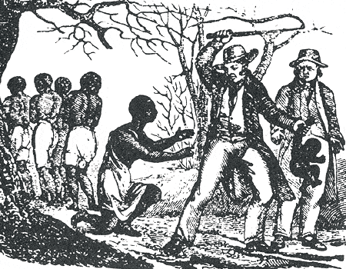
The Slavery
South – plantations;
North – slavery was illegal

Slide 10
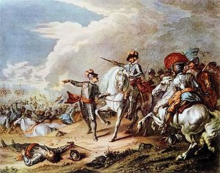
The Civil War
(1642–1651)

Slide 11
Social changes

Slide 12
Women’s role

