Slide 1
Tetyana Yablonska
1917 - 2005

Slide 2
Biography
Yablonska was born in Smolensk,Russia.Her father was a famous teacher.In 1928 their family moved to Luhantsk,Ukraine She studied at the Kiev State Institute of Art .She worked very productively until the very end of her life, reportedly painting her last pastel etude on the very day of her death. She elected as Member of parliament of USSR in 1951–58, became member of the Ukrainian Artists' Union in 1944, member of the board of the USSR Artists' Union in 1963, member of the Academy of Art of the USSR in 1975.

Slide 3
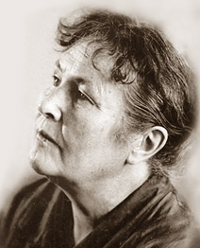
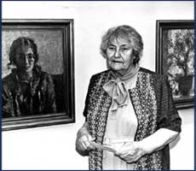
Her early vital pictures are devoted to work and a life of Ukrainian people. She has passed to generalizing images of the nature, differing a subtlety of plastic and color rhythms.

Slide 4
She has had more that 30 private exhibitions in London,Moscow, Budapest, Kiev and other cities.
She has had many honors including :
“Peoples Artists of the USSR" in 1982,
"Artist of Year" (UNESCO) in 1997,
"Woman of Year“ (Cambrige,2000)
She was the winner of the USSR State Prize (Stalin prize: 1949, 1951 and State Prize: 1979), winner of the Shevchenko State Prize of Ukraine (1998).
She died June 17 of 2005 in Kiev,from long illness.

Slide 5
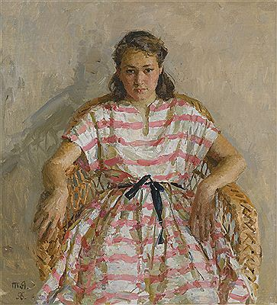
Tatyana Yablonsky’s works
The portrait of her daughter,
1943

Slide 6
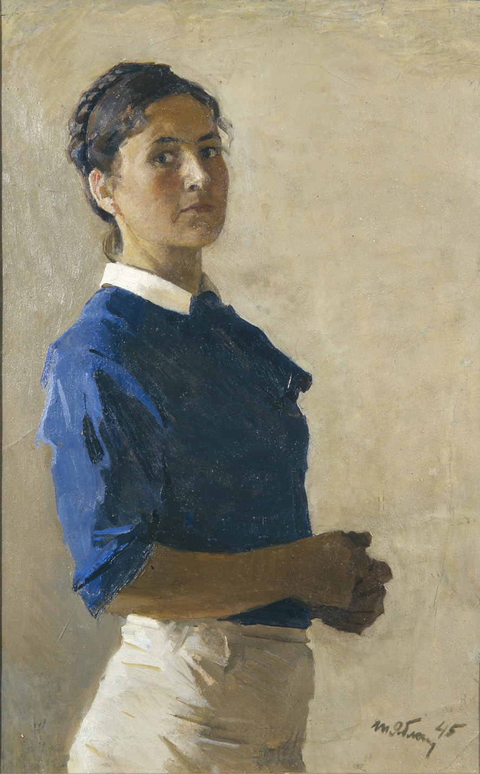
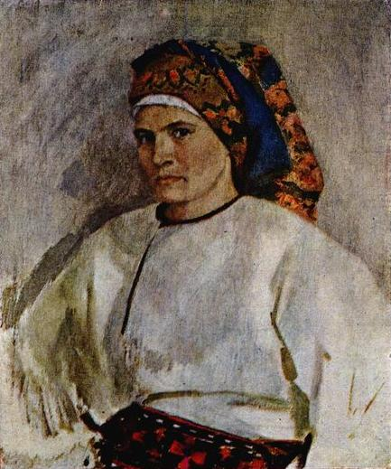
self-portraits
(1944-1945)

Slide 7
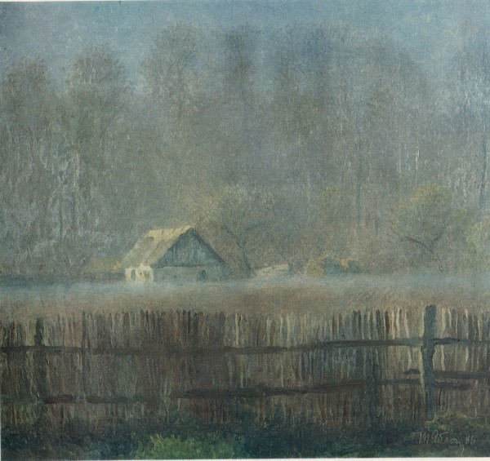
“Fog”,1986

Slide 8
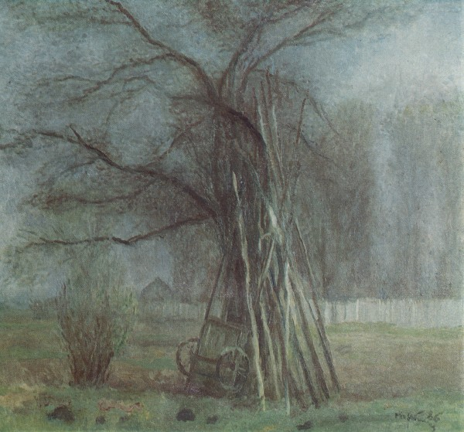
“Old appletree”,1986

Slide 9
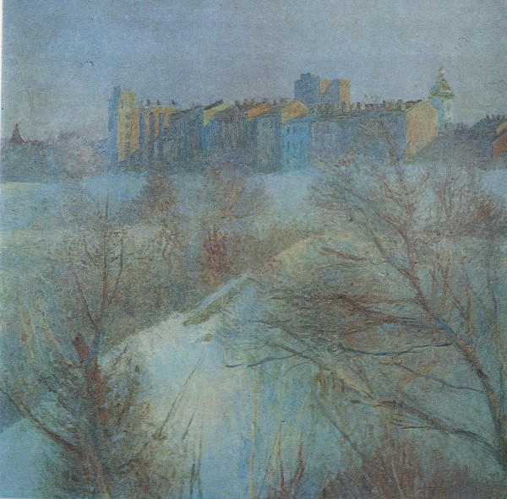
“Beautiful Kiyv”,1987

Slide 10
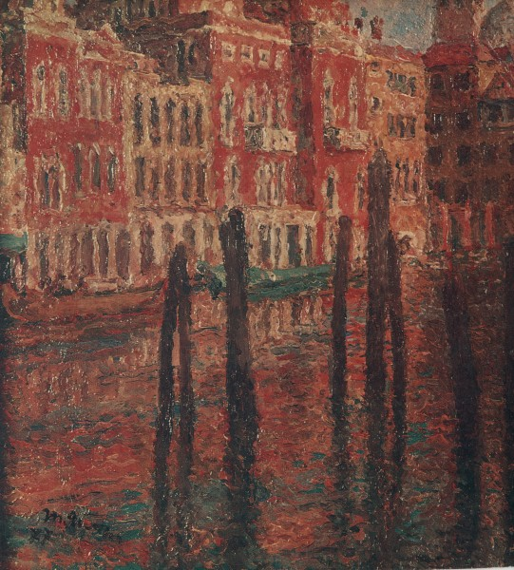
“The Grad Channel,Venice”,1977

Slide 11
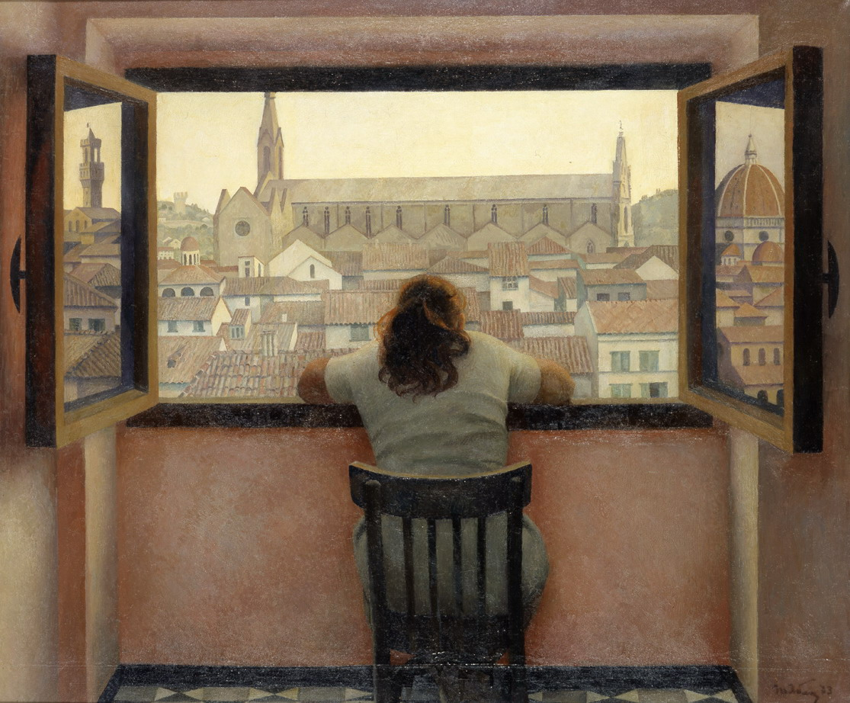
“Evening in the old Florence”,1973

Slide 12
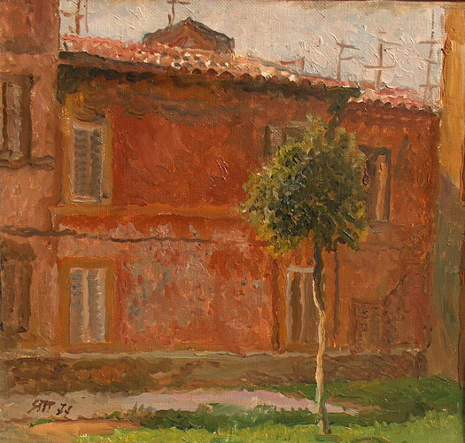
“Italy”,1977

Slide 13
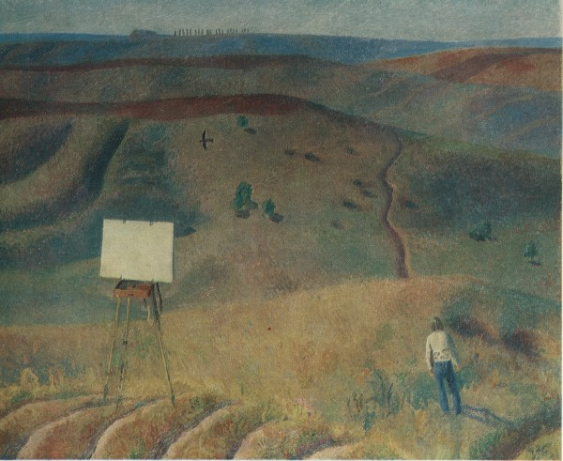
“Silence”,1975

Slide 14
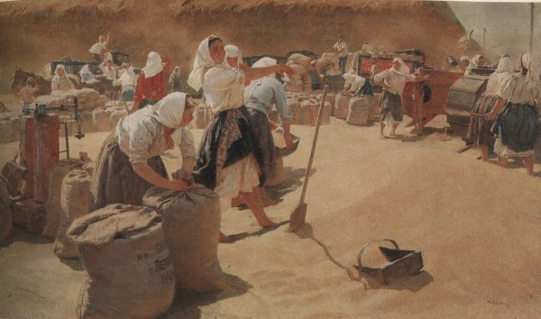
“The bread”,1950

Slide 15
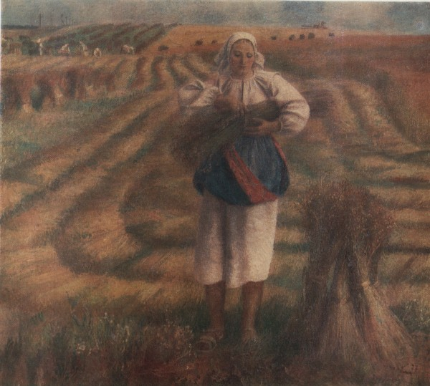
“The flax”,1977

Slide 16
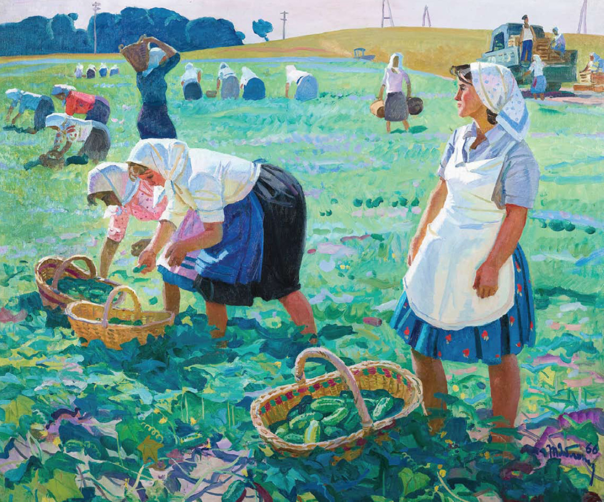
“Women harvest”,no year

Slide 17
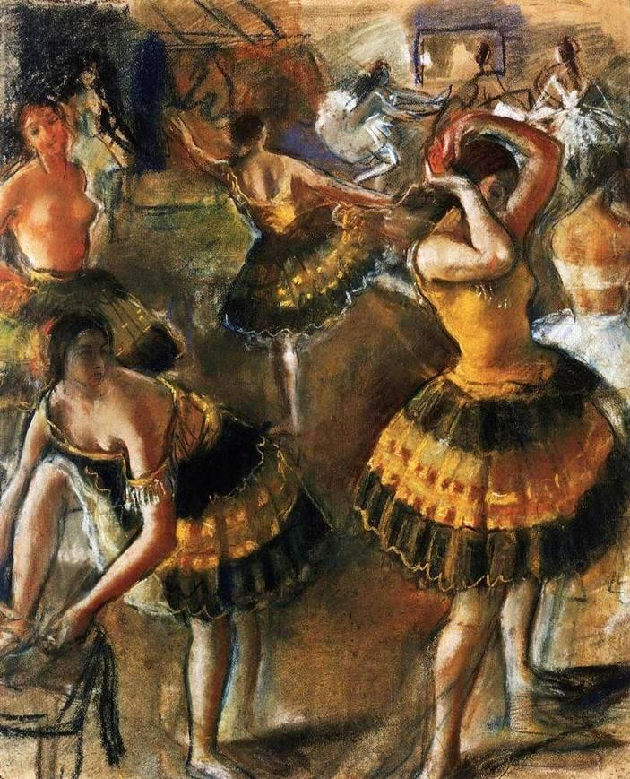
“Ballerina”,1999

Slide 18
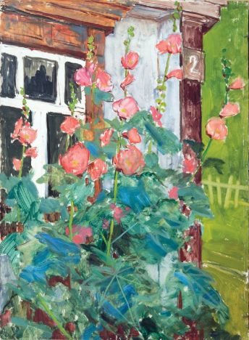
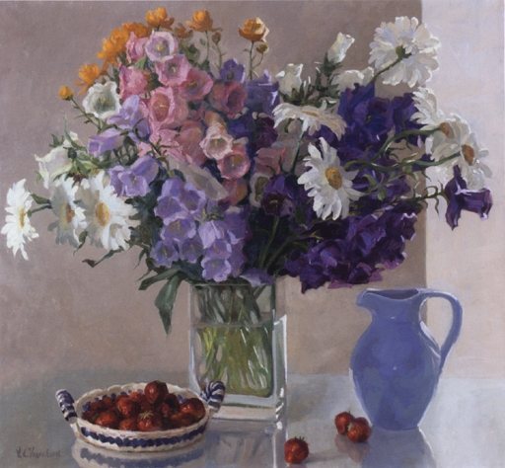
“Mallows”,1975 and “Flowers in the bouquet “,1979

Slide 19
This presentation was made by Iryna Pashchyna.
The End
2013,Cherkassy

