Slide 1
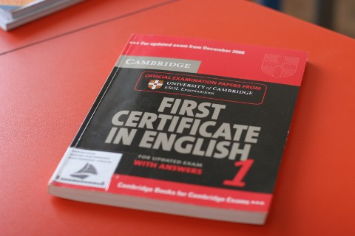
First Certificate in English
By Olha Ostroverkh, Form 11-B

Slide 2
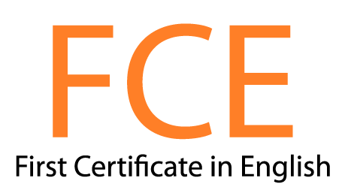
Good afternoon, everyone, and welcome! The purpose of this presentation is to get you acquainted with international examination of English, which is called FCE.

Slide 3
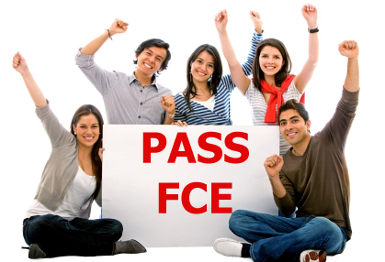
First of all, let’s find out what is FCE.
The First Certificate in English (FCE) is one of the examinations available from University of Cambridge Examinations in England.
Its possession proves one's adequacy in the English language, and its successful completion means that one is able to interact socially efficiently.
The FCE examination falls in the grade A2, B1, B2 and C1. Its advantage is that its expiration date is throughout life.

Slide 4
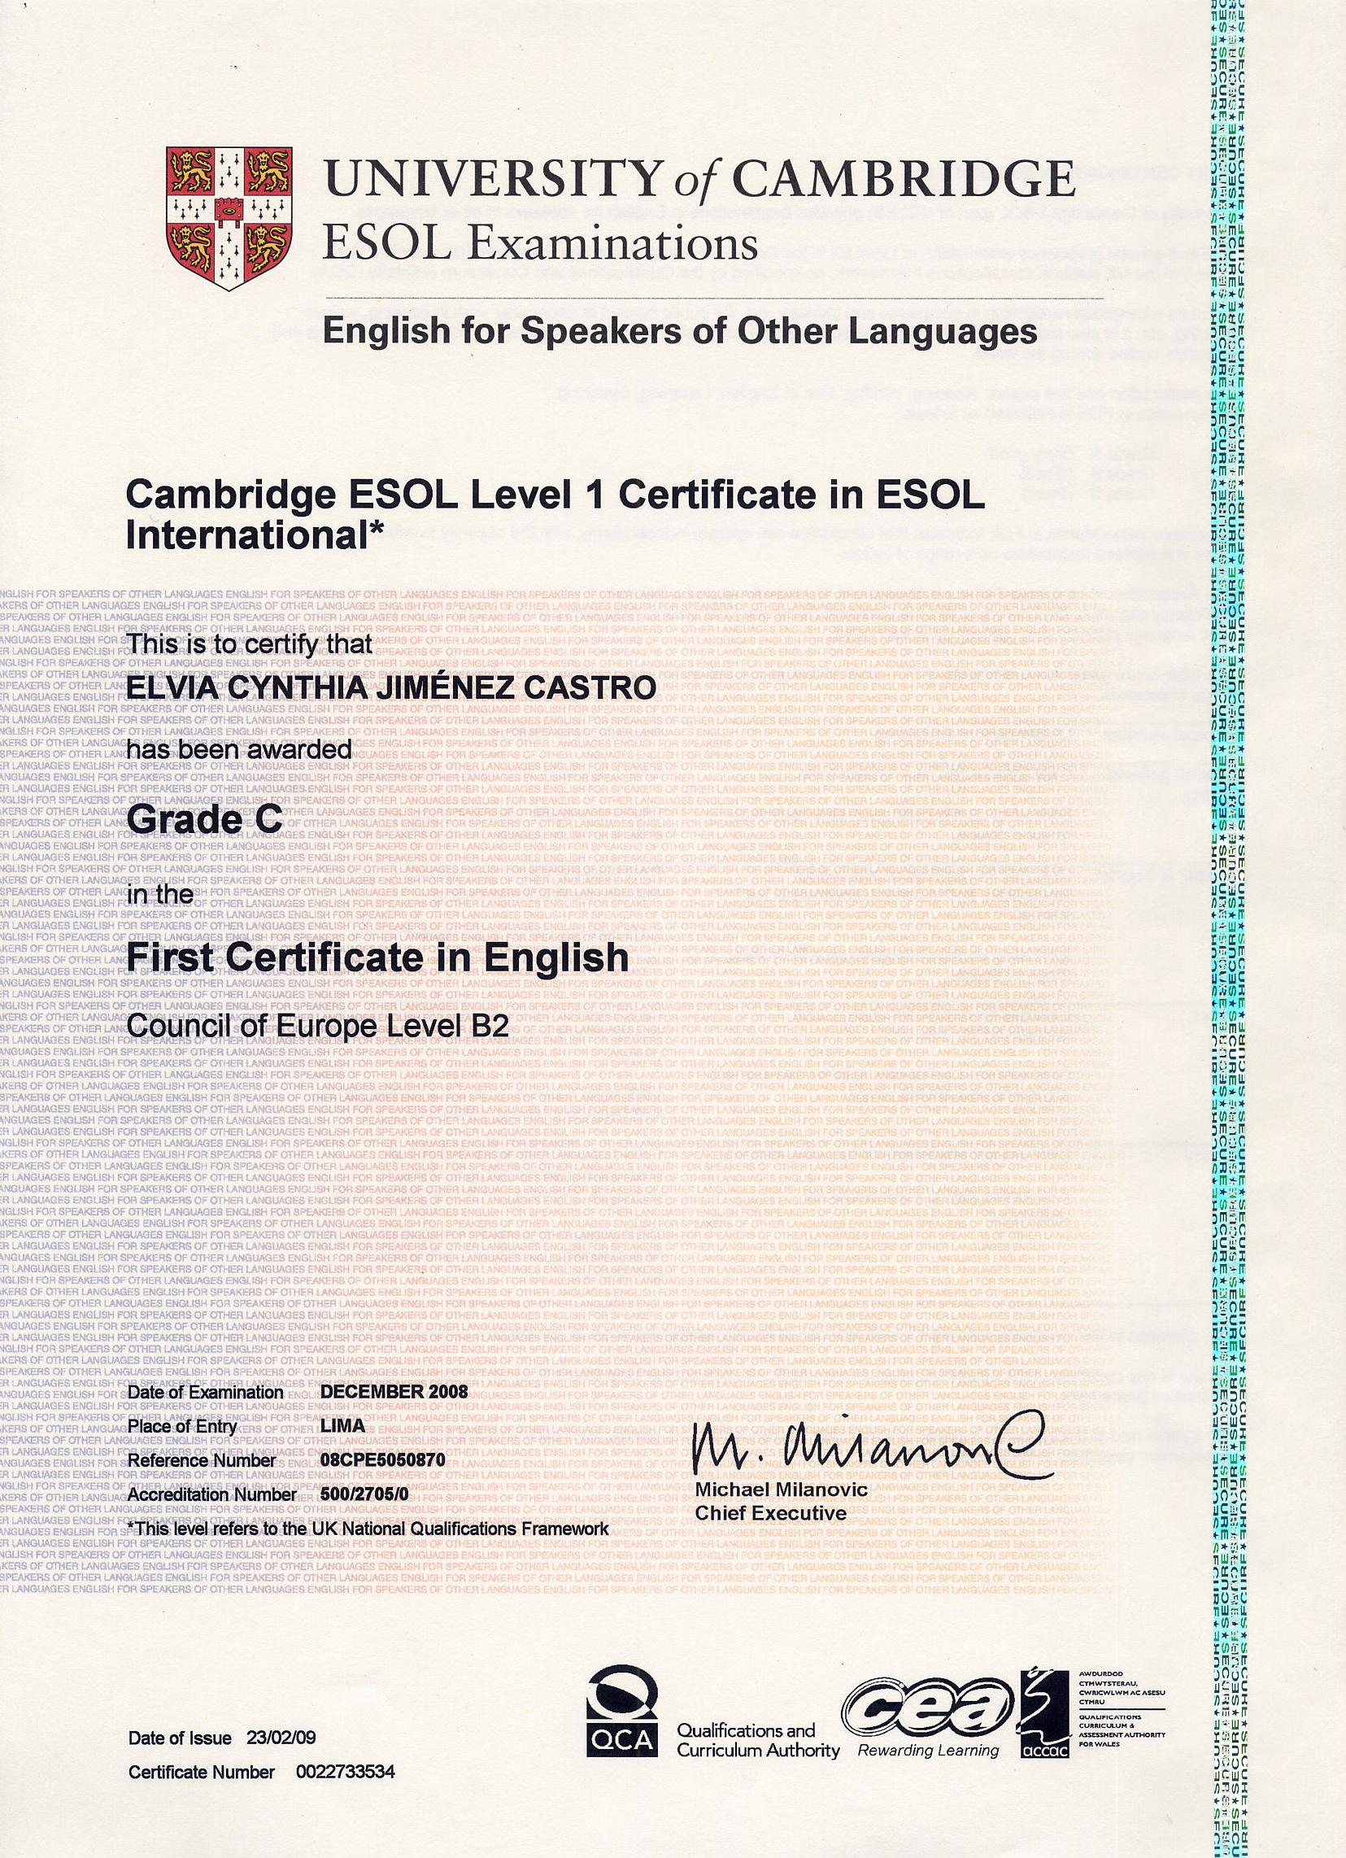
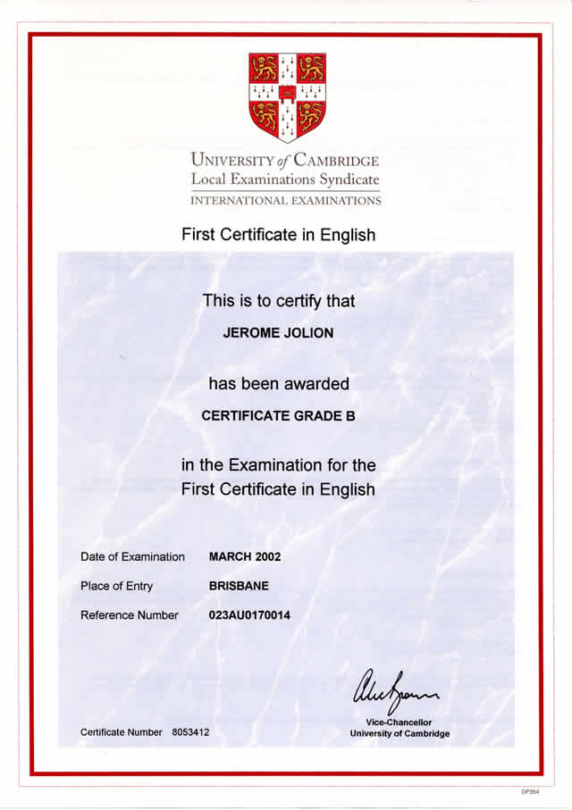

Slide 5
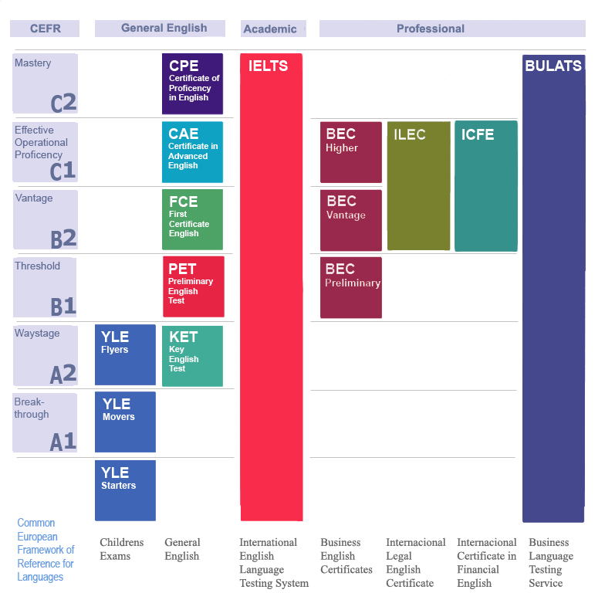
Sections
The test consists of five sections:
Reading
Writing
Use of English
Listening
Speaking

Slide 6
Reading
In the reading section, the candidate is expected to answer a set of questions based on the context of three texts, which are approximately 350-700 words in length each. Types of questions include multiple choice, multiple matching or gap filling. This part of the exam lasts 60 minutes.
Writing
The Writing section consists of two parts. The first task is usually a letter, which has a stricter format, and the second one's type ranges from discursive compositions to articles, whose format is less stringent. This part of the exam lasts for 80 minutes.
Use of English
The Use of English section includes four tasks, whose types vary, including multiple choice filling, open gap filling, word formation and key word transformation. This part of the exam lasts for 45 minutes.
Listening
The Listening section consists of a set of questions based on four texts. The texts vary from news announcements to speeches and dialogues.This section lasts 40 minutes.
Speaking
It consists of a dialogue between you and another candidate and tests your ability in communicating. It is divided into 4 parts. The first is a simple questionnaire between each candidate and the examiner. The second part includes a turn of 1 minute each of the candidates to describe the 2 photos given to them. The third part includes a dialogue only between the two candidates to describe together and talk about the photos given that all of them are related to only one topic. The fourth is similar to the third. This section lasts about 15 minutes (two candidates) and 17 minutes (when there are 3 candidates).

Slide 7

Grading
The FCE grade is based on the total score gained in all five papers. Each paper is weighted to 40 marks.
Five FCE papers total 200 marks, after weighting. It is not necessary to achieve a satisfactory level in all five papers in order to pass the examination.
Certificates are given to candidates who pass the examinations with grade A, B or C. A is the highest. All candidates are sent a Statement of Results which shows their relative performance in each one.

