Slide 1
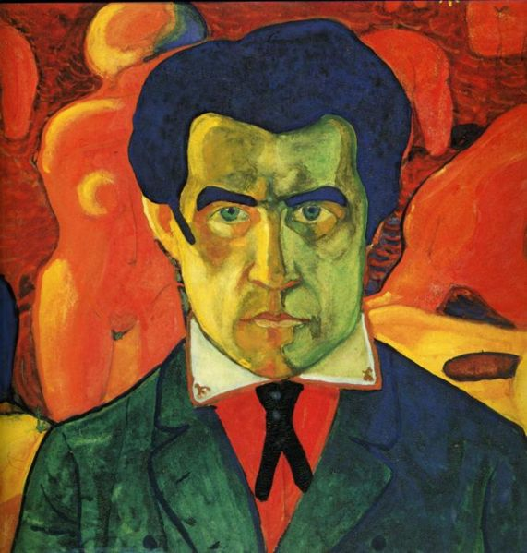
Kazimir Malevich

Slide 2
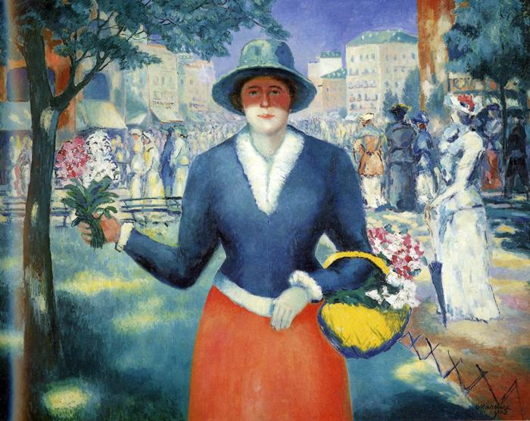
Flower Girl, 1903

Slide 3
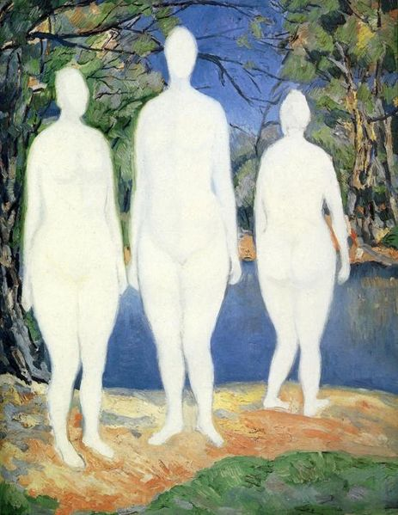
Bathers, 1908

Slide 4
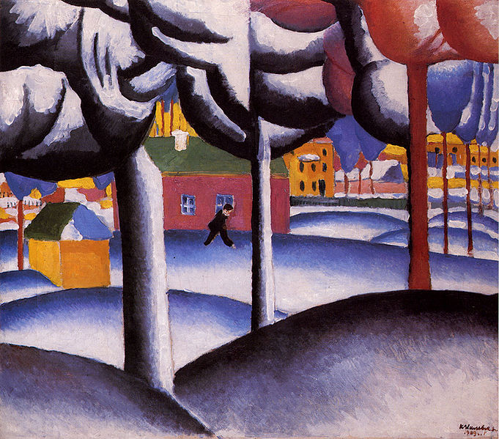
Winter, 1909

Slide 5
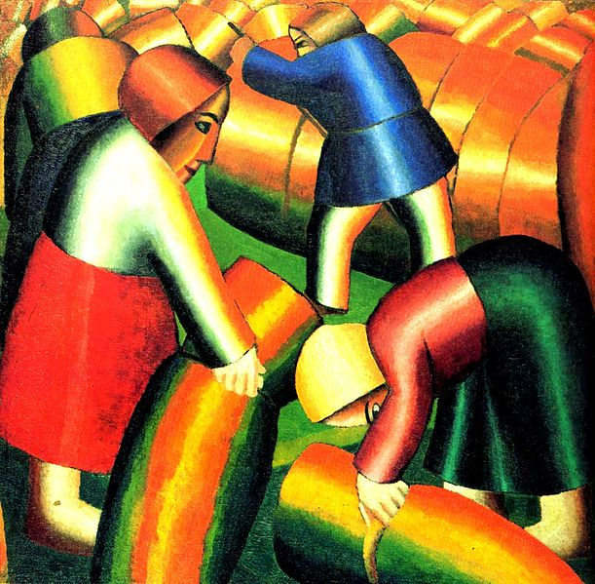
Taking in the Rye, 1911

Slide 6
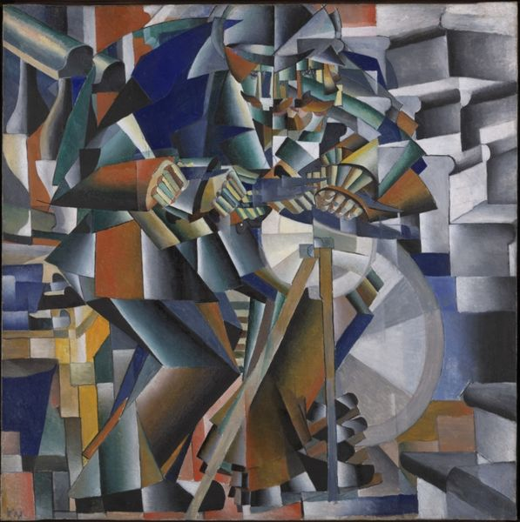
The Knifegrinder, 1912

Slide 7
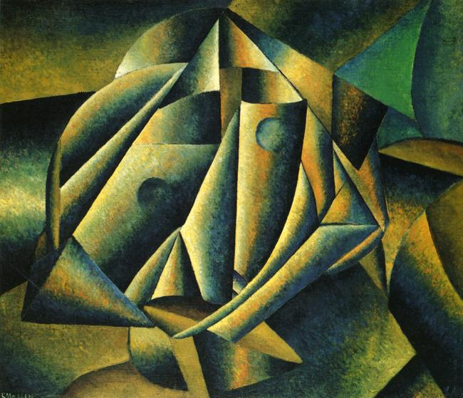
Head of a Peasant Girl, 1912-1913

Slide 8
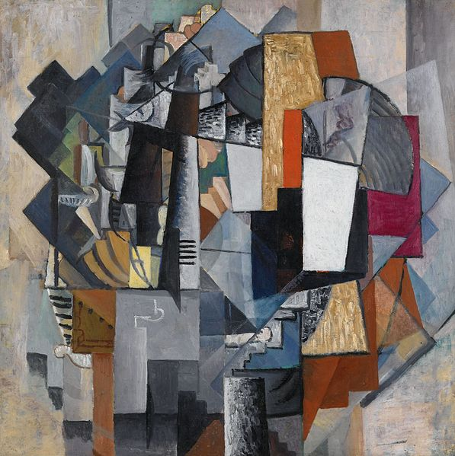
Bureau and Room, 1913

Slide 9
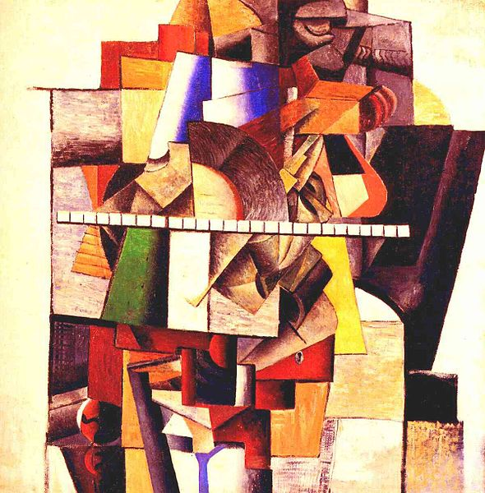
Portrait of Matiushin, 1913

Slide 10
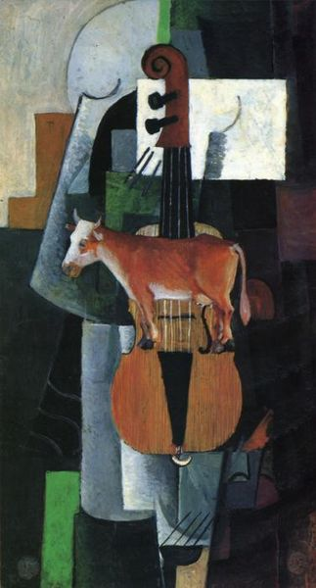
Cow and Fiddle, 1913

Slide 11
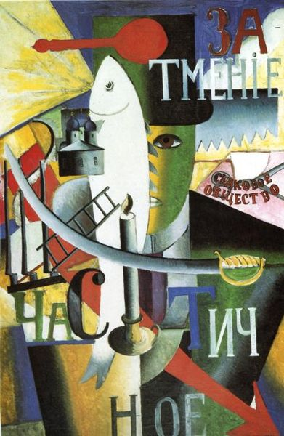
Englishman in Moscow, 1914

Slide 12
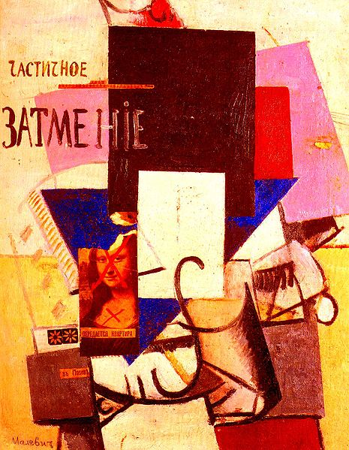
Composition with the Mona Lisa, 1914

Slide 13
Black Square, c.1923, State Russian Museum, St. Petersburg, Russia

Slide 14
Black Circle, 1915, State Russian Museum, St. Petersburg, Russia

Slide 15
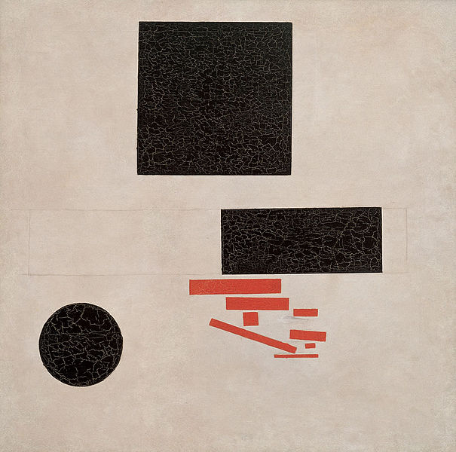
Suprematist Composition, painted 1915

Slide 16
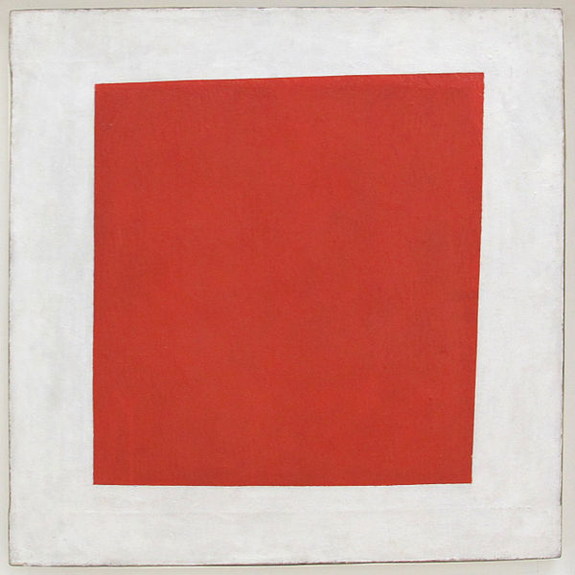
Red Square: Painterly Realism of a Peasant Woman in Two Dimensions, 1915.

Slide 17
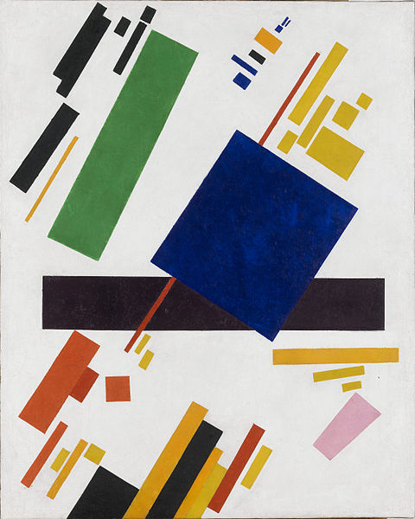
Suprematist Composition, 1916

Slide 18
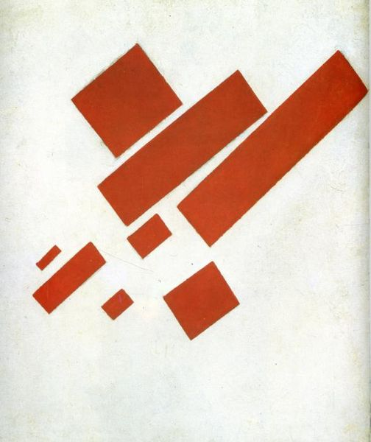
Suprematist Painting: Eight Red Rectangles, 1915

Slide 19
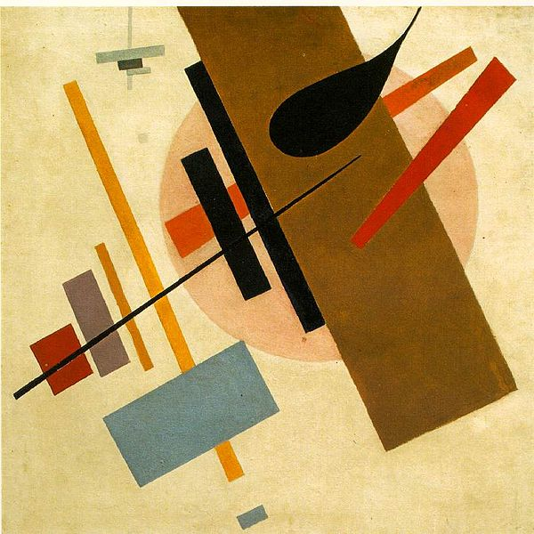
Suprematism, Museum of Art,Krasnodar 1916

Slide 20
Suprematism, 1921-1927

Slide 21
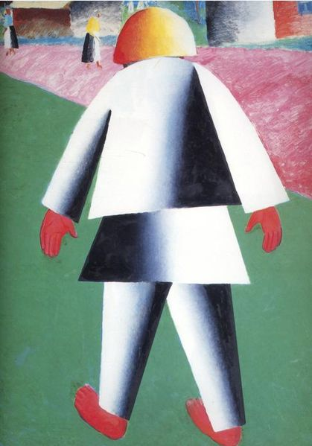
Boy, 1928-1932

Slide 22
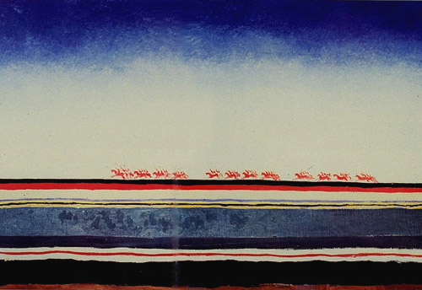
Red-cavalry, 1928-1932

Slide 23
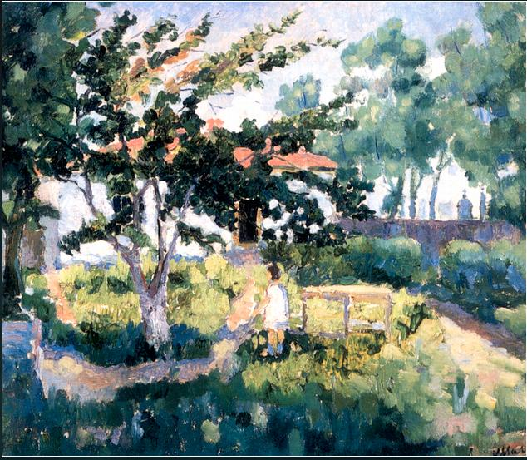
Summer Landscape, 1929

Slide 24
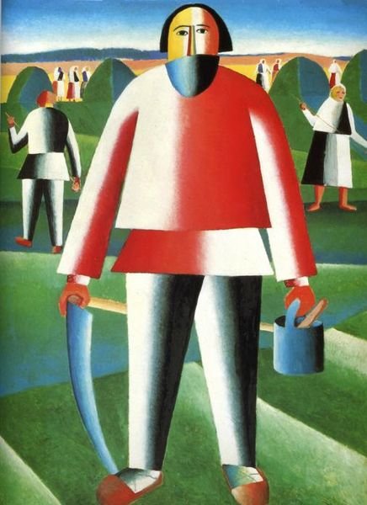
Mower, 1930

Slide 25
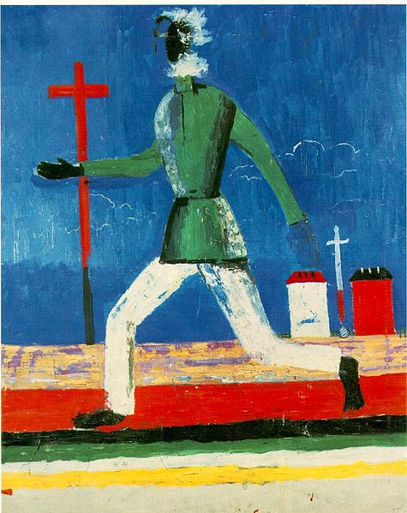
Mower, 1930

Slide 26
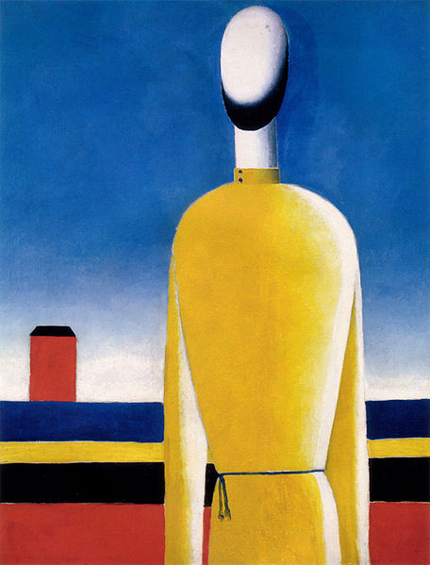
Complex Presentiment: Half-Figure in a Yellow Shirt, 1928-1932

Slide 27
Thank you for your attention Skakalova Olexandra 11-a

