Slide 1
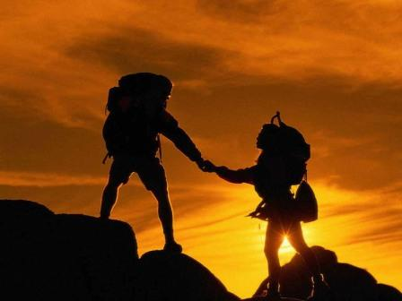
Sports tourism-is life

Slide 2
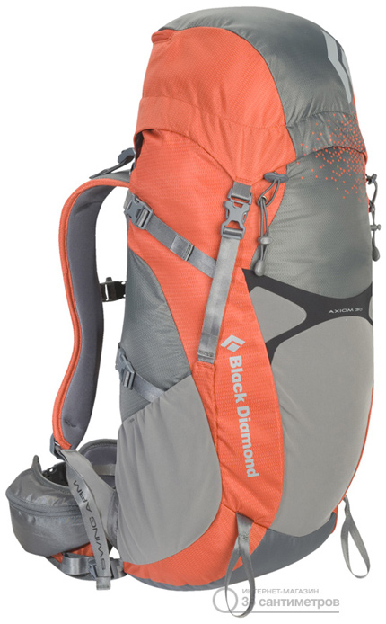
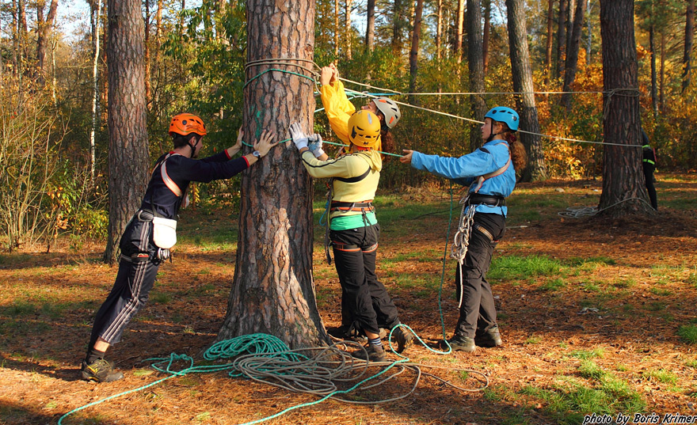
Sports tourism- is not only a backpack and training…

Slide 3
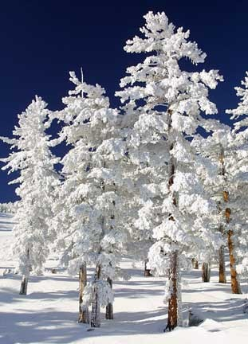
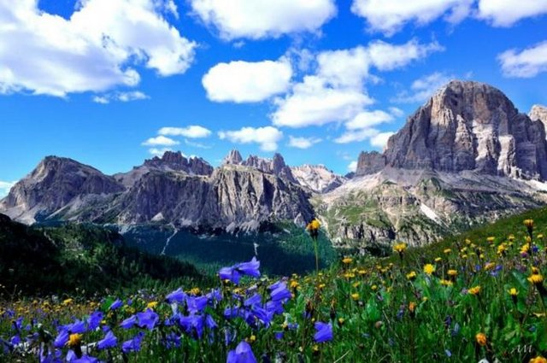
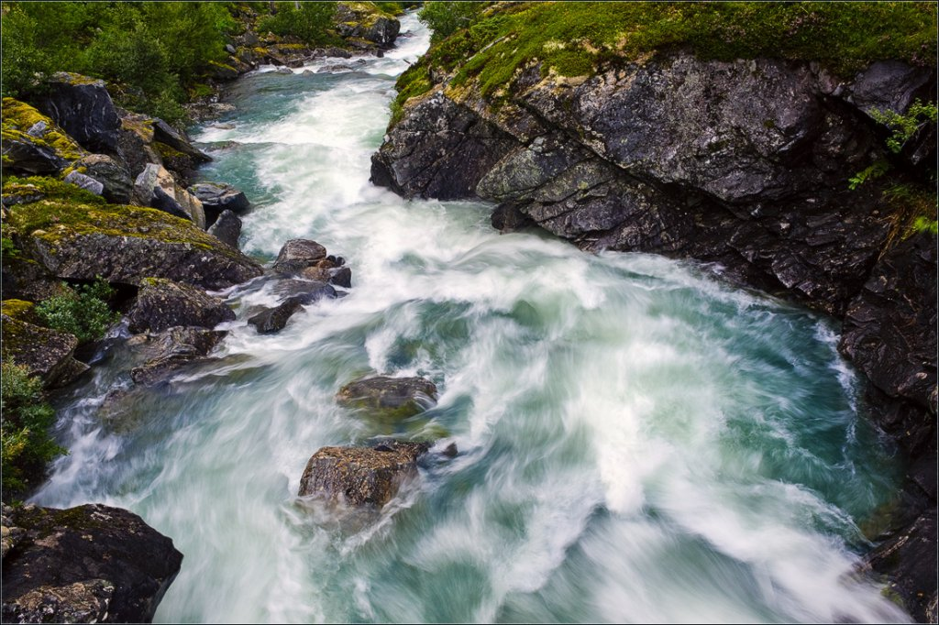
…it's high mountains, wild rivers and fluffy snow!

Slide 4
Every tourist should be able to:
Cycle
Walk in the mountains
Swim canoe
Tie knots

Slide 5
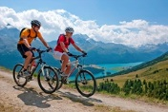
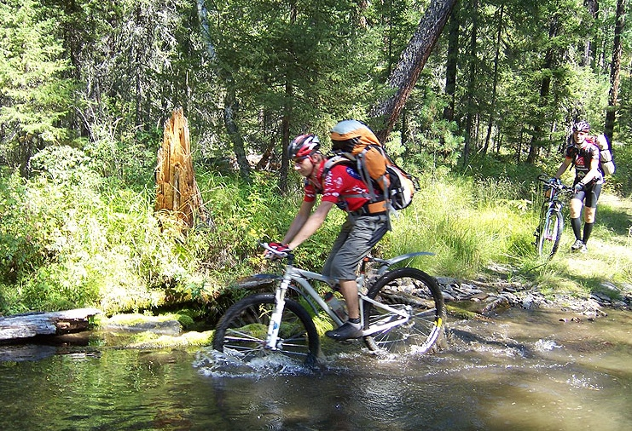
Cycle

Slide 6
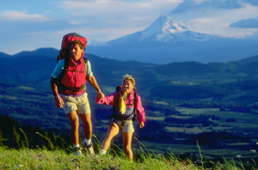
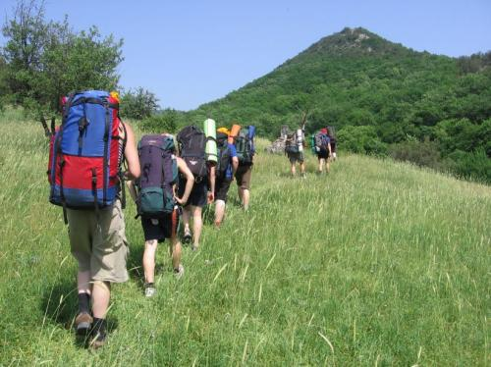
Walk in the mountains

Slide 7
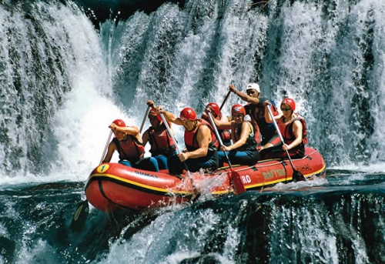
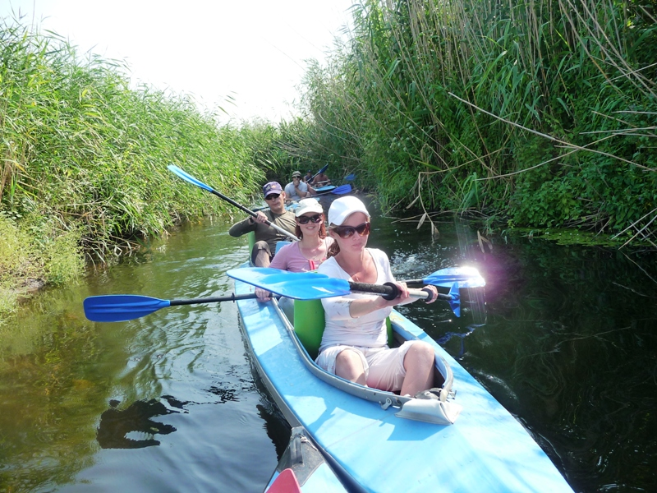
Swim canoe

Slide 8
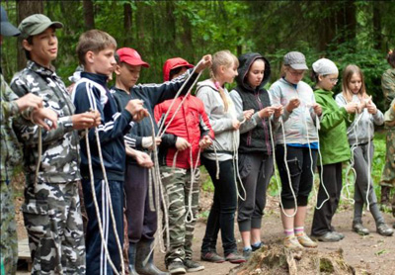
Tie knots

Slide 9
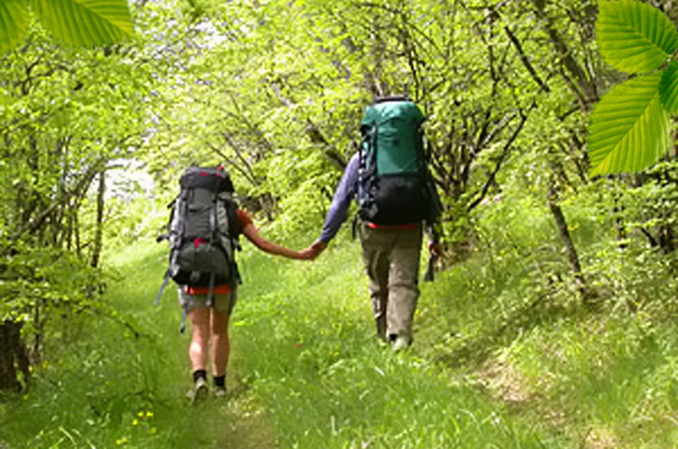
Tourism is good for health and gives a lot of pleasure

Slide 10
In a healthy body, healthy mind

Slide 11
Thank you for your attention!

