Slide 1
«Мy restaurant»
Zinchenko Alina
10-A

Slide 2
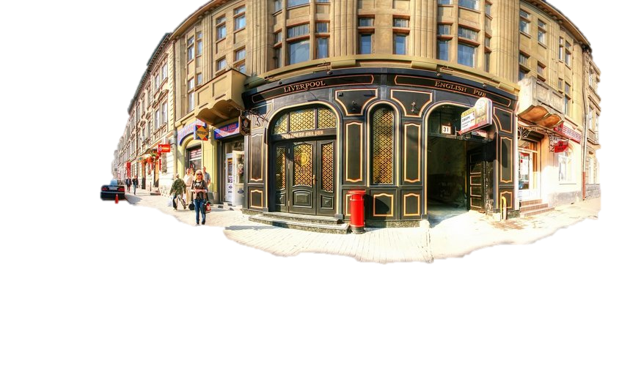
The English pub-restaurant
«Liverpool Pub»
We are:
Lviv, vul. Kulish, 31
+38 (032) 243 55 66,
+38 (098) 648 48 18,
+38 (095) 318 28 04
We invite you to relax in an English pub-restaurant «Liverpool Pub» - a beautiful and serene place!

Slide 3
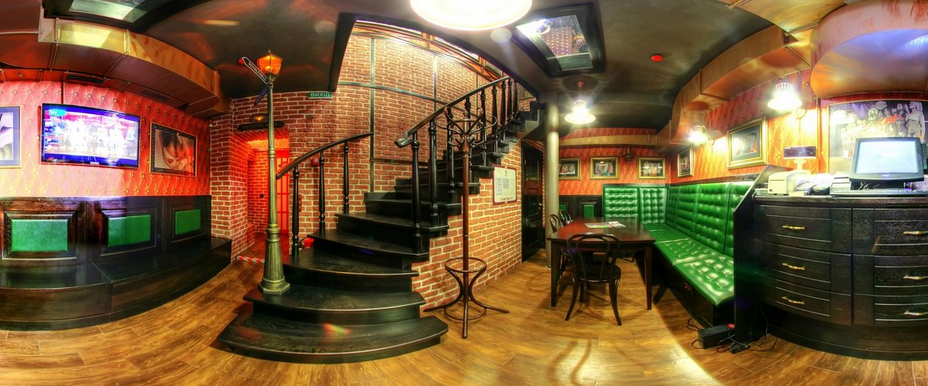
The English pub-restaurant «Liverpool Pub» («Liverpool») - the first classic pub in Lviv!
The bar dark, comfortable leather furniture , friendly staff , tasty beer, good company - all true English pub in Ukraine «Liverpool Pub» ( Liverpool ). Come here to the place that is hidden away from the modern pace of life with its hassles and problems. Here you can sit nice and fun to drink a mug , a favorite for the table , being ill for your favorite football team. Here with friends or with your loved one, you can relax and I get a lot of positive emotions.

Slide 4
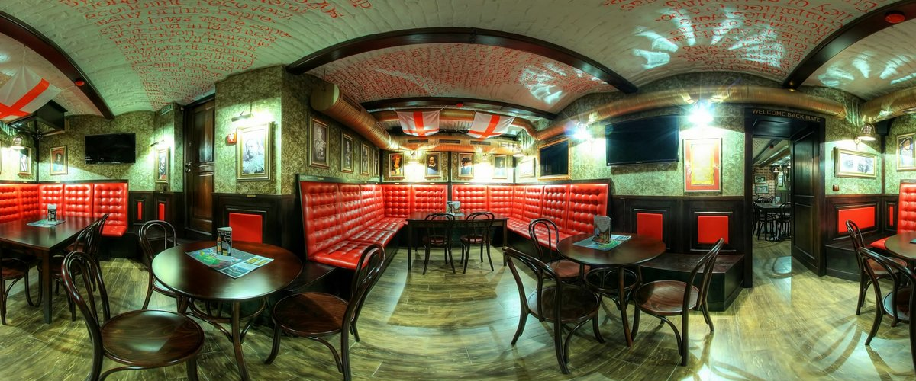
The English pub - restaurant «Liverpool Pub» invites to gourmet meals English and European, Italian and Mediterranean cuisine which you can enjoy during your breakfast, business lunch or organized in the small banquet facility (up to 45 people). For your friendly bartender offer to taste signature soup with lamb and root vegetables , eggs, english steak " Butterfly " and branded drinks - beer " Lager " and honey ale, drink " Liverpool ".

Slide 5
Services
FOOD
reservations
Banquet facilities up to 45 persons, advance pre-payment - 10%
Breakfast on the menu
Lunch 12:00-15:00, 35 USD,
Monday through Friday
Kitchen Restaurant
The English kitchen
European Cuisine
Italian Food
Mediterranean cuisine
Language Support
English
Polish
Russian
Ukrainian

Slide 6
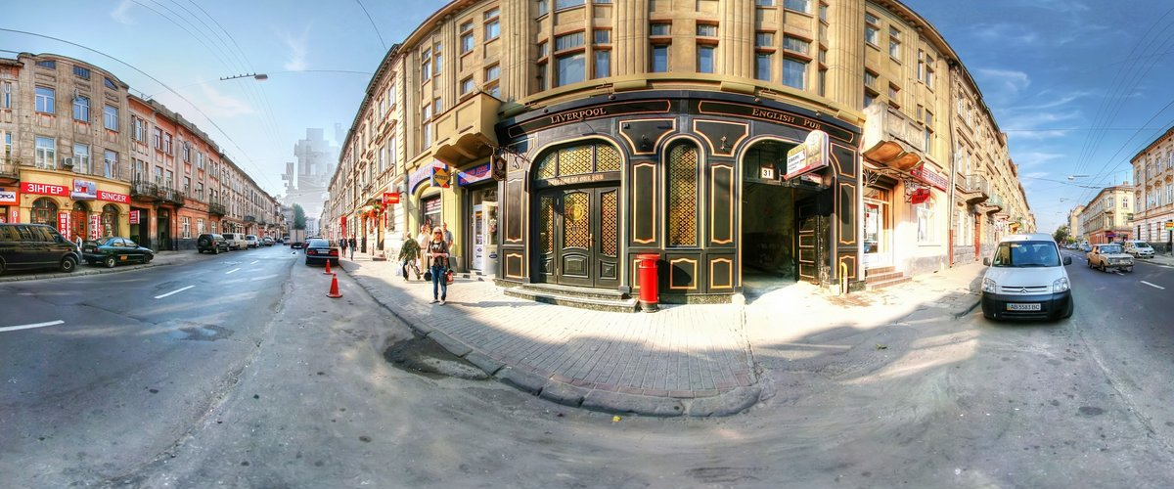

Slide 8
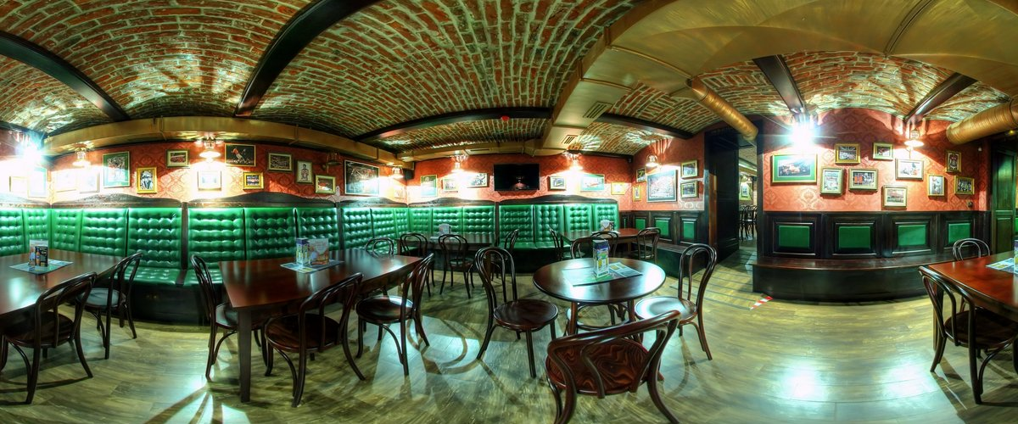

Slide 9
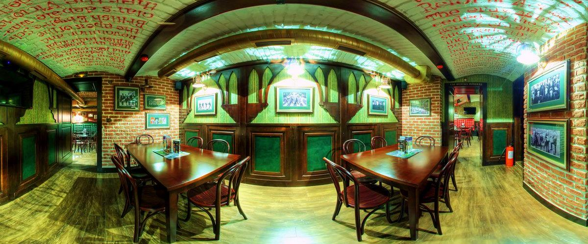

Slide 10
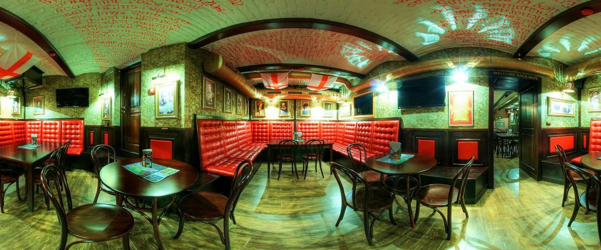

Slide 11
