Slide 1

United Kingdom
Olga Novik
Form 10-B

Slide 2
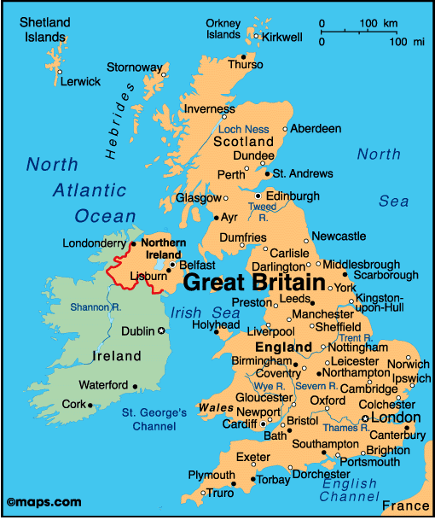
.
The United Kingdom of Great Britain and Northern Ireland commonly known as the United Kingdom (UK) or Britain.
The UK consists of : England, Scotland, Wales, and Northern Ireland.

Slide 3
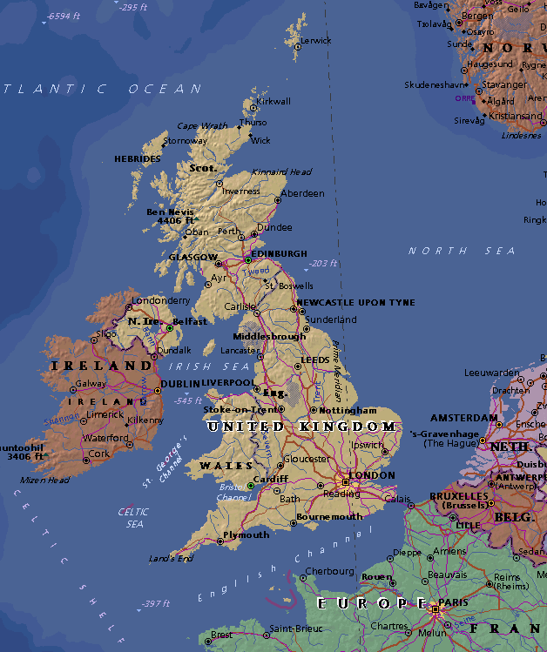
Geography
The United Kingdom of Great Britain and Northern Ireland is situated off the north – west coast of Europe between the Atlantic Ocean in the north – west and the North Sea in the east.
The United Kingdom has an area of 244.000 square kilometers (94.249 square miles). The capital of the country is London.
English is an official language.

Slide 4
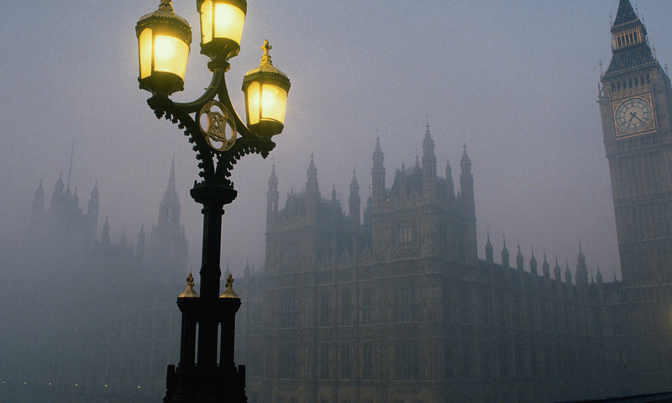
Climate
The United Kingdom has a temperate climate, with plentiful rainfall all year round.
Summers are warmest in the south-east of England, being closest to the European mainland, and coolest in the north.
The temperature varies with the seasons seldom dropping below −11 °C or rising above 35 °C .
Atlantic currents, warmed by the Gulf Stream, bring mild winters; especially in the west where winters are wet and even more so over high ground.

Slide 5
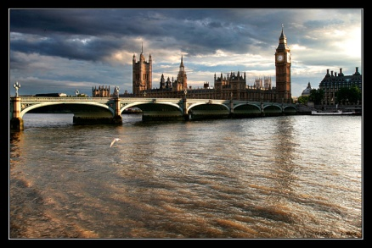
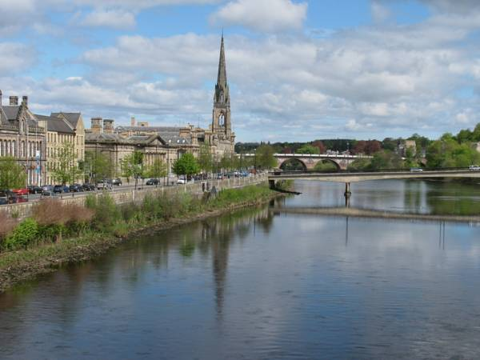
The longest river in the United Kingdom:
England – Thames
Scotland - Tay

Slide 6
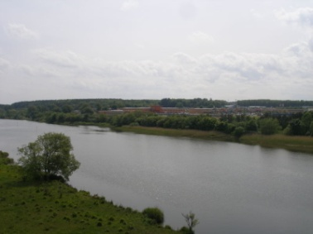
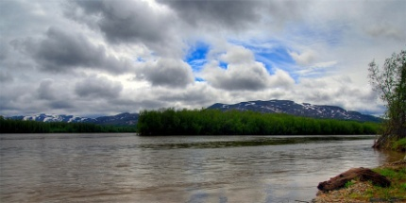
Northern Ireland - Bunn
Wales - Towy

Slide 7
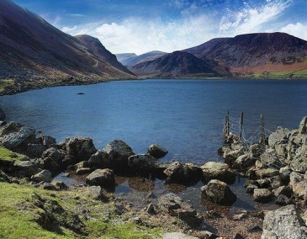
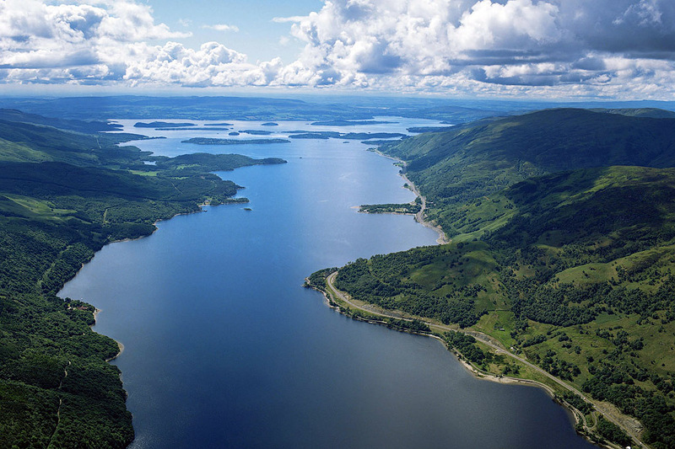
The largest lakes in the UK:
Northern Ireland - Lough Neagh
Scotland - Loch Lomond

Slide 8
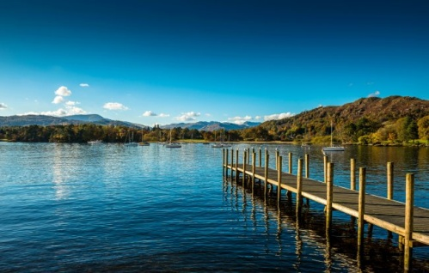
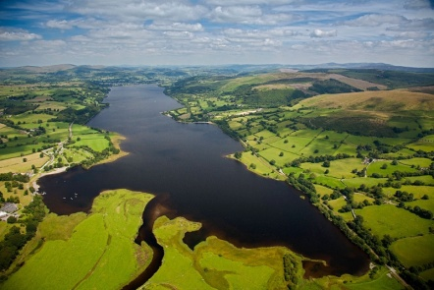
England - Windermere
Wales - Bala Lake

Slide 9
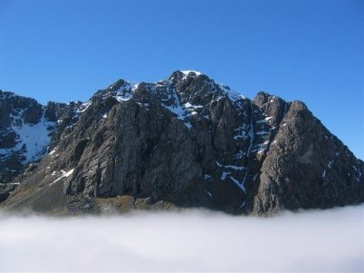
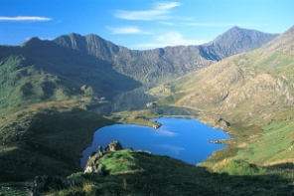
The highest point in the United Kingdom:
Scotland - Ben Nevis
Wales - Snowdon

Slide 10
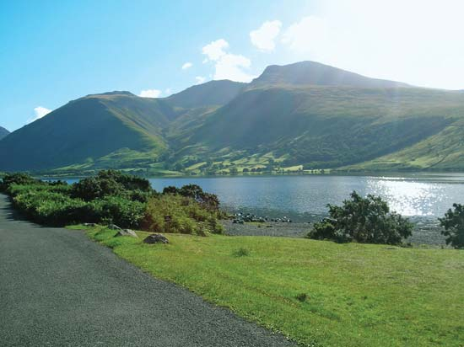
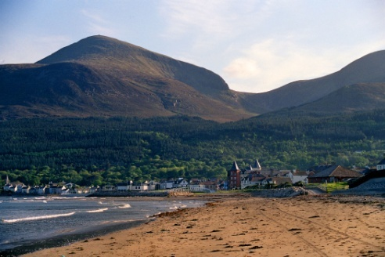
England - Skayfel Pike
Northern Ireland - Draining Donard

Slide 11
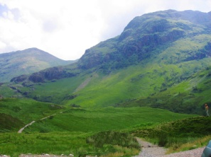
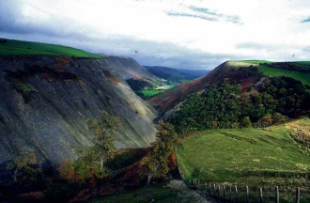
Ridges and hills:
Scotland - Grampians Kairgorm, Scottish Highlands, Southern Uplands
Wales - Cambrian Mountains, Snowdonia

Slide 12
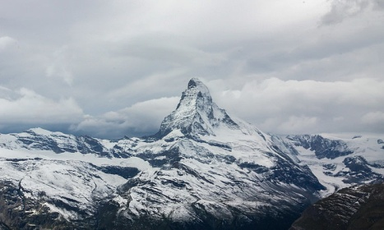
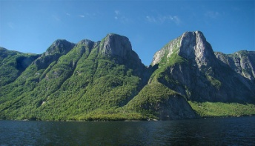
England - Brecon Beacons, Exmoor, Lake District, Pennines
Northern Ireland - Mourne, the Antrim Plateau

