Slide 1
To leave or not to leave...?
‘One year to miss.
Ukraine v.1.0’
By Roman Leyzerovych

Slide 2
Figures represented in thousands
 | 2010 | 2011 | 2012
School leavers (1) | 338 | 230 | 316
OE Participants (2) | 293 | 194 | 266
Don’t take part in OE (1-2) | 45 | 36 | 50
Not enrolled (3) | 20 | 14 | 18
Total n. of GAP YEAR STUDENTS ((1-2)+3) | 91 | 50 | 68

Slide 3
TOTAL : 209 000 FOR 3 YRS.

Slide 4
WHAT DO THEY HAVE TO DO?

Slide 5

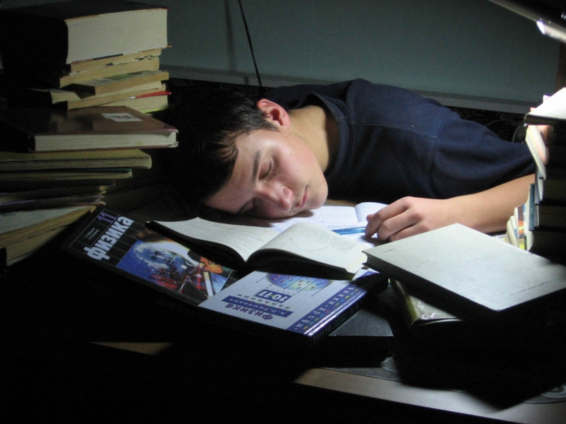

To get ready for the exams the next year

Slide 6



Find a job

Slide 7


Have a rest at home

Slide 8

Travelling, volunteering and LANGUAGE COURSES

Slide 9

1).
Come study the English language abroad in England this year at one of five Eurocentres locations.\
Bournemouth, Brighton, Cambridge, and London (and Lee Green, south London).
Вegin throughout the year
general language skill courses
business English courses
semester/academic year programs for credit
FCE & IELTS certification exam preparatory courses
Accommodation options vary by location, but home-stays are always encouraged to further the student's exposure to the language and English culture.
http://www.eurocentres.com/en

Slide 10

2). China Gap Semester - Thinking Beyond Borders
Take a gap year with purpose. Go beyond just travel or service.
Explore solutions to critical global issues throughout China in this 13-week program. This semester includes:
- Daily Mandarin Language Classes & Immersion
- Living with Host Families
- Fieldwork with Local Experts
- Academic Study
- Independent Student Travel
We combine deep cultural immersion, working with inspiring local leaders, and engaging readings and discussions. You'll be supported by TBB Program Leaders as you shape your purpose and direction.
The China Gap Semester is an opportunity to become who you want to be!
www.thinkingbeyondborders.org

Slide 11

3). Year Course - Gap Year Program in Israel
Immerse yourself in the fascinating history of Israel when traveling with Year Course!
One third of the program
approximately 3 months
in 3 locations:Jerusalem, Bat Yam and Negev.
Jerusalem provides the historical context in visiting Israel
Bat Yam has fantastic beaches
Negev is one of the most beautiful and mysterious locations in the country.
Year Course's program provides participants with a meaningful and enriching experience in the already religiously profound nation!
http://www.yearcourse.org/the-program

Slide 12
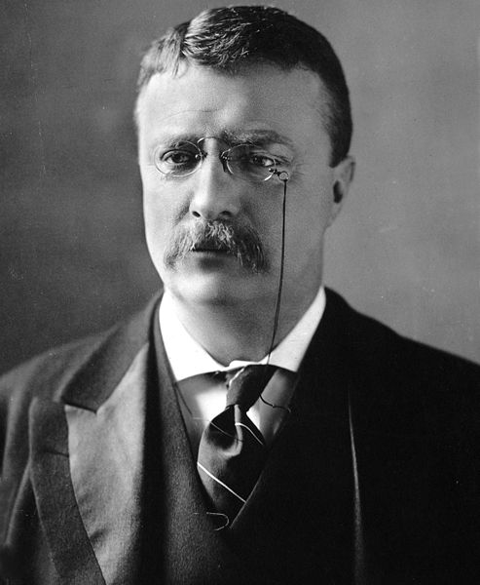
“In any moment of decision, the best thing you can do is the right thing. The worst thing you can do is nothing.“
Theodore Roosevelt
Your choice is up to you!

