Slide 1
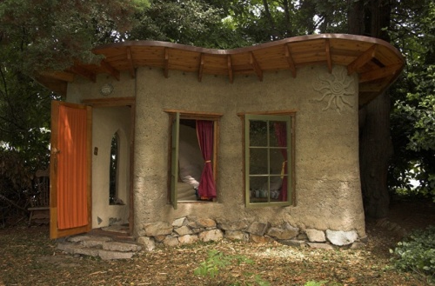
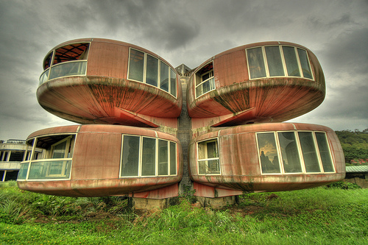
Unusual buildings in the world

Slide 2
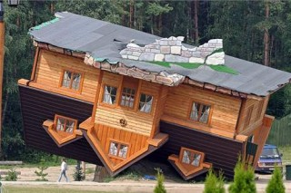
Upside Down House, Poland, Szymbark
This Upside Down House was designed by Polish businessmen and philanthropist Daniel Czapiewski. House was built in 2006 by Czapiewski's company which specializes in wooden houses. It took 114 days to build the house when typical project would normally take 21 days to build. By setting a traditional Polish house on its roof, Czapiewski wanted to express the disorientation people feel in a rapidly changing world, both during Communism regime and nowadays.

Slide 3
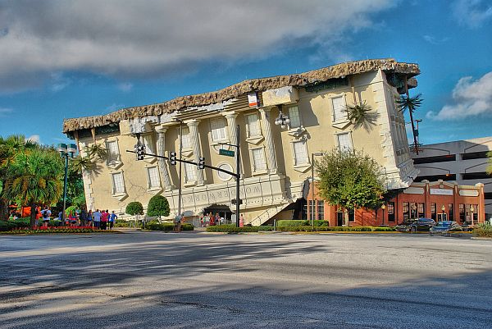
In Florida, there is a wonderful museum Wonder Works ( Inverted house) . According to popular legend , this building was a research center and is located on the island of Bermuda Triangle. Scientists in the experiment in this building created a tornado without calculating its strength. Huge whirlwind caught the building and flying a great distance it landed on the roof in the city of Orlando in Florida. The building was transformed into an unusual museum , which annually can receive millions of visitors . Entrance to the museum is located in the attic window , inside the building " flip houses " still turned on its head, ie ceiling is on the floor , and the floor to the ceiling , so the chairs are on the ceiling and on the floor you can find a chandelier.

Slide 4
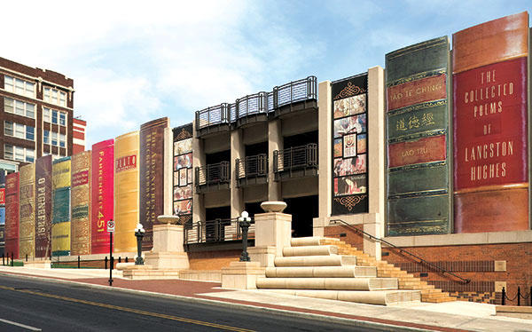
In the midst of downtown Kansas City , Missouri that is worth a gigantic bookshelf lined with huge tomes . What's inside - not hard to guess . Over the eight-meter -colored spines of books hidden Central Library .Thus, the state government decided to bring the ranks of book lovers more citizens , and along with the world famous . Incidentally , it is the residents of Kansas to decide which books adorn the facade of the library. And now on the huge walls of the cover - gold letters the names of the most beloved writers of townspeople , including the immortal Shakespeare 's "Romeo and Juliet " with John Tolkien " Lord of the Rings " and many others .

Slide 5
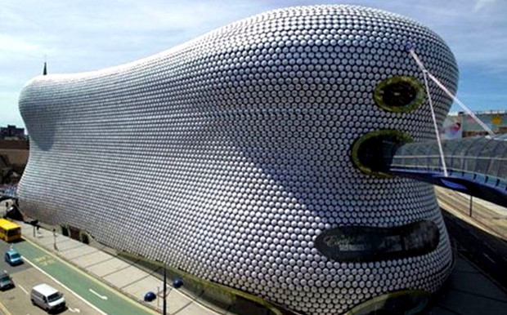
The Bullring Shopping Centre is part of the construction project in Birmingham , Europe's largest shopping center , consisting of four objects : an indoor food market on the 90 trading locations ( opened in 2000 ) A feature of the design concept is the combination of different architectural styles - from classical to avant-garde . Bullring consists of nine levels: Level 3 - shopping malls , 2 levels by road parking, located directly underneath the complex , one dedicated to the management of shopping centers and the remaining three are technical level .

Slide 6
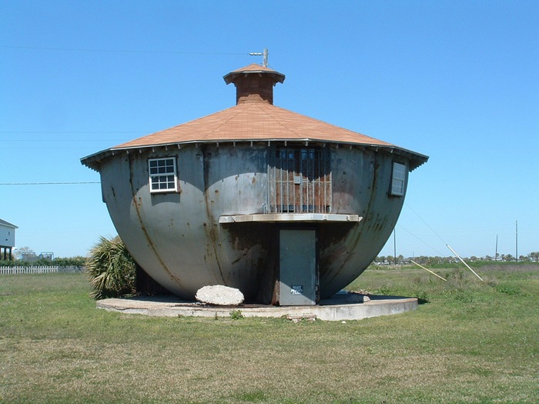
Kettle House in Texas, USA, not only looks like a kettle, but there are rumors that he is working as a kettle. In this house no one lives, but people see as a regular young man comes and does something to it. Nobody could talk to him, so we'll just have to guess, what built this house. Maker or float it in case of flooding?

Slide 7
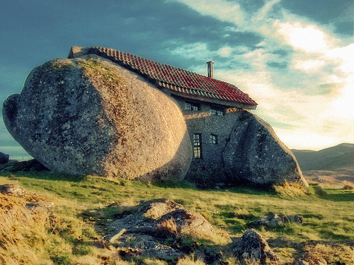
This stone house in Portugal is a good example of how the elements of nature may find practical application. As surprising as this house did not look, but people actually live in it.

Slide 8
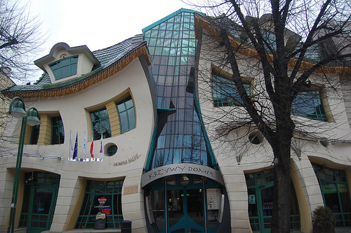
Crooked House is one of the best examples of that is capable of design idea and how now developed construction technology. Outline curves make it one of the most exceptional and unusual houses in the world. The inscription above the entrance and says "Crooked House".

Slide 9
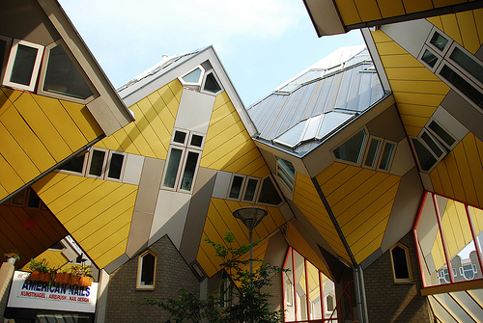
House-cube from Rotterdam, Netherlands, combines a group of houses that have the geometry of a cube. Most surprising of all this is that it is unclear how it all holds and how this construction managed not to fall.

Slide 10
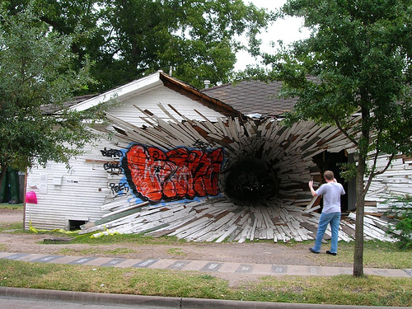
House-hole from Texas, USA, creates a stunner. Entrance to the house is done in a way that gives the impression that this is some kind of art project, but for many it is associated with the consequences of a terrible accident.

