Slide 1
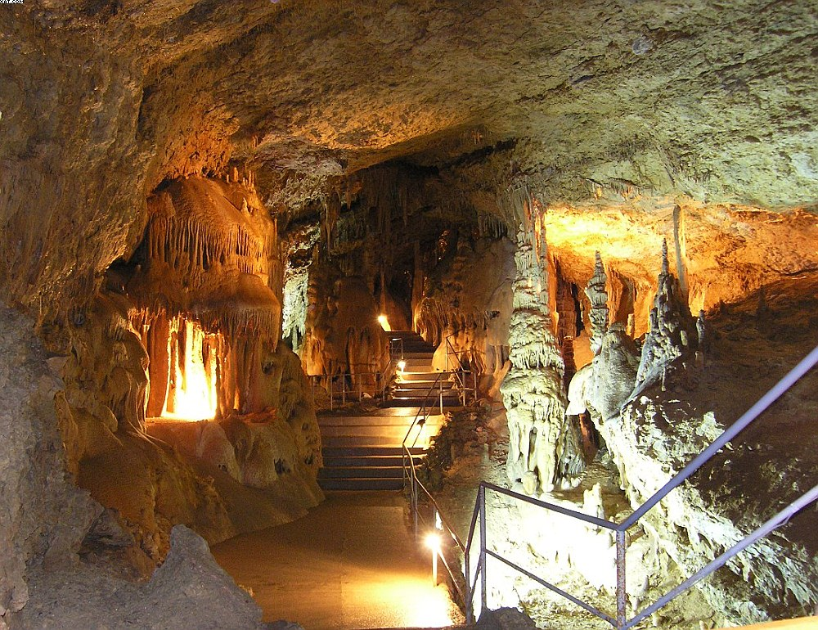
Marble Cave

Slide 2
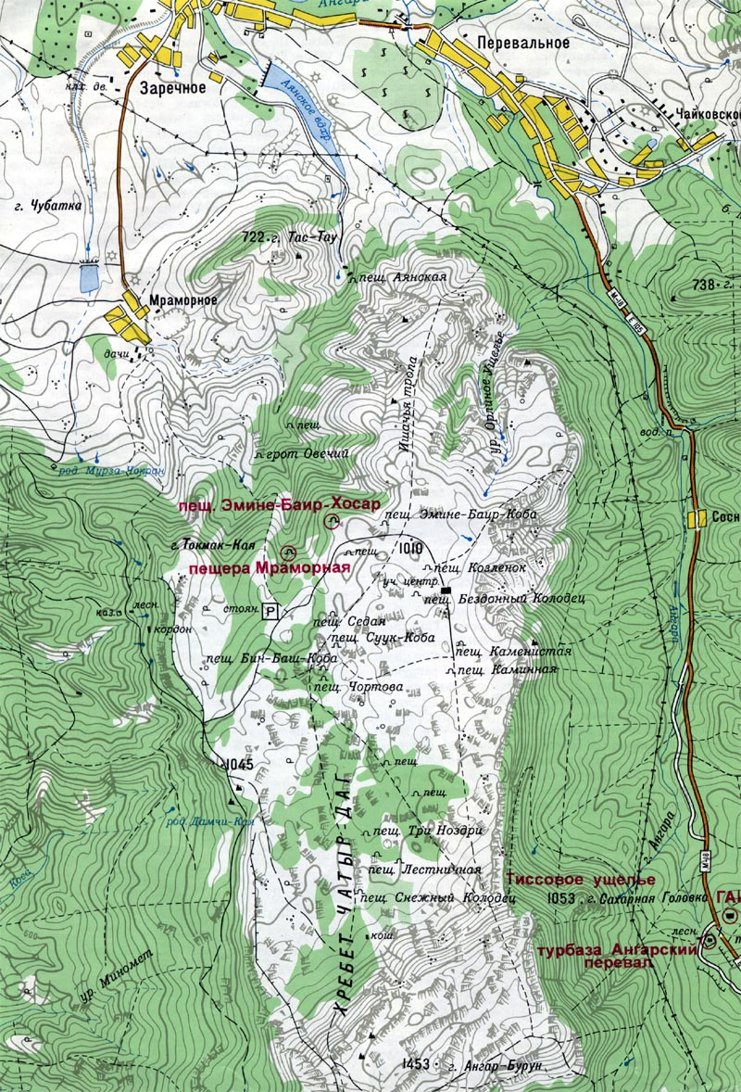
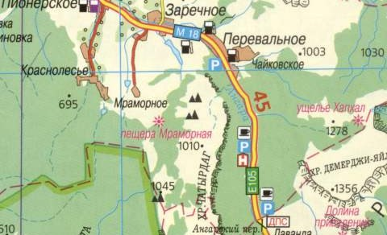
Location
This popular tourist attraction is located in Simferopol region of Crimea in Ukraine, near the village Zarechnoye. The Cave is on the lower plateau of massif Chater-Dag in Crimean Mountains.

Slide 3
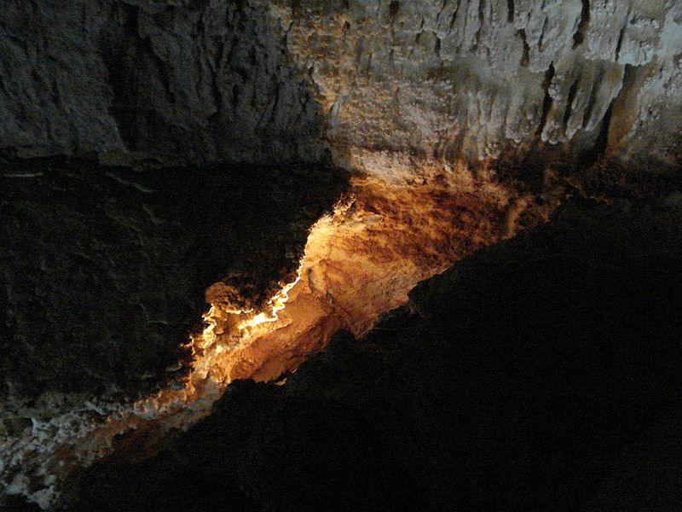
General information
Marble Cave was explored in 1987 by local scientists. The entrance to the cave is located on 920 m above the sea level. It consist of three parts: the Main Gallery, The Bottom Gallery and The Tiger passageway.
The galleries of enormous sizes are divided into separate rooms. The length of explored passages is 2050 m and depth is 60 m.

Slide 4
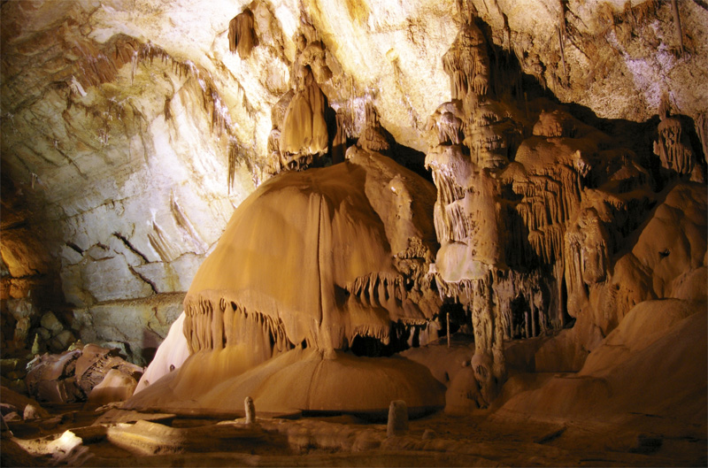
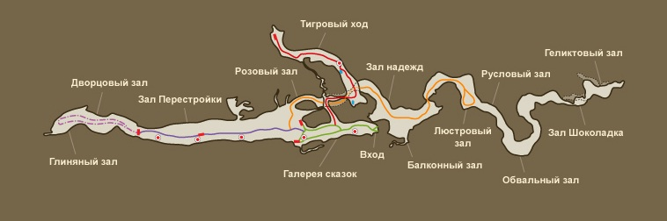
Excursions
Duration of excursion in the Cave is 1 hour. Length of tourist routes is more than 1 km. Temperatures in the area kept at +9 ° C. The part of the Marble Cave is a cave Emine-Bair-Khosar, which also attracts a huge number of visitors to the variety of stone formations, interior and beauty in the caves.

Slide 5
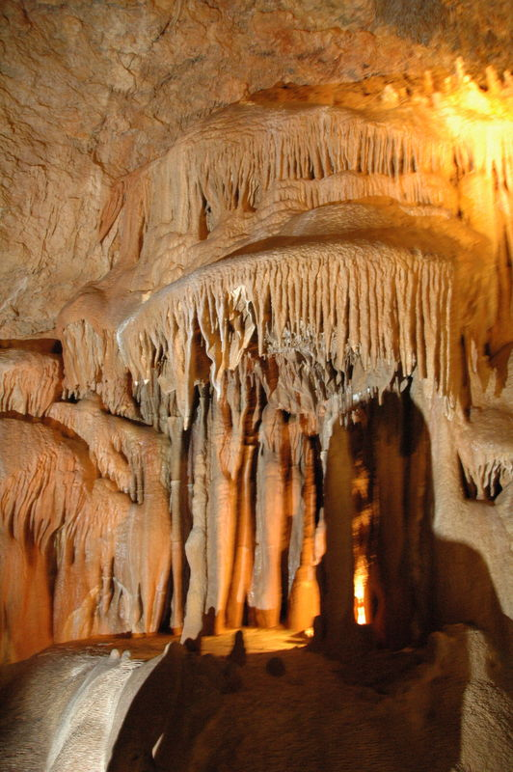
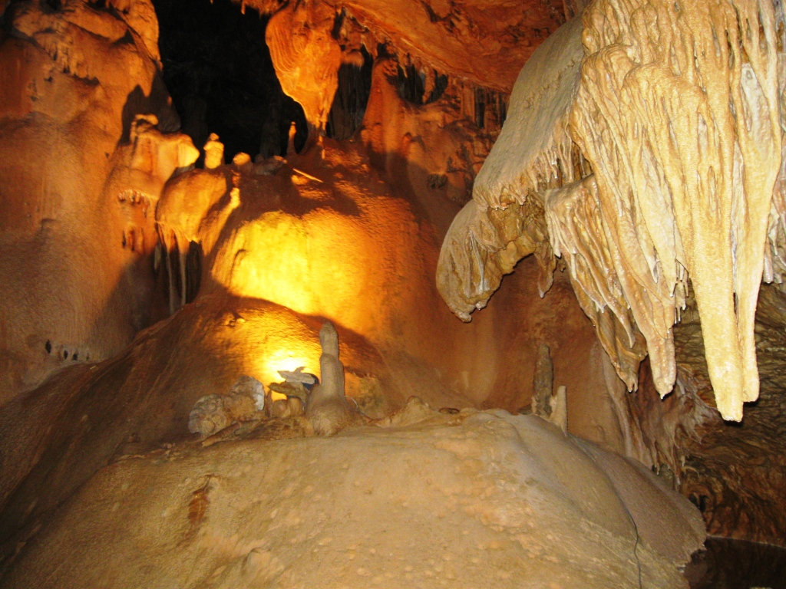
Popularity
The unique of the Marble Cave brought her international fame. According to the famous cave explorers, it belongs to the top 5 most beautiful caves in the world. This one of the most visited caves in Europe in 1992 was admitted to the International Association of caves (in Italy). Marble Cave was announsed as one of the 7 natural wonders of Ukraine in August 26, 2008.

Slide 6
