Slide 1
Ideal Family
Were prepared by Iryna Molokova and Ilona Synytsia

Slide 2
Everyone has his own definition of what a family should be like. The meaning of a family is different to each of us.

Slide 3
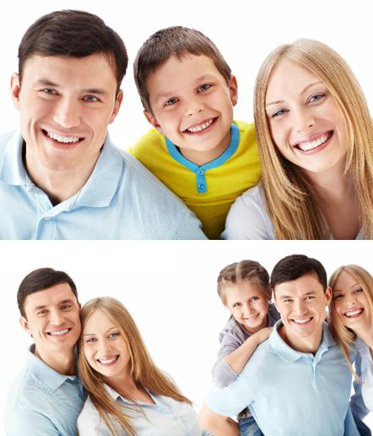
Therefore by sociologists giving definitions to what a family is, we do not have a clear idea of what family is and not all definitions adept to all families.

Slide 4
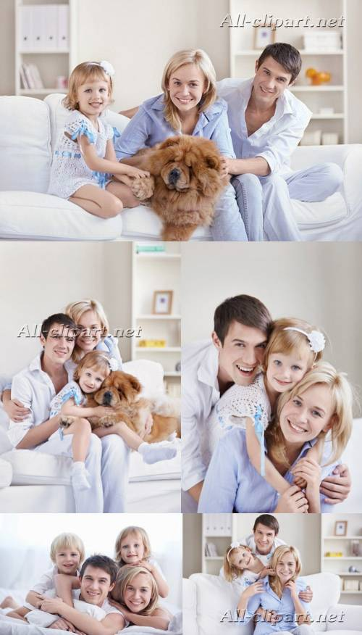
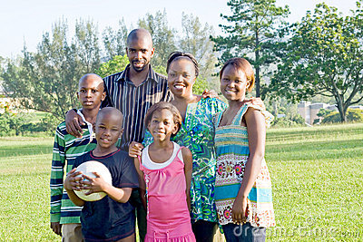
Every person in this world has another meaning of the family which is perfect for society. A person who lives in Africa has another idea of the perfect family than someone who lives in Austria.

Slide 5
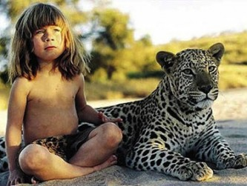
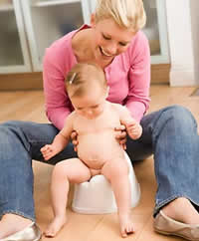
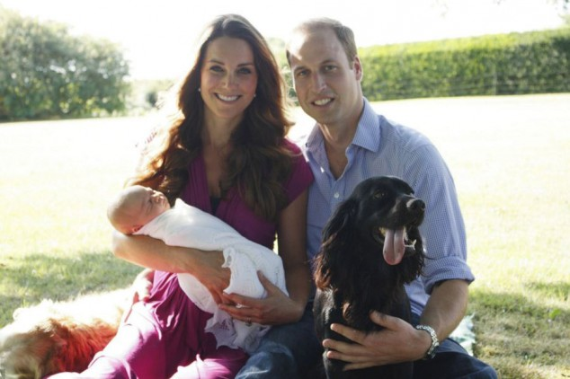
There is no “ideal family”. In the following presentation we’ll explain why.

Slide 6
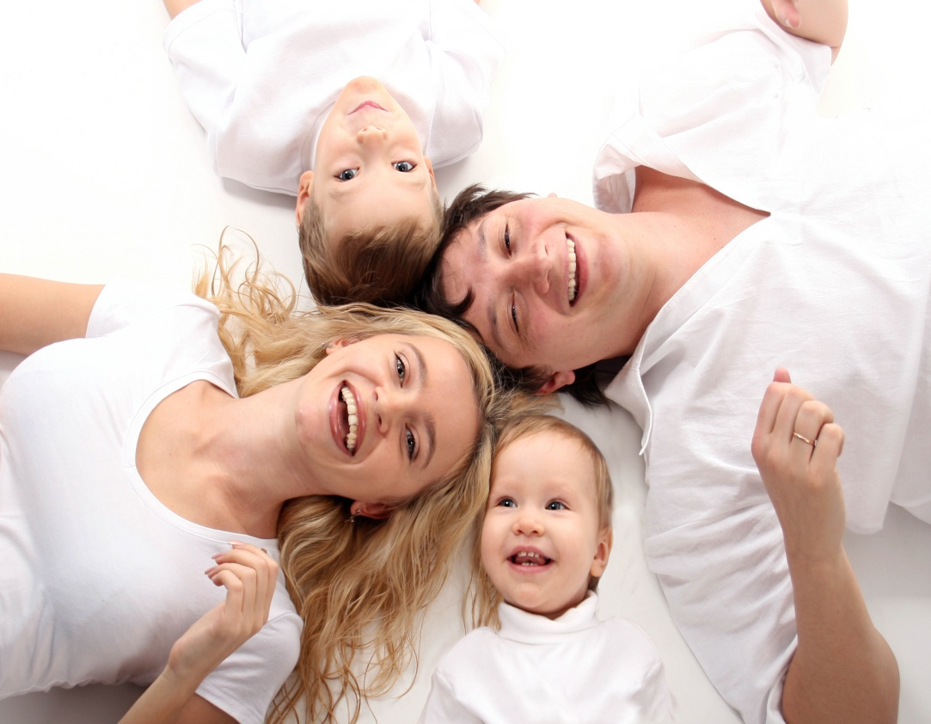
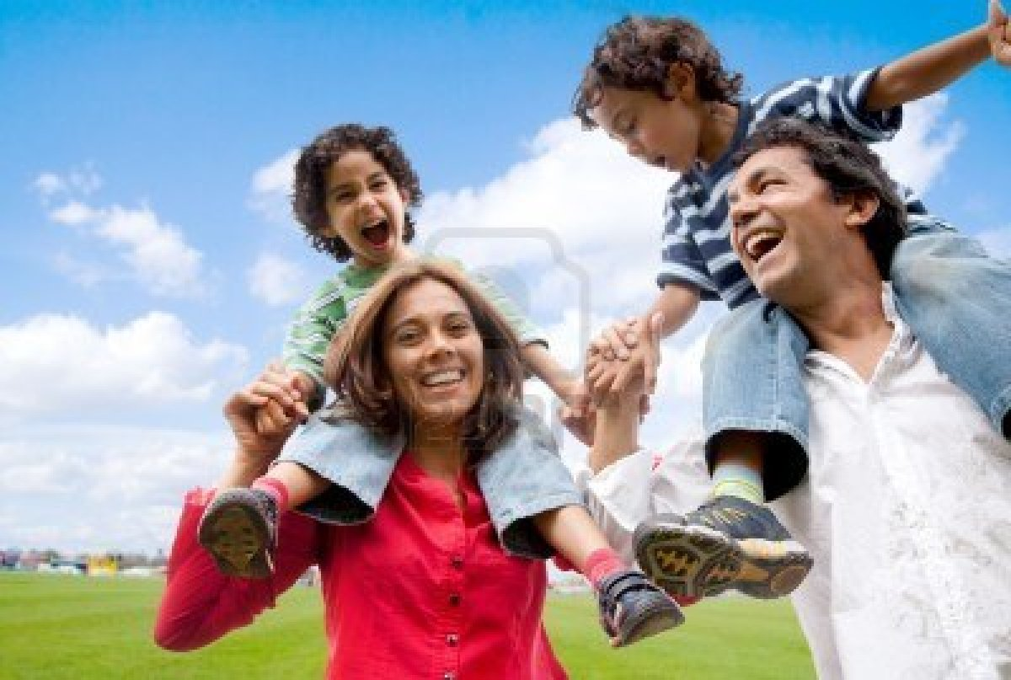
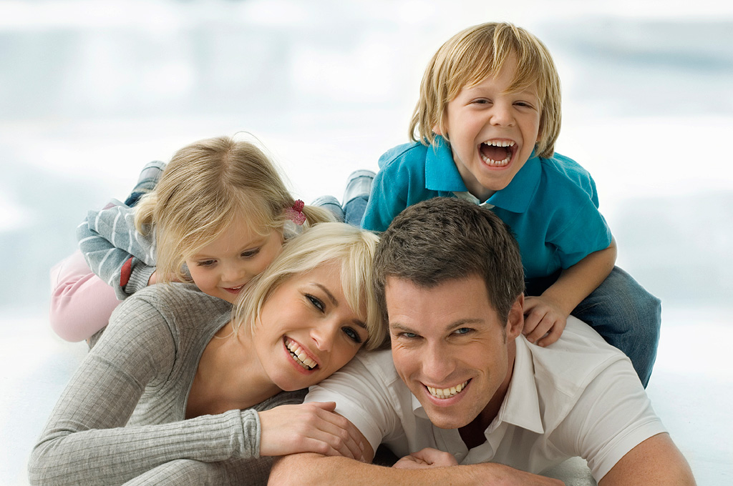
It does not matter what the constellation of a family is. For example, if there is a mother, a father and two children, for most people it seems that this is a perfect family.

Slide 7
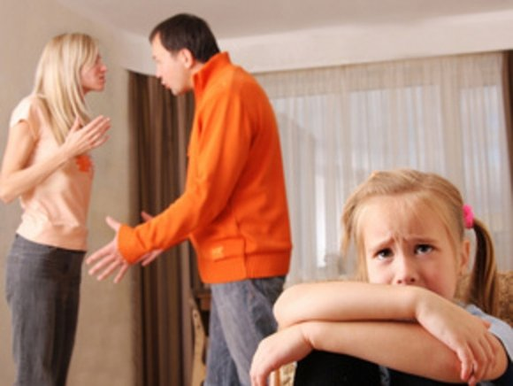
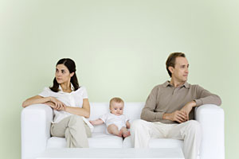
But think of the situation that the father or mother is an alcoholic. No one knows, outwardly it appears that everyone is happy.

Slide 8
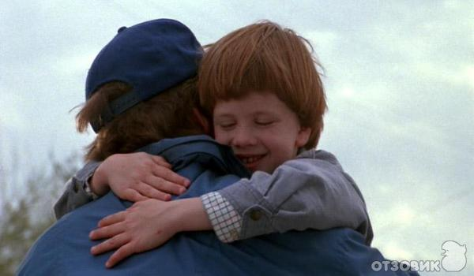
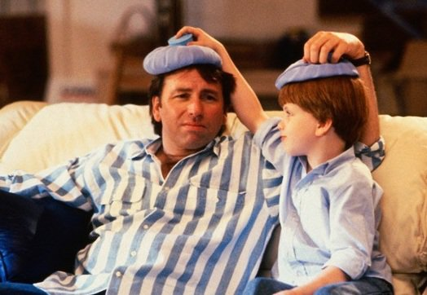
It is not important if the parents are the “real” parents, this means that the children are adopted. For instance, most of the children who are adopted have a considerably better life than before.

Slide 9
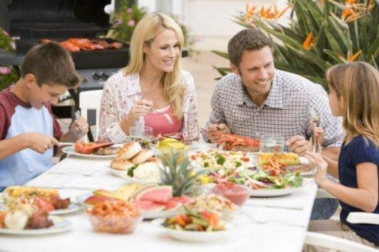
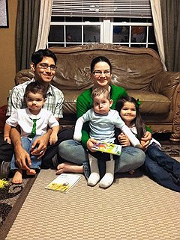
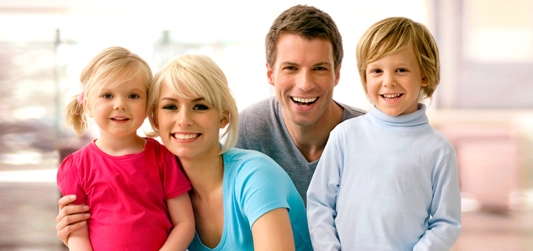
There is no connection between family constellation and relationships between family members.

Slide 10
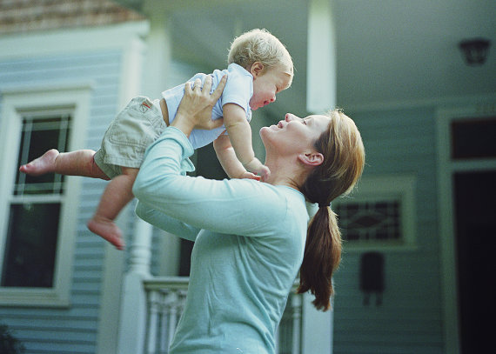
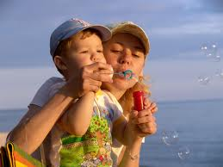
The first point is that in most instances there is a better relationship between family members in single parent families.

Slide 11
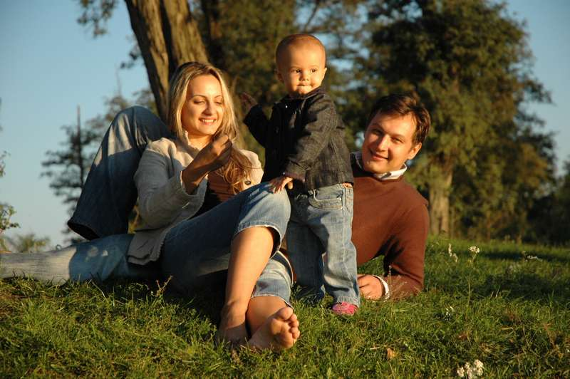
Relationship consists of giving and receiving. In other words, there could be the perfect family, but if no one thinks about the others it is impossible to live happy together.

Slide 12
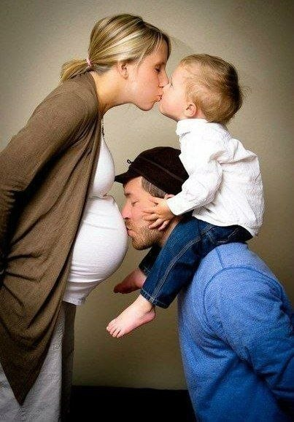
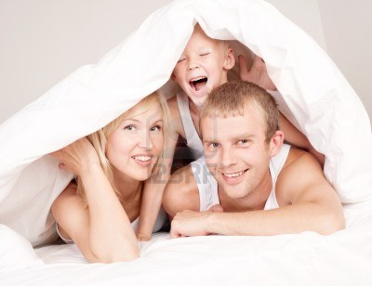
There is no classification exists, which is perfect for society. Neither a nuclear family nor any other family can live without any problems. This means that a family can look like the perfect family for years, always obliging and friendly.

Slide 13
In conclusion, the question “Which is the ideal family?” is really difficult to answer, because everyone has another opinion of it.

Slide 14
Because of that there cannot be a ideal family which contains the meaning of everyone. It depends on many factors. You always have to look at all of them.

Slide 15
The end

