Slide 1
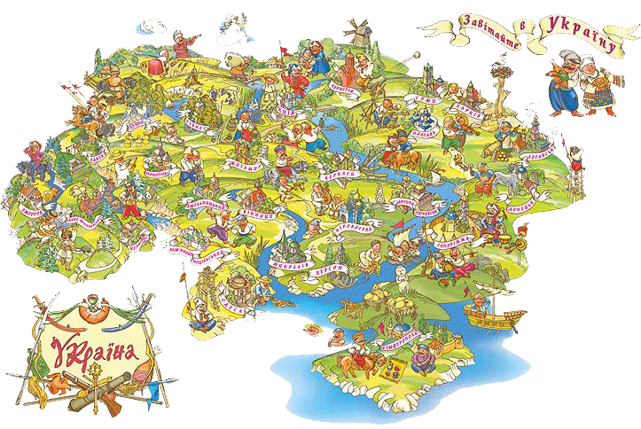
Gap year in Ukraine

Slide 2
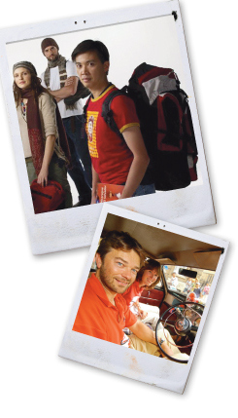
Many students decide to take a gap year before they begin university. This can be a productive way to spend a year and is viewed as a positive experience by many universities and employers. However, you must use your year productively in order to show universities and employers that it was worthwhile. And Ukraine is a perfect country for this action.

Slide 3
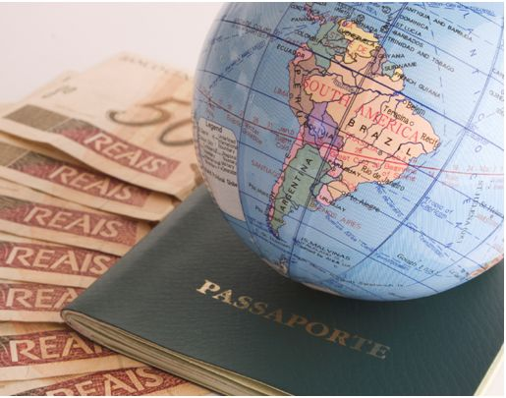
Quick Facts
Capital City:Kiev
Currency:Hryvnia, UAH
Language:Ukrainian, Russian
Time Zone:+2 GMT
Dialling Code:+380
Religion :Christianity
Total Area:603,700 square kilometres

Slide 4
Visas
Safety
Tourist visas are not required for stays less than 90 days for visitors from the EU, USA and Canada. Australians and New Zealanders, on the other hand, can get visas a few hours after visiting a Ukranian consulate having received a letter of invitation from a lodging provider.
Ukraine is a fairly welcoming and safe place for travellers however there has been a few racially motivated cases in the past concerning travellers of Asian and Afro-Caribbean descent. Take extra care on public transport to keep your belongings safe and secure particularly in the busy metro areas of Kyiv.

Slide 5

Vaccinations and Health
Medical facilities in Ukraine are not considered to be the best by any means. That said private clinics and hospitals do offer adequate care but take out comprehensive medical insurance cover before your travel. Drink only boiled or bottled water too.

Slide 6
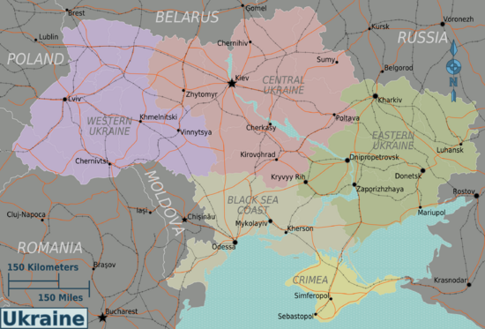
Map of the country

Slide 7
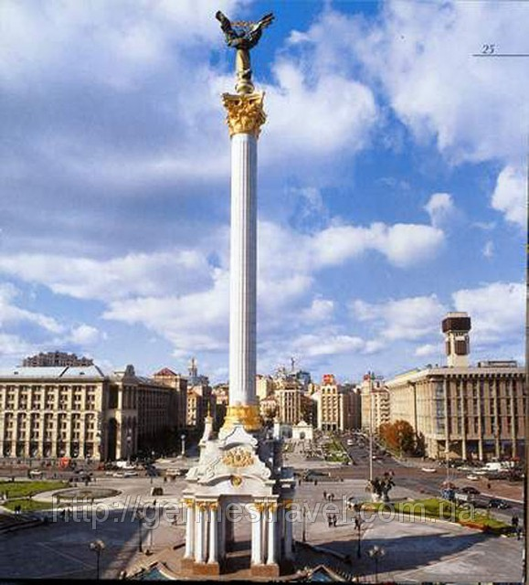
The best cities to visit
Kiev
Chernihiv
Chernivtsi
Dnipropetrovsk
Donetsk
Kharkiv
Lviv
Odessa
Sevastopol

Slide 8
Getting Around
There are trains from Berlin, Vienna, Prague, Warsaw, Budapest, Bucharest and to Lviv or Kiev.
There are inexpensive direct bus services to Lviv and Ivano-Frankivsk from Poland. They usually offer a budget level of comfort and cost about 90 to 100 hryvnia.

Slide 9
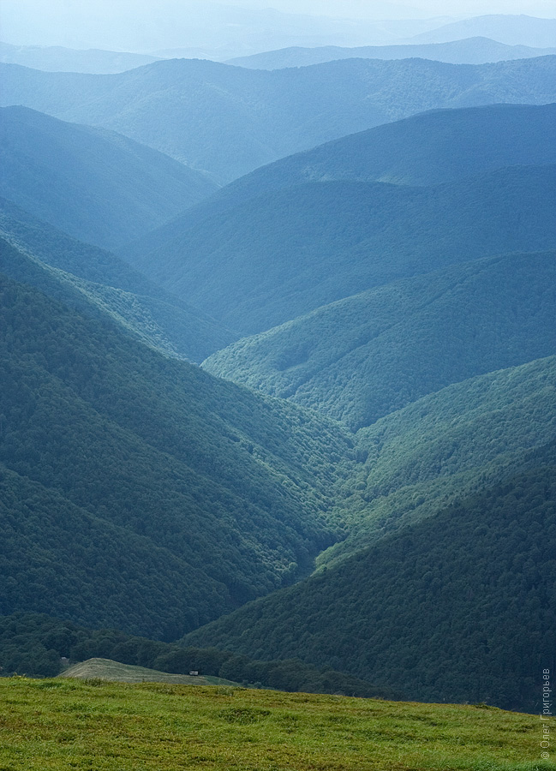
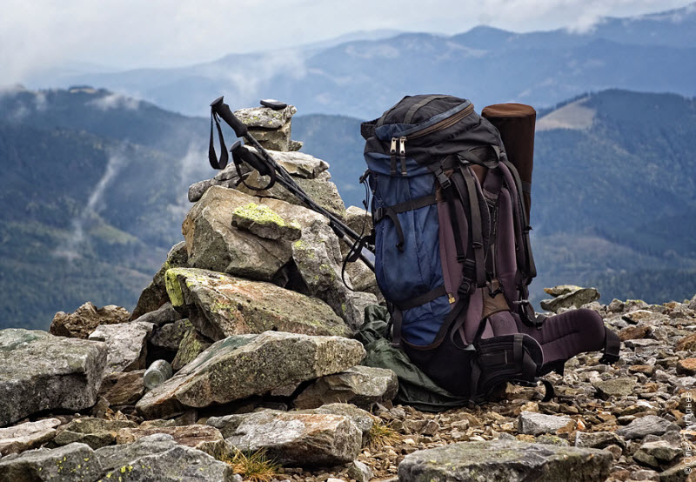
Don't Leave Here Without...
Walking with bears
Go hiking in the rugged Carpathian Mountains and you might just spot one of its brown furry residents. In winter, swap walking boots for skis and take to the slopes.

Slide 10
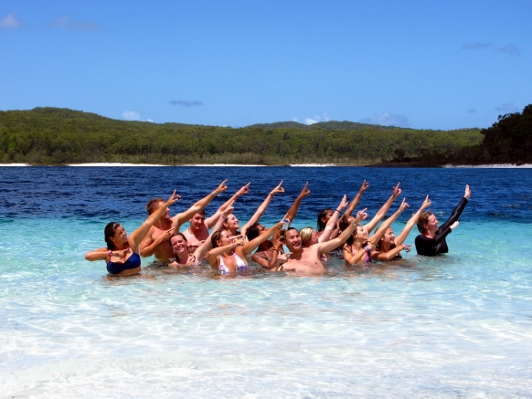
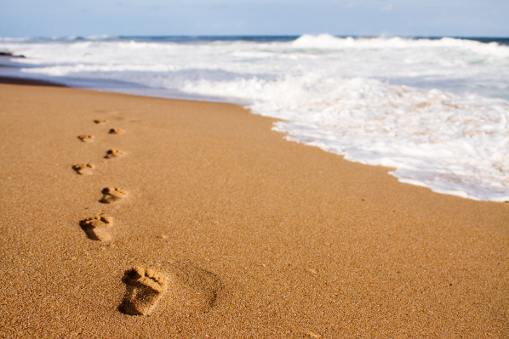
Dancing in the sea
The kaZantip music festival, a techno and house extravaganza on Popovka's sandy beaches, attracts hedonists from all over the world. Fans of the Jonas Brothers might want to give it a miss.

Slide 11
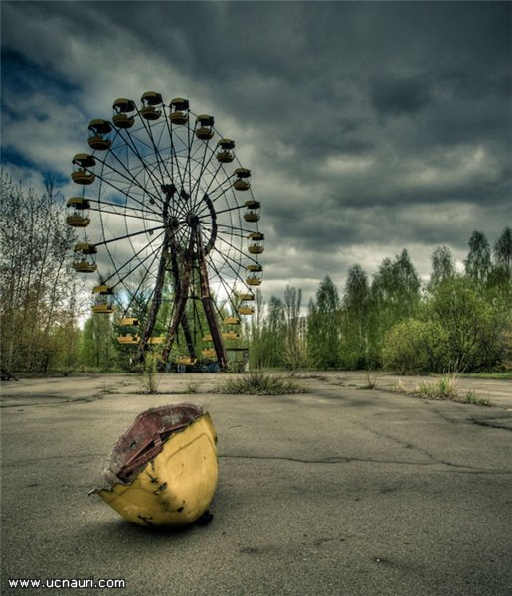
Uncovering a ghost town
Chernobyl - scene of a horrific nuclear disaster in 1986 - is an eerie, thought-provoking place. Take a walk around the radioactive-dust-covered power plant and deserted city of Pripyat.

Slide 12
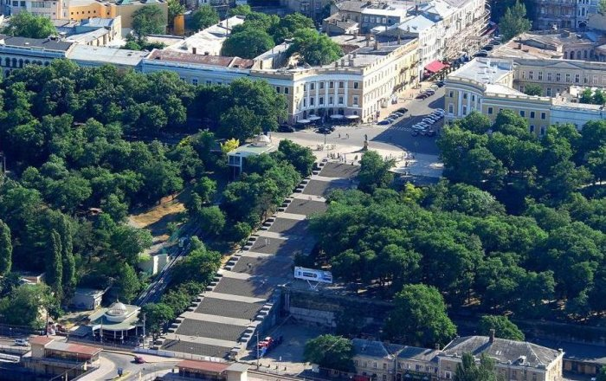
Mixing past and present
Odessa is heavy with history - it's where the sailors of Battleship Potemkin revolted in 1905. These days the plethora of outdoor seafront nightclubs means the gatherings are somewhat friendlier.

