Slide 1
Interesting Facts About Ukraine
Семібратов Б-9-4

Slide 2
1. Ukraine is the largest country which entirely located in Europe.
2. In Ukraine there is the largest stock of manganese ore in the world, 2.3 billion tons, or about 11% of all deposits of the Earth.

Slide 3
3. The geographical center of Europe is in Ukraine. In the west of the country, between Uzhhorod and Rakhiv the sign «Geographical center of Europe». This status was recorded at the Congress of Vienna of geographers in the XIX century. This was the first attempt by the scientists to define the middle of the European continent.

Slide 4
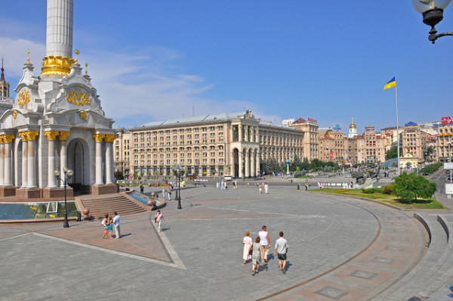
Interesting Facts About Ukraine: Khreshchatyk Independence Square.

Slide 5
4. The shortest main street of the capital in Europe is – Khreshchatyk in Kiev. Its length is 1225 meters.
5. Ukraine owns a quarter of fertile black soil of the world. Black soil – the most fertile soil of our planet. During the Second World War, the Germans took out Ukrainian soil in Germany by trains.

Slide 6
6. Ukraine – a major producer of grain (among the three largest producers of barley). Along with France, Germany and the United States – one of the largest producers of sugar beets, ahead of neighbors like Poland and Turkey. Ukraine is in the world’s seven largest producers of sugar, vegetable oil, pork and potatoes. Among the top five global producers of honey.

Slide 7
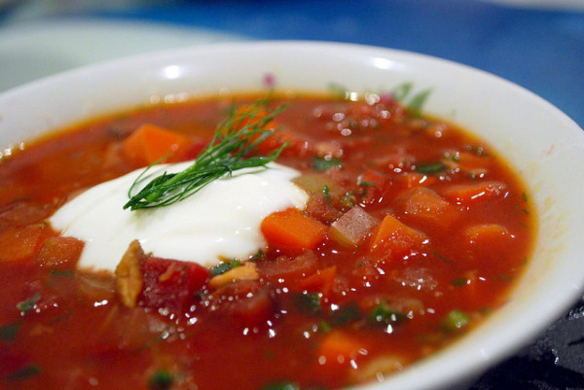
Interesting Facts About Ukraine: Borsch.
7. Borsch – is not a Russian dish, it is Ukrainian dish.

Slide 8
Interesting Facts About Ukraine: Ukranian Food & Drink.
9. Ukrainians like lard very much – it’s true. They call it «Salo». Lard in Ukraine is prepared in various ways – worth to try with a traditional Ukrainian black bread, onions and with «Horilka». «Horilka» it is the same, just a different name.

Slide 9
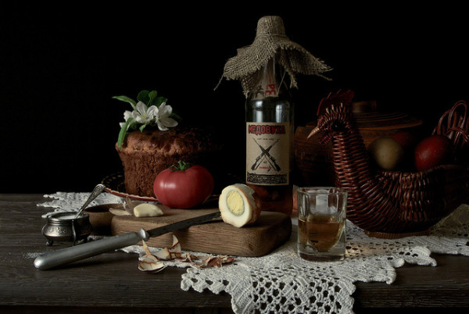

Slide 10
Thank you for
your attention!

