Slide 1


My future profession
I have been asked throughout my life by my family and close friends about my way of contributing to social prosperity. In my opinion, it is a very important question the answer to which I have discovered for myself in my future profession.

Slide 2

I want to become a doctor!
I want to be a successful doctor whose main purpose in life is to be of great use for maintaining healthcare. However, this serious decision made me feel very nervous of my future, and even propelled to ask myself whether it is really a goal of my life.

Slide 3
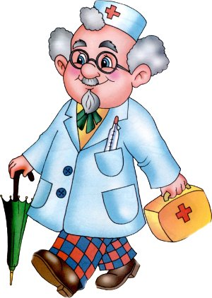
What qualities does a doctor must have?
To become a doctor I must be good at studies because a doctor is needed and responsible profession.
We trust doctors the main what we have – our life and that’s why a doctor must be a qualified specialist.
He must help people at any time of the day.
A doctor can’t make a mistake.

Slide 4

Whenever I get sick, I remain confident in the fact that regardless of any damage to my health my life is not in danger. Luckily, I have never been in a serious accident with strong consequences. I lead a healthy lifestyle.

Slide 5

Reach your goals!
So far I have not decided what kind of a doctor I want to be. Whether I once become a surgeon, pediatrician, or physician, all I know now is that I certainly want to become one of those people who are exalted by people for the job that they do. It can take years of studying, taking very expensive courses, getting a loan in the bank for the purpose of paying tuition, and going through many obstacles on the way to obtain a diploma of a qualified specialist. However, I believe that as long as it is what I set as my life’s aim, I am able to fulfil my dream.

