Slide 1
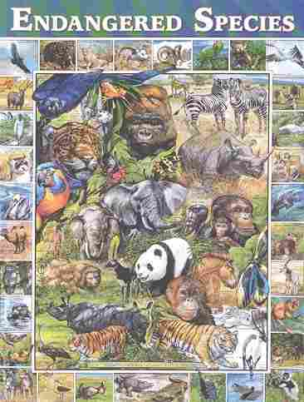
Endangered
Animals
Mammals
Birds
Insects
Fish

Slide 2
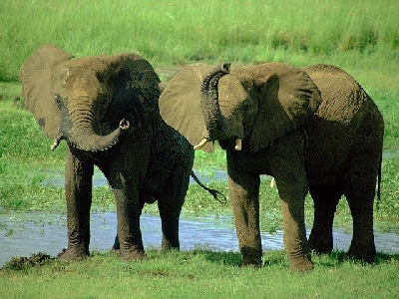
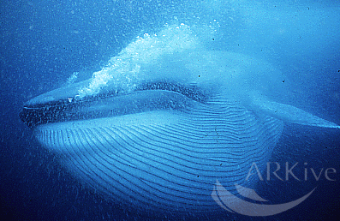
Asian Elephant & Blue Whale
The Asian elephant is also known as the Indian elephant. It stands up to ten feet high and weighs up to 10,000 pounds.
The Asian elephant is classified as an endangered species due to a reduction of at least 50% of the Asian elephant population over the last three generations based on a decline in area of occupancy and levels of exploitation.
The Asian elephant has four subspecies: the Indian, Ceylon, Sumatran, and Malaysian elephants.
The male blue whale grows to about 82 feet long, and the female grows to about 85 feet long. They weigh up to 285,000 pounds as an adult.
The blue whale is endangered due to a reduction of at least 50% of the blue whale population over the last three generations based on direct observation, an index of abundance, and levels of exploitation.
The blue whale is the largest mammal to have lived on the earth, but it feeds on some of the smallest marine organisms - plankton.

Slide 3
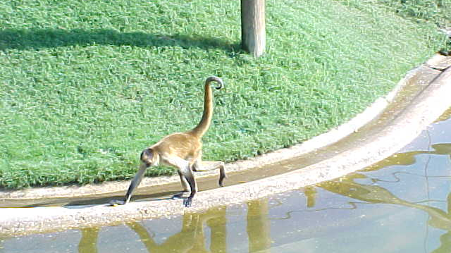
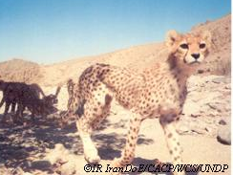
Hybrid Spider Monkey
& Asiatic Cheetah
The hybrid spider monkey grows to almost two feet long, not including the tail. It weighs from ten to fifteen pounds.
The hybrid spider monkey is classified as an endangered species due to the fact that it only exists in severely fragmented subpopulations, and that there has been continuing decline in the hybrid spider monkey population.
The hybrid spider monkey is known for its ability to use its tail as an extra limb.
The Asiatic cheetah is classified as a critically endangered species due to an estimated population of less than 50 mature individuals, a continuing decline in numbers of mature individuals, and the fact that all Asiatic cheetahs are in a single population.
Asiatic cheetahs can be found in Iran.

Slide 4
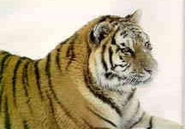
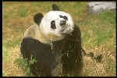
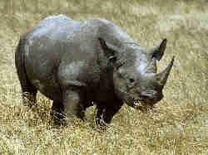
Tiger, Giant Panda &
Black Rhinoceros
The male tiger grows up to ten feet long from its head to the tip of its tail, and weighs up to 575 pounds.
The tiger is classified as an endangered species due to the projected tiger population declining to at most 50% within three generations due to exploitation and a decline in area of occupancy.
The tiger consists of eight subspecies, distinguished by the colour of their coat.
The male giant panda stands up to five feet tall, and weighs up to 265 pounds. The female giant panda is smaller and weighs less.
The giant panda is classified as an endangered species due to the fact that it only exists in severely fragmented subpopulations consisting of up to 250 mature adults, and that there has been continuing decline in the area of habitat.
The giant panda feeds mainly on bamboo, even though it is classified as a carnivore.
The black rhinoceros grows up to twelve feet long and six feet high. It weighs up to three thousand pounds.
The black rhinoceros is classified as a critically endangered species due to a reduction of at least 80% of the black rhinoceros population over the last three generations based on direct observation, an index of abundance, and a decline in area of occupancy.
The black rhinoceros is the most aggressive species in the rhinoceros family, and can charge at speeds up to thirty miles per hour.

Slide 5
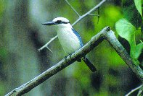
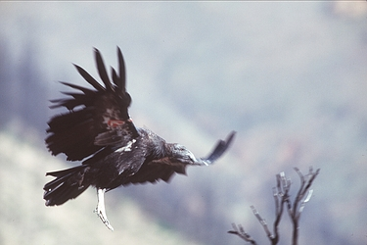
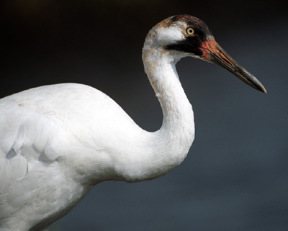
Marquesan Kingfisher,
California Condor & Whooping Crane
The marquesan kingfisher is classified as an endangered species due to a severely fragmented population and a projected decline of mature marquesan kingfishers and area and quality of habitat.
The California condor is classified as a critically endangered species due to an estimated population of less than 50 mature individuals. The California condor can be found in the United States.
The whooping crane is classified as an endangered species due to an estimated population of less than 250 mature cranes. The whooping crane can be found in Canada and the United States.

Slide 6
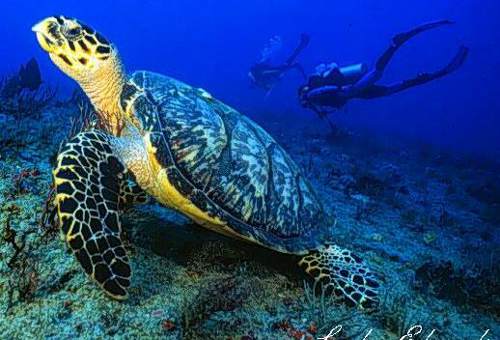
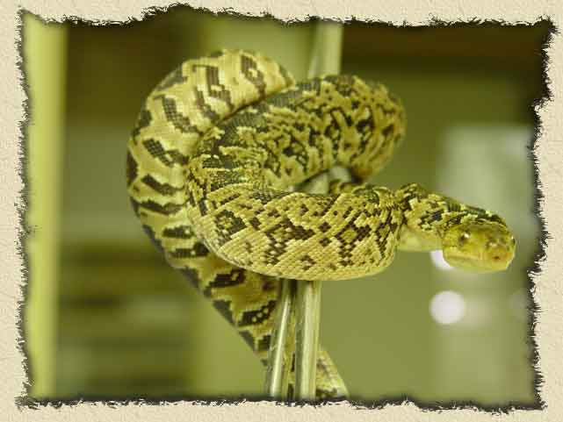
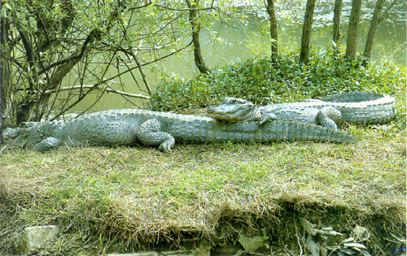
Hawksbill Sea Turtle, Cuban Boa
& Chinese Alligator
It is very difficult to classify how endangered hawksbill turtles are because they are found throughout the world and are migratory. In some places, they may be very scarce, and in others they may thrive. Also, since there is little knowledge of their early population levels, it is very hard to know how much the populations have declined.
Currently (throughout the world), it is illegal to trade hawksbill turtle products. In order to succeed in keeping hawksbill turtles in existence, there must be cooperation among all nations that have hawksbill populations in their waters.
The Cuban boa is an endangered island-dwelling animal. It is found in holes and rock piles and on cultivated land. They are primarily arboreal (living among trees). They can reach a length of 4 m, being one of the larger species of boa of this genus. They may live up to 20 to 30 years.
Living on an island, the Cuban boa is at risk from disturbances (e.g. fire, hunting, cyclones), which can quickly push the species towards extinction. There is an international breeding programme for the species, which is coordinated by Prague Zoo.
The Chinese Alligator is believed that it will become extinct in about fifteen years. At the moment in a area called Anhui in China, are thirteen ponds with only about ten of these actually holding the alligators with any one pond having a max of eleven animals.
This is the animal that provided the much known chinese dragon myth. There is a breeding program setup by biologist and they are protected under the maximum law but they still need international help to secure the habitat and educate the public on these wonderful animals.

Slide 7
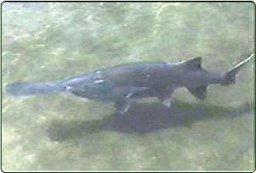
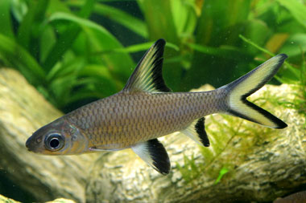
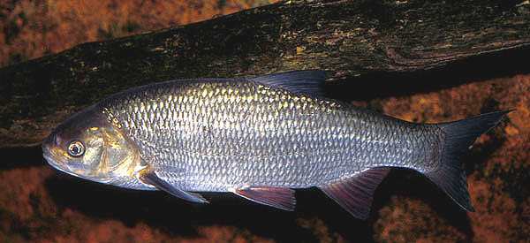
Chinese Paddlefish
Silver Shark & Wild Common Carp
The Chinese paddlefish is classified as a critically endangered species due to a projected reduction of at least 80% of the Alabama sturgeon population over the next ten years based on levels of exploitation and a decline in area of occupancy.
The silver shark, also known as the Bala shark, is classified as an endangered species due to a reduction of at least 50% of the silver shark population over the last ten years based on direct observation and a decline in area of occupancy.
The wild common carp is classified as a critically endangered species due to a projected reduction of at least 80% of its population over the next ten years based on a decline in area of occupancy and introduced pollutants, parasites, or other threats.

Slide 8

The END

