Slide 1

Volleyball

Slide 2


Volleyball – «kick the ball in the air» - a sport in which two teams play.

Slide 3

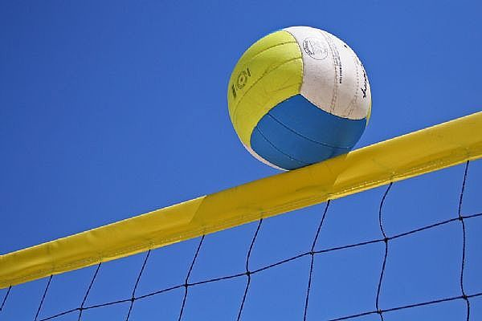
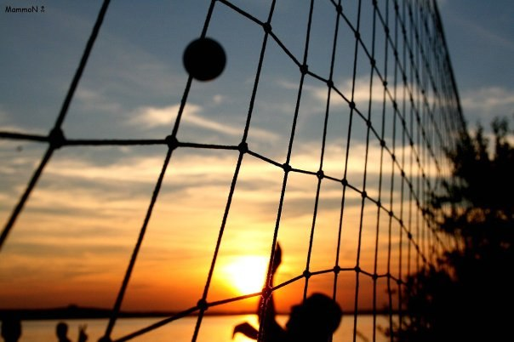
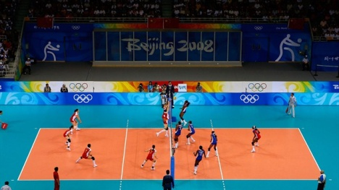
Teams compete in a special playground with a ball.

Slide 4
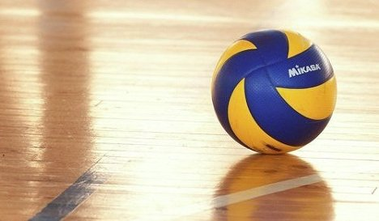
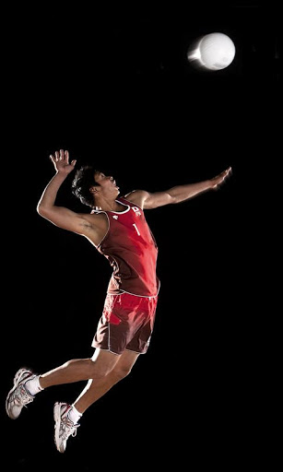
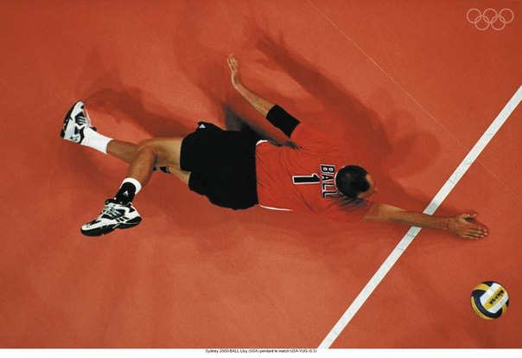
The aim of game - to finish off the attack hit the ball to the floor, that is, to the playing surface.

Slide 5
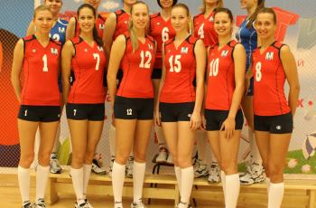
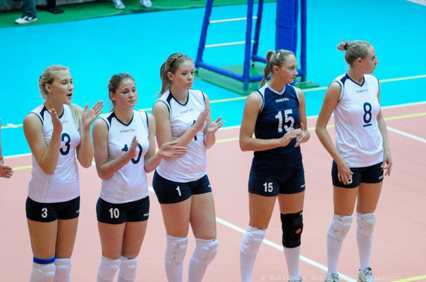
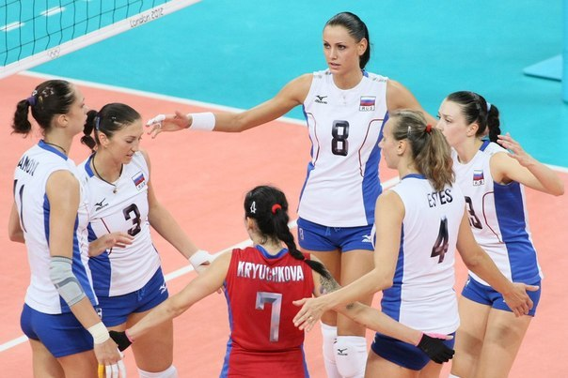
Each team has 6 people.

Slide 6
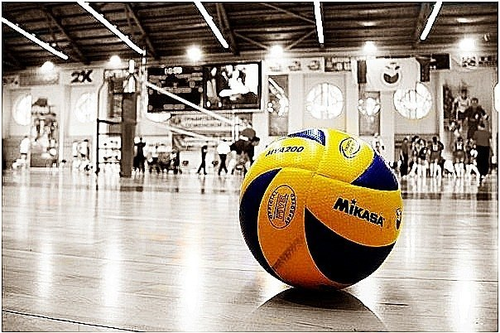
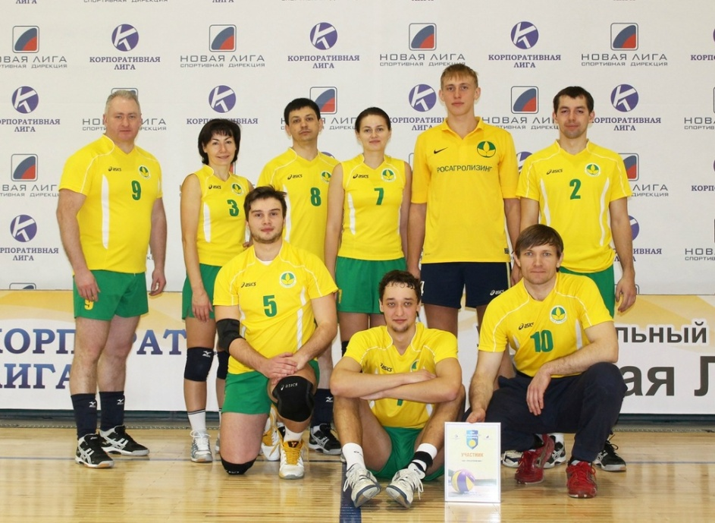
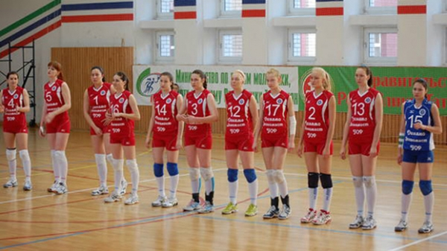
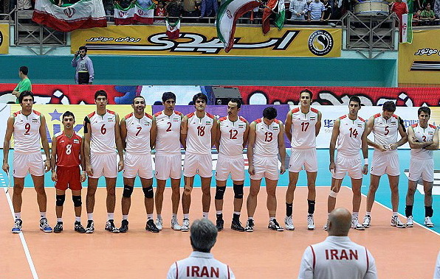
Volleyball players should be dressed neatly and in the same shape.

Slide 7

The basic rules
Each team can only touch the ball three times before transfer it to the enemy.
One player can not touch the ball twice.
The player can bounce the ball with any part of the body.

Slide 8

The team loses the ball, if
the ball goes out of bounds
or any of the players in that team touches the net.

Slide 9
