Slide 1
Computers in our life

Slide 2
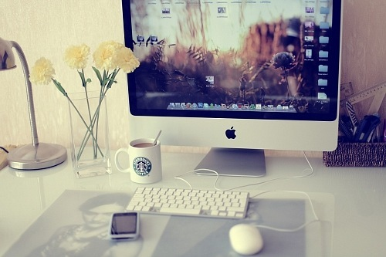
Nowadays computer is a part of our life

Slide 3
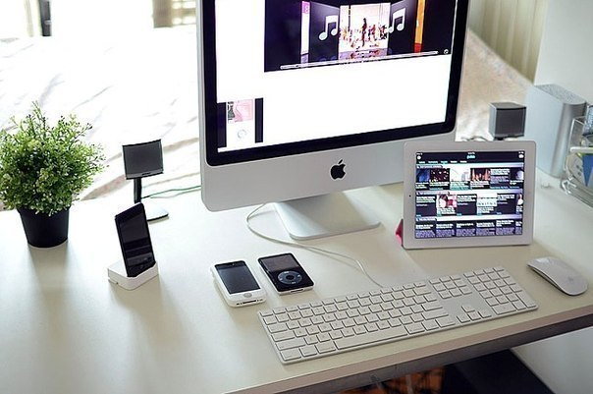
A computer is an electronic machine which can be used to store, process and display data

Slide 4
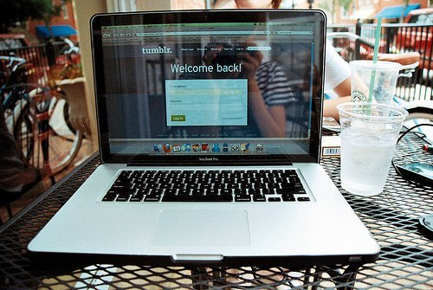
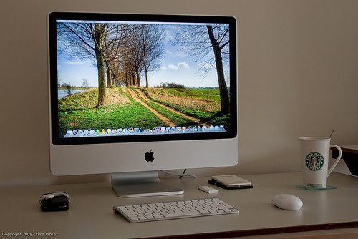
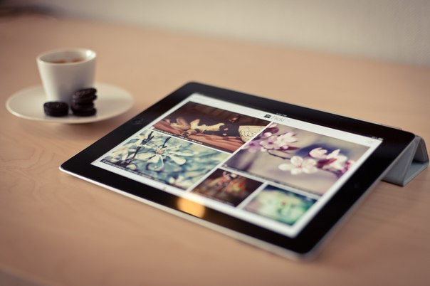
We know many types of computer:
A personal computer
A desktop
A laptop
A notebook
A subnotebook
A palmtop

Slide 5
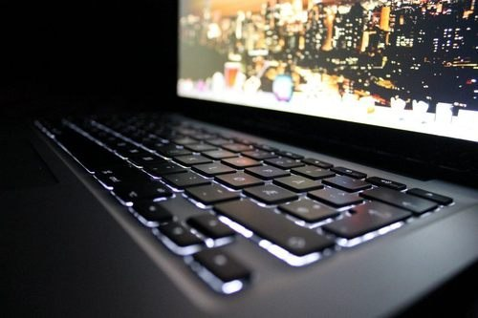
The central idea of computing system is that input is processed into output

Slide 6
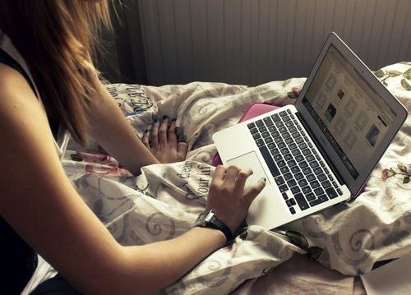
The potential uses of computers are infinite. We use computer everyday: in school, in work, at home

Slide 7
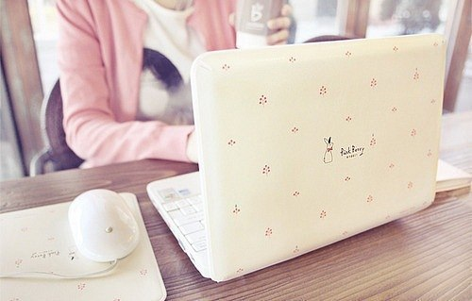
Computer help you to use Internet. Internet is a network of communication and information

Slide 8
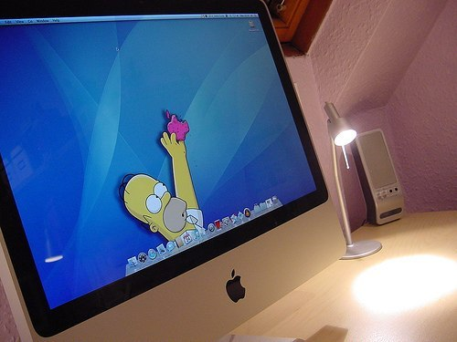
All people can use Internet how they want: some people for studies, some for distraction.

Slide 9
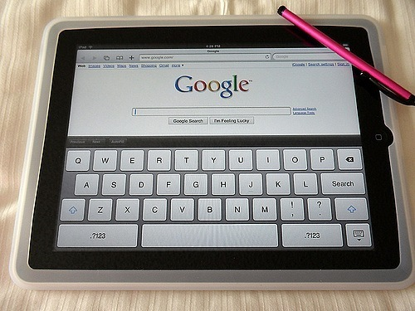
Internet can help you quickly search all information what you want. Its very help in studies.

Slide 10

Also you can use Internet in your wish:

Slide 11
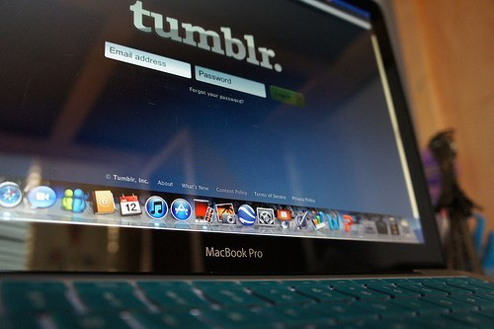
Write and publish blogs

Slide 12
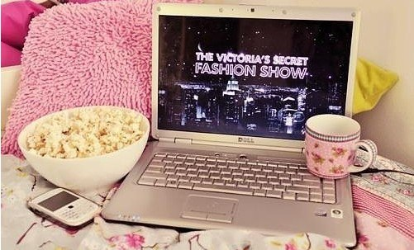
2. Download a files

Slide 13
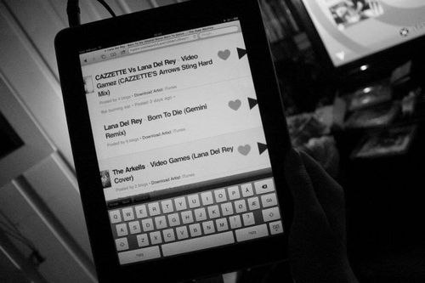
3. Send e-mails

Slide 14
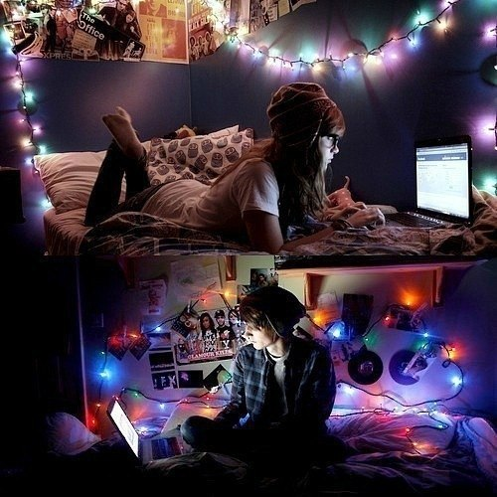
4. Find new friends from another countries

Slide 15
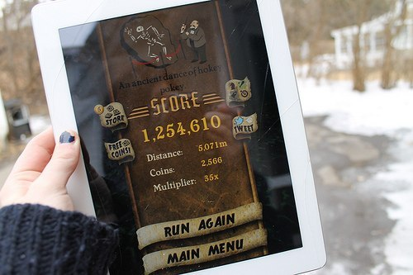
5. Play online games

Slide 16
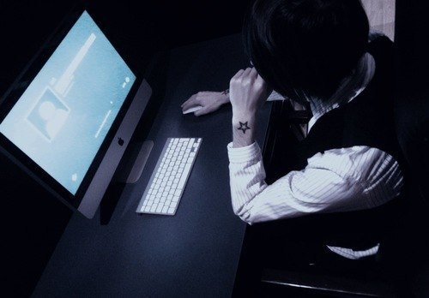
But be careful!
In Internet on you waiting danger!

Slide 17
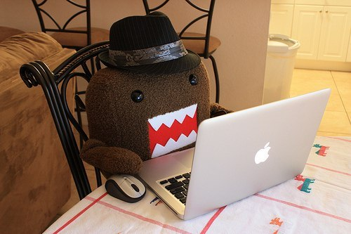
In every moments you can get sacrifice of criminal

Slide 18
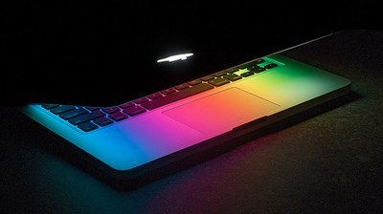
Is very easily rules “How defend yourself in Internet”:
Never publish personal photos

Slide 19
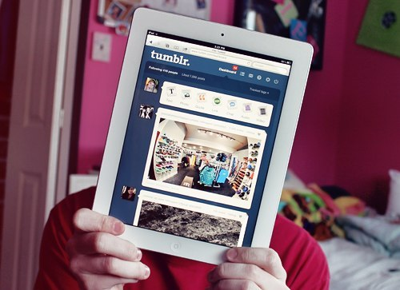
Never call your phone or credit card number
Never download a file an pirates pager

Slide 20
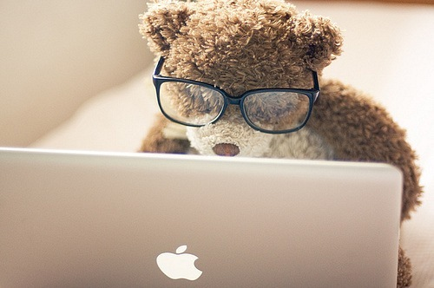
Used computer and Internet with mind, and be in safety

