Slide 1
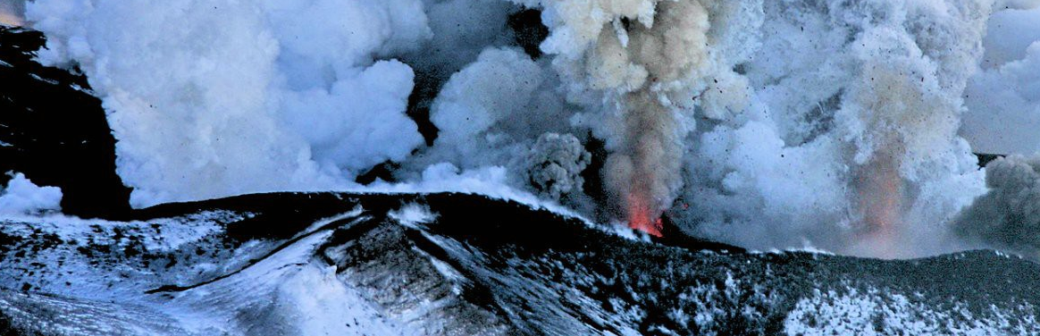
Natural Disasters
Geography

Slide 2
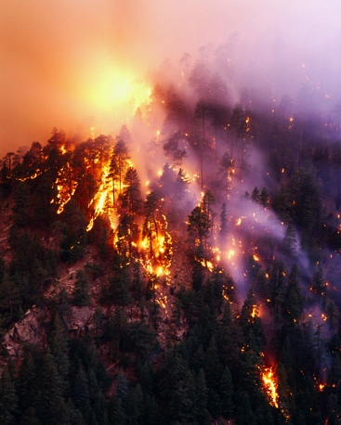
A natural disaster is a major adverse event resulting from natural processes of the Earth.
Examples include:
Floods
Severe weather
Volcanic eruptions
Earthquakes
Other geologic processes

Slide 3

Floods
A flood is an overflow of an expanse of water that submerges land.
Flooding may result from the volume of water within a body of water, such as a river or lake, which overflows or breaks levees, with the result that some of the water escapes its usual boundaries.
Tropical cyclones also can result in extensive flooding and storm surge.

Slide 4
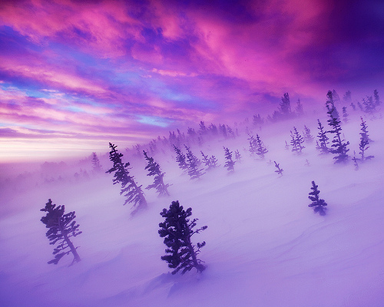
Blizzards
Blizzards are severe winter storms characterized by heavy snow and strong winds. When high winds stir up snow that has already fallen, it is known as a ground blizzard. Blizzards can impact local economic activities, especially in regions where snowfall is rare.

Slide 5
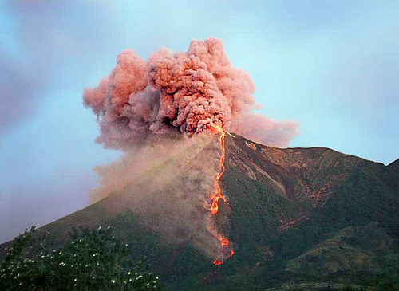
Volcanic eruptions
Volcanoes can cause widespread destruction and consequent disaster in several ways. The effects include the volcanic eruption itself that may cause harm following the explosion of the volcano or the fall of rock.

Slide 6
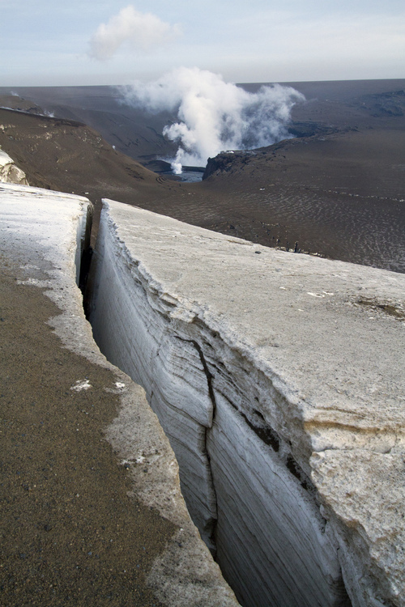
Earthquakes
An earthquake is the result of a sudden release of energy in the Earth's crust that creates seismic waves. At the Earth's surface, earthquakes manifest themselves by vibration, shaking and sometimes displacement of the ground. The vibrations may vary in magnitude. Earthquakes are caused mostly by slippage within geological faults, but also by other events such as volcanic activity, landslides, mine blasts, and nuclear tests.

Slide 7
Protection by international law
International law requires that "States shall take, in accordance with their obligations under international law, including international humanitarian law and international human rights law, all necessary measures to ensure the protection and safety of persons with disabilities in situations of risk, including the occurrence of natural disaster." And further United Nations Office for the Coordination of Humanitarian Affairs is formed by General Assembly Resolution 44/182. People displaced due to natural disasters are currently protected under international law (Guiding Principles of International Displacement, Campala Convention of 2009).

Slide 8
References
Information:
http://en.wikipedia.org/wiki/Natural_disaster
Pictures:
http://weheartit.com
http://tumblr.com

Slide 9
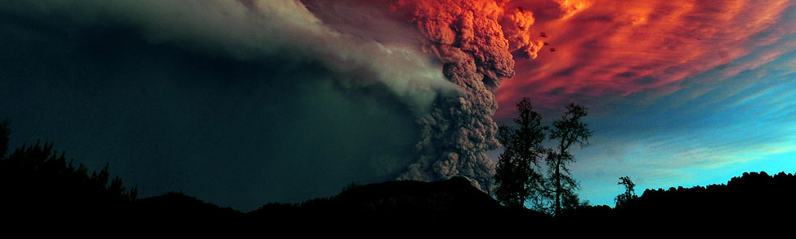

Thank you!

