Slide 1
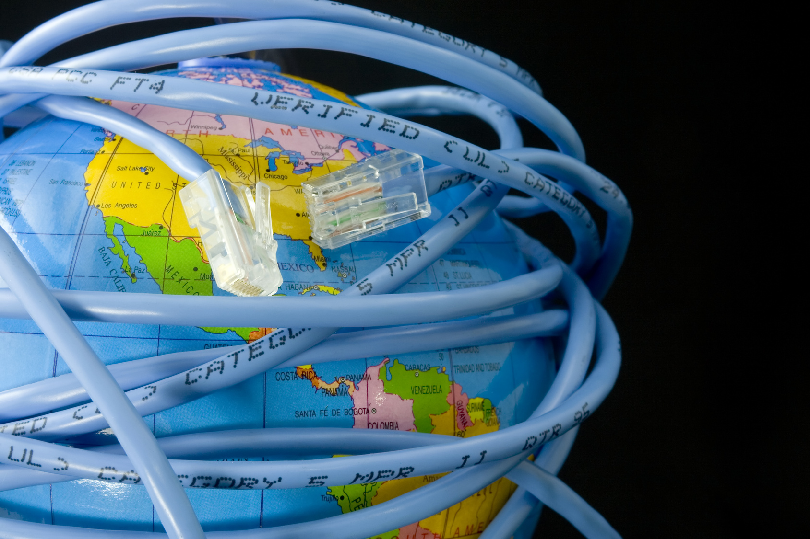
INTERNET

Slide 2
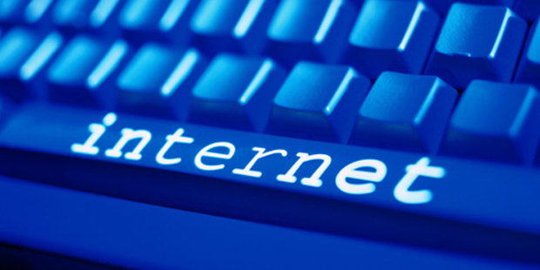
The Internet is:
a network of computers;
an information resource;
a communication system;
a community of users;
a collection of services.

Slide 3
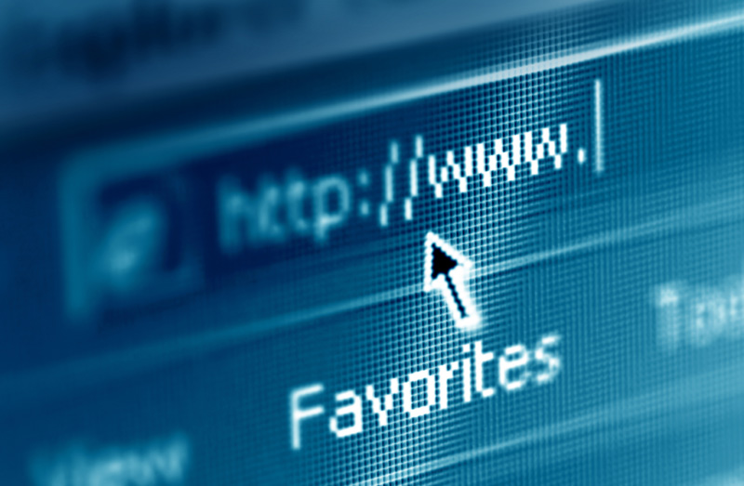
World Wide Web is the set of pages
that are linked references.
* set – набор
* referance - ссылка

Slide 4
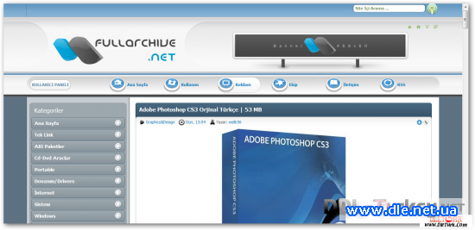
Site is a group of pages that belong
to one organization.
* belong – принадлежать

Slide 5
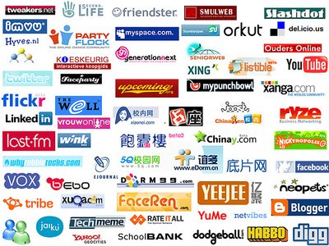
Social Network is a website that is
designed for social interaction of people.
* designed – предназначеный
* interaction - взаимодействие

Slide 6
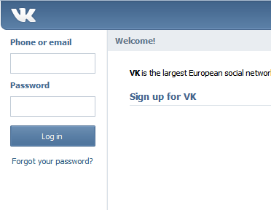
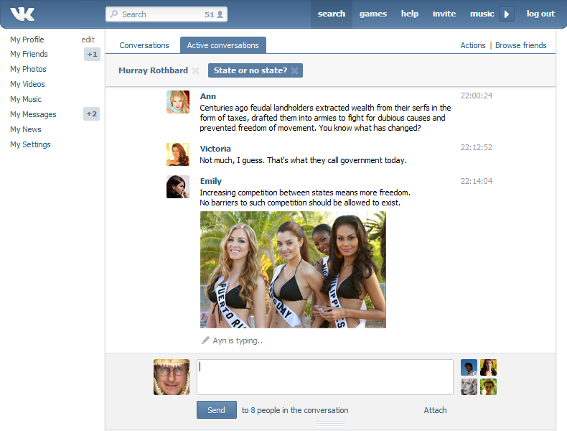
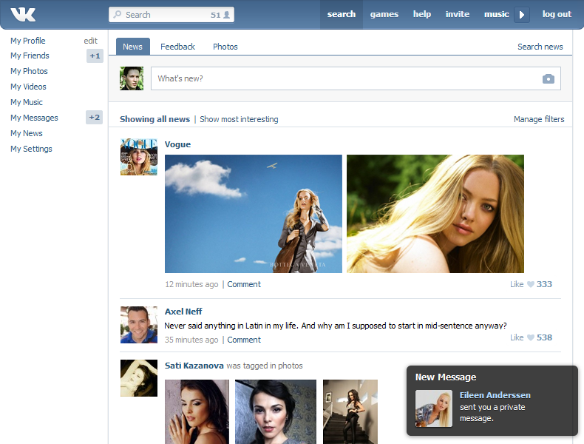
for example…
Vkontakte

Slide 7
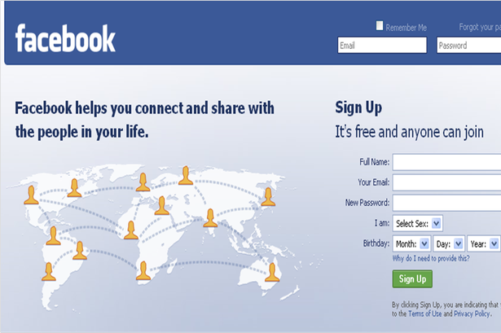
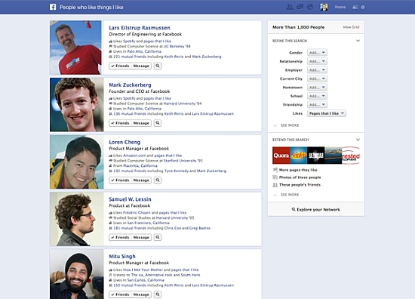
Facebook

Slide 8

Odnoklassniki

Slide 9
As well as…
www.liveinternet.ru
www.blogs.mail.ru
www.mindmix.ru
www.my-lib.ru
and many others.

Slide 10
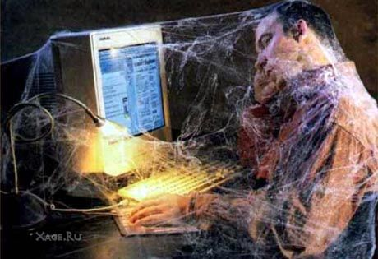
There are many advantages of Internet. I think
that the Internet becomes a way of a person life
and it is very harmful for our health. I don't
against the Internet, but it should have reasonable
limits.
* advantage – преимущество; harmful - вредно against – против; reasonable - разумный

Slide 11
Prepared by Valeria Khasanova.
27.03.2013

