Slide 1
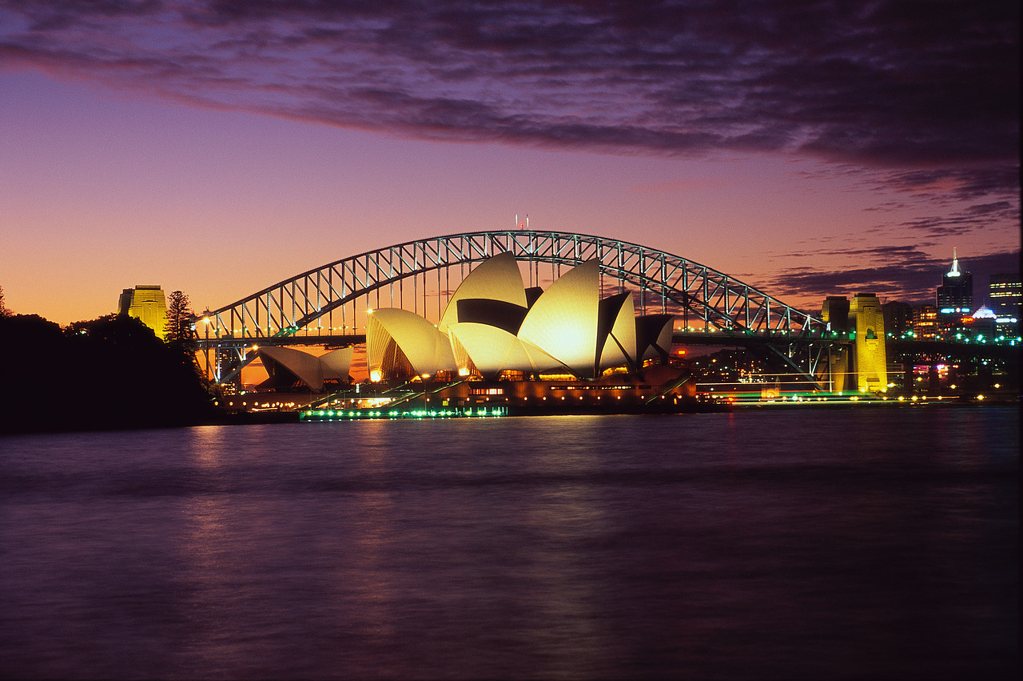
Sydney

Slide 2
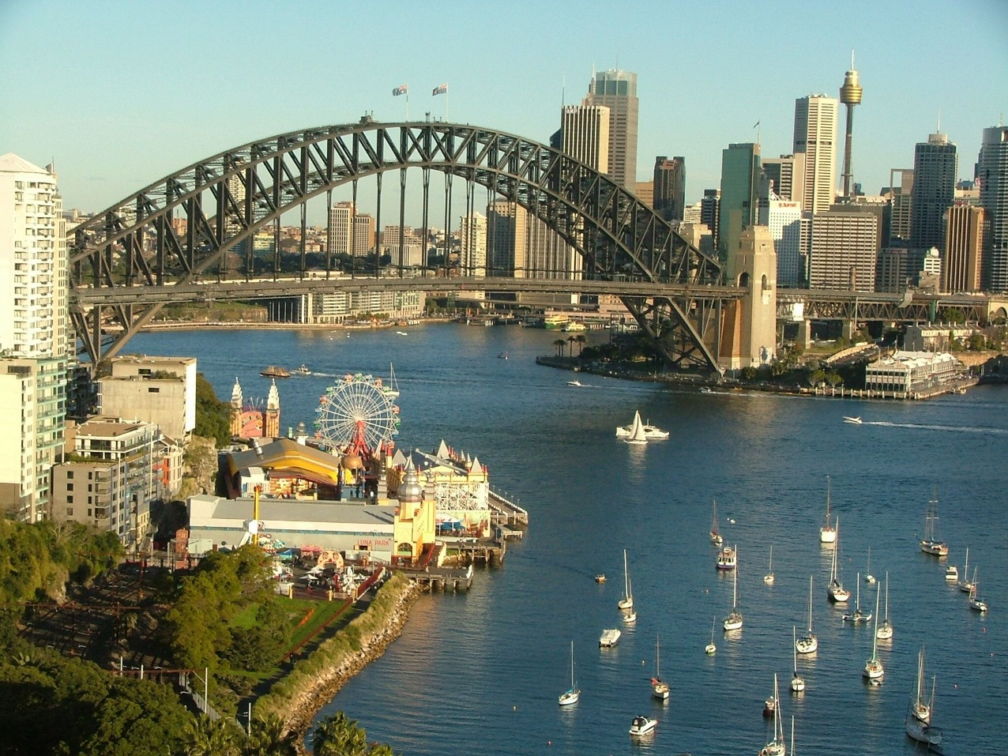
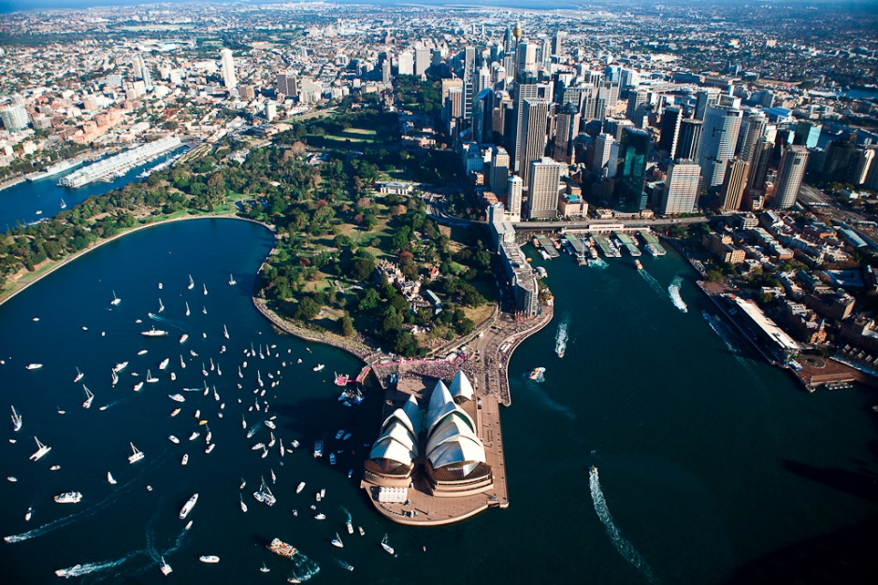
Sydney is the state capital of New South Wales and the most populous city in Australia. It is on Australia's south-east coast, on the Tasman Sea. In June 2010 the greater metropolitan area had an approximate population of 4.76 million people.

Slide 3
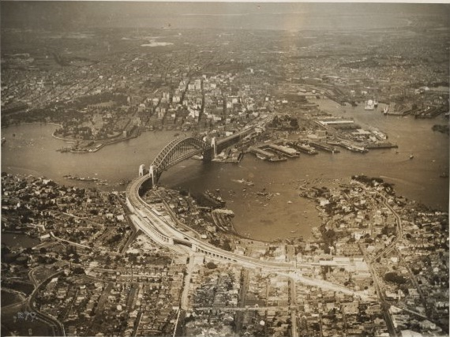
The site of the first British colony in Australia, Sydney was established in 1788 at Sydney Cove by Captain Arthur Phillip. The original name was intended to be Albion, but Phillip named the settlement after the British Home Secretary, Thomas Townshend, Lord Sydney, in recognition of Lord Sydney's role in issuing the charter authorising Phillip to establish the colony.
Sydney harbour in 1932

Slide 4
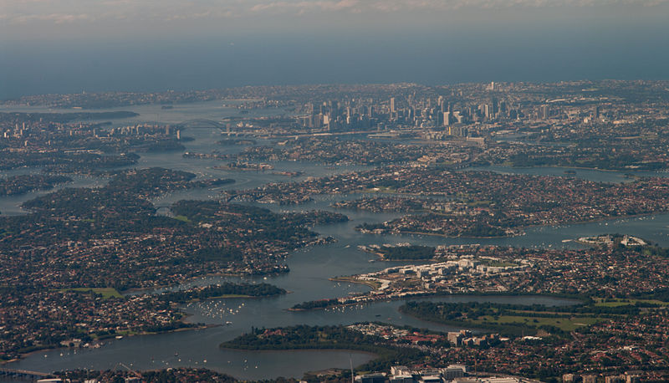
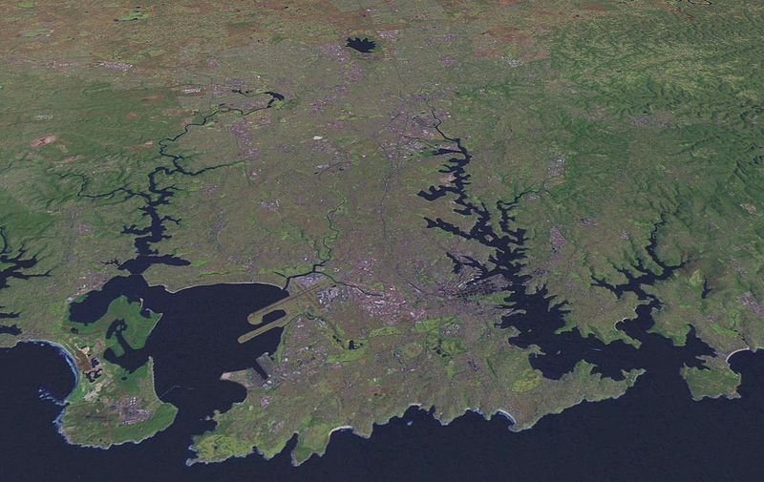
Sydney's urban area is in a coastal basin, which is bordered by the Tasman Sea to the east, the Blue Mountains to the west, the Hawkesbury River to the north and the Royal National Park to the south. It lies on a submergent coastline, where the ocean level has risen to flood deep river valleys (ria) carved in the Hawkesbury sandstone.

Slide 5
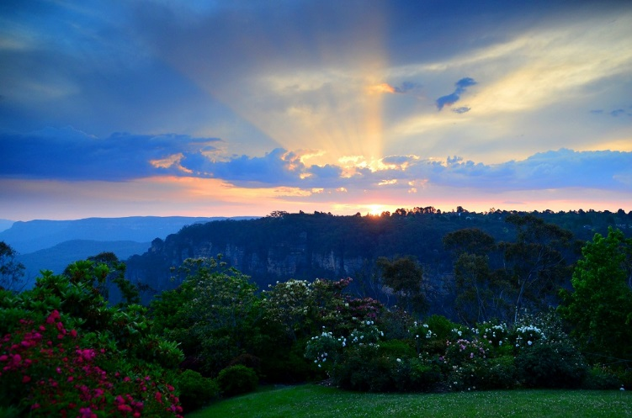
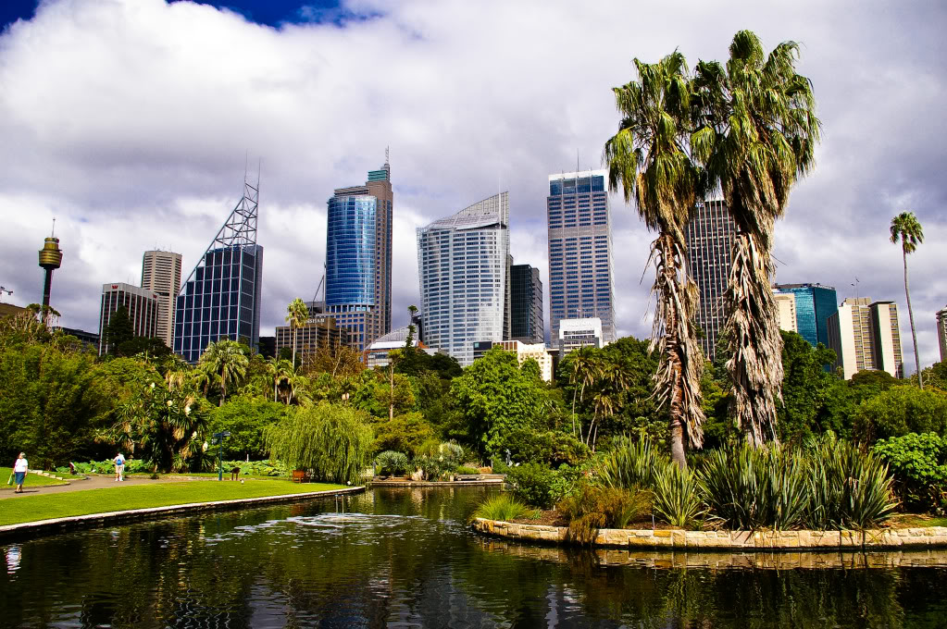
Sydney is well-endowed with open spaces and access to waterways, and has many natural areas botanic gardens and parks. Within the CBD are the Chinese Garden of Friendship, Hyde Park, The Domain and the Royal Botanic Gardens.

Slide 6
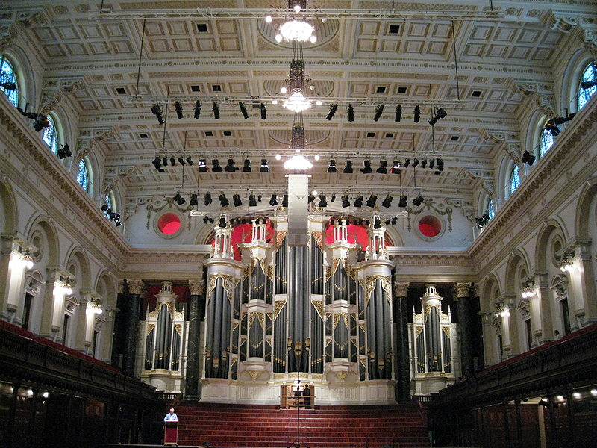
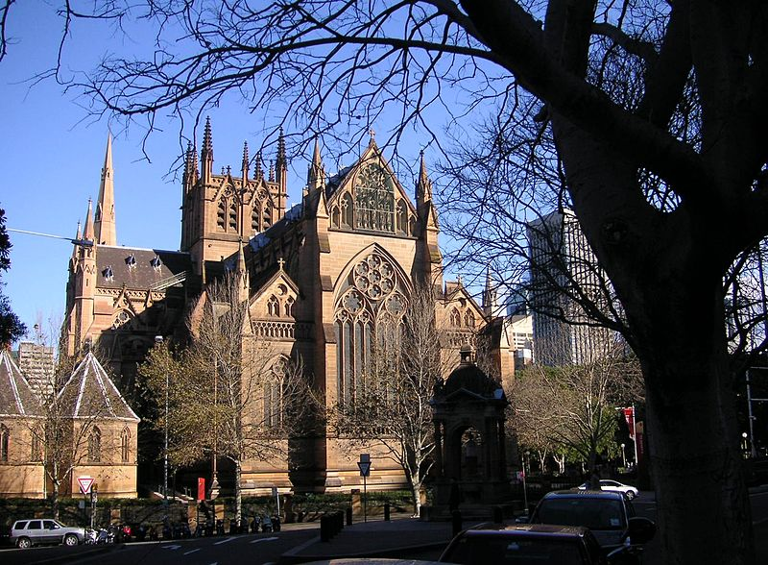
Sydney has various heritage listed buildings, including Parliament House (1816), Sydney Town Hall (1889), the Queen Victoria Building (1898), and the Australian Museum.

Slide 7
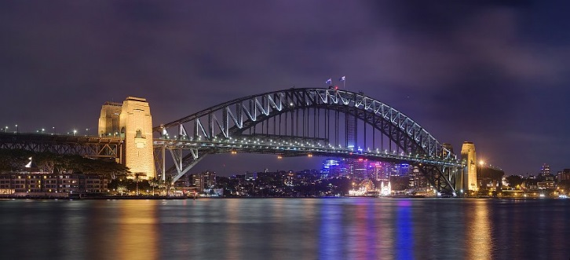
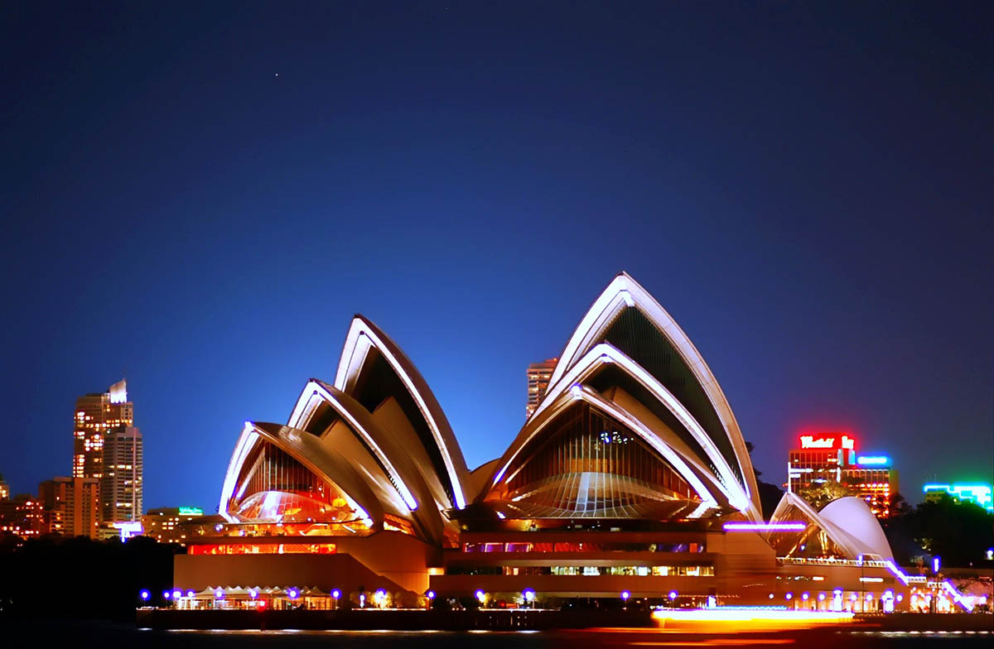
Two easily recognizable landmarks which often depict Australia rather than just Sydney are the Sydney Harbour Bridge and the Sydney Opera House.

Slide 8
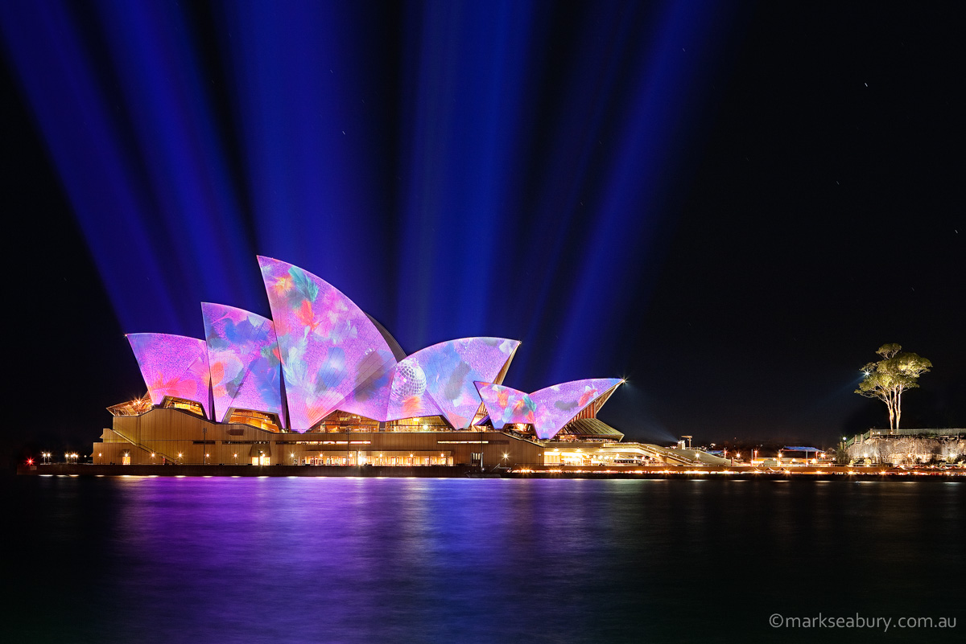
Sydney Opera House is an extraordinary structure and one of the world's premier performing-arts facilities. Its organic shape and lack of surface decoration give the Opera House a timeless beauty. It is recognised globally as a modern wonder. Opened in 1973, it has taken its place among the world's most architecturally significant buildings. It was designed by Danish architect Jorn Utzon and took almost 15 years to build. Twice a week, a special behind-the-scenes tour explores the interior of the Sydney Opera House, including rehearsal rooms, lighting booths, the scenery dock and more.
There are also daily front-of-house tours and dinner and performance packages covering the Australian
Ballet, Opera Australia,
Sydney Dance Company, the Sydney Symphony Orchestra and Sydney Theatre Company.

Slide 9
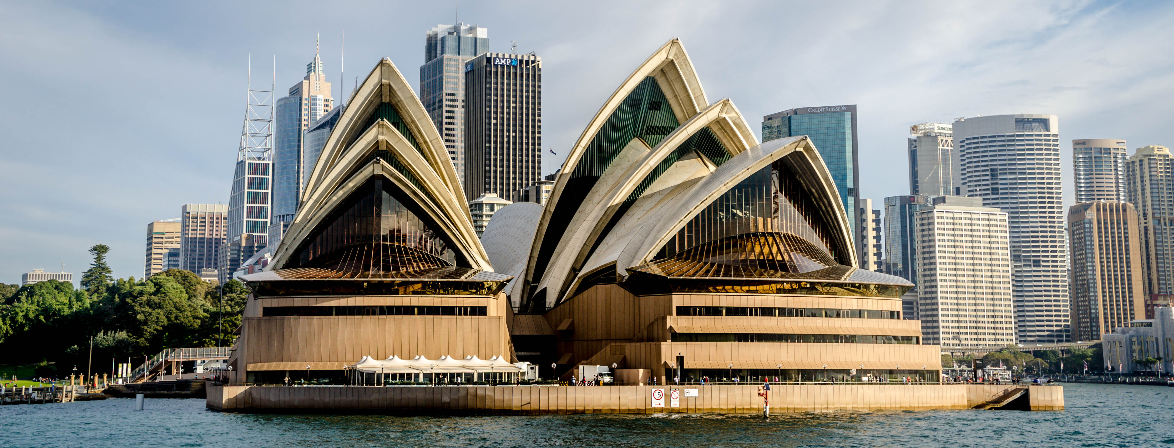
Sydney Opera House

Slide 10
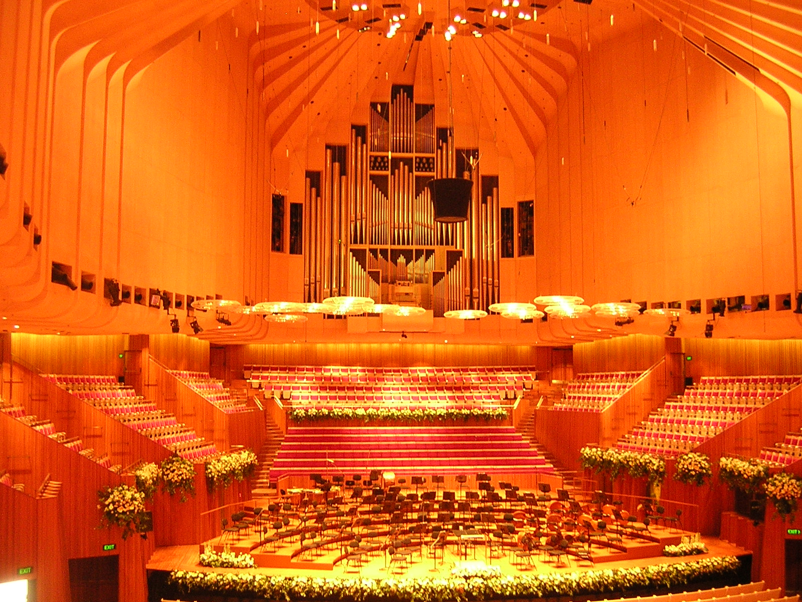

Slide 11
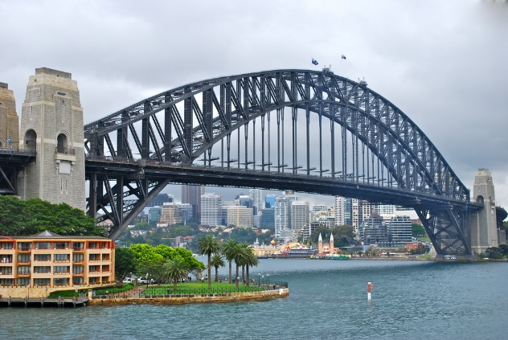
Sydney Harbour Bridge is an international Aussie icon. Opened in 1932 and affectionately known as the 'Coathanger', the single arch construction was built from both ends to join in the middle. It is 1,149 metres long, weighs 52,800 tonnes, has 6 million rivets and needed 272,000 litres of paint for its initial coat. To test the bridge's strength before it opened, 96 railway engines were driven onto it, the equivalent to 5,900 cars. It takes 10 years and 30,000 litres to apply one coat of paint, and this work goes on continuously. Today visitors to Sydney have the chance to climb the Bridge on safe, supervised guided tours to marvel at this engineering wonder and its stunning views over Sydney Harbour.
Sydney Harbour Bridge

Slide 12
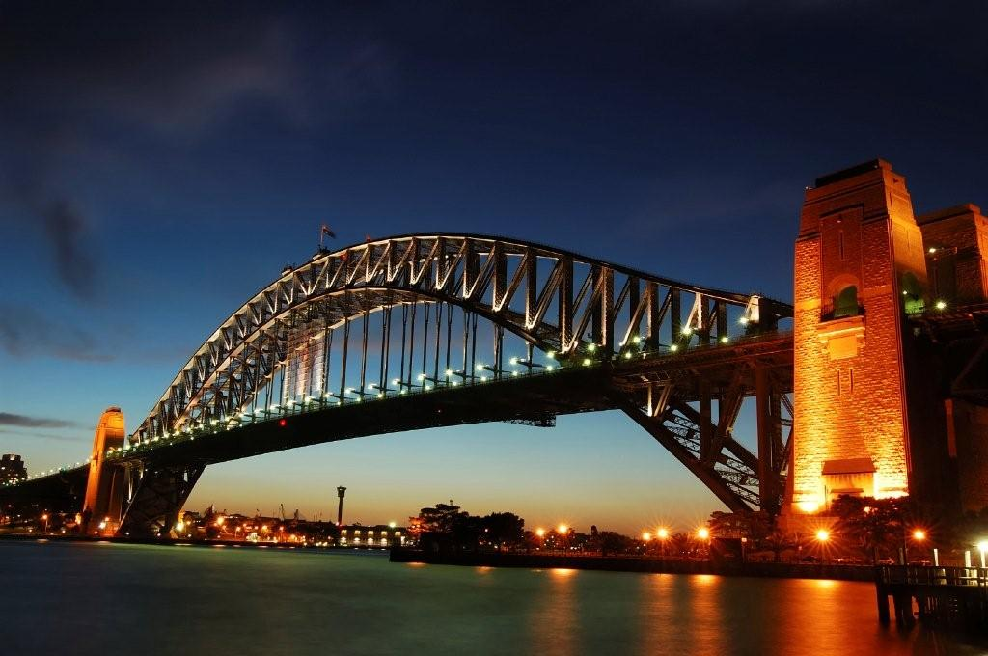

Slide 13
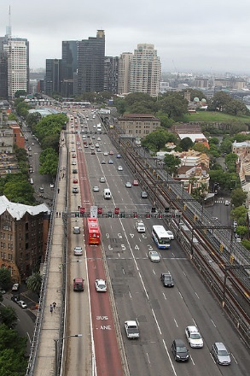
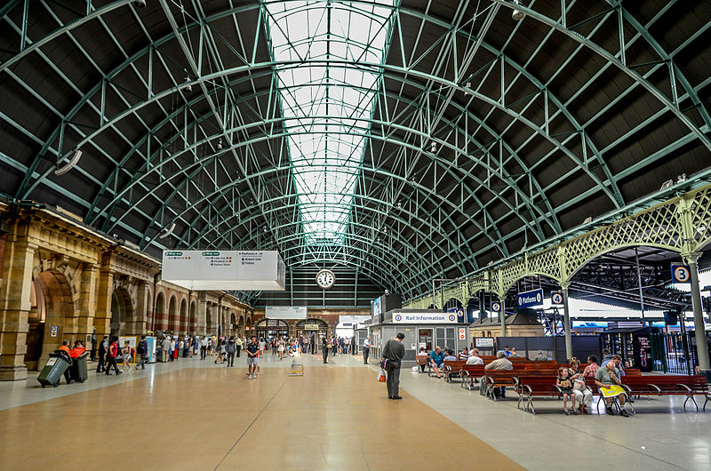
Public transport in Sydney consists of an extensive network of road transport as well as rail transport and water transport modes. Sydney was once served by one of the largest tram networks in the world, with routes covering 181 mi (291 km), but this was closed in February 1961.

Slide 14
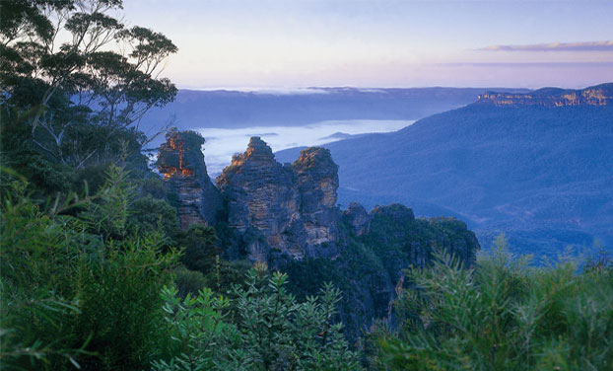
The Blue Mountains
The Blue Mountains is a popular place for Sydneysiders.The Blue Mountains can receive snow during the winter months. The area is heavily forested with steep cliff walls and some spectacular waterfalls. Colourful parrots, and other birds are abundant, and quite often they come really close to people when they are looking for food.

Slide 15
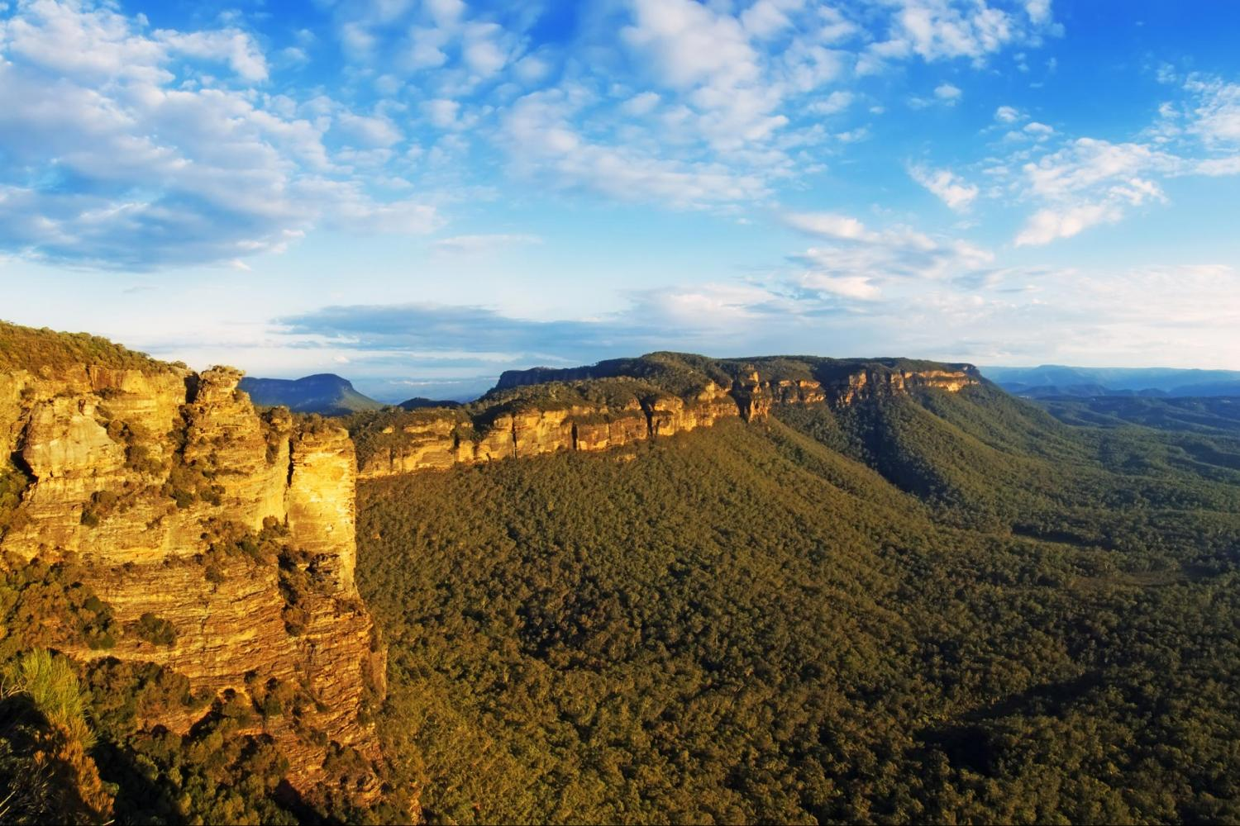

Slide 16
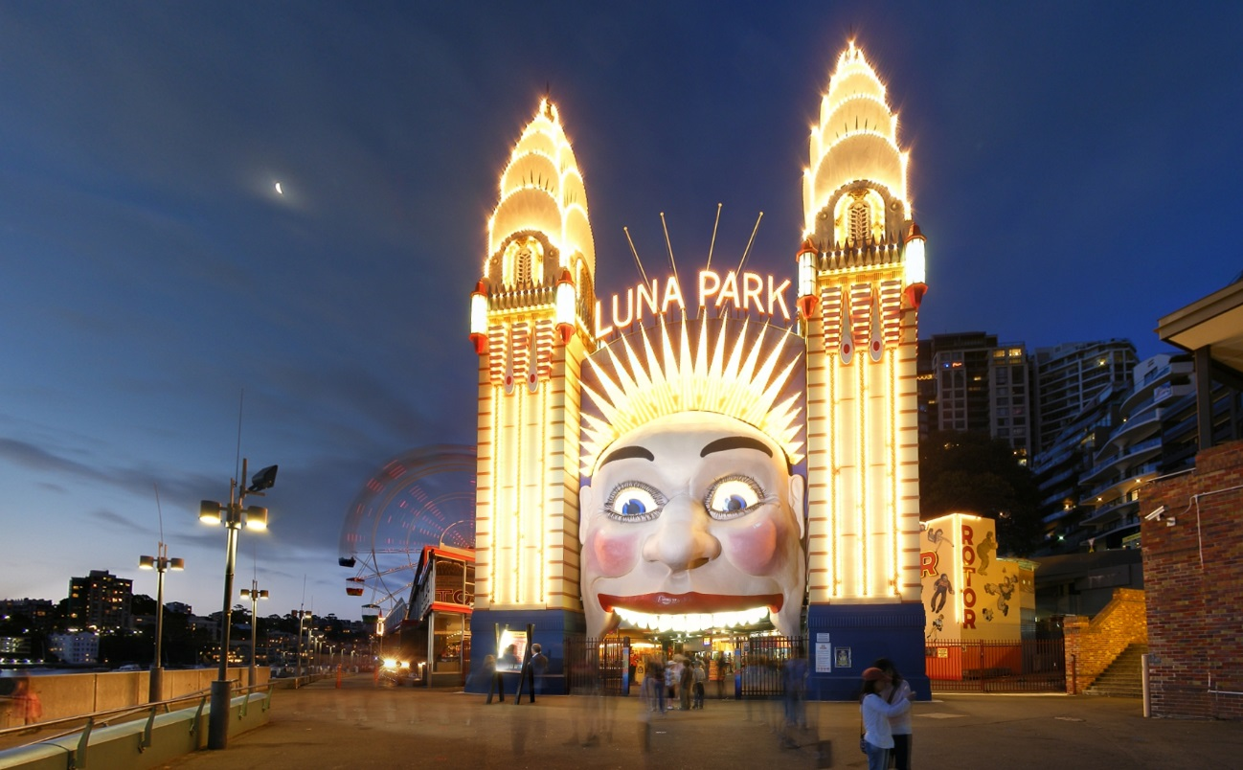
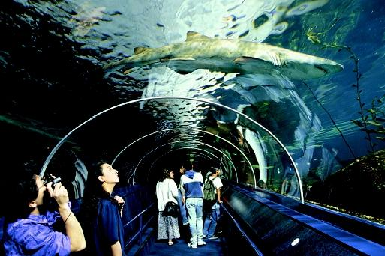
Tourism
In the year ending 2012, Sydney received a total of 10.5 million international and domestic visitors, which injected $11.7 billion into the state of New South Wales' economy.[95] The most well-known attractions include the Sydney Opera House and the Sydney Harbour Bridge. Other attractions include Royal Botanical Gardens, Luna Park, Darling Harbour, some 40 beaches and Sydney Tower

Slide 17
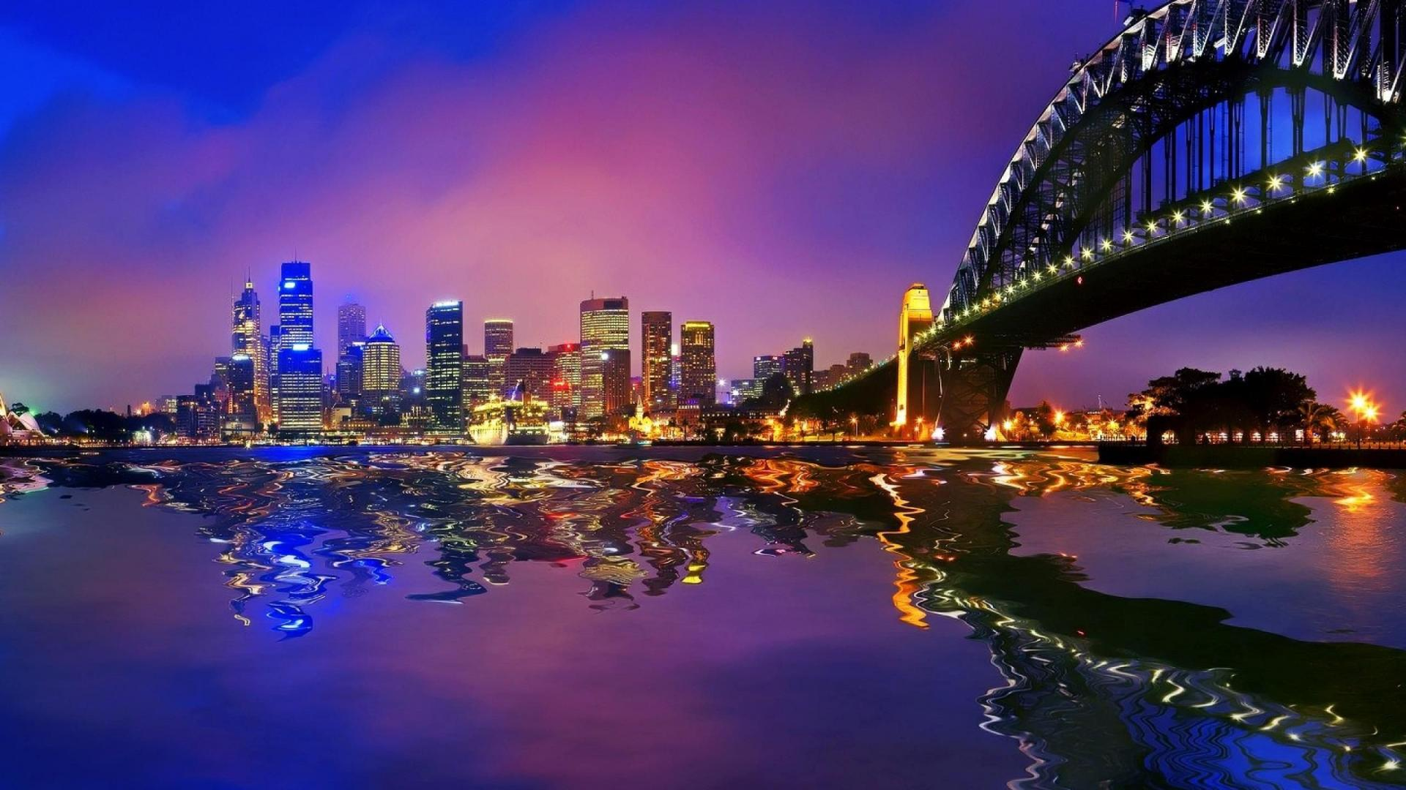
Thank you for watching

