Slide 1
TAKING A GAP YEAR
By Olga Kucherenko
11-V

Slide 2
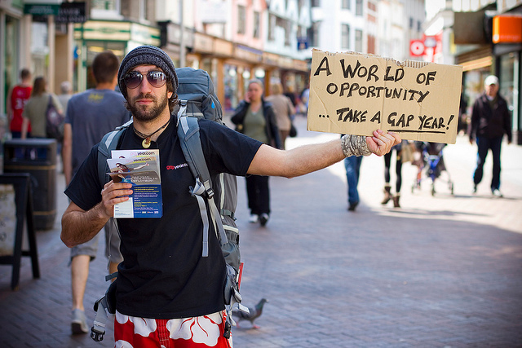
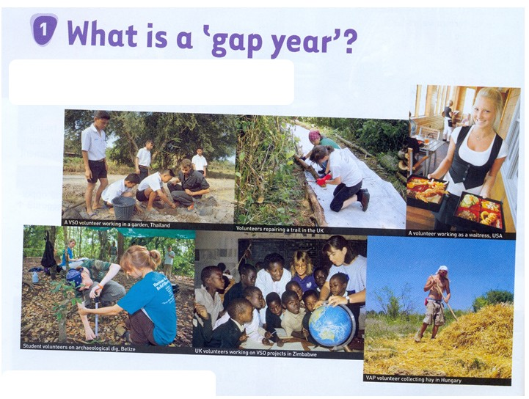
What is a Gap Year?
GAP YEAR - vacation, provided the student or senior secondary vocational school for medical reasons and in other cases (disasters, family problems).

Slide 3
Structured work programmes
A number of companies are operating gap year schemes which are a great opportunity to gain work experience, as well as earn a competitive salary.
All volunteer projects and expeditions are team based - with 8-16 Gap Year and university students on each, led by one or two of our trained and experienced leaders.

Slide 4
opportunities
Gap year provides an opportunity for students:
to solve their problems (health or other);
to prepare for training;
go sightseeing;
experience a different culture firsthand .
communicate every day in English;
professional development…

Slide 5
The main disadvantage gap year is a student misses an important year of study.

Slide 6
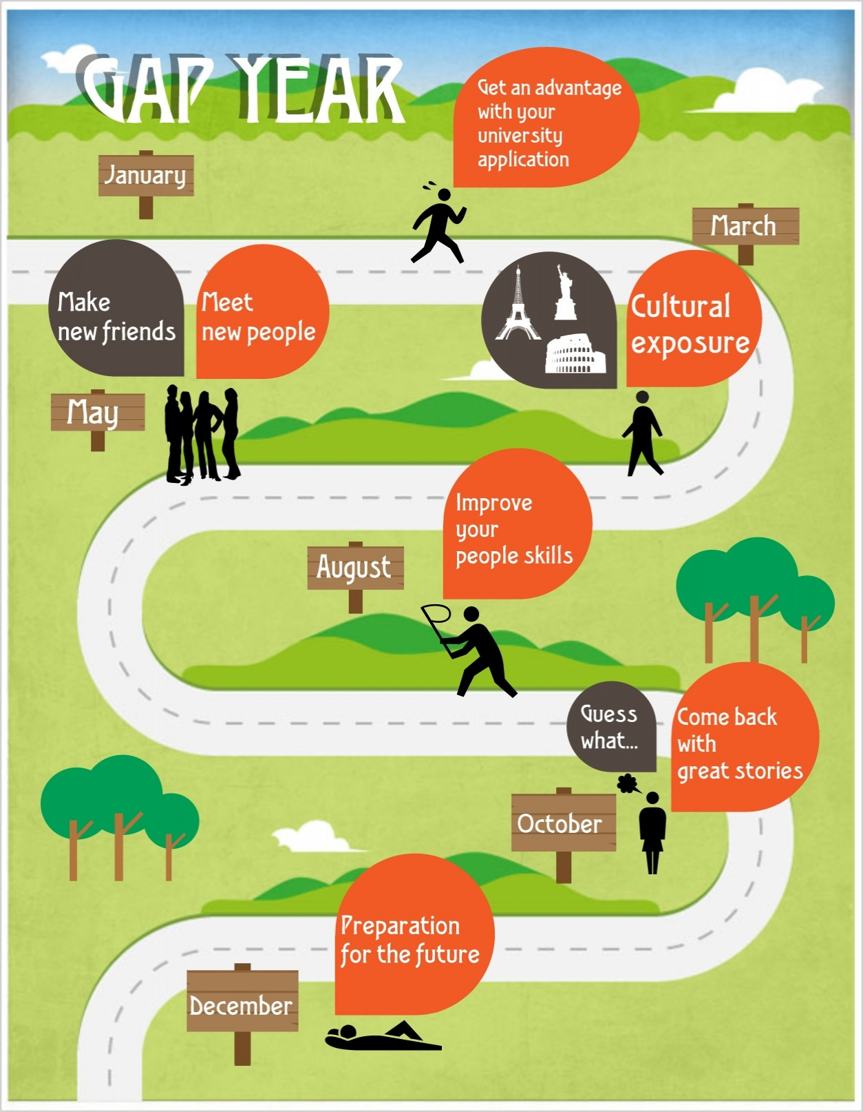

Slide 7
Work Experience Abroad
Working abroad during your gap year will give you the opportunity to truly experience a country while gaining invaluable skills that employers and universities highly regard.

Slide 8
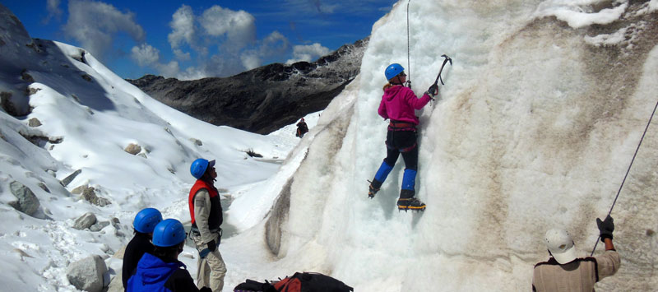
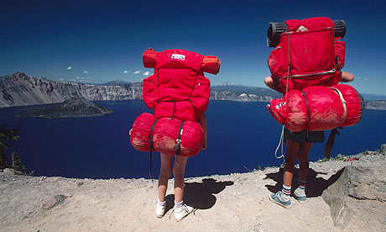
Your gap year is an opportunity to experience a different world, whether it be part of a project, expedition or combined trip - be part of something extraordinary.
This is your chance to do something really amazing...

Slide 9
Thank you for your attention!

