Slide 1
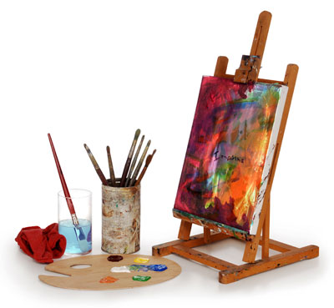
The World of Painting

Slide 2
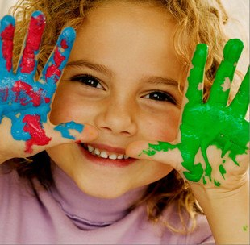
Our life seems to be impossible without art.

Slide 3
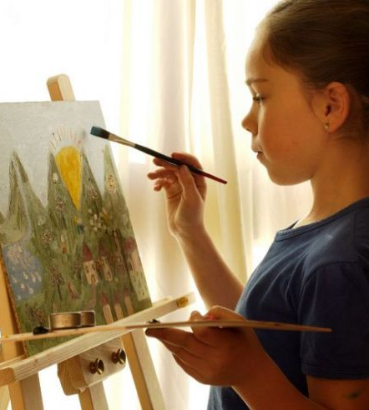
It really occupies an important part in our life. Art offers us not only pleasure and amusement but it is also a vehicle of culture and education. Art penetrates into all spheres and sides of our life. Art makes our life brighter, richer and more intellectual.

Slide 4

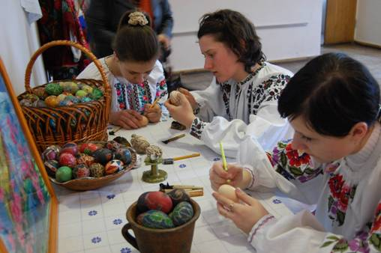
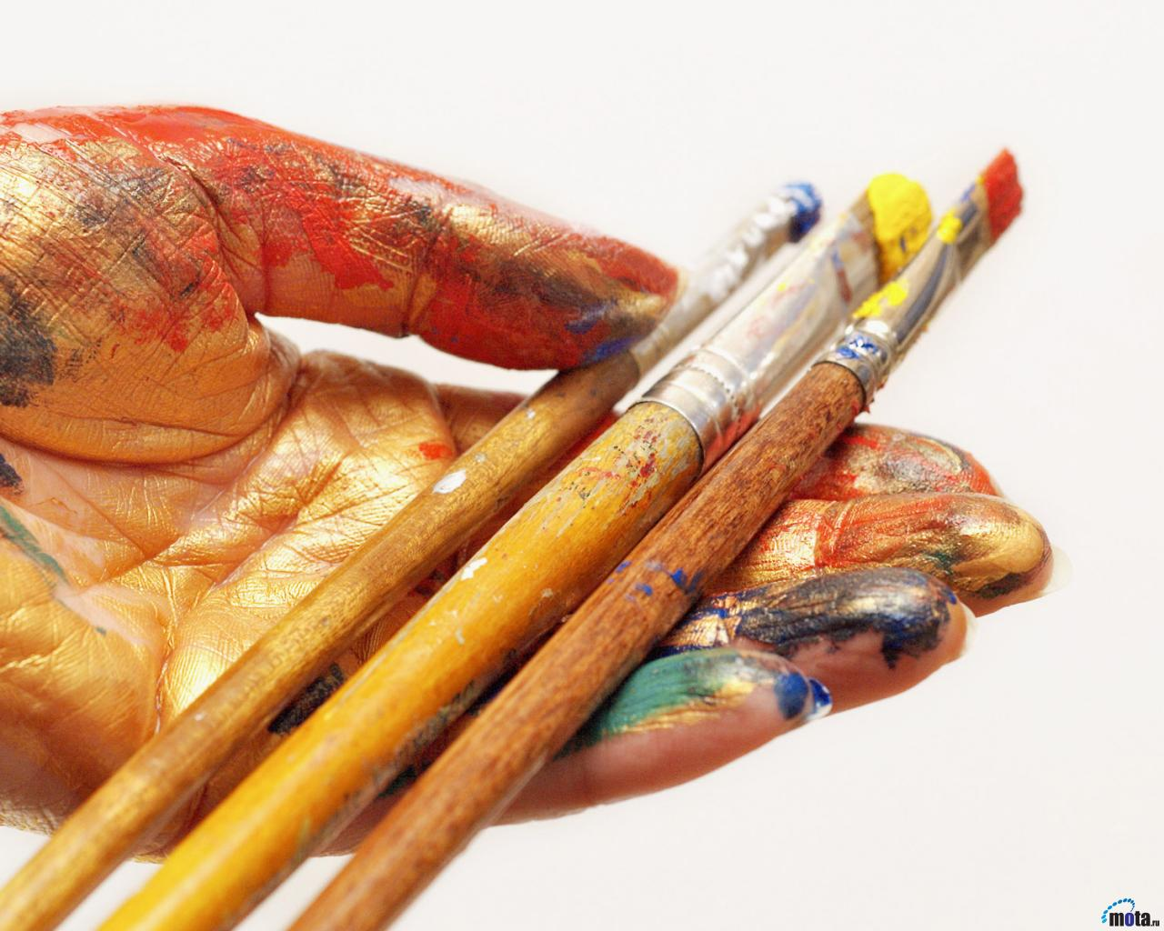
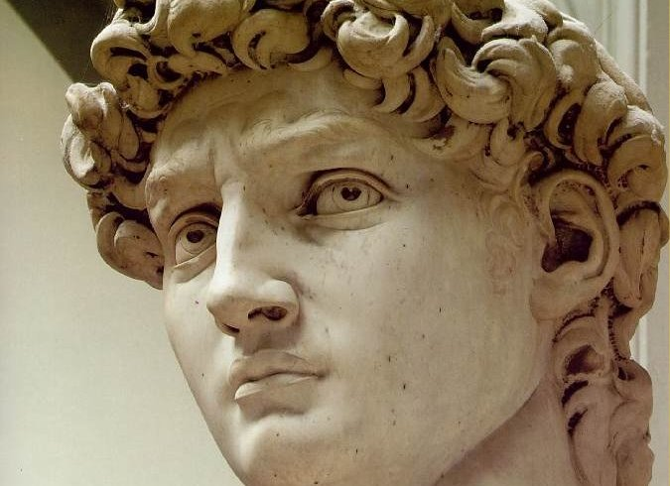
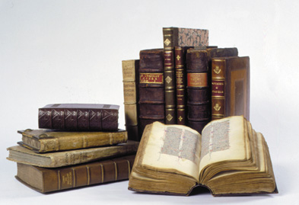
People like and know different types of art.

Slide 5
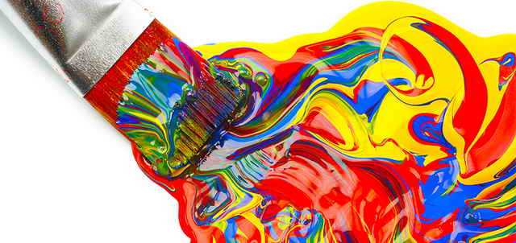
Some of them are fond of painting.

Slide 6
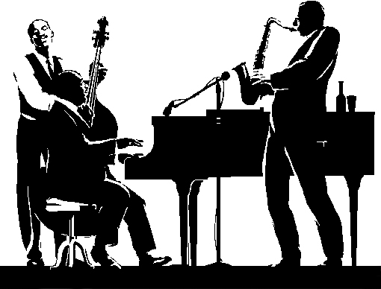
Others have a special liking for music.

Slide 7
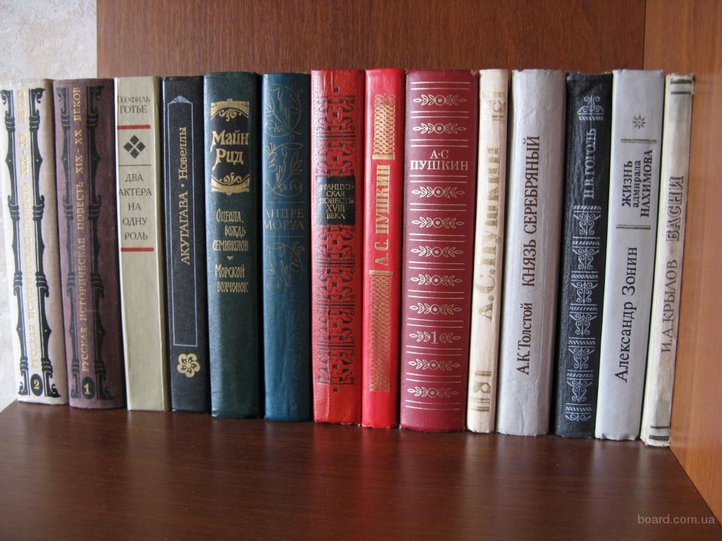
Many people are fond of literature.

Slide 8
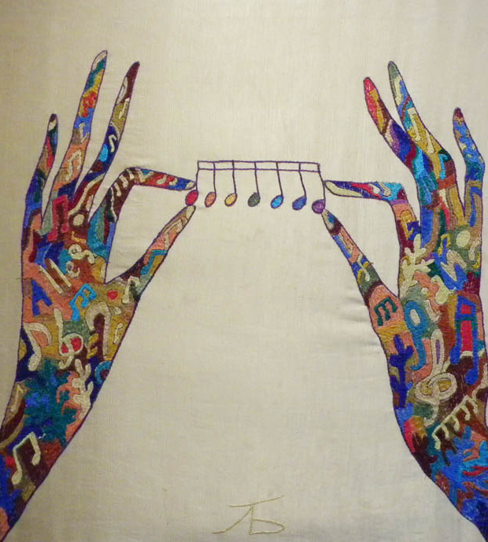
Art unites different people. It influences the development of personality. Art maker our inner world richer. It fills your soul with different feelings. It makes us stronger, enforces us in different situations. Time is flying art is forever!

Slide 9
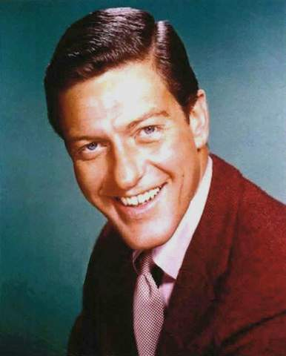
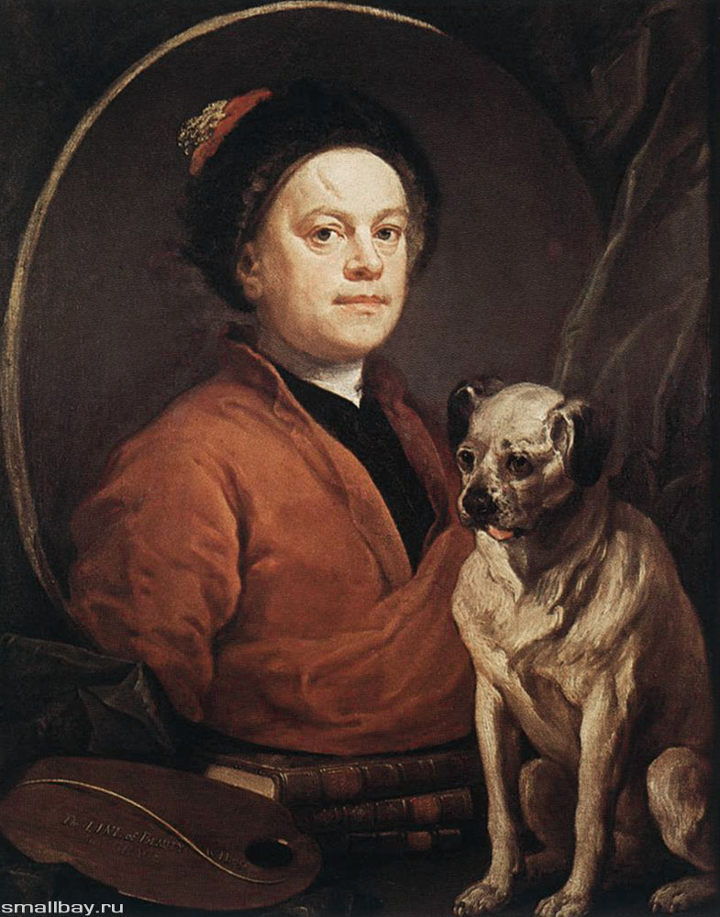
There are many foreing painters.
Van Dyck
William Hogart

Slide 10
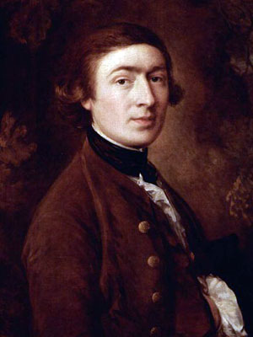
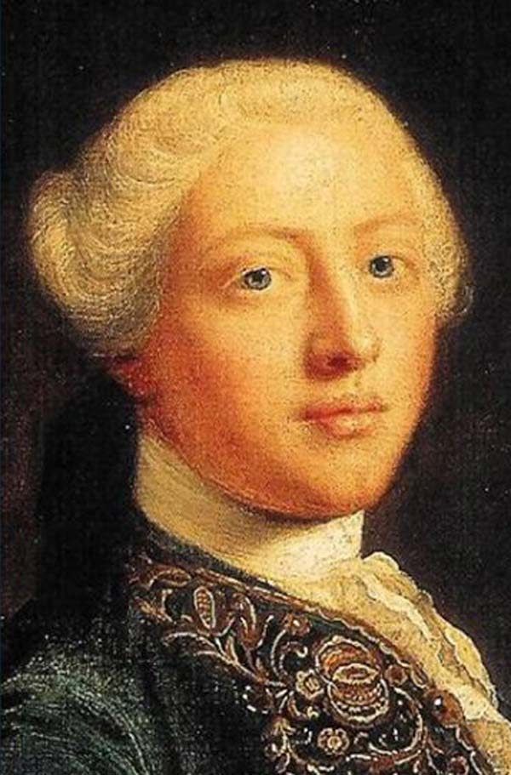
Gainsborough
Reynolds

Slide 11
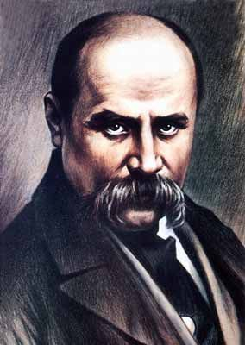
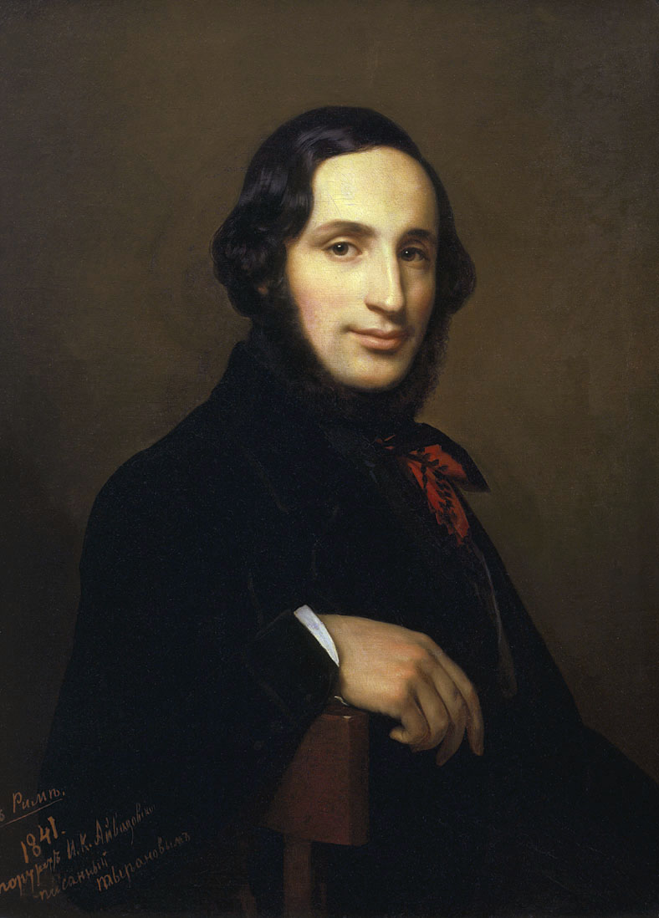
There are many ukrainian painters.
Shevchenko
Aivazovskyi

Slide 12
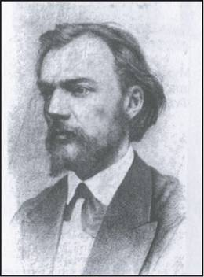
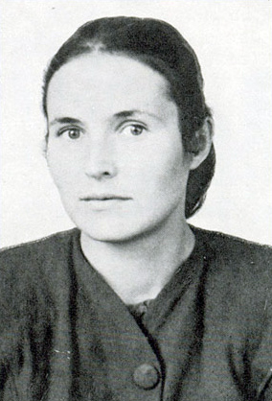
Pymonenko
Yablonska

Slide 13
Furman Alina
Form 10

