Slide 1
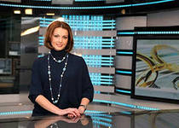
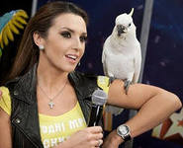
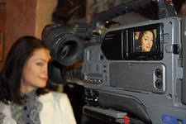
MY FUTURE PROFESSION is TV PRESENTER

Slide 2
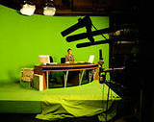

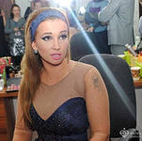
There are many interesting and useful professions and it is really not an easy task to choose the right one. Occupation TV presenter, journalist is not only interesting but also very complicated. And in the future in an excellent professional, you need to master the theoretical and practical knowledge, and most importantly - learn how to harmoniously unite them in the process.

Slide 3
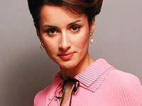
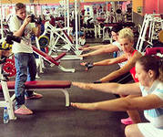
Lead - Media Officer, who works at the scene on television (TV presenter) and radio (radio host), personifying the information that it serves. Delivers news, entertainment and sports programs, says race and matches. Anchorman is the face of the program.
For TV presenters essential parameter is the appearance, for radiveduchyh-diction. TV presenter - one of the most famous trades on TV.

Slide 4
Pros profession: | Cons profession:
Talk with famous people A real chance to become famous Recognition of spectators attention of fans High fees (in certain driving) Interesting work. | Publicity profession Unpredictable schedule Persistence of some fans The need to always be in a good mood High psychological stress.

Slide 5
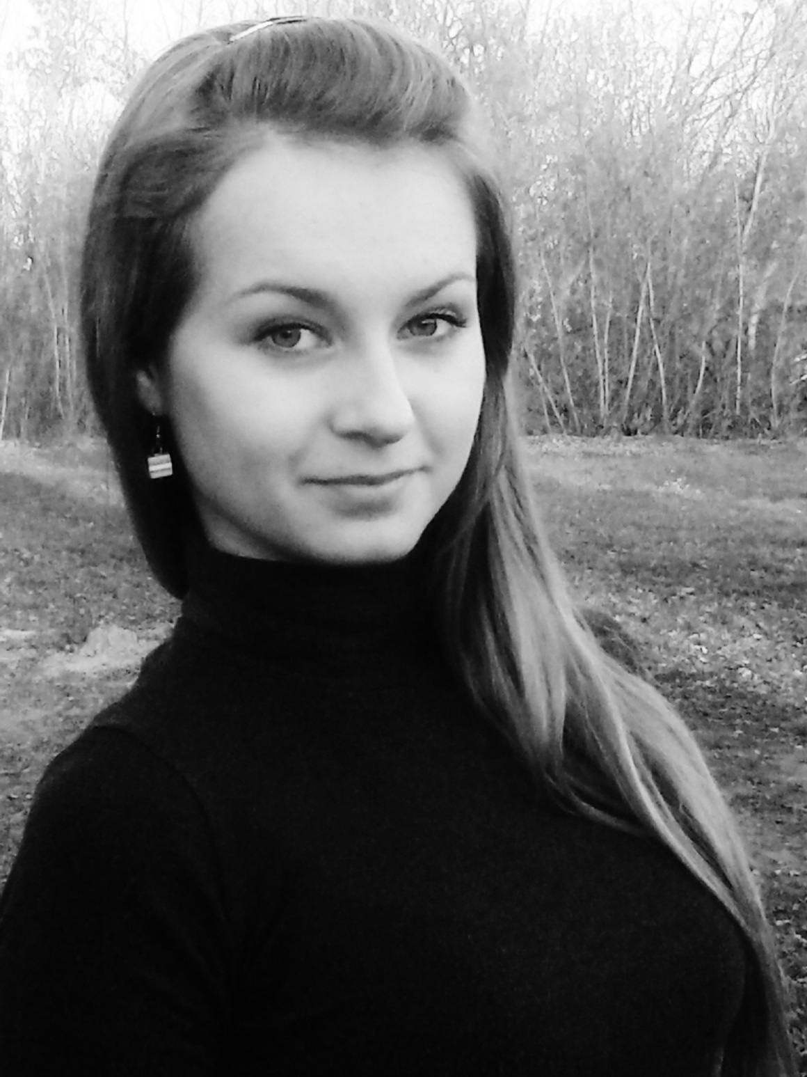
Presentation worked
Aya Stecenko
Form 11

