Slide 1


Slide 2


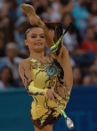


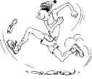
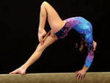
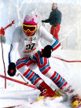
Sport is our life. We go in for sport every day. It helps us to keep fit.

Slide 3





The most popular sport among girls is…

Slide 4
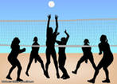
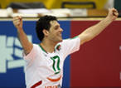

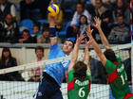

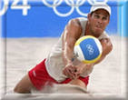

volleyball

Slide 5





The most popular sport among boys is…

Slide 6
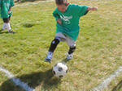






football

Slide 7
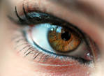




People with brown eyes are very kind-hearted. Most of all they like…

Slide 8





ski

Slide 9


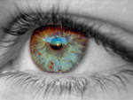

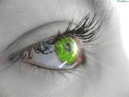

People with green eyes are helpful and smart. They like…

Slide 10



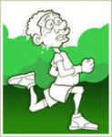

ATHLETIKS

Slide 11
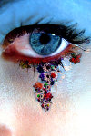




Blue eyes are like sea. People with blue eyes are so generous! And they like…

Slide 12

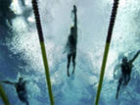


swimming

Slide 13
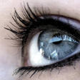



People say that our eyes are the mirror of the soul. People with grey eyes are responsible. They like…

Slide 14
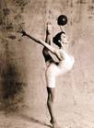
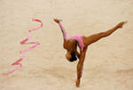
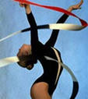
Gymnastics

Slide 15

I think that some guys of my class can get sport world records in future!

Slide 16
Sport is our life! Remember it!

Slide 17

Thank
You
For
Attention…

