Slide 1
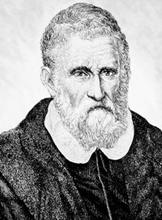
MARCO POLO
Marco Polo was born in September, 15 1254 in Venice. Marco Polo was born to a Venetian merchant Nicola Polo, whose family was engaged in trade jewelry and spices.
Italian merchant and traveler, who presented the story of his journey to Asia in the famous "Book of the diversity of the world."

Slide 2
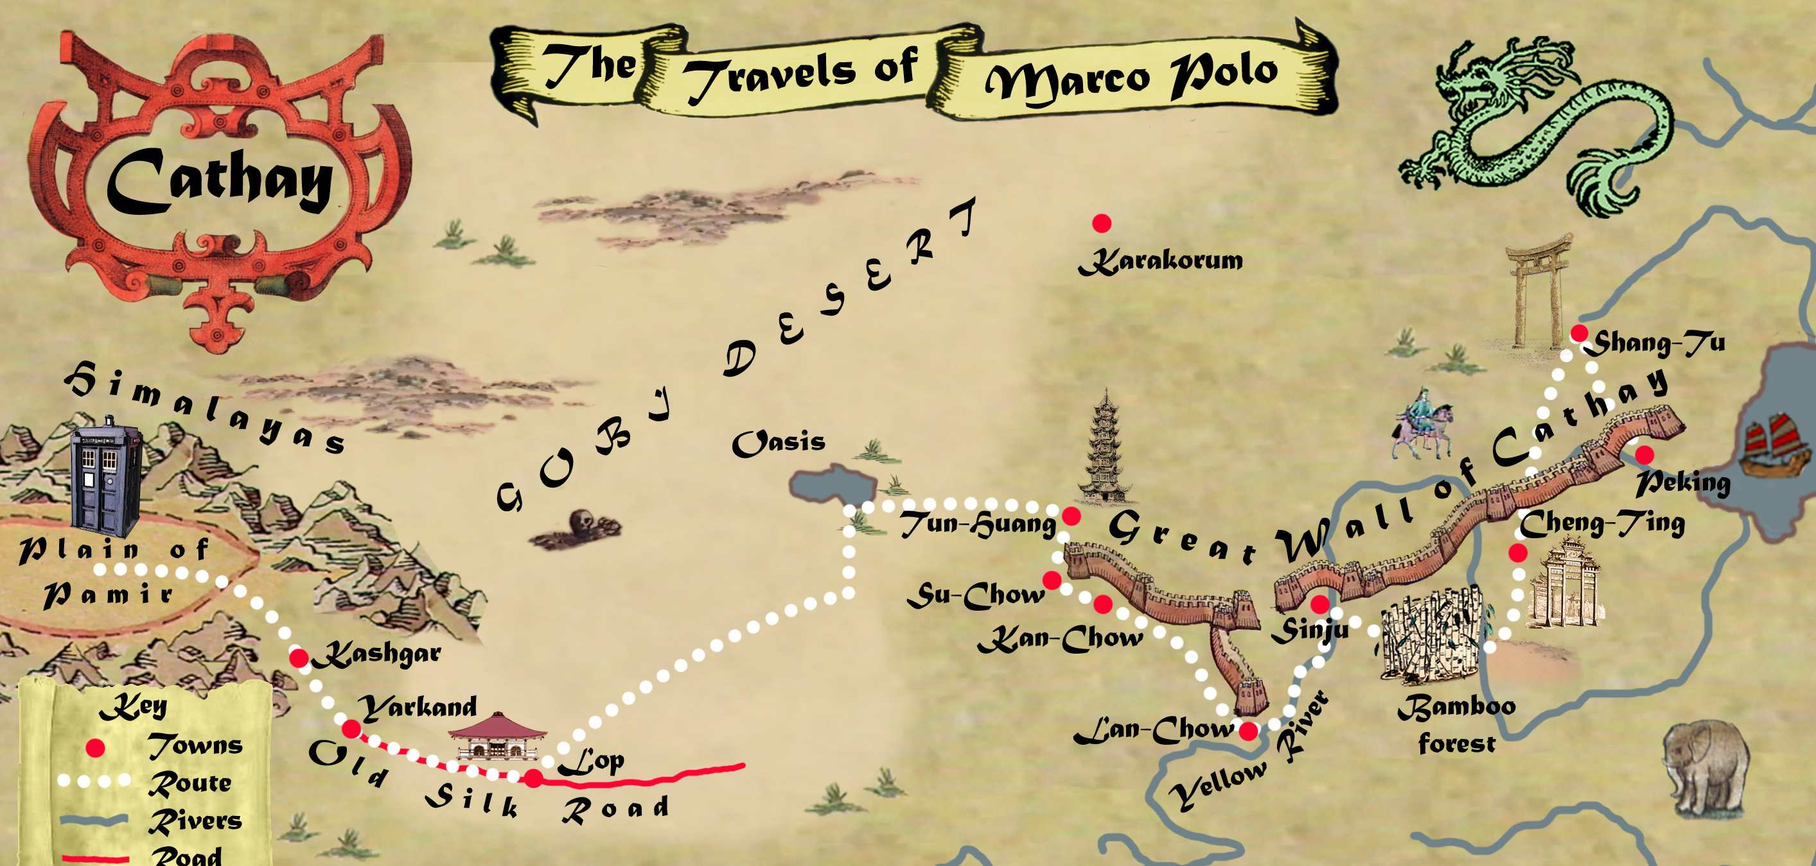
Marco Polo in China
A lot of important information about the nature and peoples of distant Asia were produced by Italian traveler Marco Polo. At the end of the XIII century. He along with his father and uncle Venetian merchants, he made a trip to China, where he lived for about 17 years.

Slide 3
Marco Polo in China
The first Chinese city where in 1275 the family got the Polo was Shachzha. In the same year they made ​​it to the summer residence of Kublai Khan in the shandy. According to Polo, Khan was delighted with them, gave different instructions, did not allow him to return to Venice, and even for three years kept him governor of the city of Yangzhou. In addition, the Polo family) was involved in the development of the army of Khan and taught him to use a catapult during the siege of fortresses.

Slide 4
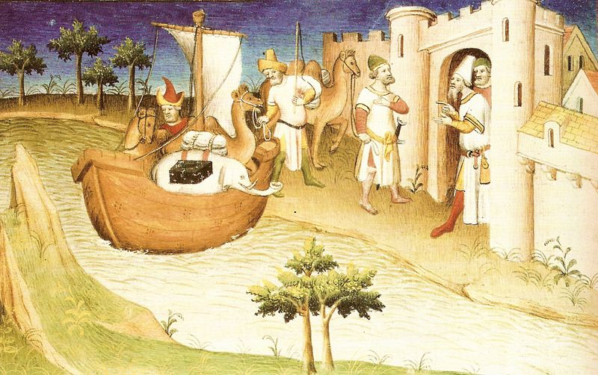
The whole journey took almost four years.
Their journey lasted from 1271 by 1295. The return trip he made to the sea, having sailed from China to the shores of the Persian Gulf. Back in Italy, Marco Polo told a lot of what he saw as he was the first European PWM informing about such unprecedented countries, many did not believe him. For many of his countrymen Asia remained unexplored continent, and the stories of traveler - just amusing stories.

Slide 5
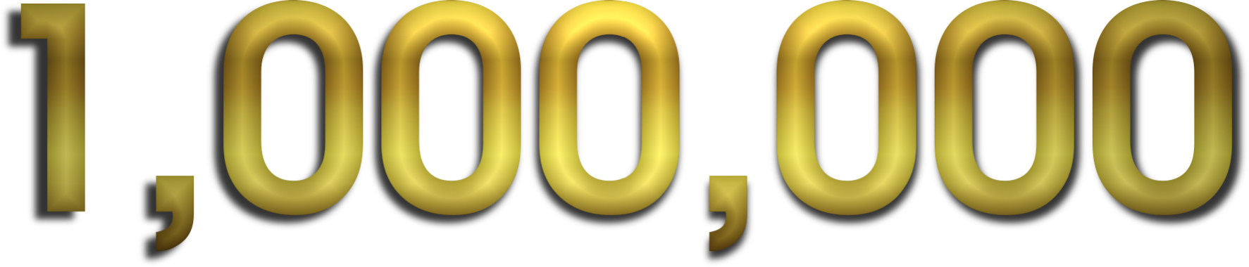
A little history
The word has a million of its own "creator". Marco Polo, who visited China in the 13th century to convey his admiration for untold riches, and coined the word million.

Slide 6
"The book about the diversity of the world."
Marco Polo introduced the story of his journey to Asia in the famous "Book of the diversity of the world." Despite doubts about the veracity of the facts contained in this book are expressed from its inception to the present, it serves as a valuable source of geography, ethnography, history, Armenia, Iran, China, Mongolia, India, Indonesia and other countries in the Middle Ages. This book had a significant impact on seafarers, cartographers. In particular, she was on the ship of Christopher Columbus during his search for a route to India, according to researchers, Columbus did on her 70 marks

Slide 7

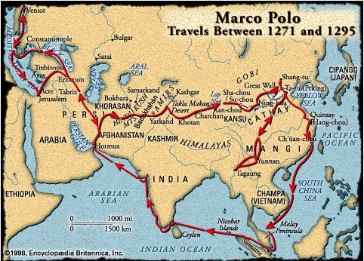
"The book about the diversity of the world."
Marco Polo's book is one of the most popular objects of historical research. Bibliography, compiled in 1986, includes more than 2,300 scientific papers only in European languages

Slide 8
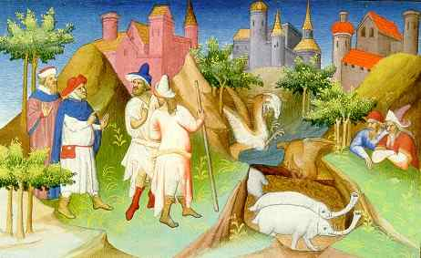
Marco Polo's descriptions are full of inaccuracies. This applies to the names of individual cities and provinces, their relative locations, and descriptions of the objects in these cities. In defense of Marco Polo can be said that the description of them was carried by memory.

Slide 9

Thank you for your attention

