Slide 1
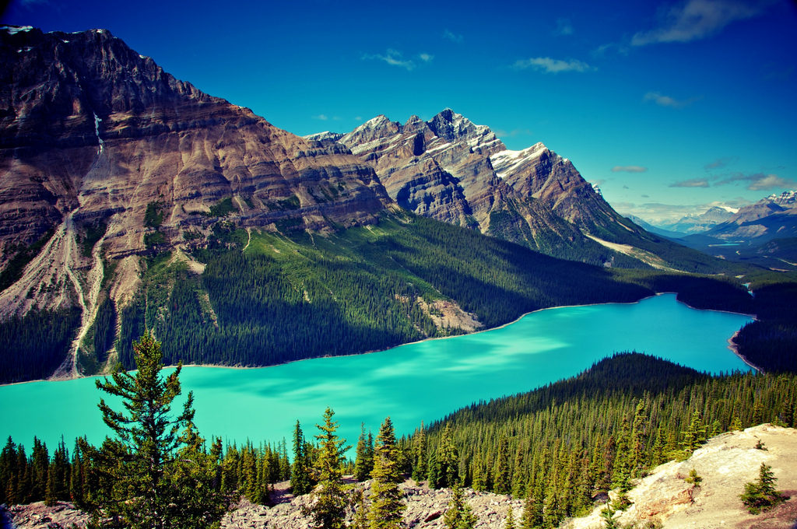
Canada

Slide 2
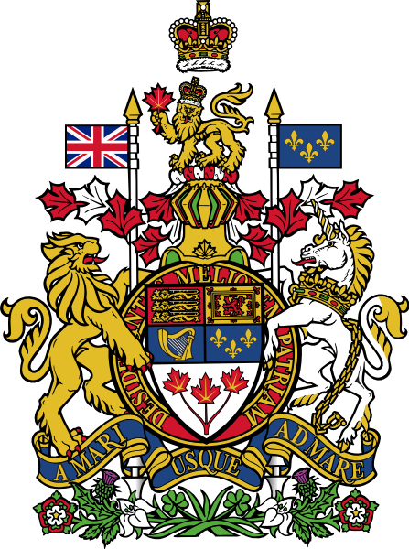
Flag Emblem

Slide 3
Basics
Official name – Canada
Official languages ​​- English and French
Capital – Ottawa
Area - 9,984,670 km ²
Population - 34,568,211 people

Slide 4
Geographical position
Canada occupies most of northern North America. Canada has a land border with the United States to the south and the north-west and stretched from the Atlantic Ocean in the east to the Pacific - the west and the Arctic - in the north. It also has a maritime border with France and Denmark. In eastern Canada St. Lawrence River flows into the Gulf of St. Lawrence, with the largest estuary in the world, where the island of Newfoundland, and Prince Edward Island is located to the south of it.

Slide 6
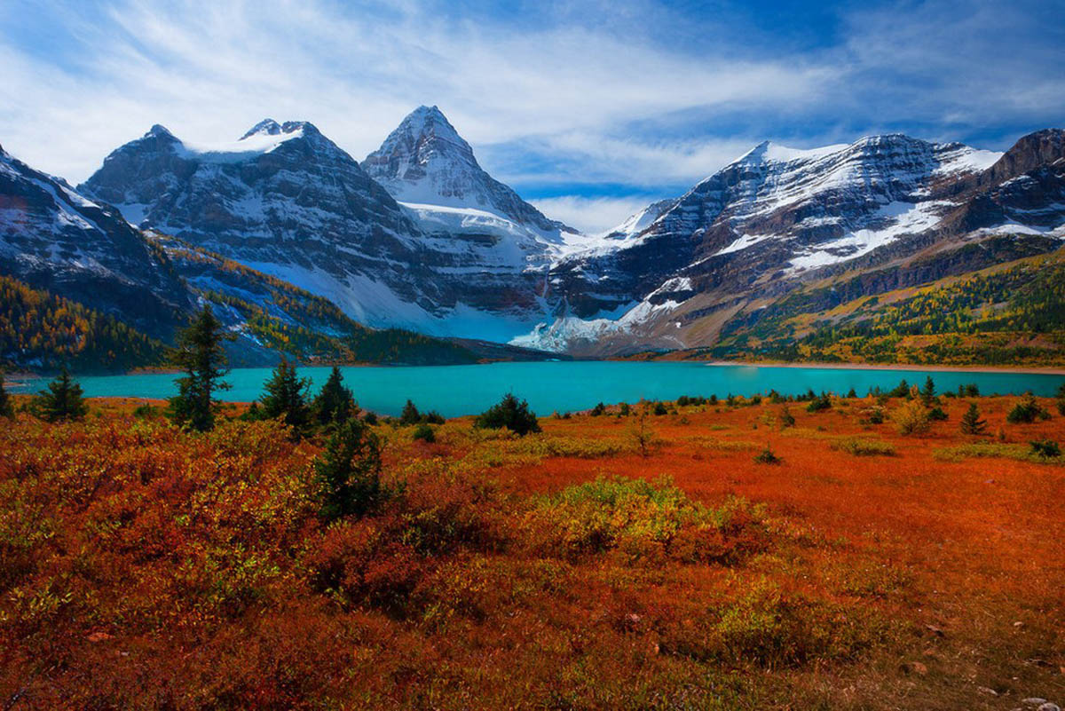
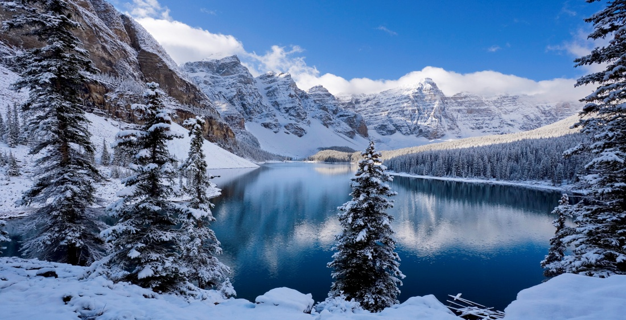
Climate
Average temperatures in January and July are different for each area. Winter can be very severe in some regions of the country, average temperatures can reach 15 ˚ C below zero in the southern part of the country, and sometimes -45 ˚ C with strong winds of. The lowest temperature ever observed in Canada is -63 ˚ C (Yukon). Every year, the snow level up to several hundred centimeters.

Slide 7
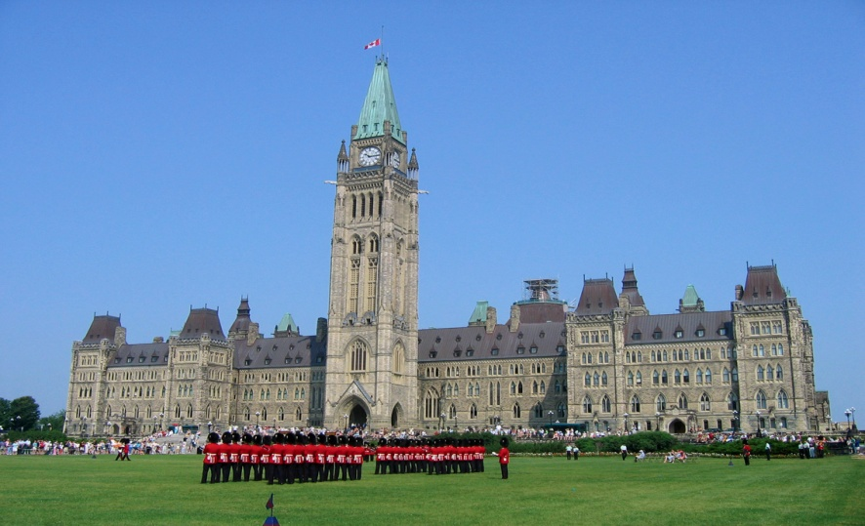
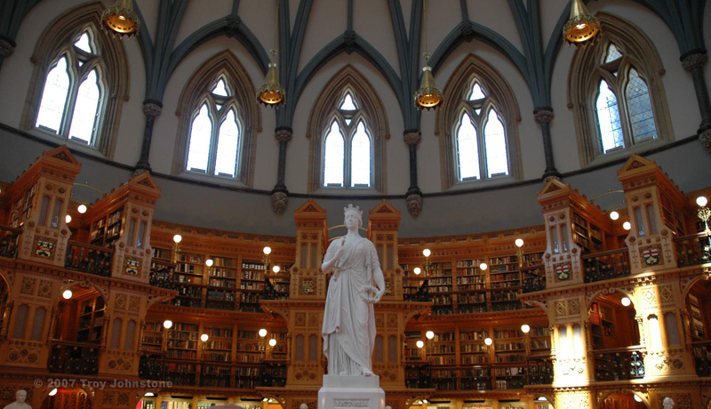
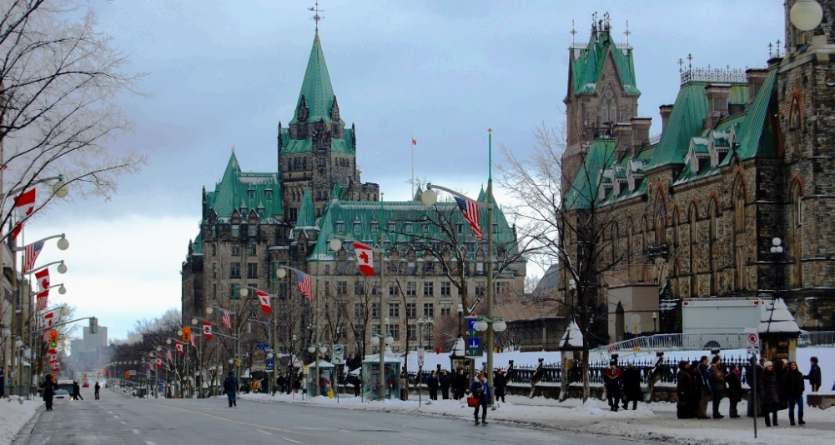
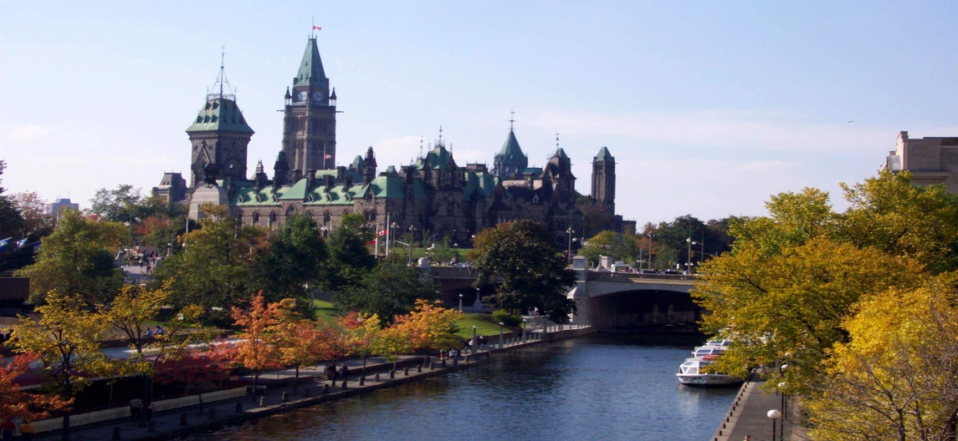
State Structure
Canada - a member state of the British Commonwealth rights of dominion, whose head of state is the British Queen. Official representative of the Queen in Canada is the Governor-General, appointed by the Queen on the advice of the Prime Minister. In addition, Canada - a parliamentary federal system with a democratic tradition dating back to the XVI century British democracy. The legislature consists of the Parliament, including the queen of the Senate and House of Commons.

Slide 8
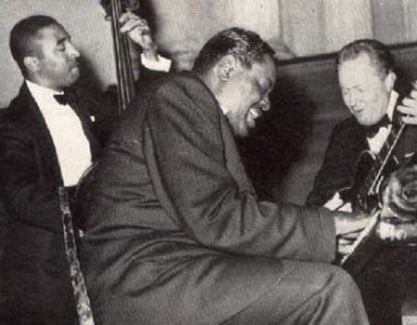
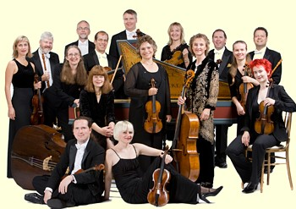
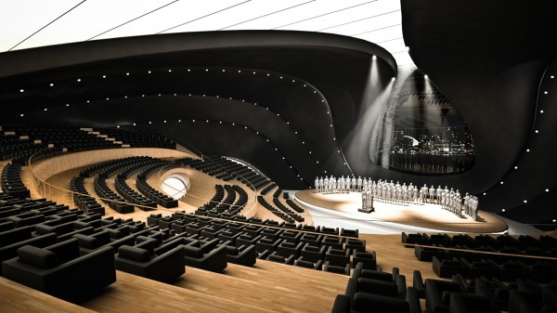
Culture
Many elements of Canadian culture is very close to the culture of the United States of America, including movies, television, clothing, housing, private transport, consumer goods and food products. Despite this, Canada has its own unique culture.
In Canada employs many internationally renowned orchestras such as the Quebec Symphony Orchestra, the Toronto Symphony Orchestra and especially Montreal Symphony Orchestra under the direction of Kent Nagano.

Slide 9
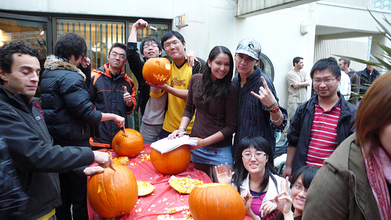
Education
For education in Canada, the provinces and territories are responsible, at the moment there is no government in Canada, the Ministry of Education. Each of the educational system is similar to others, while displaying their own history, local culture and geography of the province.

Slide 10
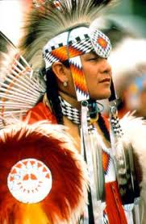
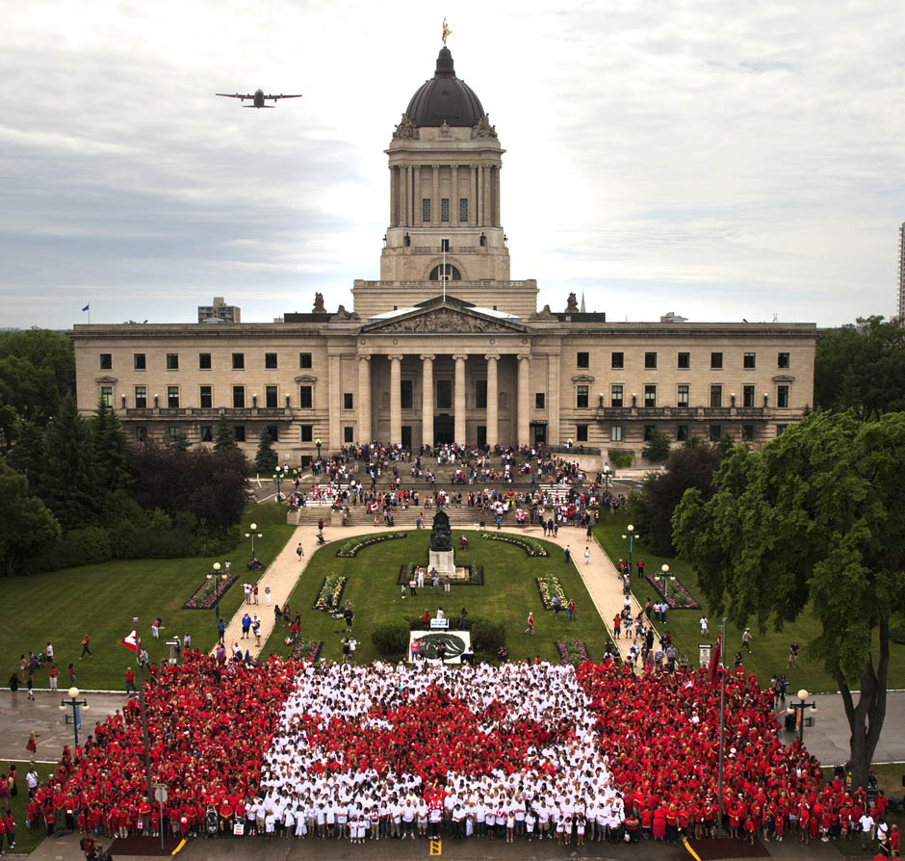
Religion
Canadians profess a large number of religions. According to the latest census, 77.1% of Canadians consider themselves Christians, most of them are Catholics. The most important Protestant Church - United Church of Canada.

Slide 11
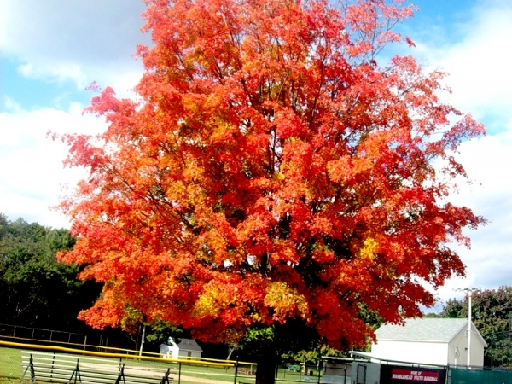
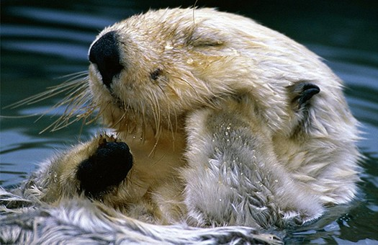
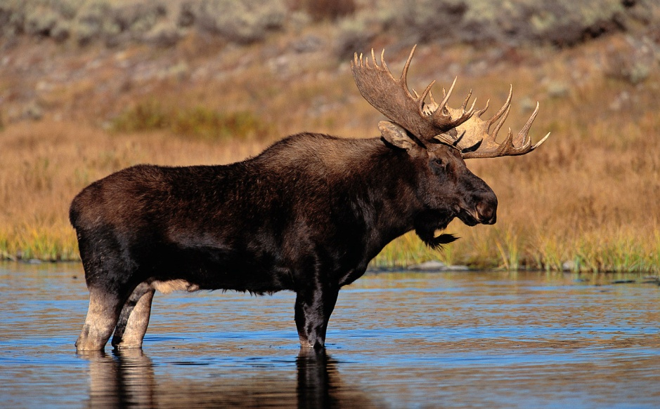
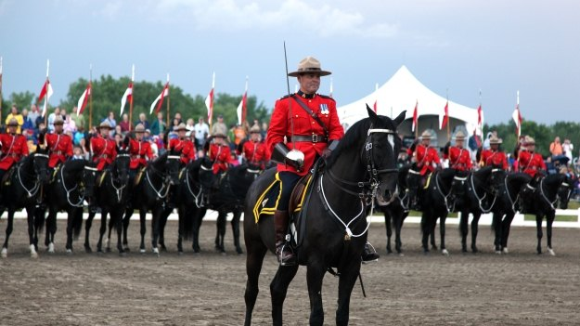
Symbols of Canada
Maple Maple-leaf Beaver
Elk Royal Canadian Mounted Police

