Slide 1
Healthy lifestyle
Done by Anastasia Pockachailo

Slide 2


More than anything else, the ordinary decisions we make every day are the things that most influence our health and wellbeing — what we eat, how much we move our body, how we deal with stress.

Slide 3



You hear a lot about living a healthy lifestyle, but what does that mean? In general, a healthy person doesn't smoke, eats healthy and does exercises. Sounds simple, doesn't it?
The trick to healthy living is making small changes...taking more steps, adding fruit to your cereal, having an extra glass of water...these are just a few ways you can start living healthy without drastic changes.

Slide 4
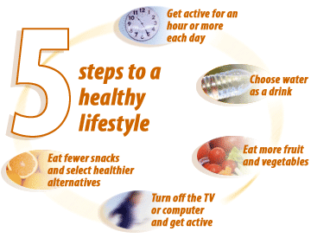
5 Steps to healthy lifestyle

Slide 5
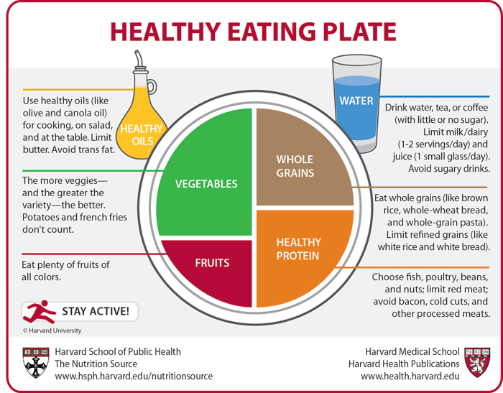

Slide 6
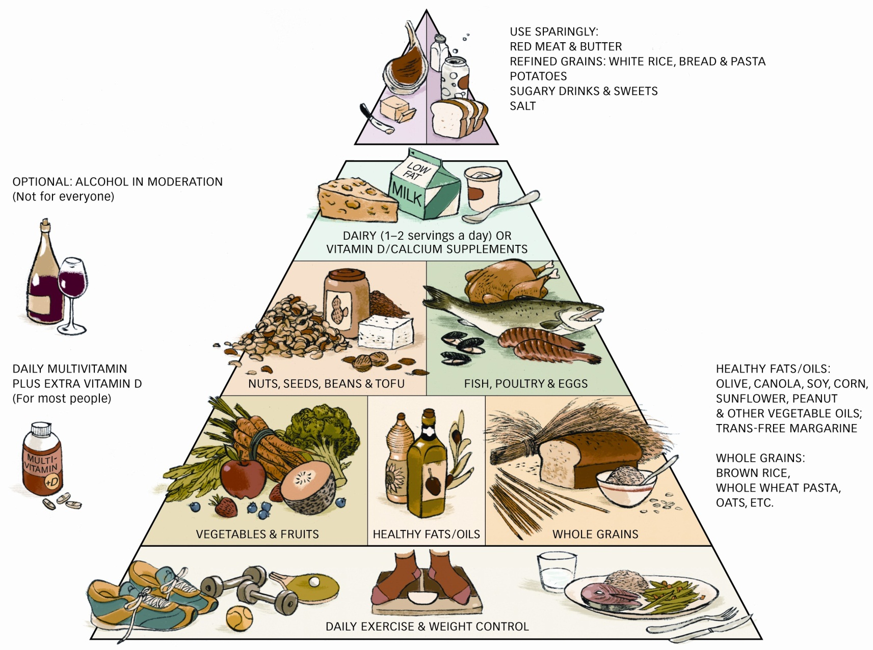
The Healthy Eating Pyramid is a simple, trustworthy guide to choosing a healthy diet. Its foundation is daily exercise and weight control, since these two related elements strongly influence your chances of staying healthy. The Healthy Eating Pyramid builds showing that you should eat more foods from the bottom part of the pyramid (vegetables, whole grains) and less from the top (red meat, refined grains, potatoes, sugary drinks, and salt).

Slide 7

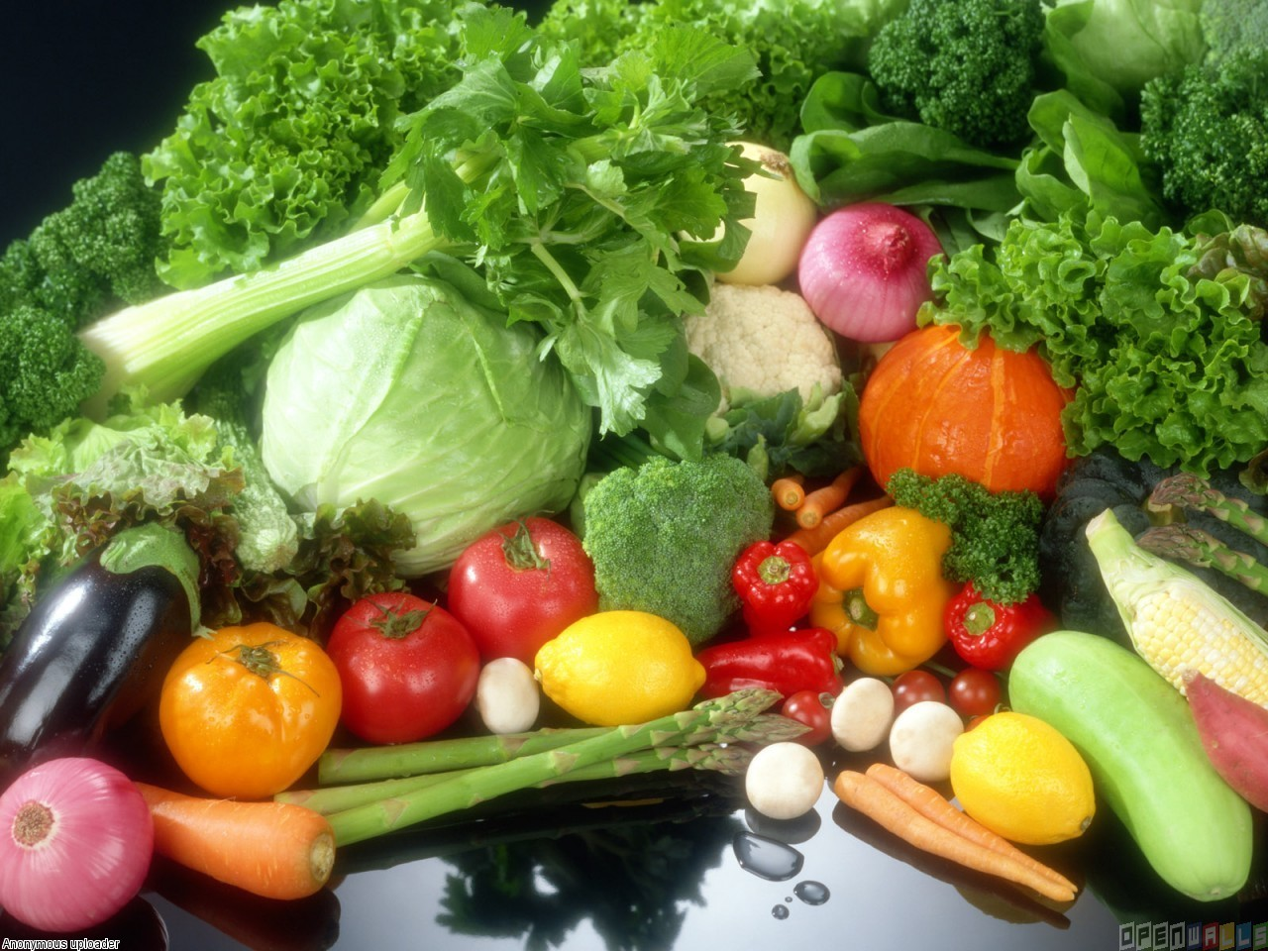
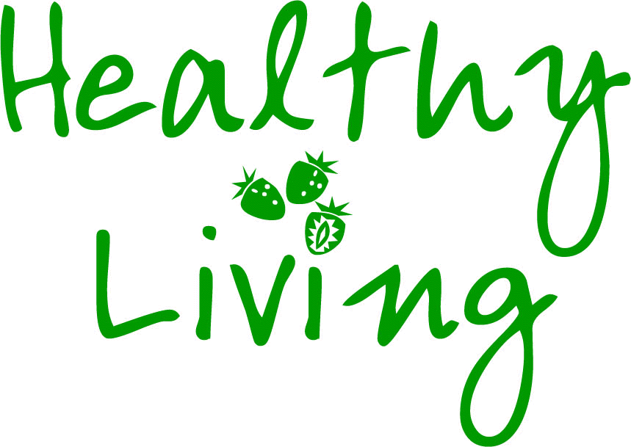
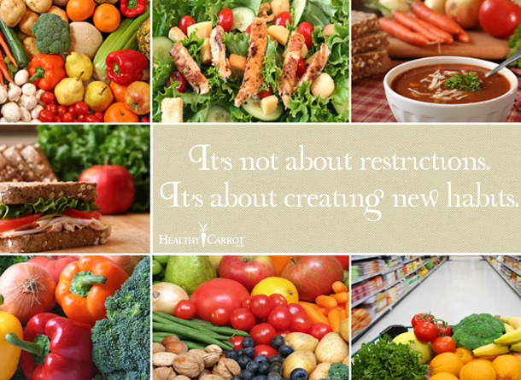
Finally, there are three main messages to follow for healthy eating:
First, we should eat less fat, particularly saturated fat.
Secondly, we are to cut down on sugar and salt.
Thirdly, we must eat more fresh fruit and vegetables.

