Slide 1
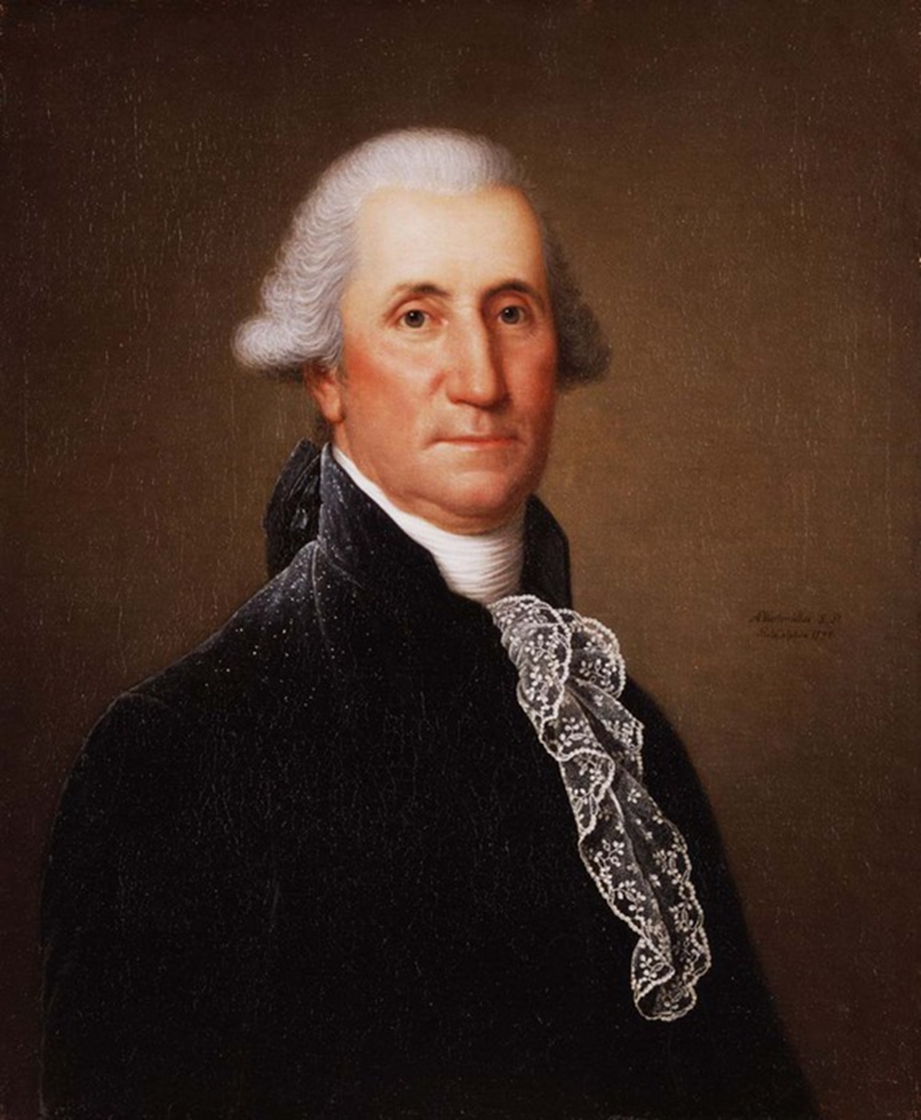
George Washington
George Washington (1732—1799) won a lasting place in American History as the "Father of our Country". For nearly twenty years he guided his country much as a father cares for a growing child.

Slide 2
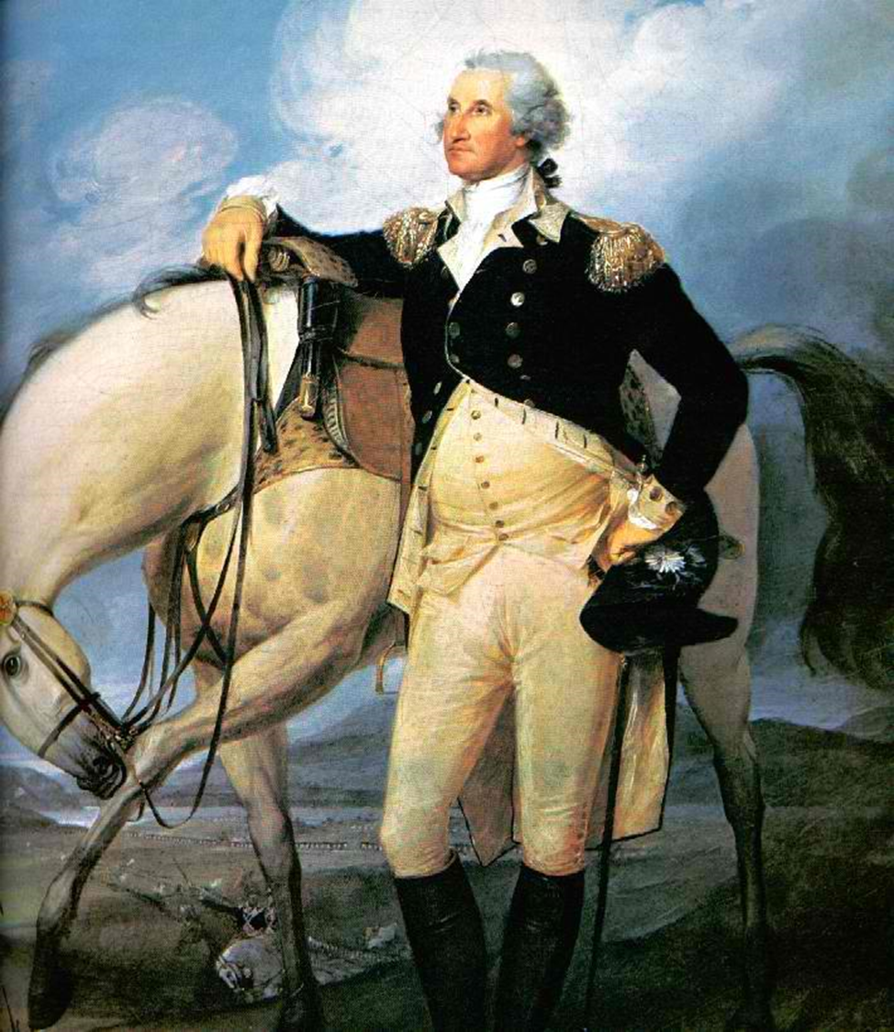
Washington lived an exciting life in exciting times. As a boy, he explored the wilderness. When he grew older, he helped the British fight the French and Indians. Many times he was nearly killed. As a general he suffered hardships with his troops in the cold winters.
He lost many battles, but led the American Army to final victory. After he became President, he successfully solved many problems facing his country, Washington belonged to an old colonial family that believed in hard work, in public service and in worshipping God.

Slide 3
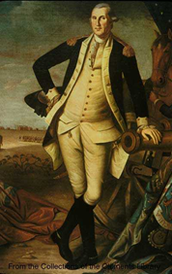
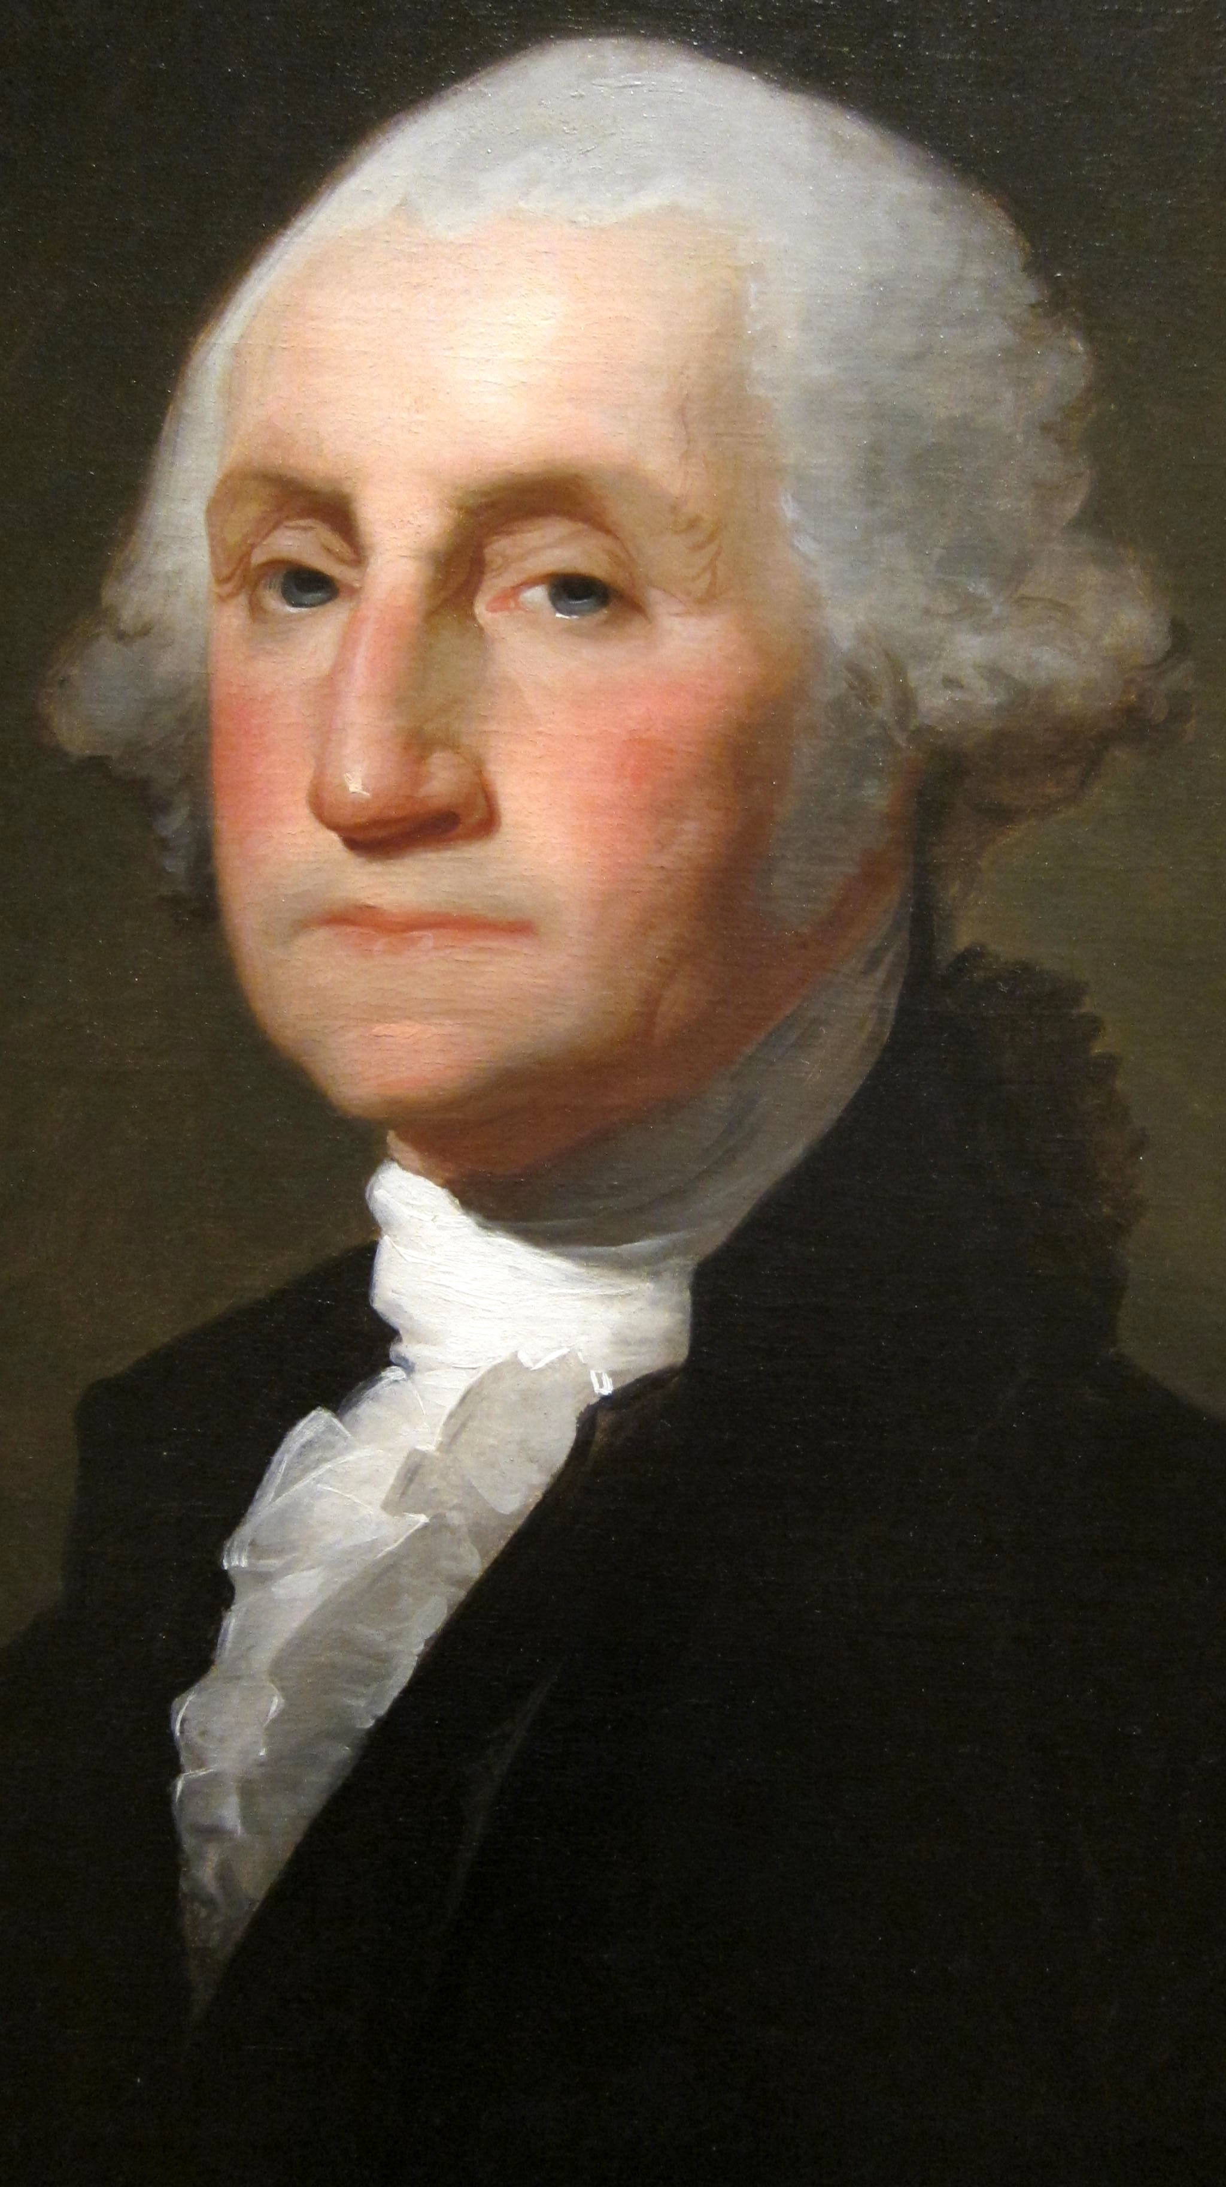
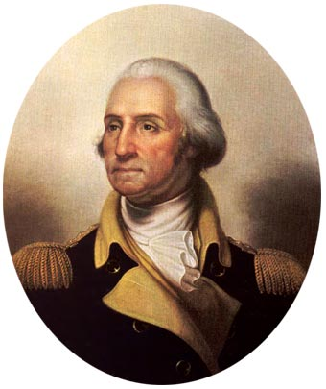
George Washington was born in Westmoreland county, Virginia; on a farm, on February 22, 1732. His first American ancestor came to Virginia from England in 1657. Farming, land buying, trading, milling, and the iron industry were the means by which the family rose in the world. George's father, Augustine, had four children by his first wife and six by his second wife, Mary Ball, George's mother.

Slide 4
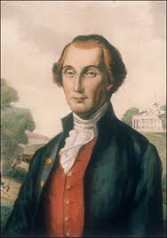
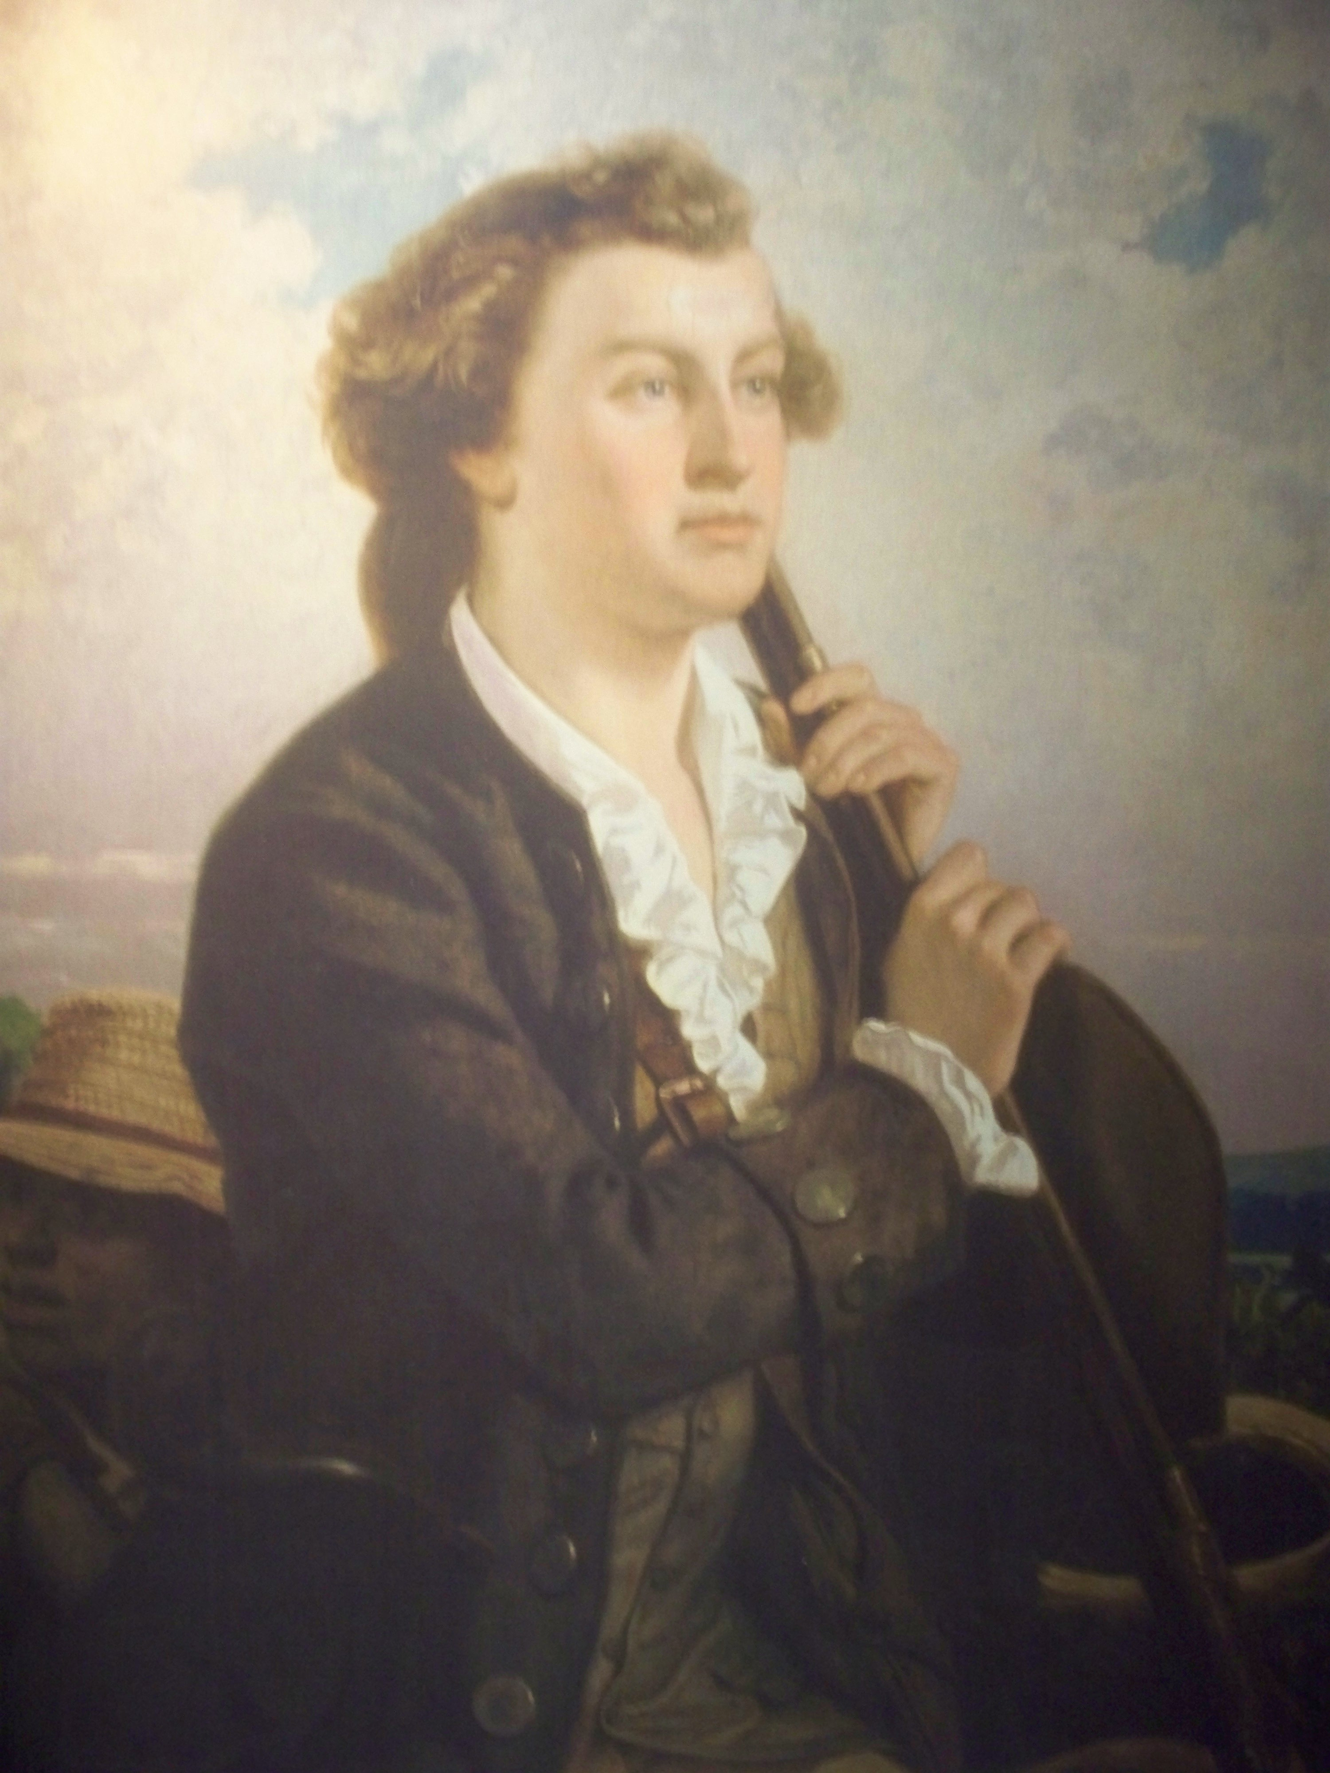
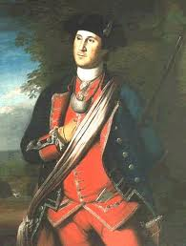
Of George's early life little is known. His formal education was slight: no more than 7 or 8 years of school. Men, plantation life and the haunts of river, field and forest were his principal teachers. His favourite subject was arithmetic. He studied enough history and geography to know something of the outside world. But he never learned very much about literature, foreign languages and history.
At the age of 14 he began to work as a surveyor, making many trips into the wilderness areas of Virginia and Pennsylvania. His first military experience came in the French and Indian War (1754—1763), when he was sent on two missions deep into the Ohio county.

Slide 5
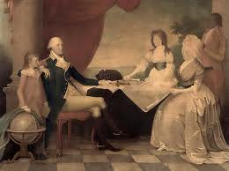
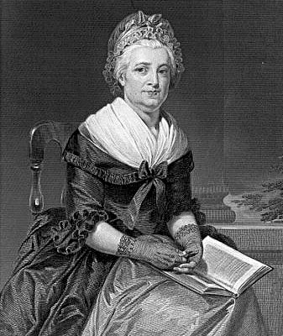
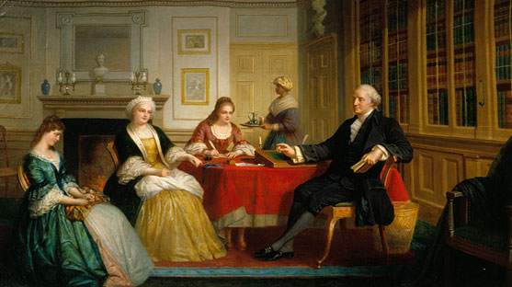
In 1759 Washington retired and married Martha Dandridge, a rich widow. He became a loving stepfather to Martha's two children. He was a progressive farmer of that time.

Slide 6
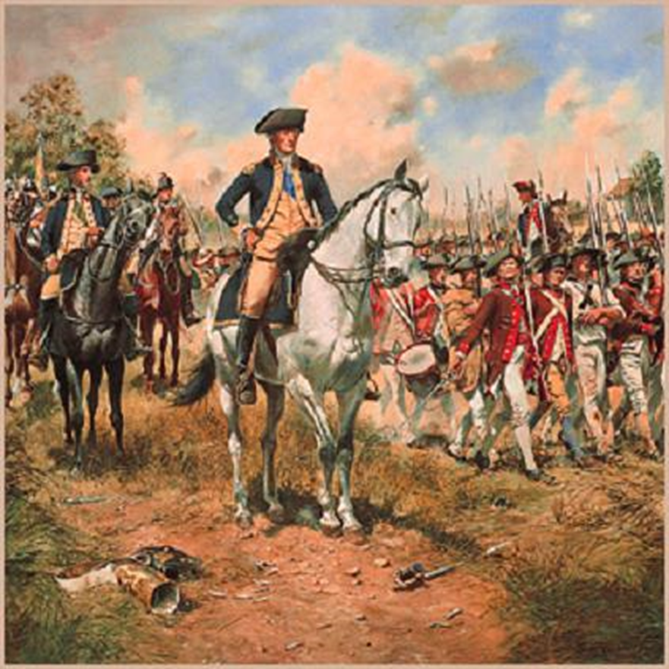
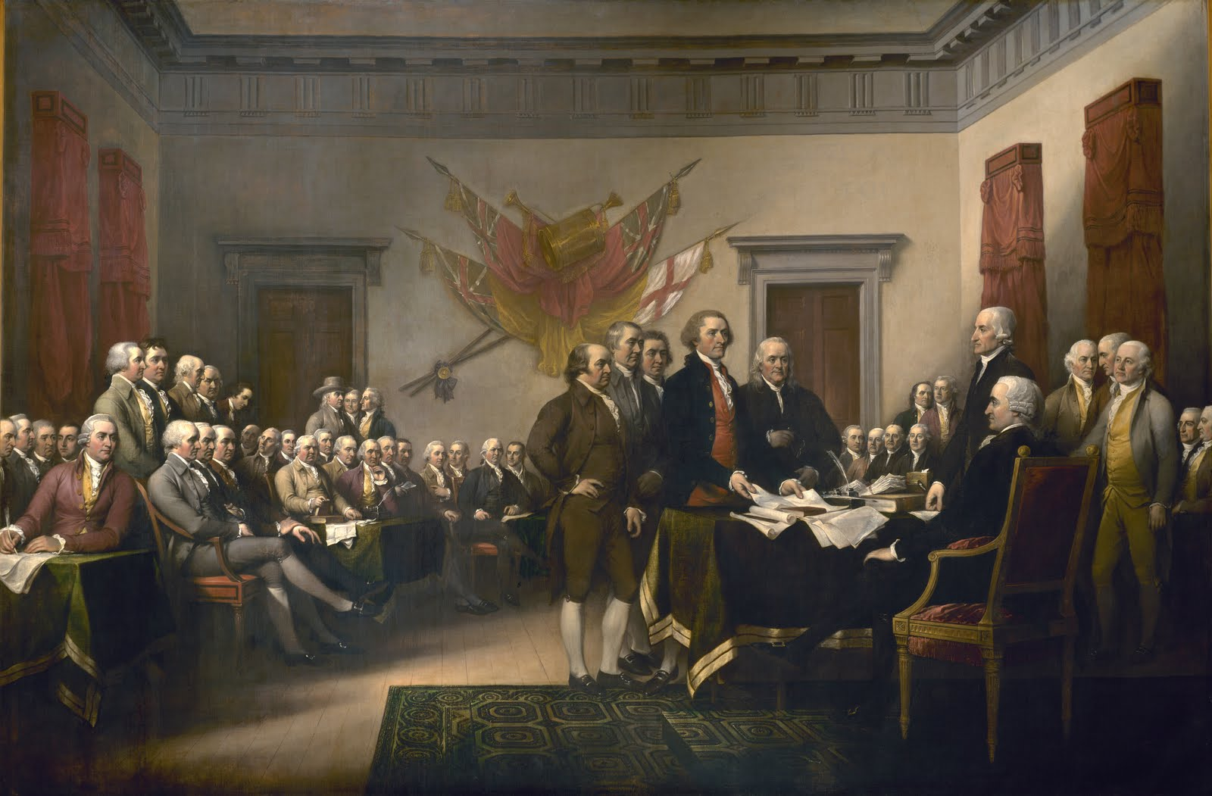
In 1760's the American colonists grew angrier and angrier at the taxes placed on them by Great Britain. In September 1771 the Continental Congress met, where Washington had his first chance to meet and talk with leaders of other colonies. The members were impressed with his judgement and military knowledge. He was sent to attend the Second Continental Congress (1775) where he was elected a commander-in-chief of the Continental Army. He proved himself a capable commander of the War of Independence.

Slide 7
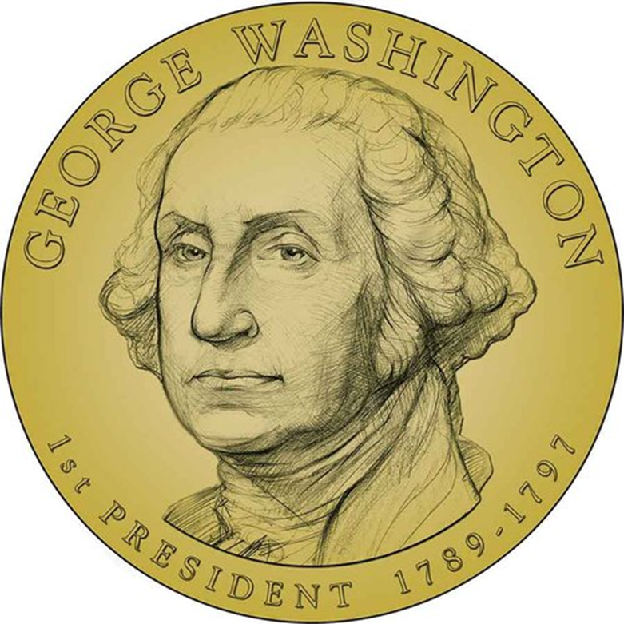
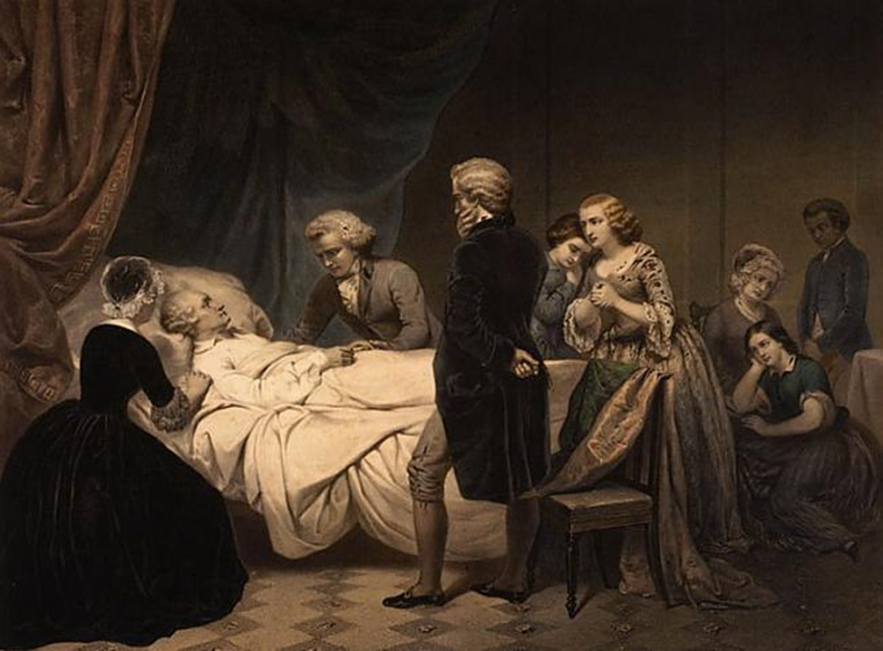
In 1787 Washington was chosen president of the Continental Convention and later elected first president of the republic (1789), followed by reelection (1792).
George Washington died after an illness of two days on December 14, 1799.

Slide 8
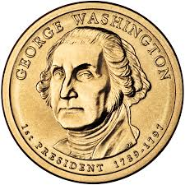
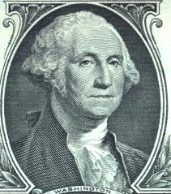
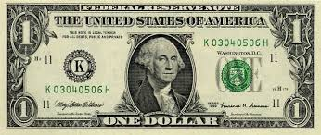
No other American has been honoured more than Washington. The nation's capital, Washington D. C., was named after him. There the giant Washington Monument stands. The state of Washington is the only state named after President. Many cities, parks, streets, bridges, lakes, and schools bear his name. Washington's portrait appears on postage stamps, on the $1 bill, and on the quarter.

