Slide 1

Sport in our life
Prepare:
Roman Matviichuck
Form 10 A
School 25

Slide 2
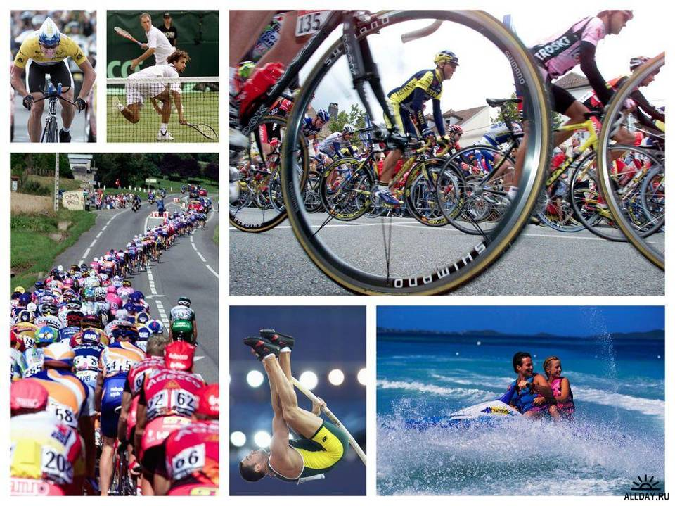

Slide 3

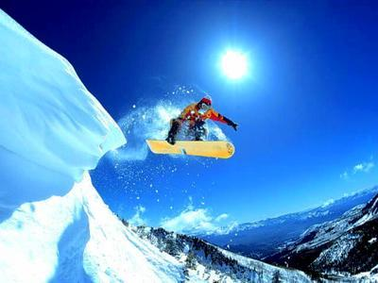
Introduction
Sport plays an important role in our life. Sport makes people healthy, keeps them fit, more organized and better disciplined. People go in for many kinds of sports. There are sports grounds near every school, every institute, every factory and plant. Besides there are sports clubs and sport school in every town.

Slide 4
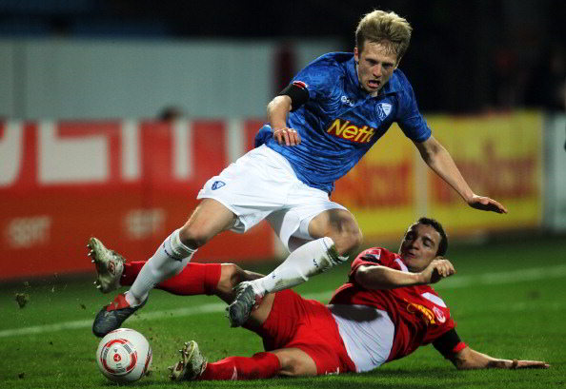
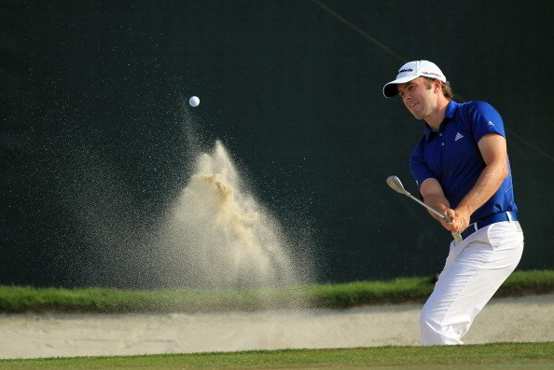
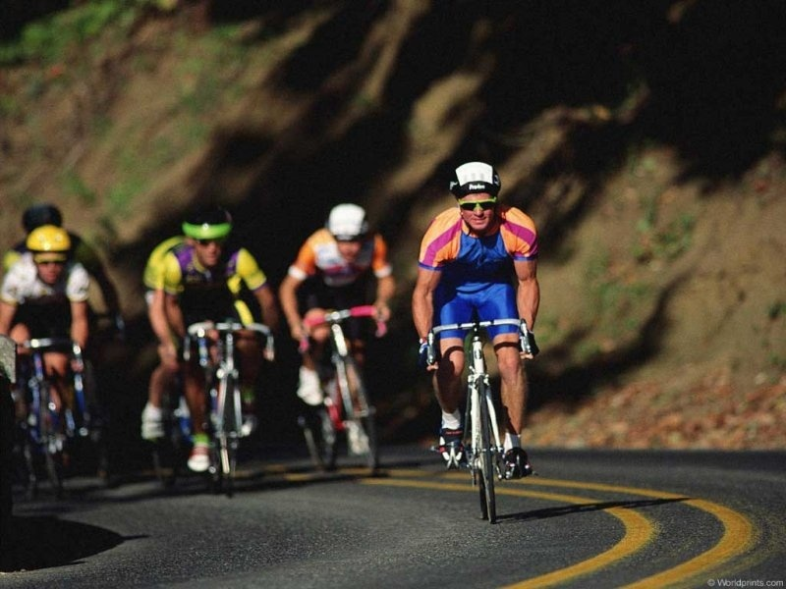
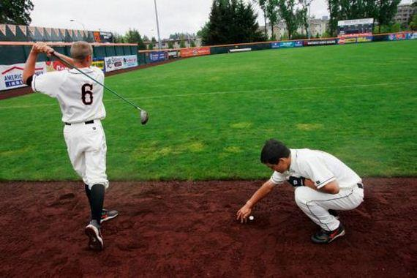
Football
Ol
Summer sports

Slide 5
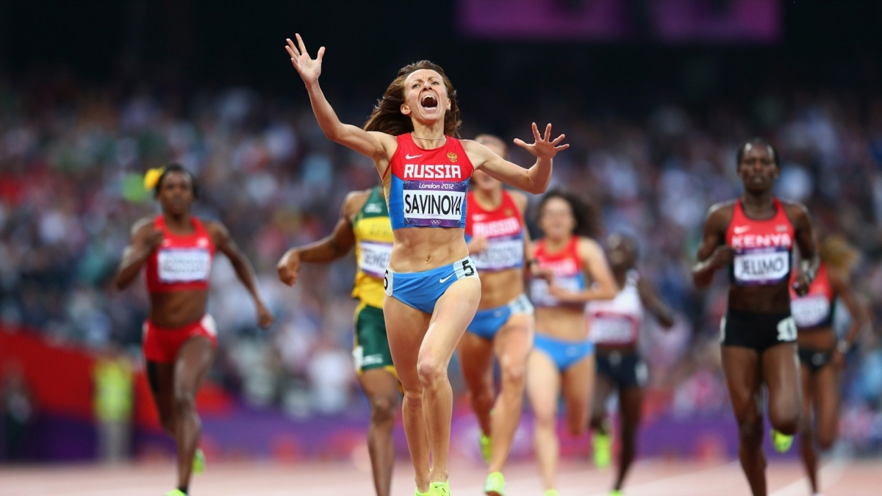
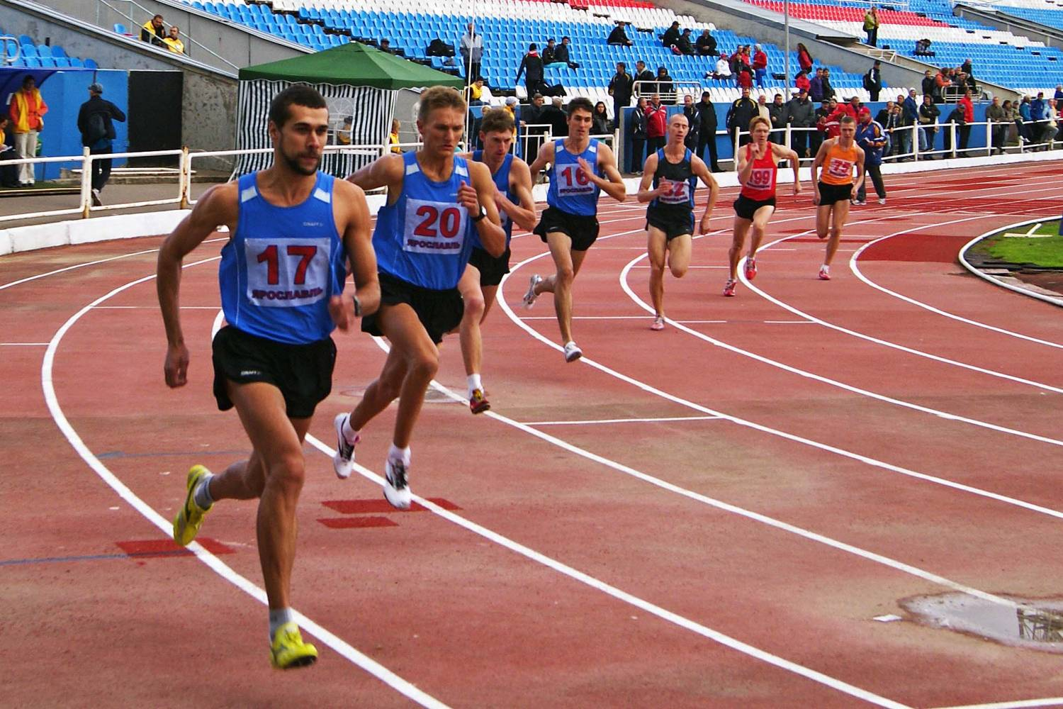
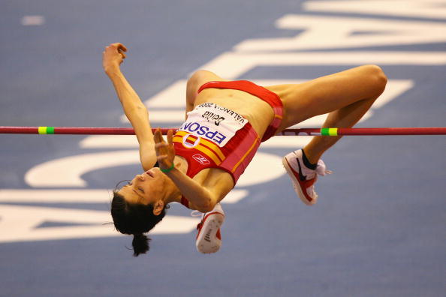
And games

Slide 6
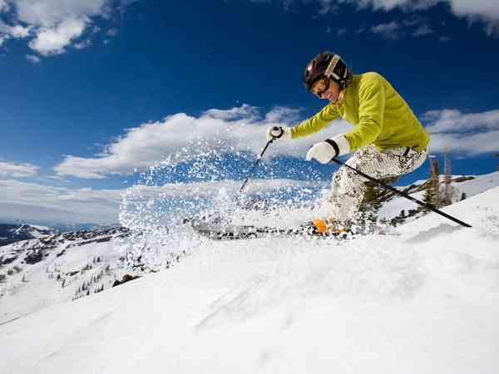
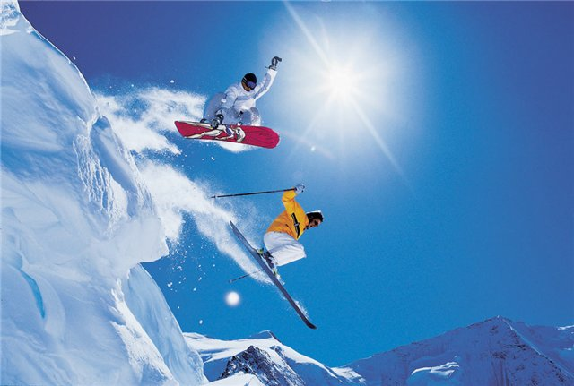
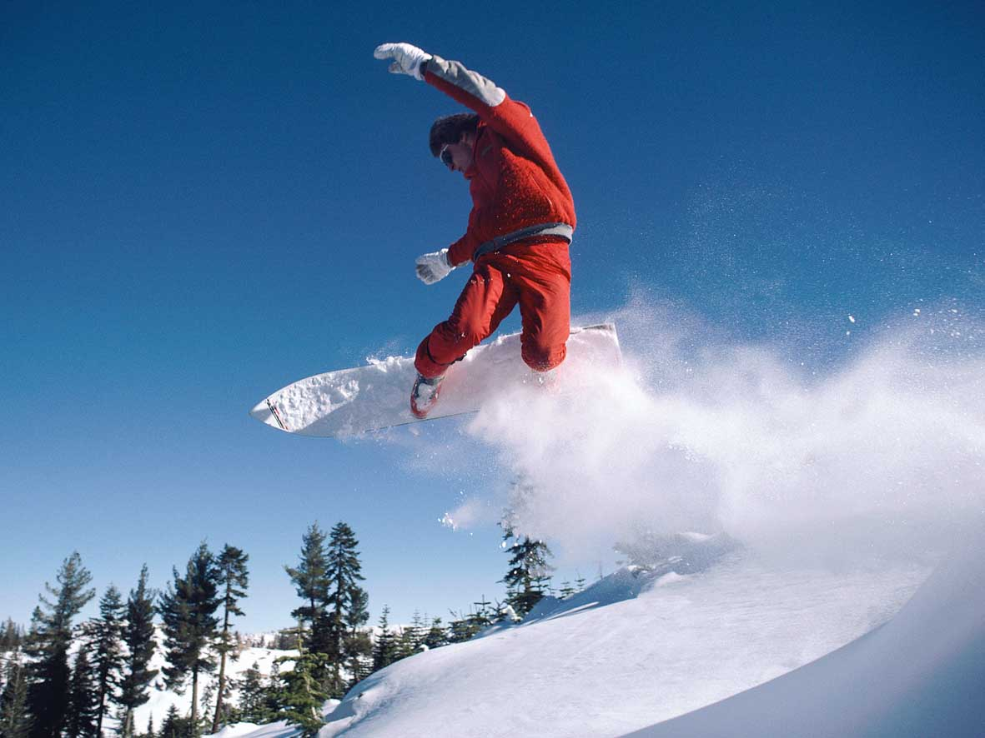
winter games

Slide 7
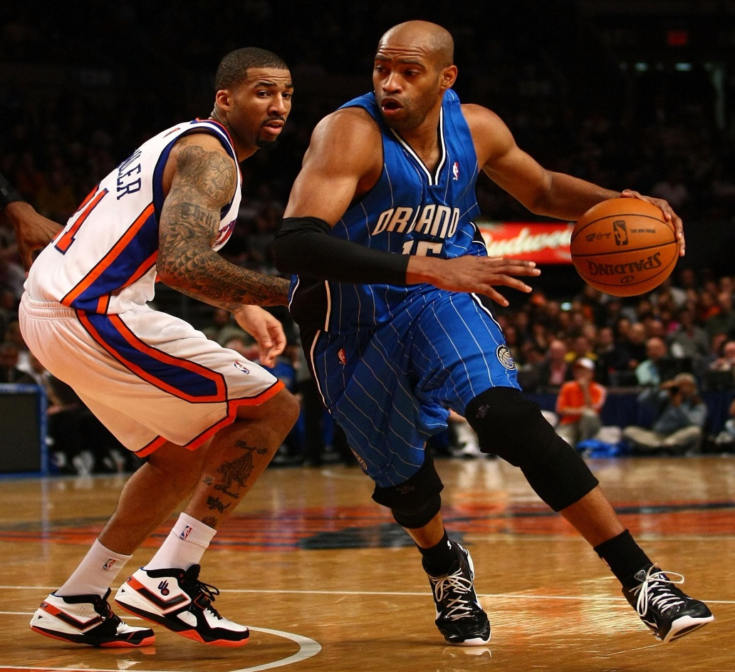
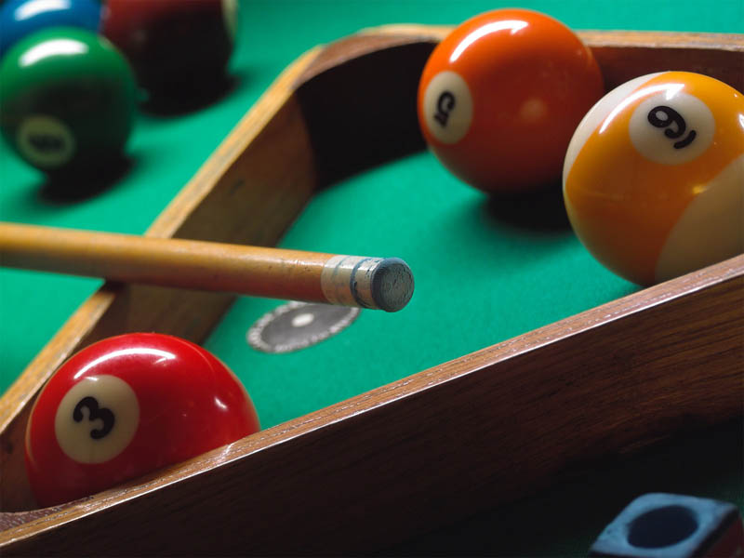
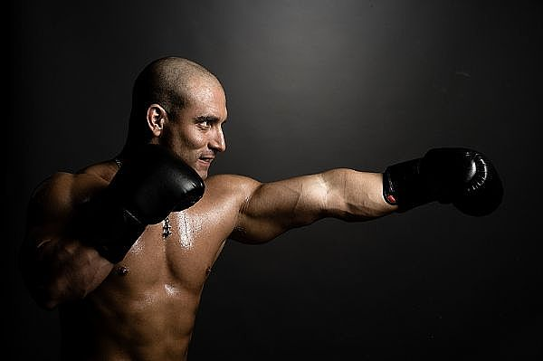
Indoor sports

Slide 8
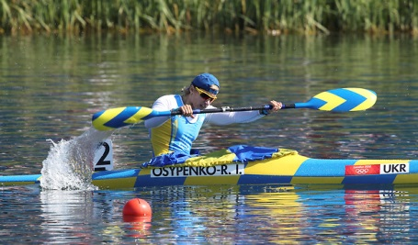
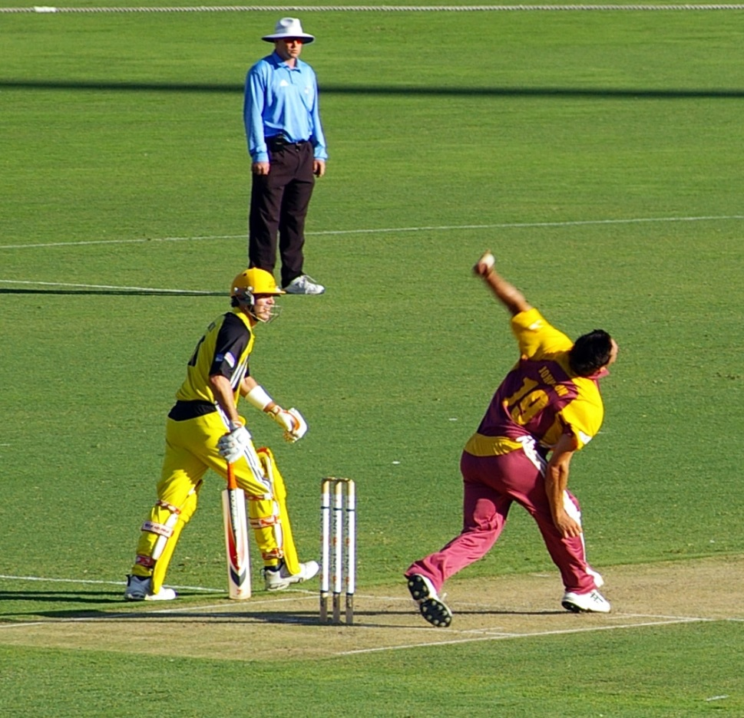
Outdoor sports

Slide 9
What kind of sport do you know?
Football Basketball Volleyball Handball Tennis Table tennis Badminton Golf Cricket Gymnastics Track-and-field athletics Boxing Cycling Wrestling Rugby Baseball Fencing | Tobogganing Skating Skiing Figure skating Ski-jumping Hockey | Water polo Swimming Boating Surfing

Slide 10
Sports for everybody
I go out cycling every day,
I get strong and fit that way,
And I play football at weekends,
With all my other healthy friends.
We like to run and swim and walk
Let's move around, no time to talk!
So we enjoy sport anyway,
We love to do sport every day.
If the weather is OK,
We can go fishing all the day.
We can jog around the park.
It's very good for the heart.
Yes, we like to swim and run and walk,
Let's move around, no time to talk!
So we enjoy sport anyway,
We love to do sport every day.

Slide 11
Remember with what kind of activities we use do, play and go.
To go
To play
volleyball
basketball
badminton
tennis
cricket
golf
football
handball
To do
athletics
gymnastics
exercises
cycling
swimming
climbing
sailing
fishing

Slide 12
Thanks for your attention !!!

