Slide 1
International exams: Cambridge’s exams
Prepared
Kolpakchi Yana
Form 11

Slide 2
Plan:
Key English Test (KET)
Preliminary English Test (PET)
First Certificate in English (FCE)
Certificate in Advanced English (CAE)
Certificate in Proficiency in English (CPE)

Slide 3
Key English Test (KET)
Exam Key English Test (KET) ranks first in the series of Cambridge examinations in English - Cambridge ESOL. It requires knowledge of English at an elementary level. In the system established for modern languages Council of Europe, it is the A2 level. To pass KET can those who speak English at a basic level, and can use it, for example, while traveling in a foreign country. For successfully passing the exam you should be able to understand the meaning of simple texts, to communicate in the easiest and most common everyday situations

Slide 4
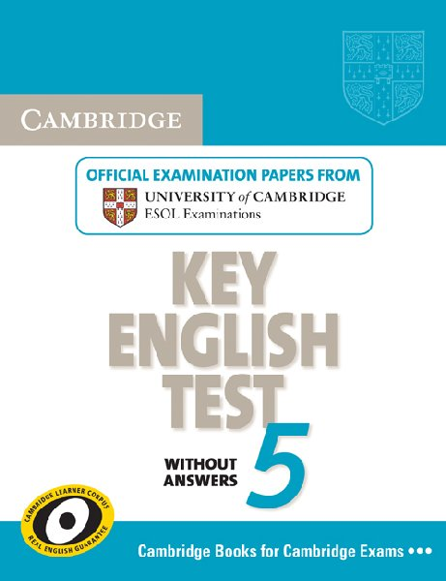
Every year KET deals more than 40 thousand people in more than 60 countries
The exam KET has three stage test ("Papers"): Reading and writing, Listening and Speaking . All written tests are sent for testing and evaluation in Cambridge. As for the Speaking test, it is taken by two examiners at the venue of the examination. All examiners are accredited by Cambridge ESOL.

Slide 5
Preliminary English Test (PET)
Certificate PET confirms the ability to read, write and communicate in English. Reaching this level of knowledge of the language You can think of that were about two-thirds of the way to getting the FCE (First Certificate in English).
Exam PET ranks second in the series of Cambridge examinations in English - Cambridge ESOL. It requires knowledge of English at intermediate level (Intermediate). In the system established for modern languages Council of Europe, it is B1. It is assumed that this level of knowledge of the language allows
you to communicate and write English in everyday situations

Slide 6
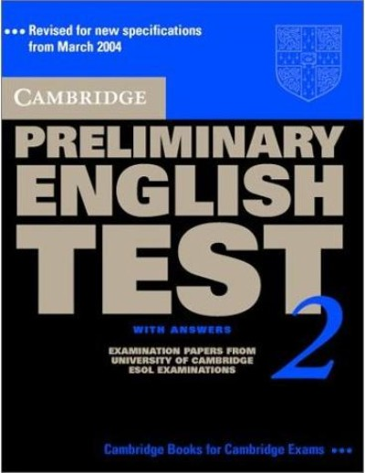
Having the knowledge of English at this level, You can read simple texts and to conduct personal correspondence, but only following more or less standard format.
Every year, PET pass more than 80 thousand people in more than 80 countries.
There are three stage of test like in KET.

Slide 7
First Certificate in English (FCE)
The Cambridge First Certificate in English (FCE) ranks third in the series of Cambridge examinations in English - Cambridge ESOL.
This is the highest level of medium level of English (Intermediate). In the system established for modern languages Council of Europe, it corresponds to level B2. It is assumed that this level of knowledge of the language allows us to talk in a foreign language and correspondence.
Each year FCE is taken over 270 thousand people in more than 100 countries.

Slide 8
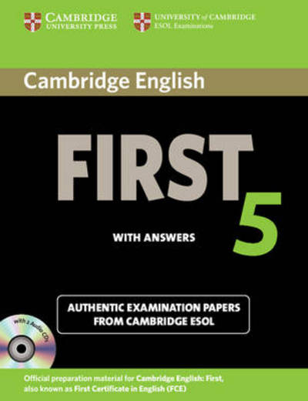
To pass FCE can those who speak the English language sufficiently to use it in everyday life, including at work and in school. For successfully passing the exam you need to have a large vocabulary, to be able to talk and use the appropriate communicative strategies in a variety of situations.
The FCE exam involves the passage of five stages of testing ("Papers"):Reading,Writing, Use of English,Listening,Speaking.

Slide 9
Certificate in Advanced English
(CAE)
Cambridge Certificate in Advanced English (CAE) ranks fourth in the series of Cambridge examinations in English - Cambridge ESOL. For this exam requires knowledge of the English language at a high level (Advanced). In the system established for modern languages Council of Europe, it corresponds to level C1.
Must be able to communicate confidently in English and how to use it in many everyday situations.

Slide 10
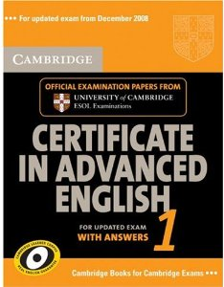
For successfully passing the exam you need to effectively use the English language confidently and communicate in everyday situations, to solve professional problems and higher education.
Every year SAE delivers more than 60 thousand people in more than 60 countries.
The stages of the exams are the same as in FCE

Slide 11
Certificate in Proficiency in English (CPE)
Cambridge Certificate of Proficiency in English (CPE) is at the highest level among the Cambridge examinations in English - Cambridge ESOL. In the system established for modern languages Council of Europe, the level of language proficiency designated as C2.
To pass the CPE can someone who speaks English at a very high level and can effectively use their knowledge in almost any situation.

Slide 12
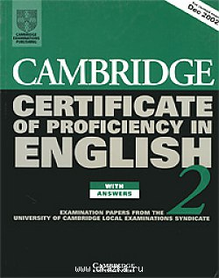
Tasks based on the tasks of everyday life, so its successful completion means that the applicant does not simply possess a large vocabulary and knows grammar, but really fluent in the language. For exam requires an appropriate level of education and life experience.
Every year CPE delivers more than 45 thousand people in more than 80 countries.
The stages of the exams are the same as in FCE and CAE

Slide 13

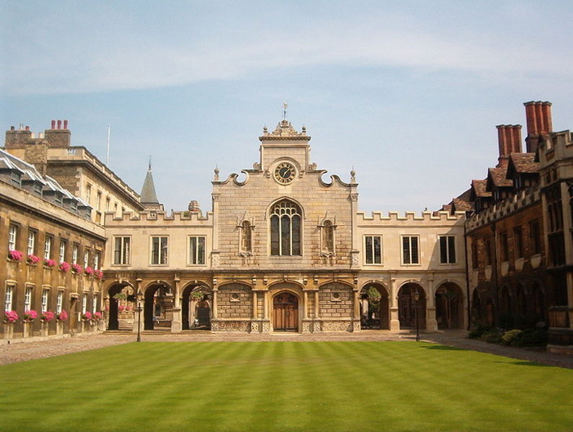



Thanks for your attantion

