Slide 1
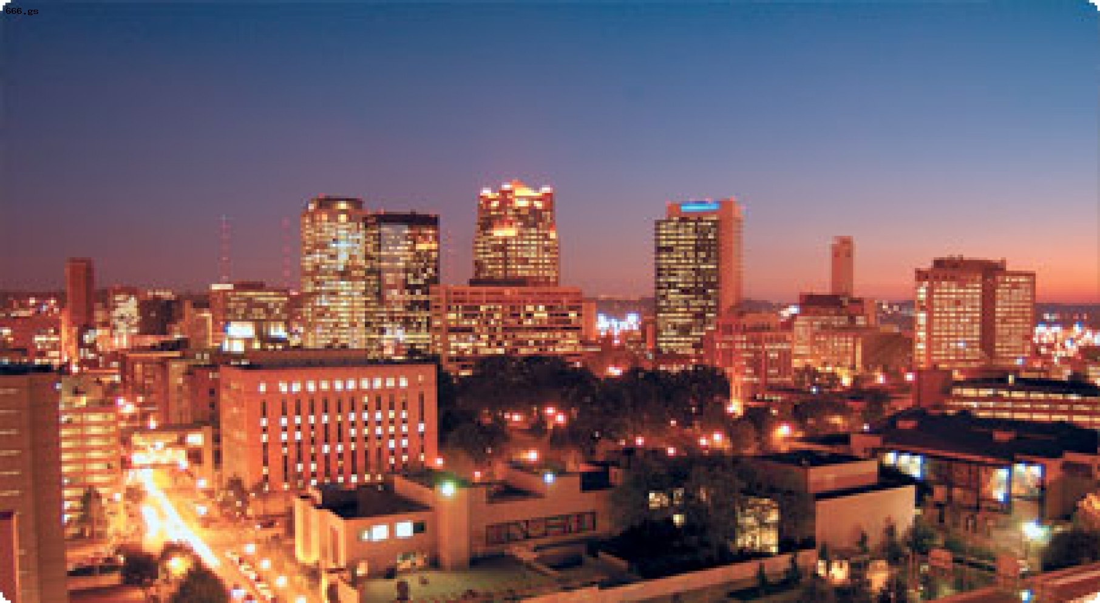
Birmingham

Slide 2
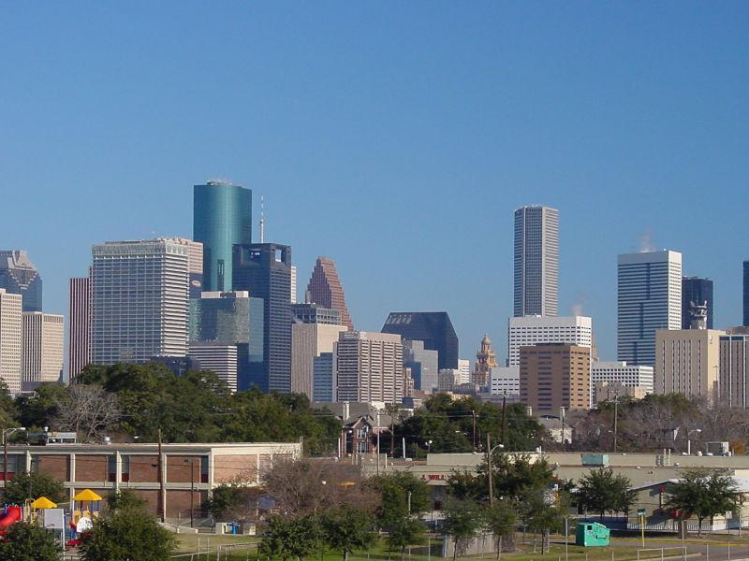
Birmingham was founded in 1871.

Slide 3
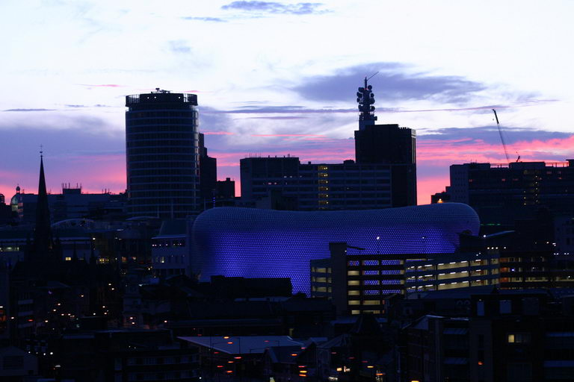

Slide 4
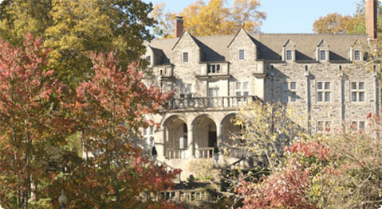
In the era of rapid development of national industry of the population of Birminghamgrew so quickly that it was called "the magic city."

Slide 5
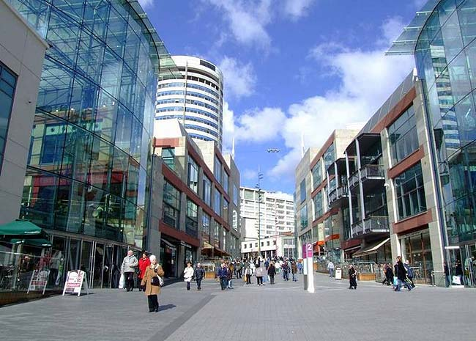

The city is the center of the
West Midlands region and the second most populous city in England after London.

Slide 6
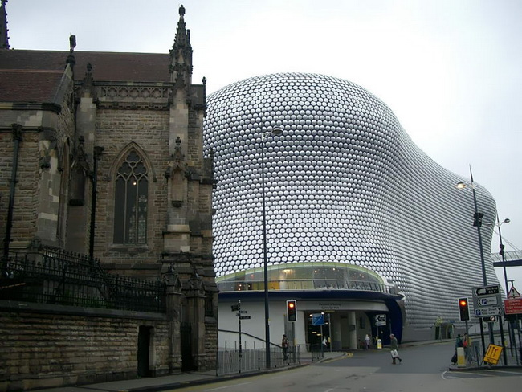

Slide 7
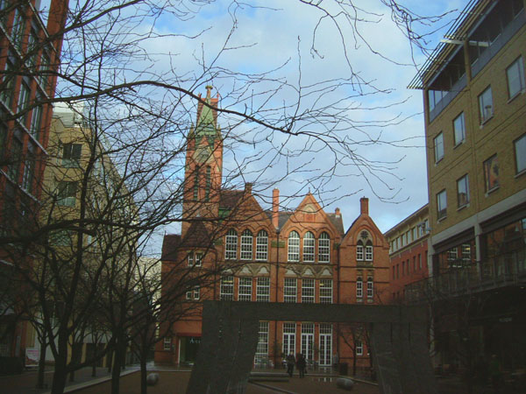
Birmingham also boasts 99 historic districts and is often referred to as the cradle of American civil rights movement.

Slide 8
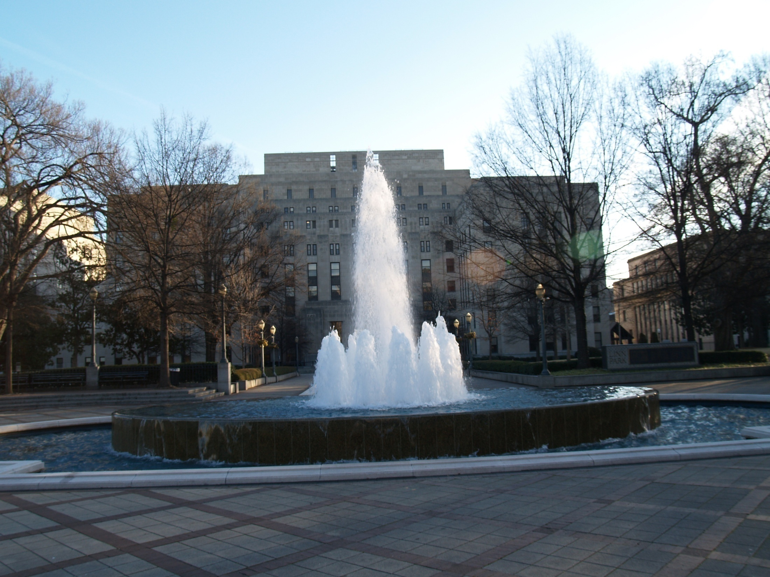

Slide 9
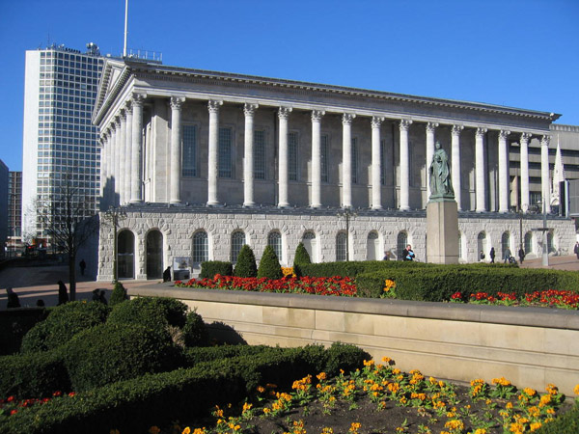
You can visit the old castle, near which necessarily broken picturesque parks. Some,such as Sutton Park and Castle Brumvich, preserve flora samples, which wereplanted a local residents a few centuries ago.

Slide 10
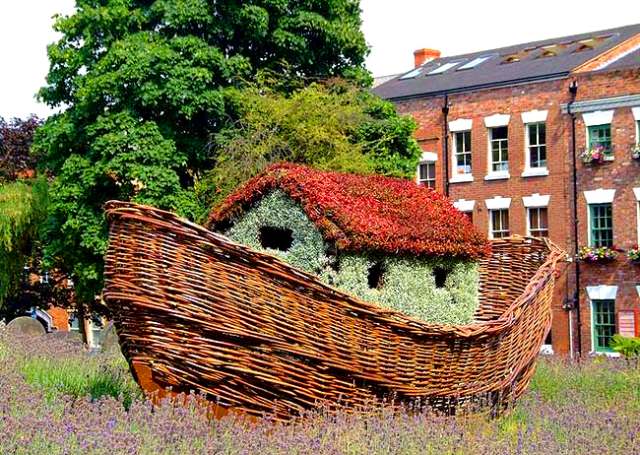

Slide 11
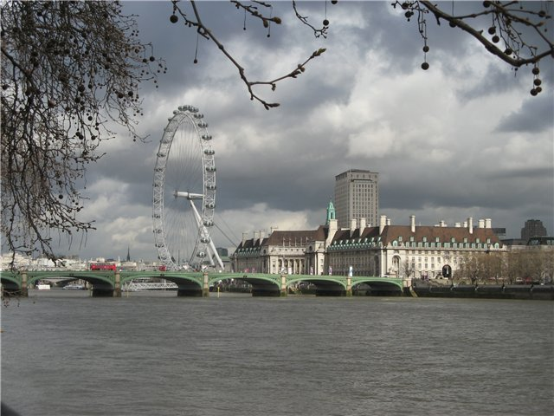
Birmingham is the second largest metropolis and the population of Great Britain.

Slide 12
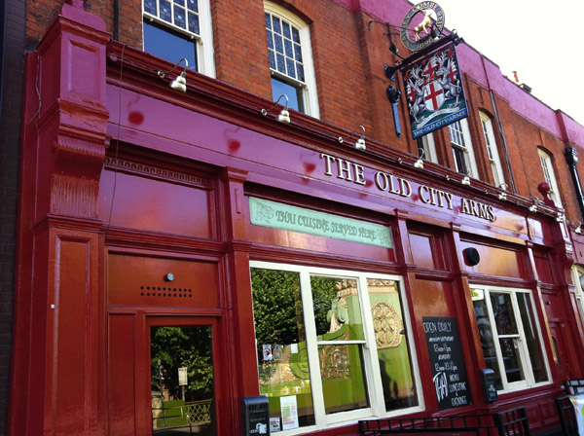
Modern architecture is used beautifully here with the old artisan quarters of the former nation, from century history.

Slide 13
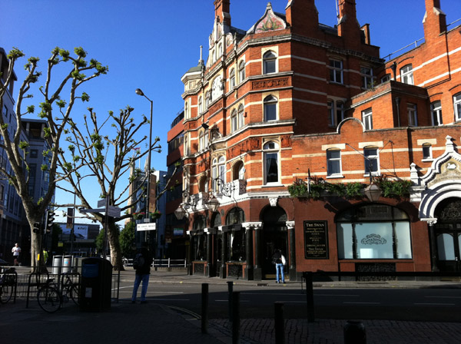

Slide 14
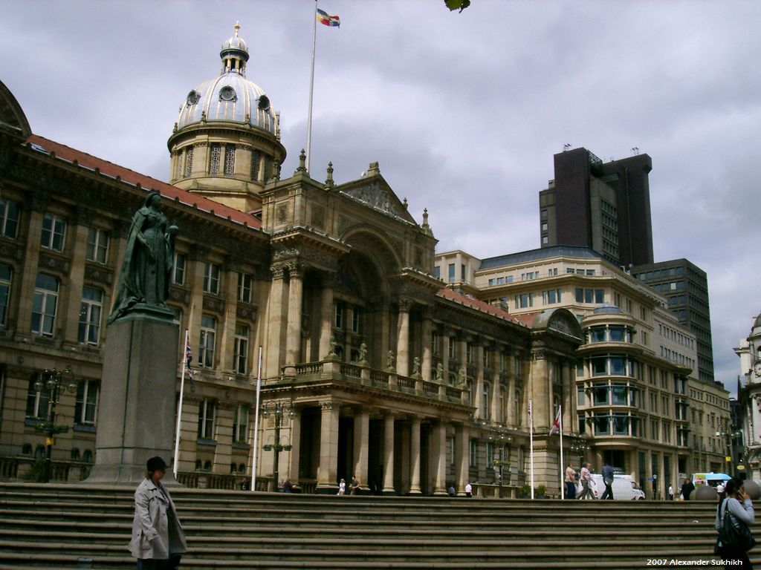
Center city

Slide 15
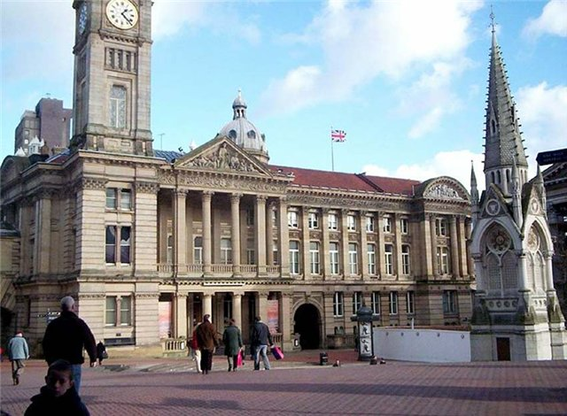
Museum of Art

Slide 16
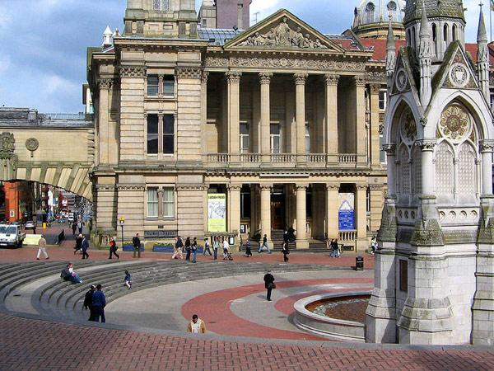
In Birmihemi can visit the Institute of Fine Arts in art galleries which are
original Renoir, Monet, Degas and other famous artists.

Slide 17
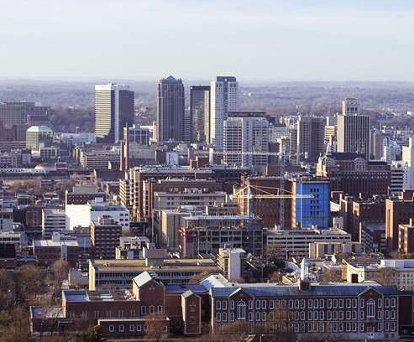

Slide 18
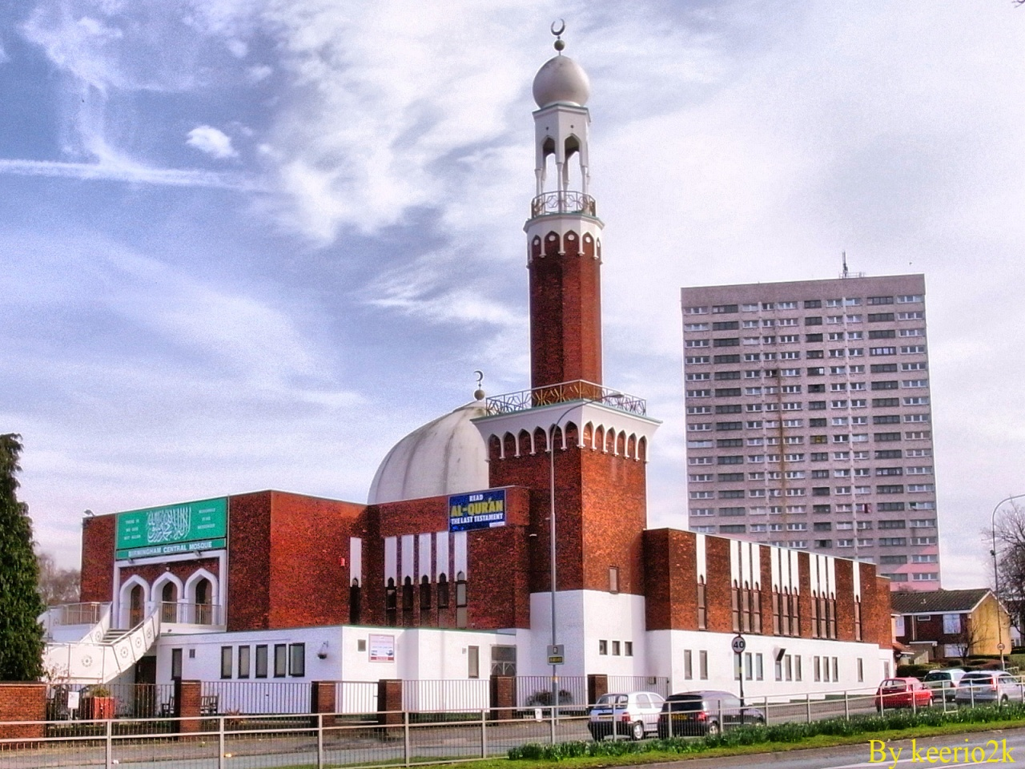
Birmingham's central mosque

Slide 19
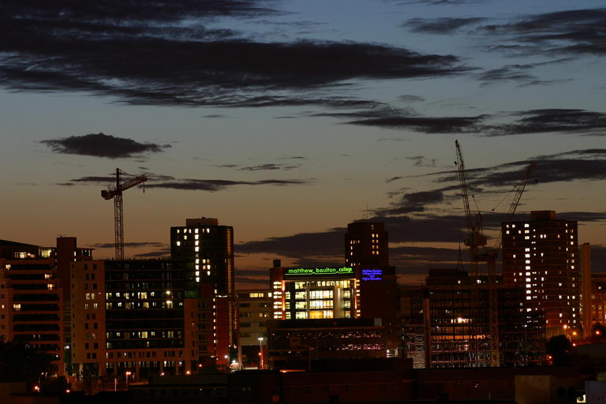

Slide 20
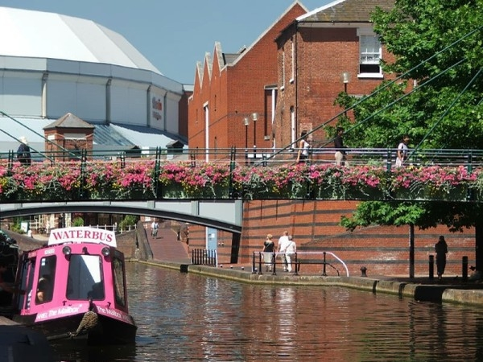

Slide 21
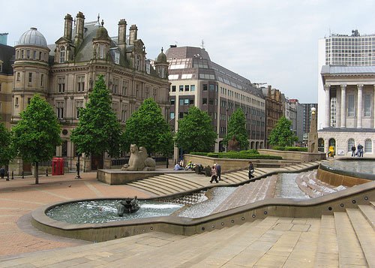
Victoria Square

Slide 22
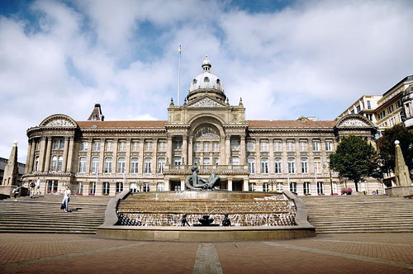
The city council of Birmingham is the largest local government in territory of Great Britain and the largest city council in Europe.

Slide 23
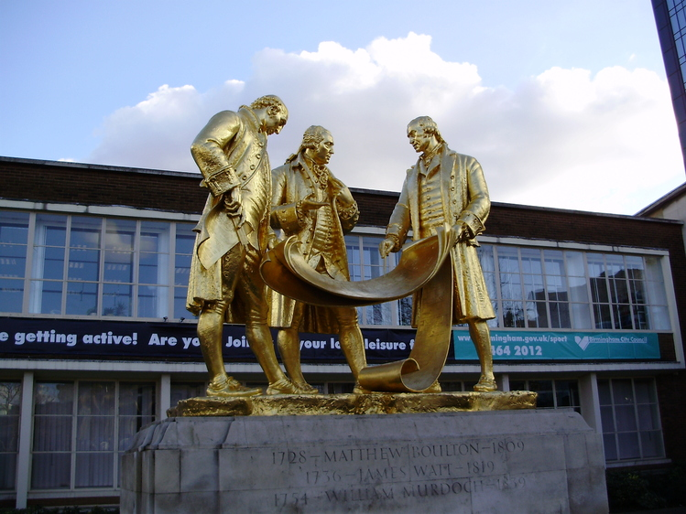

Slide 24
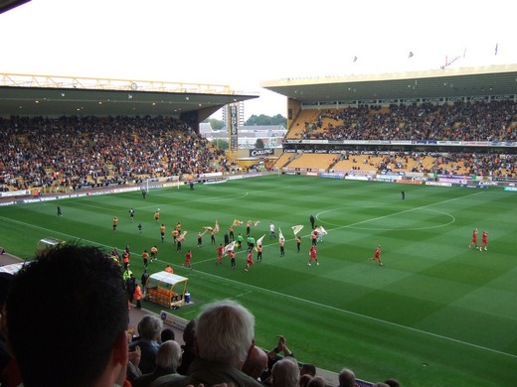
Birmingham - a city with a long sporting tradition. "Birmingham City" and "Aston Villa"are among the oldest English football clubs.

Slide 25
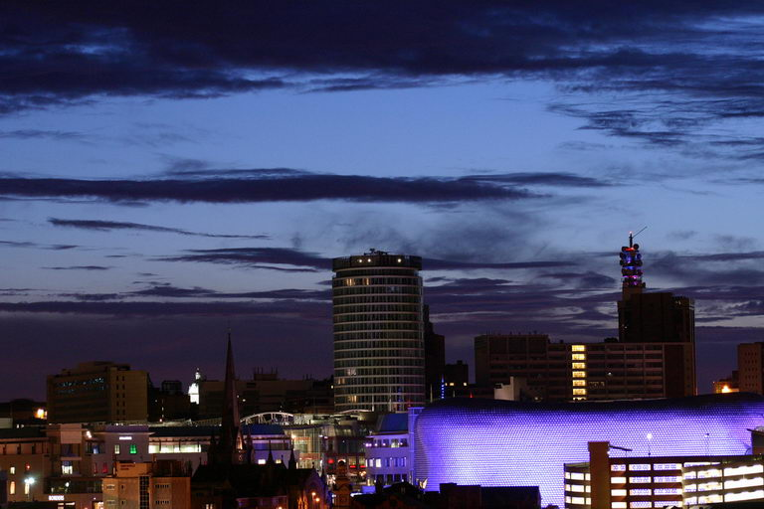

Slide 26
