Slide 1
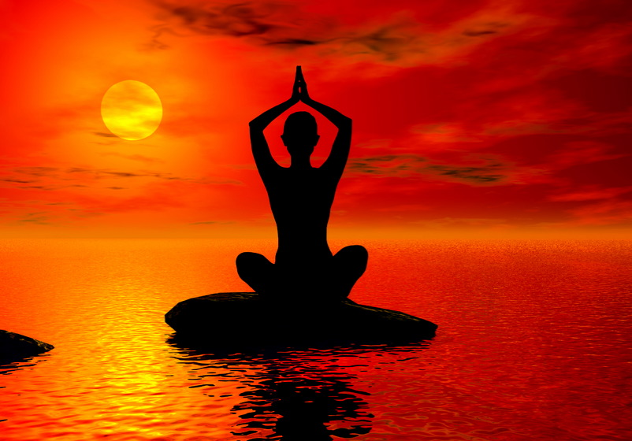
Healthy lifestyle
Pupil 11 «B» class
Shelega Margarita

Slide 2

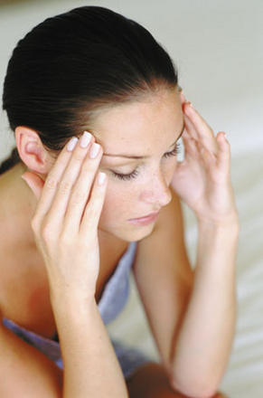
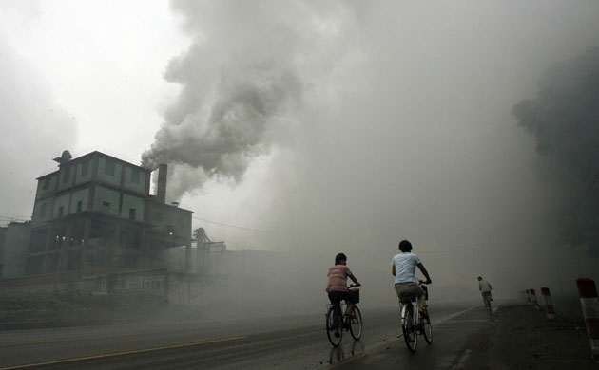
Nowadays our life is getting more and more tense. People constantly suffer from stress, noise and dust in big cities, diseases and instability.

Slide 3
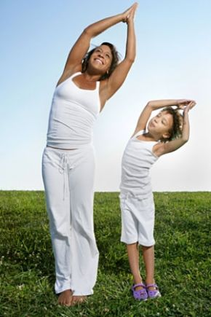
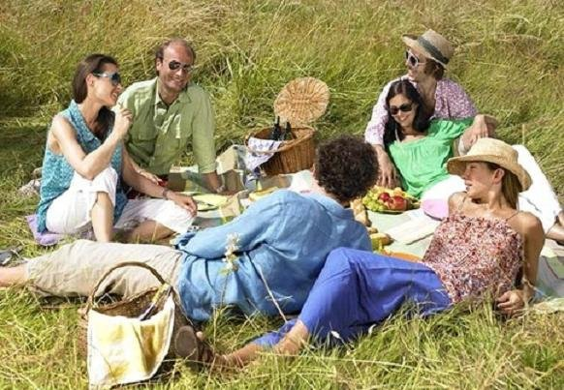
Person should be strong and healthy in order to overcome all difficulties. There are several ways to do it.

Slide 4
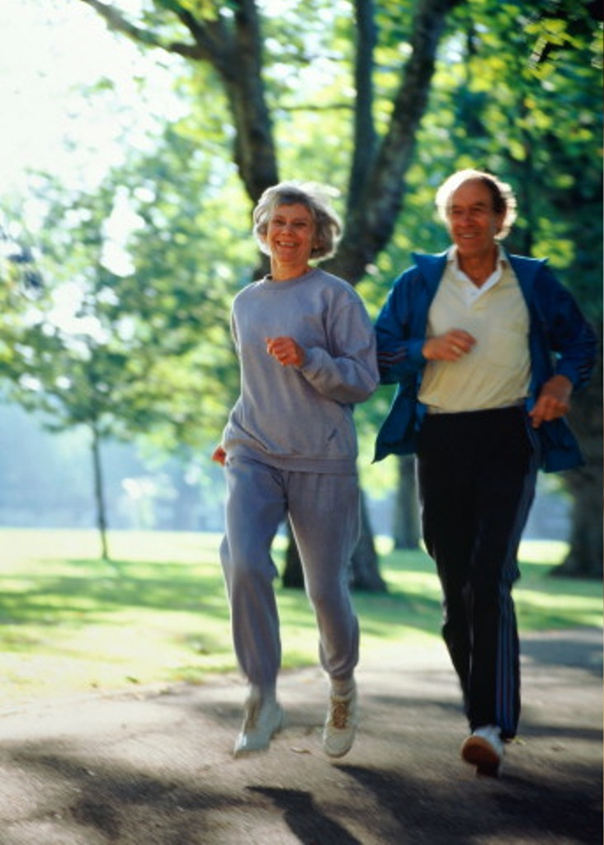
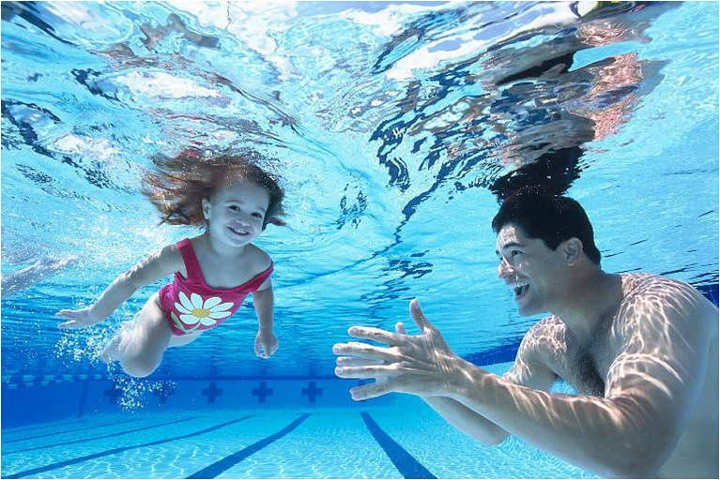
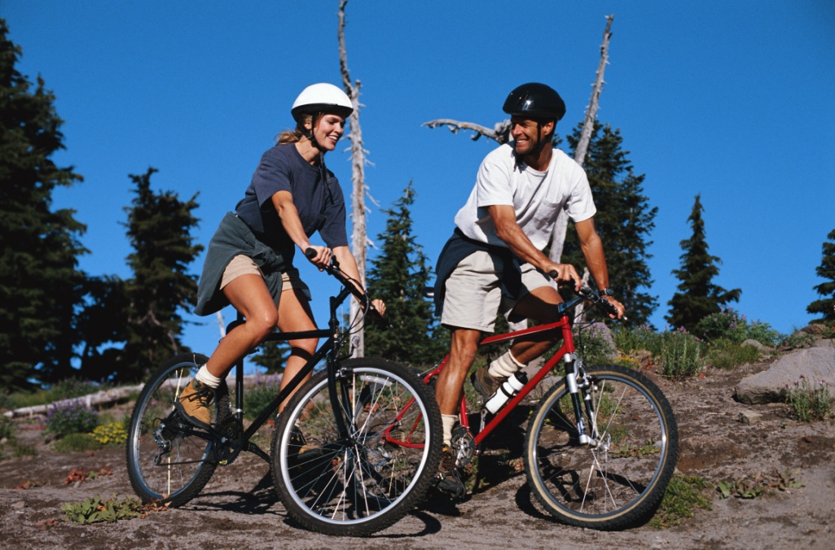
Sport is very important in our life. It is popular among young and old people. The most healthy kinds of sports are swimming, running and cycling.

Slide 5
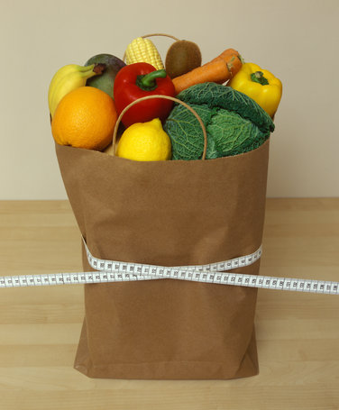
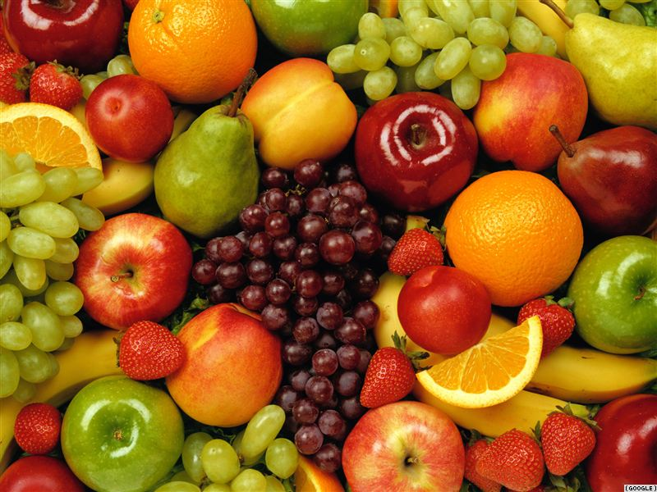
Healthy food is also a very important factor. Overeating causes many dangerous diseases. The daily menu should include meat, fruit and vegetables, milk product, which are rich in vitamins and proteins.

Slide 6
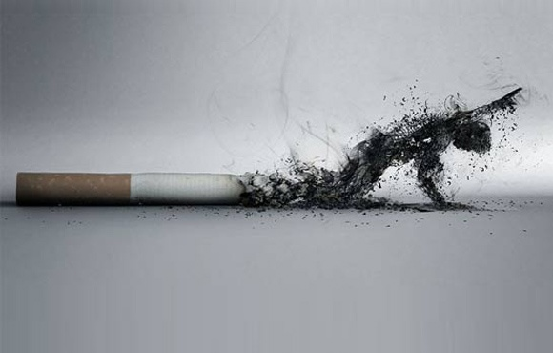

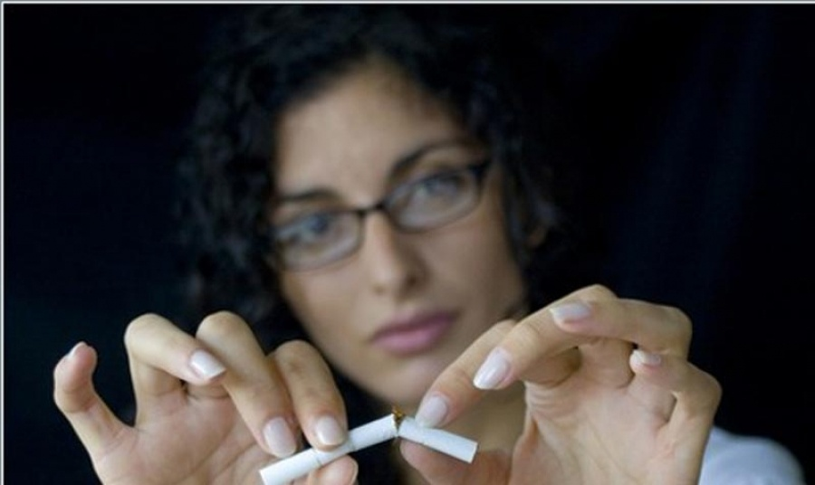
To be healthy, people should get rid of their bad habits. It's necessary to stop smoking and drinking.

Slide 7

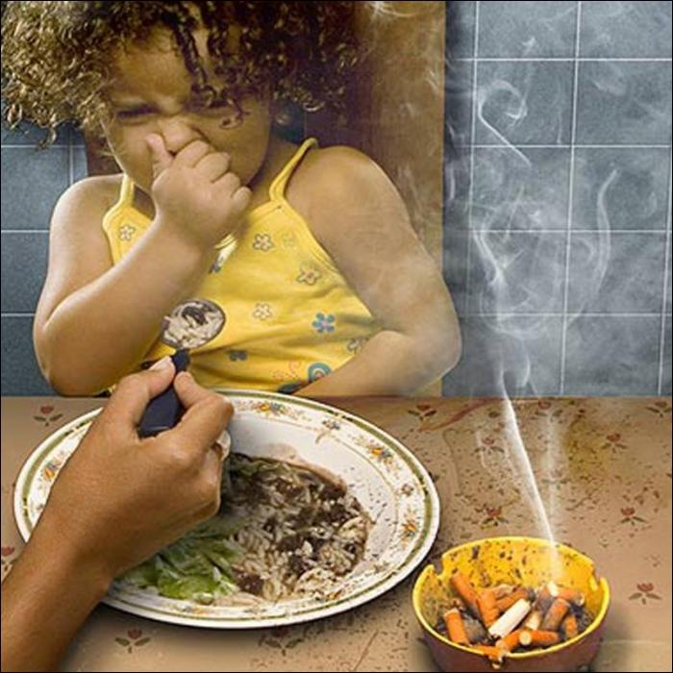

Everyone should remember that cigarettes, alcohol and drugs destroy both body and brain. To be healthy we should avoid different bad habits that can affect our health. In my opinion, smoking and drinking too much alcohol, are the worst ones.

Slide 8
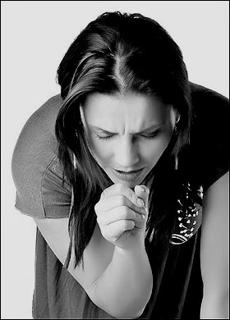


I think it is very important to be fit and healthy, and it is necessary to take care of your health. Only way to stay healthy and to keep fit is by going in for sports. Every person have to choose between healthy life style and numerous illnesses.

