Slide 1

Oxford University

Slide 2
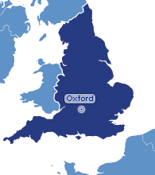
Oxford
a historic city in
Oxford shire
a short name for Oxford University

Slide 3
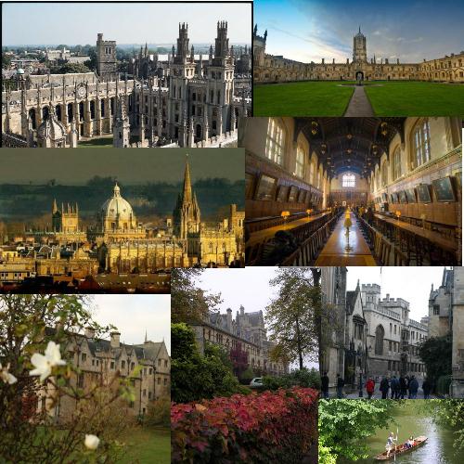
Welcome to the University of Oxford.
People from all walks of life and all parts of the world have been visiting us for nine centuries. Oxford was the first University in the English-speaking world.

Slide 4
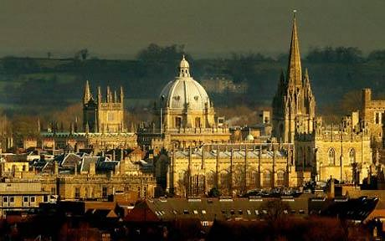
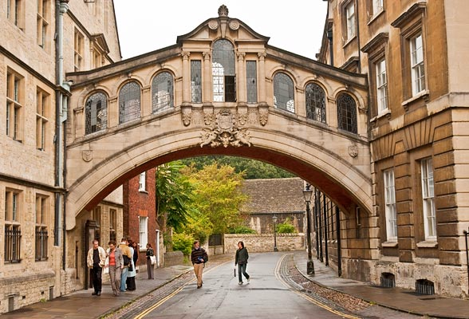
Oxford University is one of the two oldest, most prestigious and most aristocratic British universities. It was created in 1249.
Students come to Oxford from 140 different countries and territories.

Slide 5

Studying at Oxford
Oxford is a collegiate university. It consists of 39 self-governing colleges:
29 colleges for men,
5 colleges for women,
5 colleges for both men and
women members.
Each college has its own hall,
chapel and library.
The university has about 10,000 students.

Slide 6
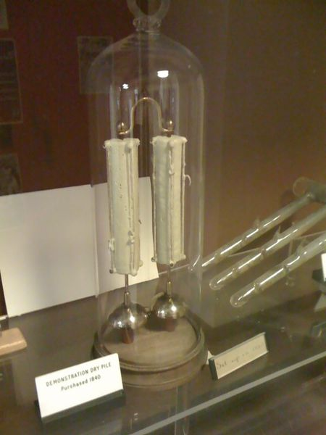
This is interesting…
At Oxford University with an electric bell that rings continuously since 1840.

Slide 7
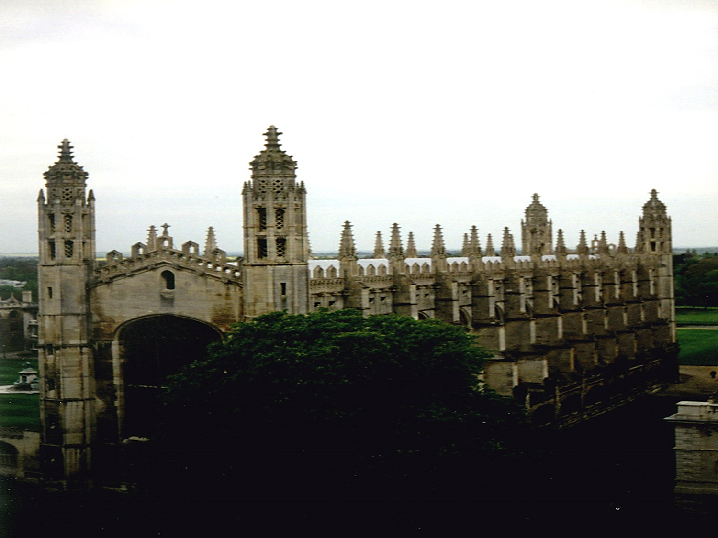
College building (Oxford)

Slide 8
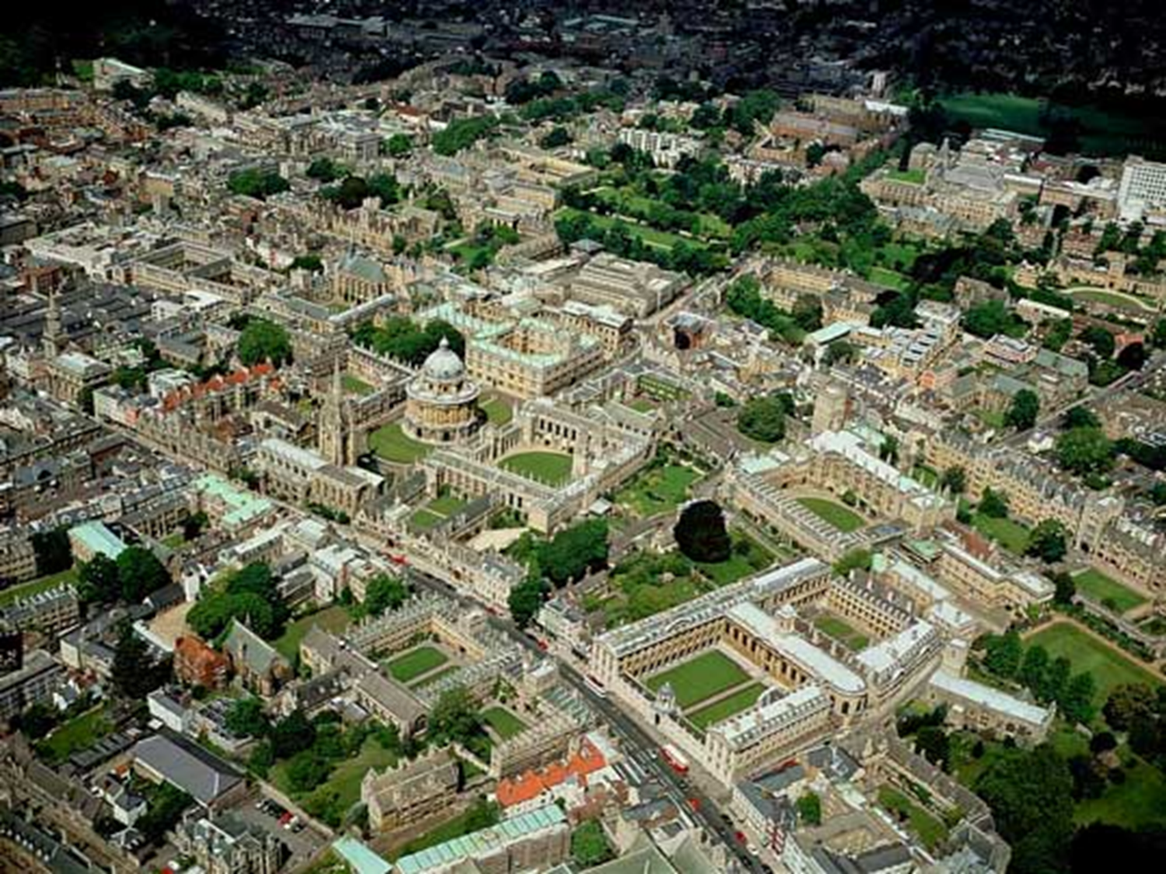
Oxford University (center)

Slide 9
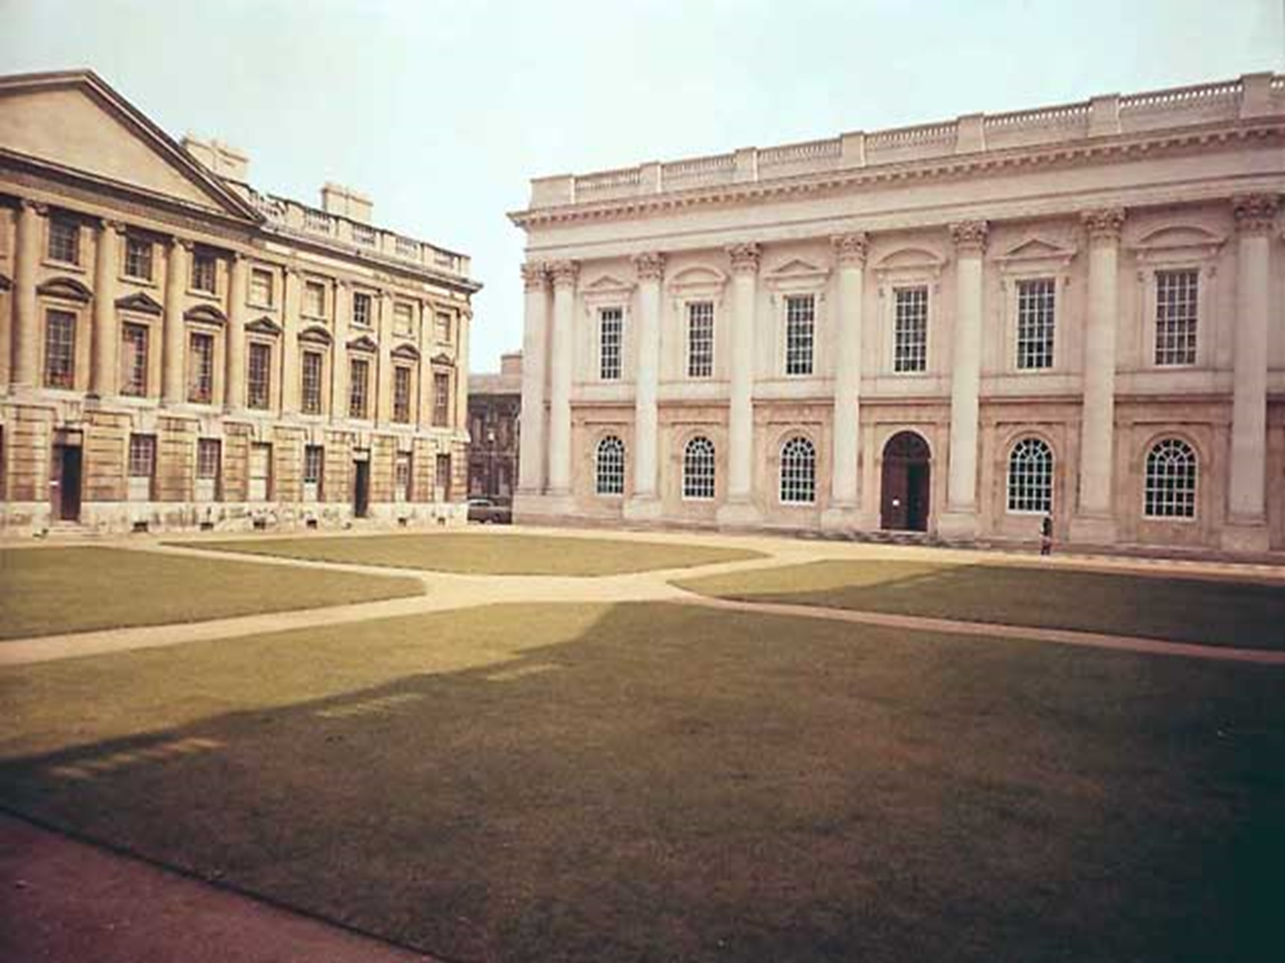
The complex of buildings

Slide 10
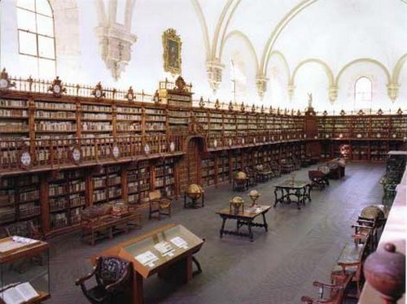
Library

Slide 11
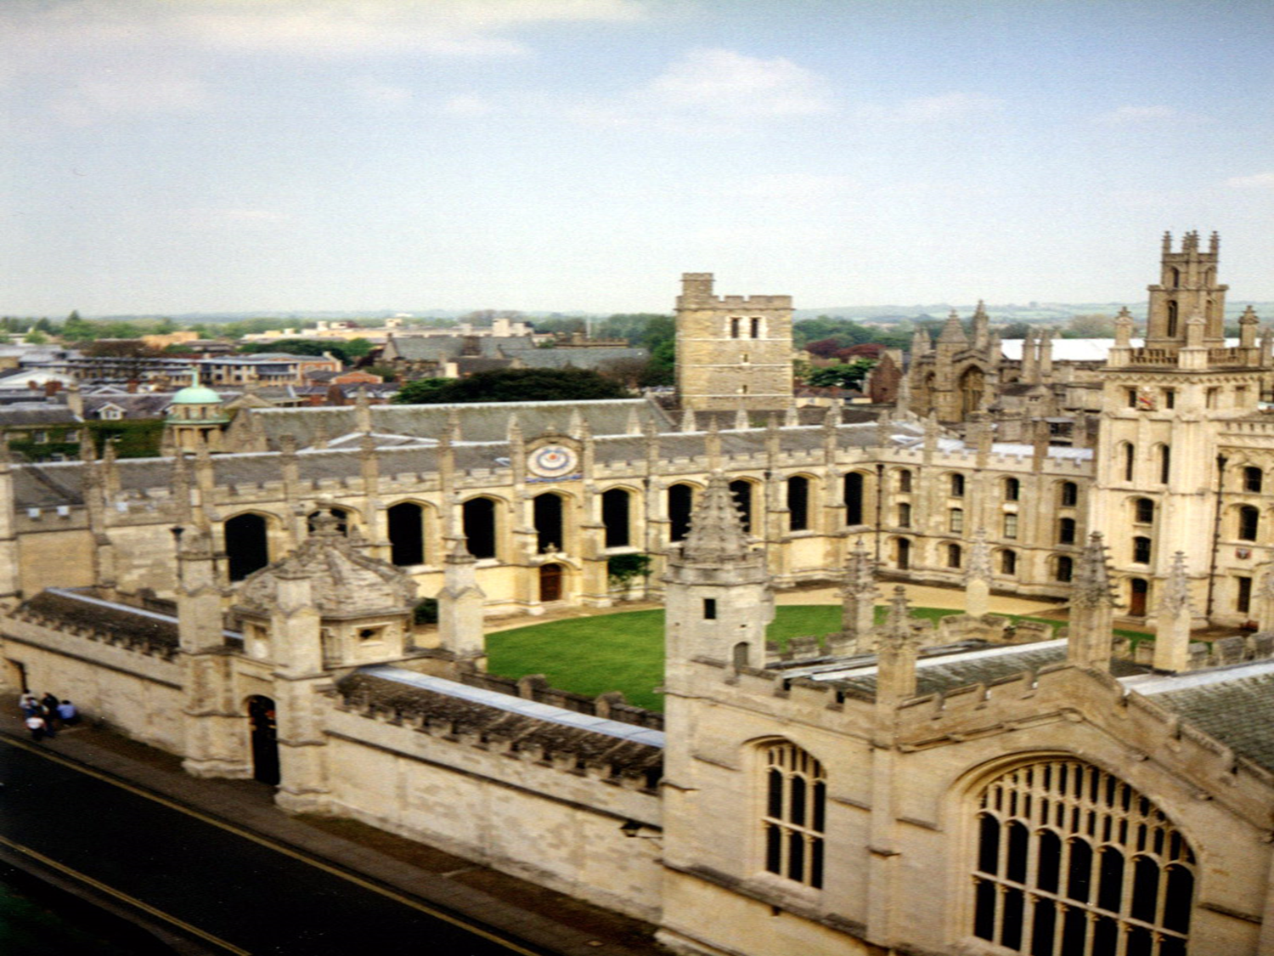
View of a college from above

Slide 12
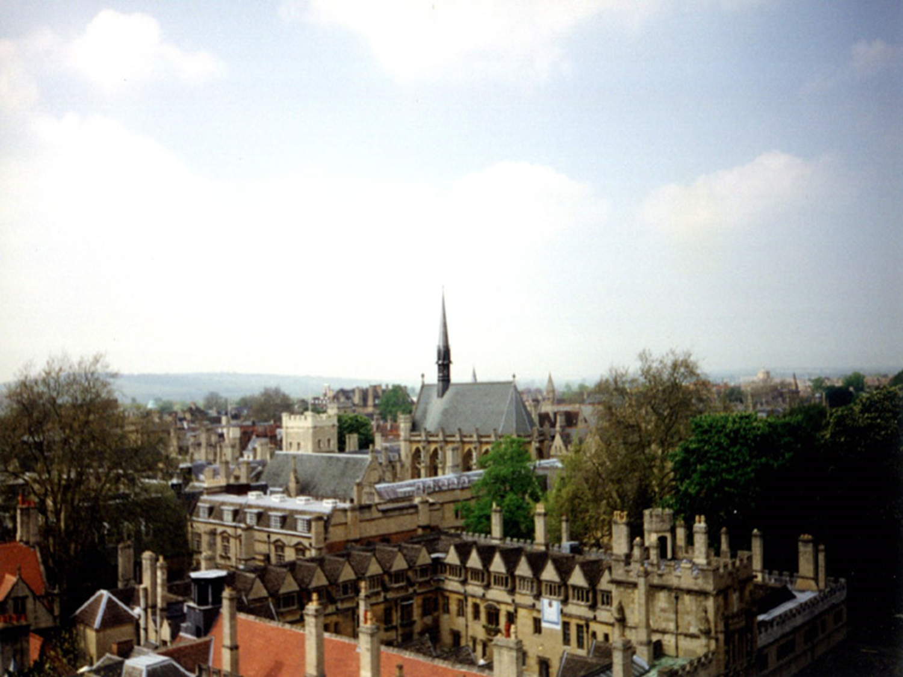
View of the city

Slide 13

Thank you for your attention!

