Slide 1
The most famous places of the USA
Grabenko Anastasiya and Grimashevich Diana

Slide 2
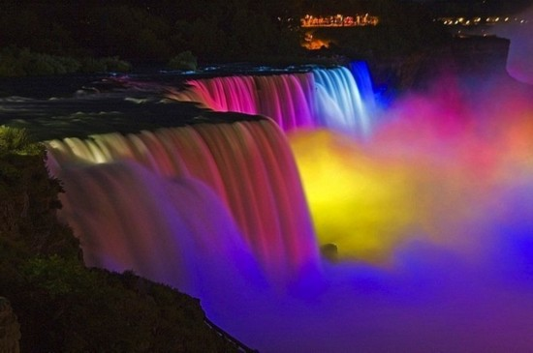
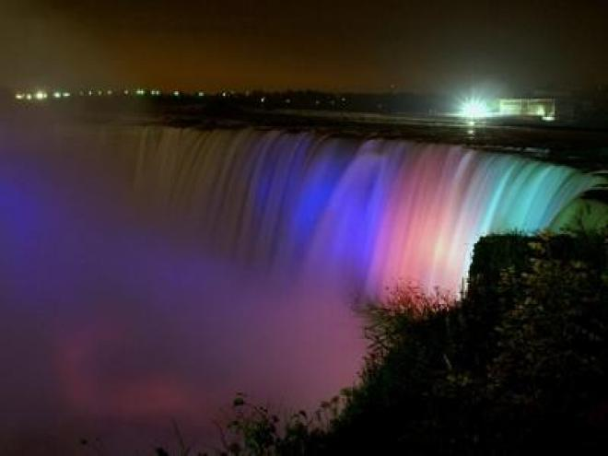
Niagara Falls
is the collective name for three waterfalls that straddle the international border between Canada and the USA ; more specifically, between the province of Ontario and the state of New York. They form the southern end of the Niagara Gorge.

Slide 3
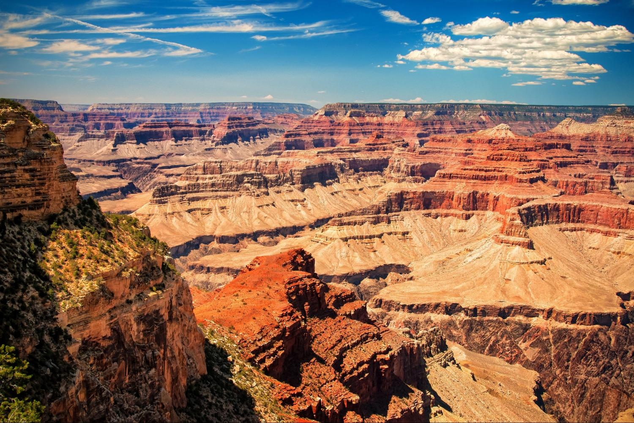
The Grand Canyon
is a steep-sided canyon carved by the Colorado River in the state of Arizona in the United States.The Grand Canyon is 277 miles (446 km) long, up to 18 miles (29 km) wide and attains a depth of over a mile (6,000 feet or 1,800 meters).

Slide 4
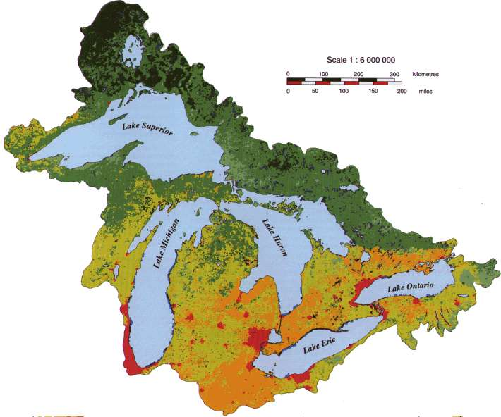
The Great Lakes
Consist of Lakes Superior, Michigan, Huron (or Michigan–Huron), Erie, and Ontario, they form the largest group of freshwater lakes on Earth, containing 21% of the world's surface fresh water by volume.

Slide 5
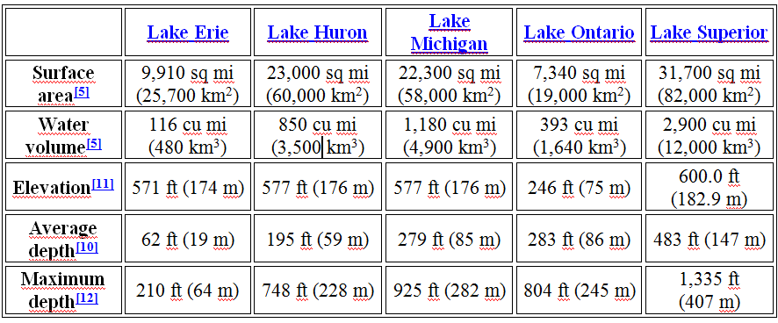
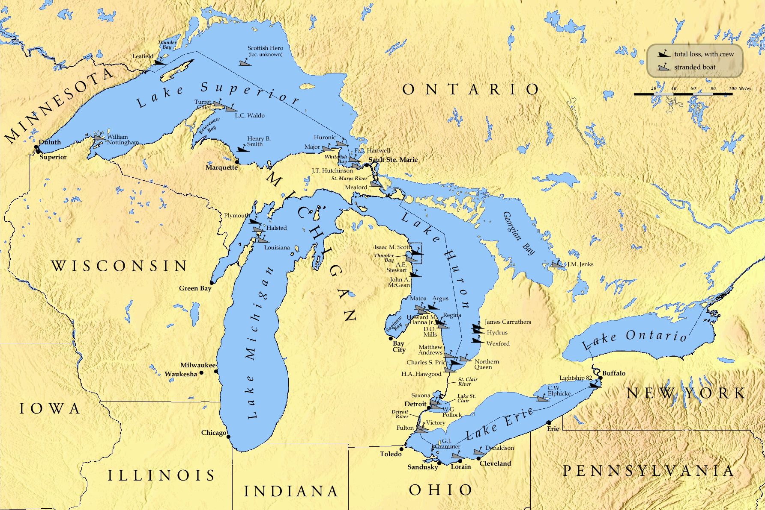

Slide 6
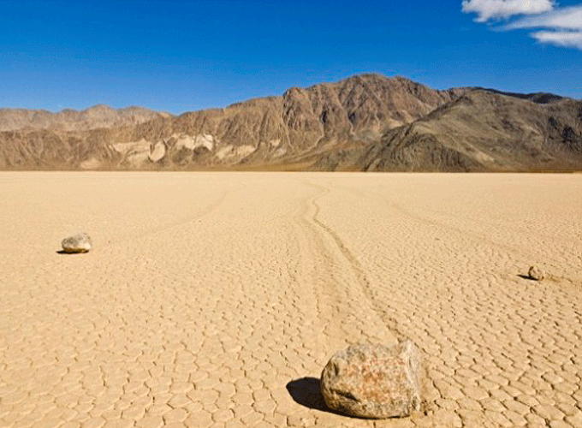
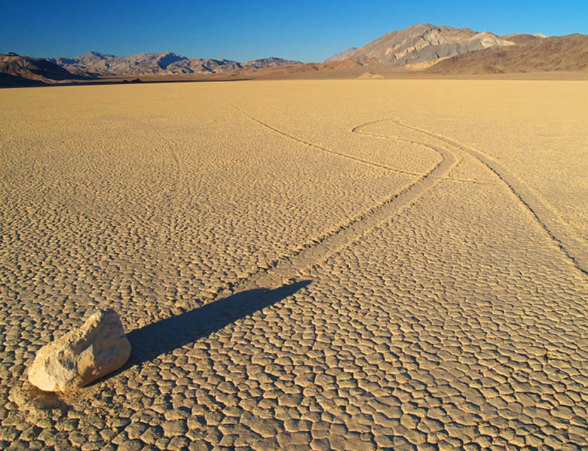
Death Valley
is a desert valley located in Eastern California's Mojave Desert, the lowest, driest, and hottest area in North America.

Slide 7
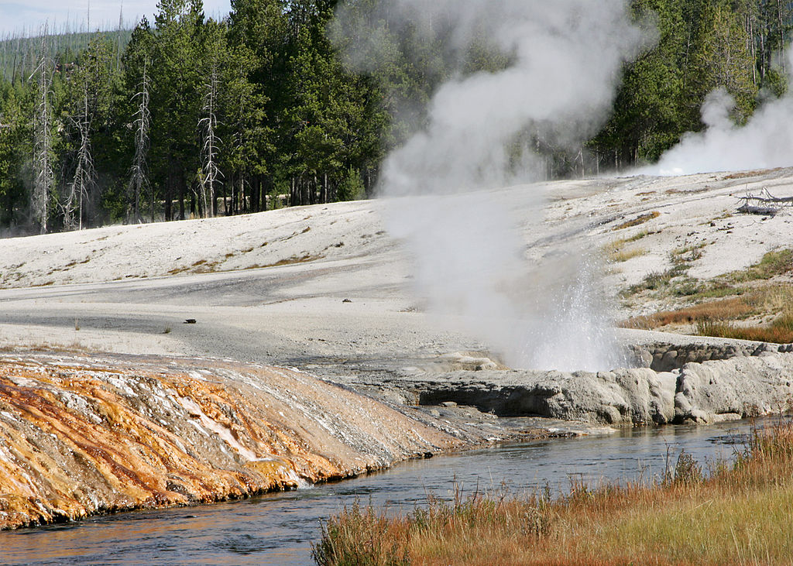
Yellowstone National Park
is a national park located primarily in the U.S. state of Wyoming, although it also extends into Montana and Idaho.

Slide 8
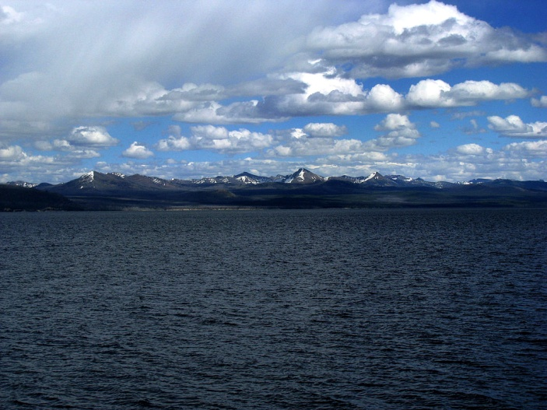
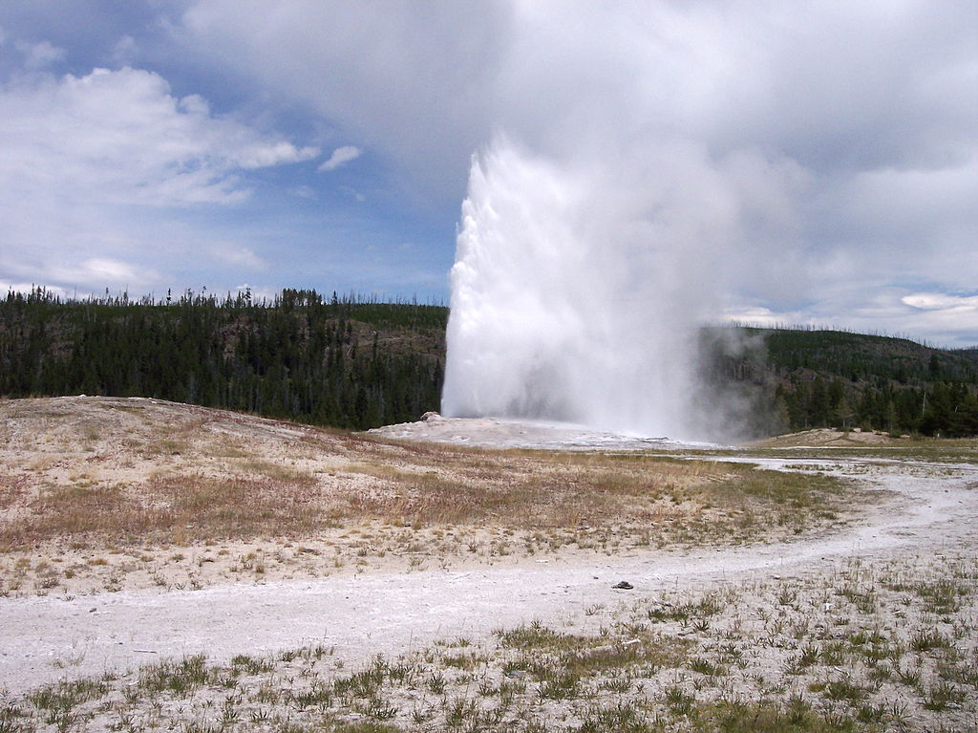
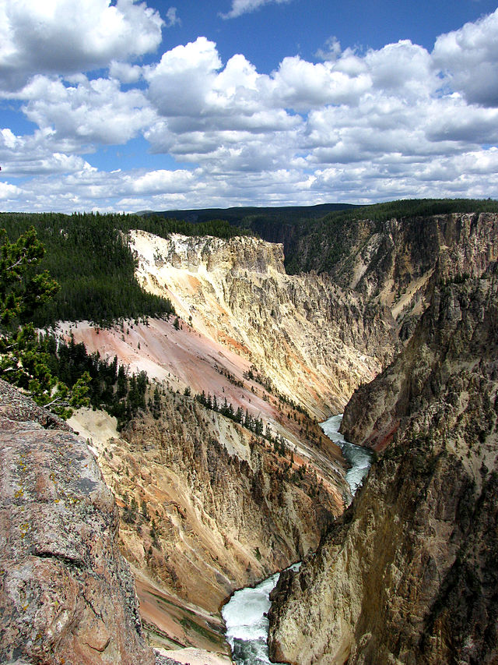
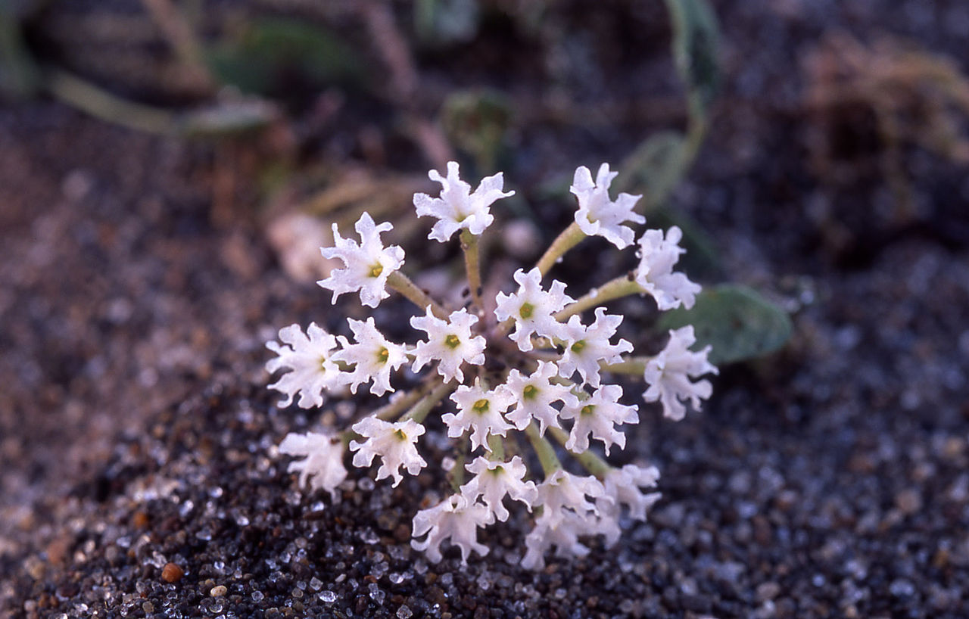
Yellowstone Lake
Old Faithful Geyser erupts approximately every 91 minutes.
Yellowstone sand verbena are endemic to the Yellowstone's lakeshores.
Grand Canyon of Yellowstone

Slide 9
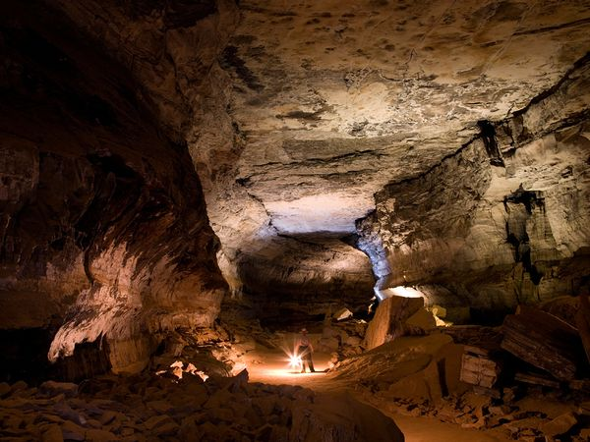
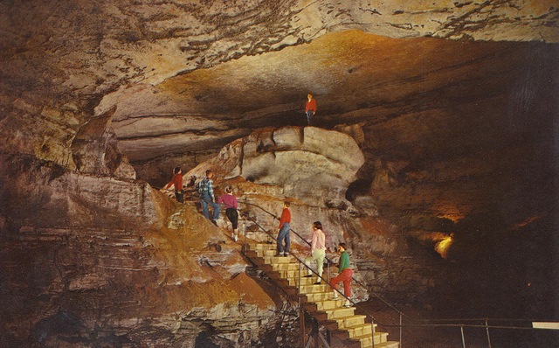
Mammoth Cave National Park
is a U.S. National Park in central Kentucky, encompassing portions of Mammoth Cave, the longest cave system known in the world.

Slide 10
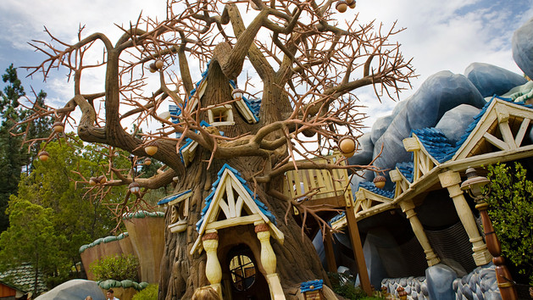
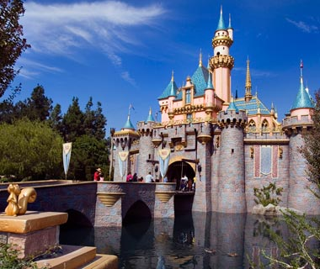

Disneyland, Anaheim, CA
To all who come to this happy place: Welcome. Disneyland is your land. Here age relives fond memories of the past, and here youth may savor the challenge and promise of the future. Disneyland is dedicated to the ideals, the dreams, and the hard facts that have created America, with the hope that it will be a source of joy and inspiration to all the world, - Walter E. Disney, July 17, 1955

Slide 11


