Slide 1

French cuisine

Slide 2
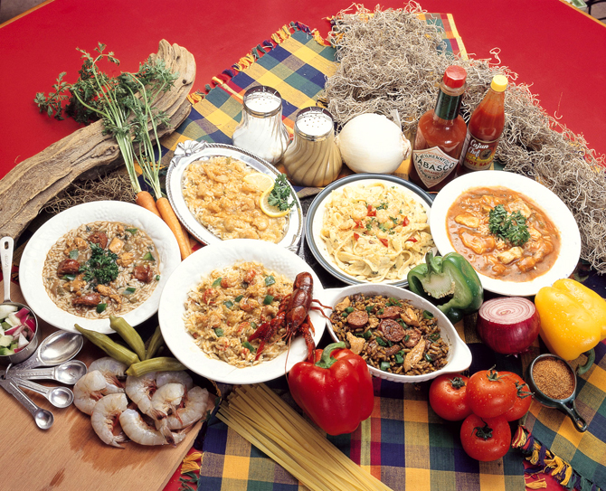
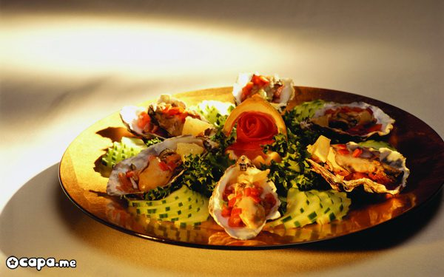
Everyone know that French are gourmands. In France, people's interest in good food is considered perfectly natural and necessary, perhaps even ahead of interest in love.
Despite regional differences , a characteristic feature of the national French cuisine is the abundance of vegetables and root crops . Potatoes, green beans, different varieties of onions, spinach , cabbage different varieties, tomatoes, eggplant , celery, parsley , salads used to prepare appetizers, first and second courses , as well as a garnish .

Slide 3
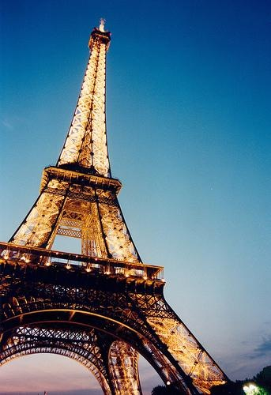
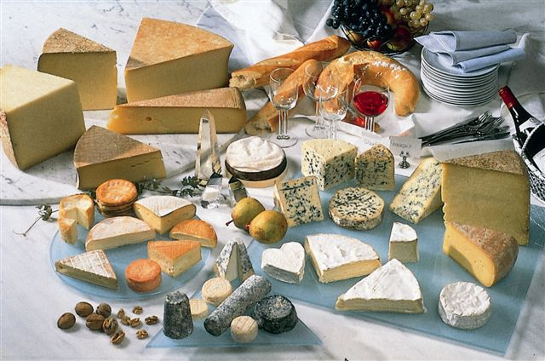
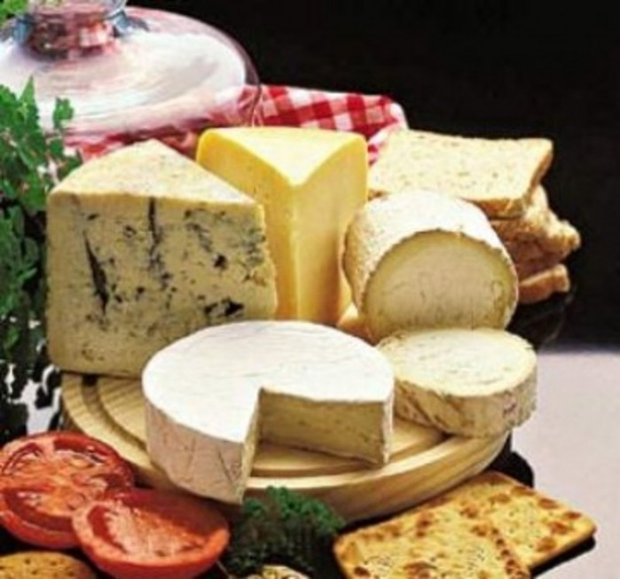
Compared with other European countries, French cooking uses less milk products. Exceptions are cheeses, famous throughout the world . Dish with cheese and lettuce necessarily served before dessert. France produces no less than 500 varieties of cheese . Maybe more, because almost every French village know their unique recipe for cheese making . Among them are such well-known , like Roquefort , Gruyere , Camembert , etc.

Slide 4
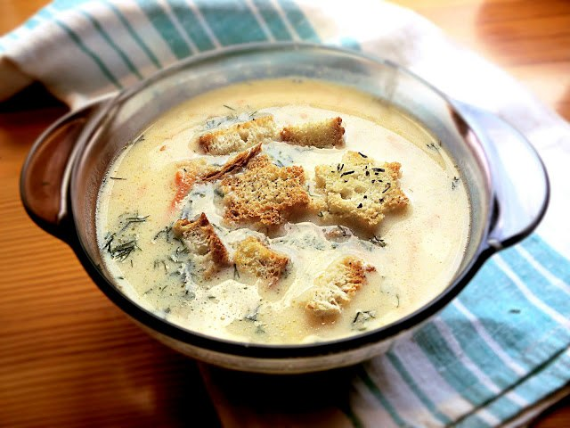
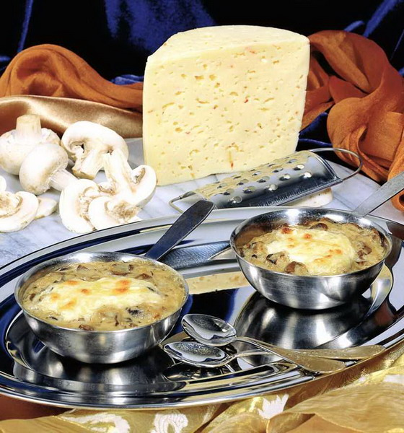
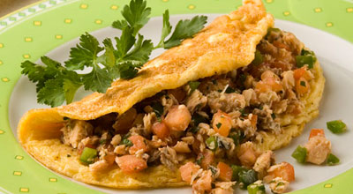
Characteristic of the French cuisine is availability of omelets and cheese soufflé, which is prepared with various condiments and toppings : ham, mushrooms and greens.

Slide 5
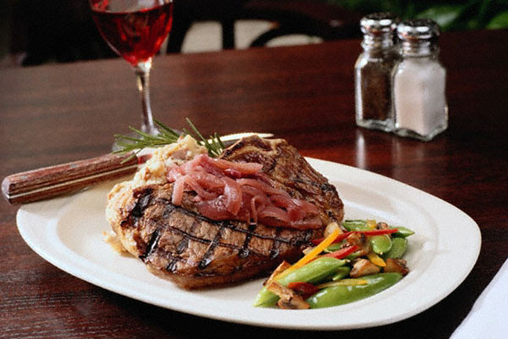
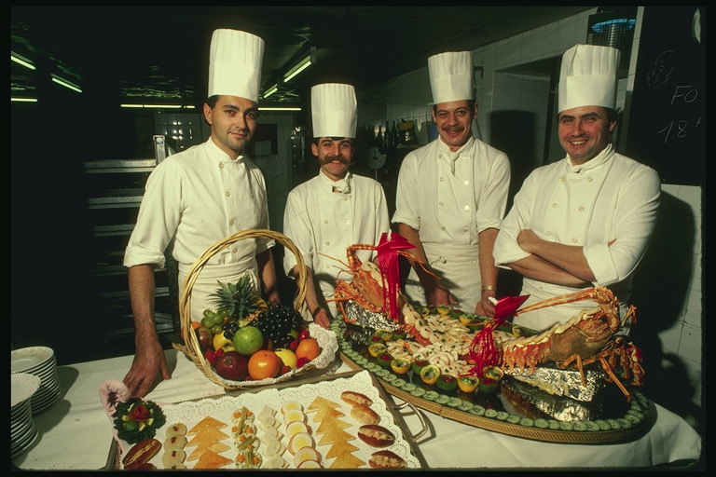
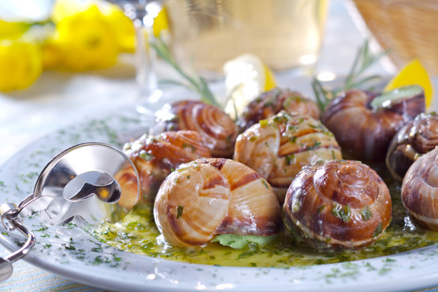
French chefs use all kinds of meats : veal, beef, lamb, poultry , game . Very popular dishes from marine and freshwater fish: cod , halibut , pike, carp , as well as seafood such as oysters , shrimp, lobster , scallops .
French is considered the inventor of sauces in their cooking and inventing new recipes you will not find them equal in the world.

Slide 6
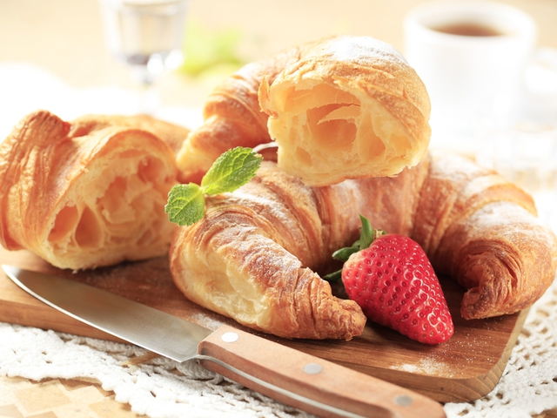
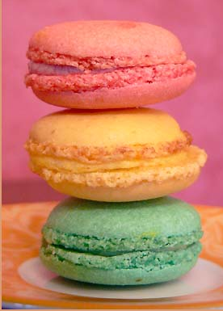
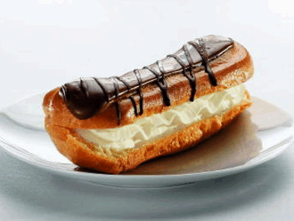
You can not conceal the posh desserts, in which the French certainly know a lot about . This tart cherry Clafoutis , delicious tarte tatin - open cakes with fruit and of course the famous creme brulee - baked with cream caramel crust - the king and ruler of all desserts.
As for me french desserts are the best in the world and I want to go to France for taste everything.

Slide 7


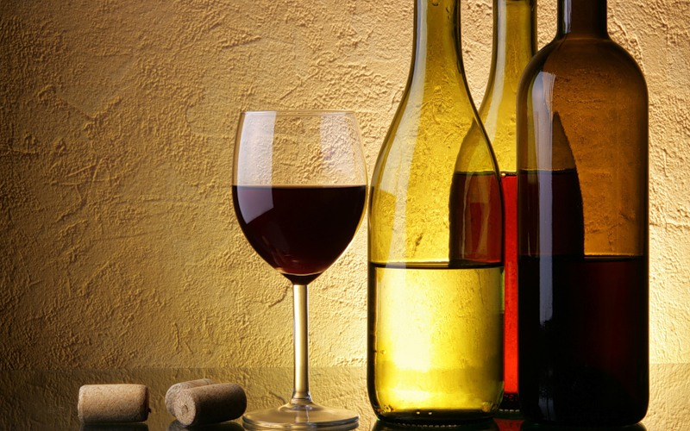
Drinks from the French prefer soki fruit and mineral water. Extremely popular coffee. Everyone thinks that the French can not live a day without a glass of wine. This is true

Slide 8

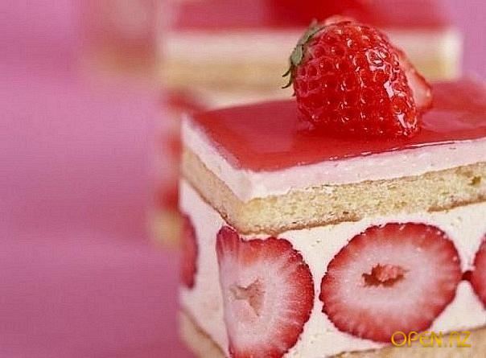
Go to France with me because their cuisine is delicious!!!

