Slide 2
the increase in world temperatures due to the
greenhouse effect.

Slide 3
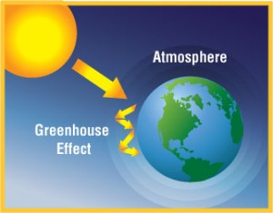
The greenhouse effect
The phenomenon by which the earth’s atmosphere traps some of the sun’s heat as it radiated from the earth’s surface

Slide 4
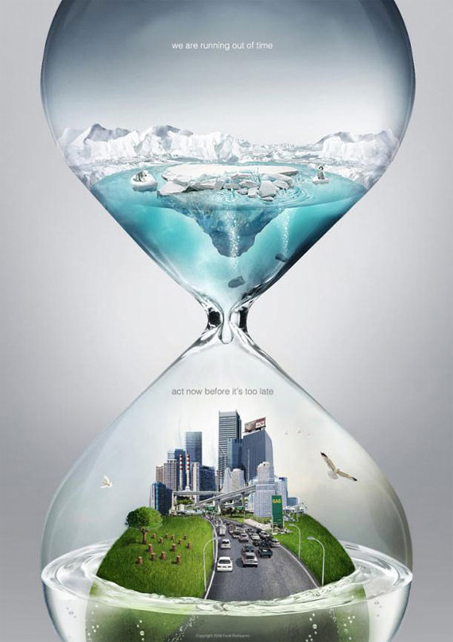
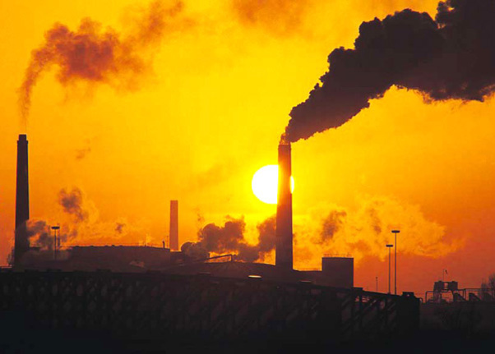
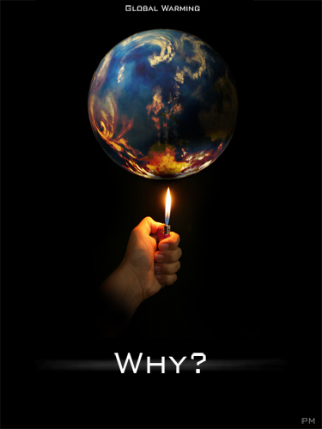
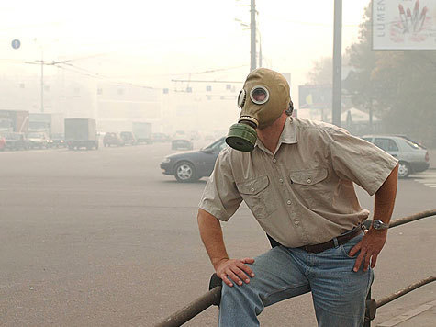
The greenhouse effect, fumes from chimneys, industrial wastes, and air pollution are the cause of global warming. As the Earth gets hotter, the ice caps and glaciers may melt and sea level may rise.

Slide 5
If people of the world don’t unite their efforts against global warming we are all sunk. If people of the world don’t unite their efforts against global warming we are all sunk.

Slide 6
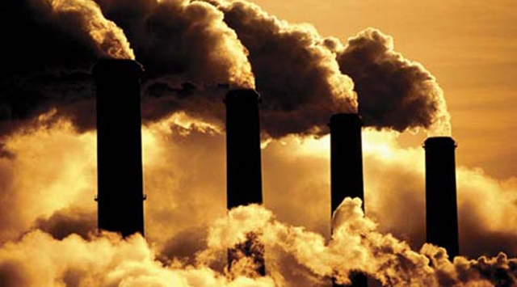
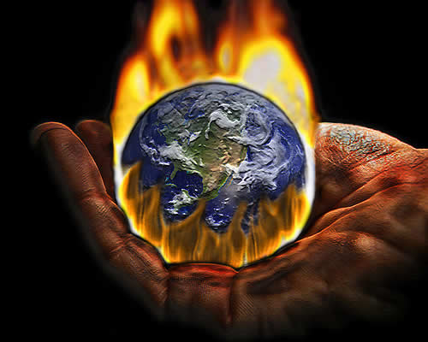
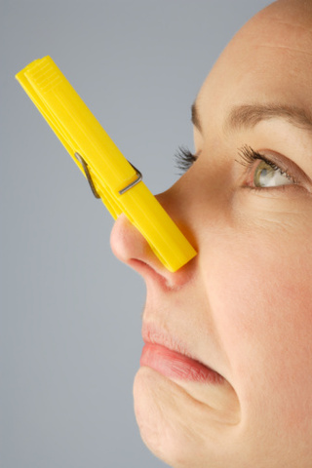
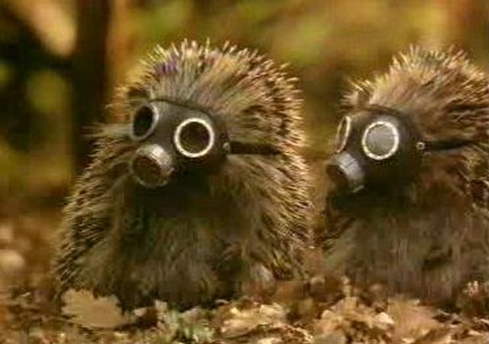
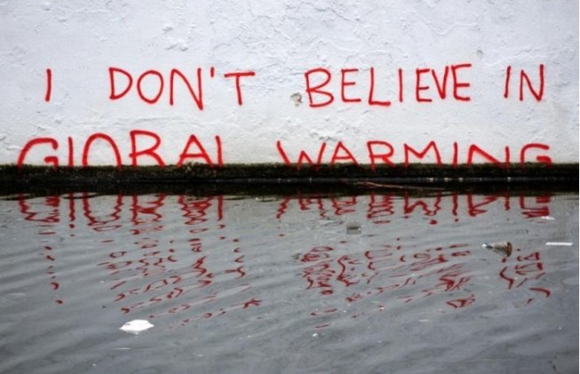
First of all plants and factories must lessen pollution, purifying air. We must lessen exhaust fumes from
public and personal transport.

Slide 7
We must protect nature and ourselves from global warming.

Slide 8
Thank you very much

