Slide 1
Save Our Planet
Presentation was prepared
by Valeria Fefelova

Slide 3
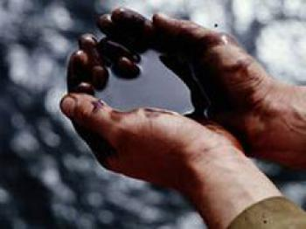
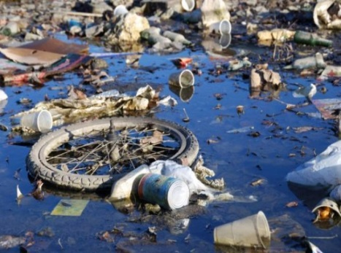
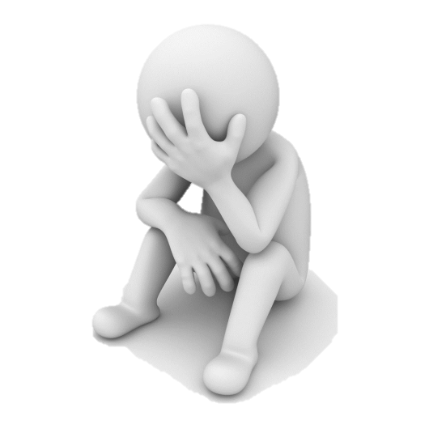
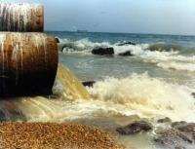
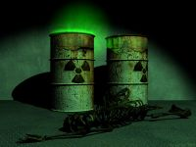
The main problem of mankind today is polluted environment in which we live.

Slide 4
Air Pollution
The main sources of air Pollution are factories and transportation.
Air polluted is a threat to all life. It covers large areas and easily comes in various countries

Slide 5
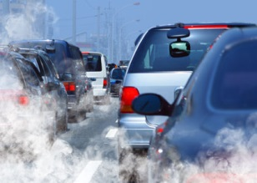
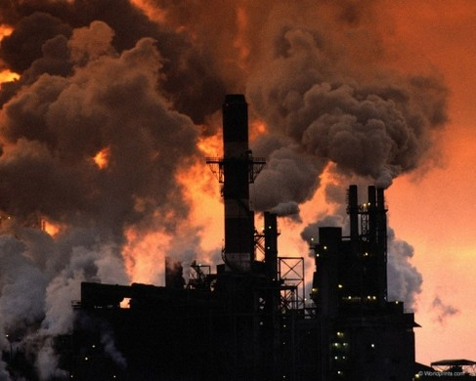
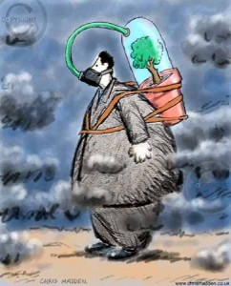
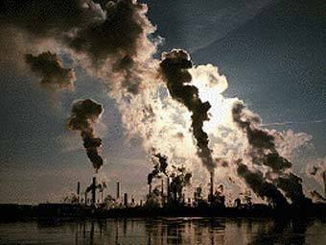
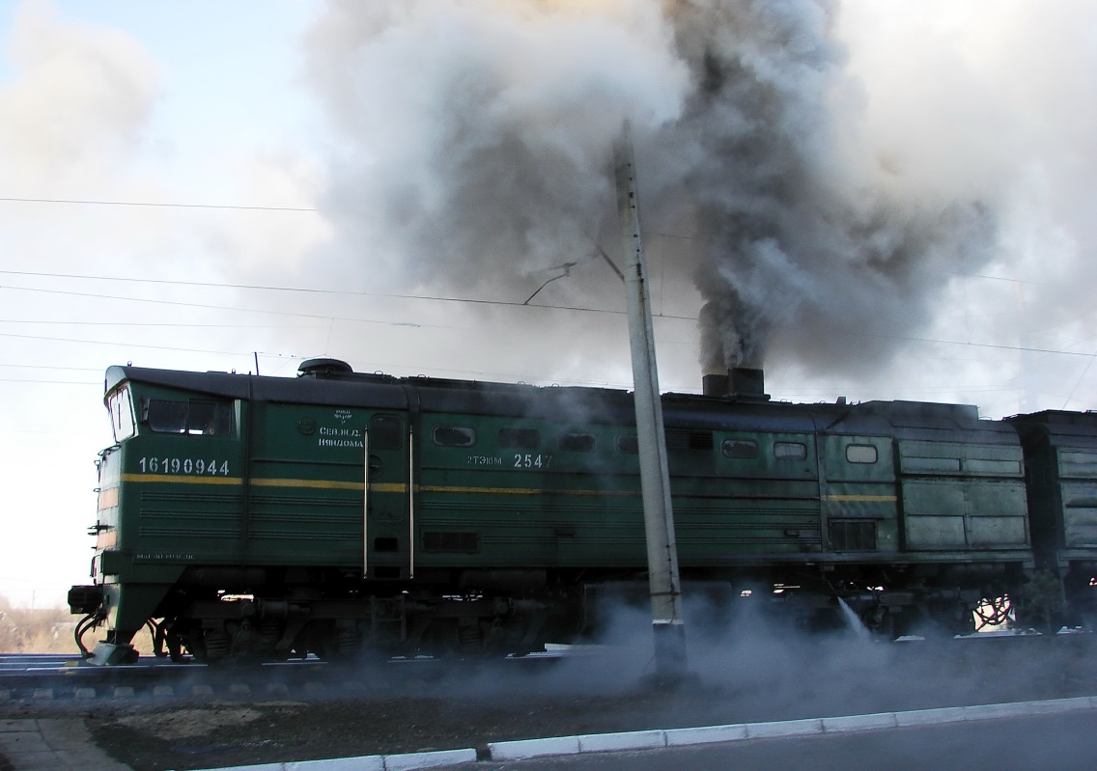

Slide 6
The consequences of air pollution have become problems such as global warming, acid rain and the formation of ozone holes.
To prevent pollution and environmental problems need to install treatment plants in industrial plants that would reduce emissions of chemicals.

Slide 7
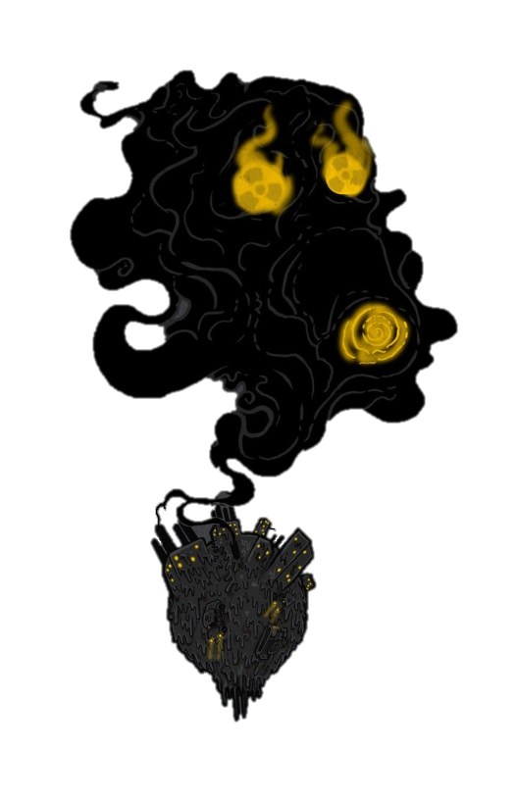
Do not allow this

Slide 8
Water Pollution
The main sources of water pollution are industrial enterprises which dumped in rivers and reservoirs of untreated sewage.
And also domestic waste and radioactive substances. Polluted water is unusable for drinking, bathing and watering plants

Slide 9
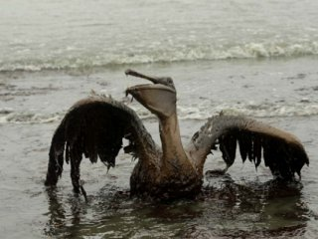
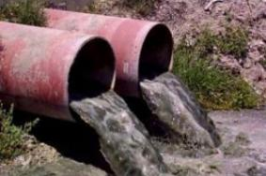
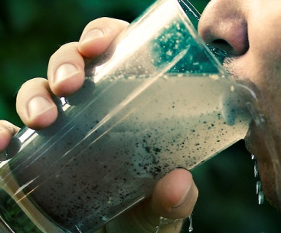
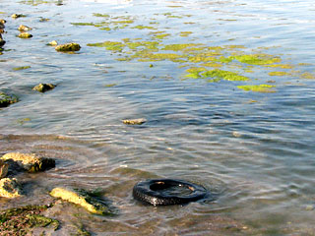
Polluted water of the river carry in the seas and oceans. Which and so oil pollution from accidents pipelines and tankers that transported it

Slide 11
The main measures struggle against water pollution are sewage treatment entering the reservoir. Of great importance is the introduction of modern drainless of technologies in industrial production.

Slide 12
Soil Pollution
Soil Pollution is the result of of economic activities in the past and now.
Most often the soil is polluted metals and organic materials, oils, tar, pesticides, explosives and toxic substances, radioactive and other harmful products.

Slide 13
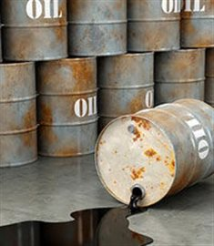
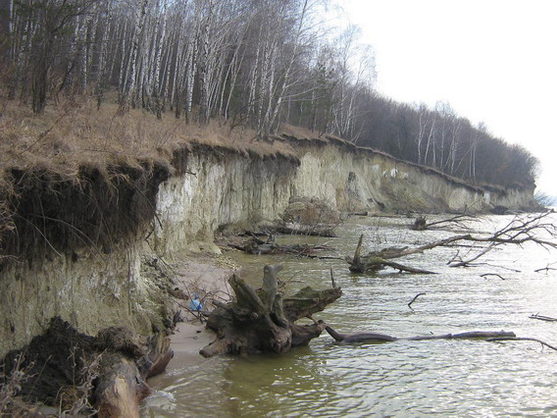
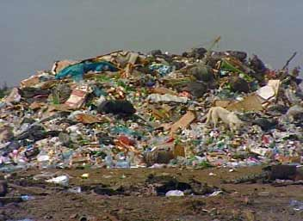
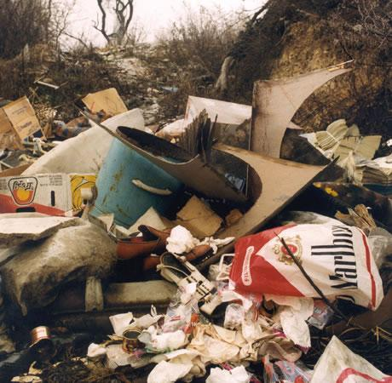
The source is industrial or household waste disposal in certain places, or unauthorized landfills

Slide 14
Protect nature
To you live here!

