Slide 1
Modern Technologys

Slide 2

What is technology?
set of methods, tools
ability to live easier
Empowerment
occasion to express themselves

Slide 3
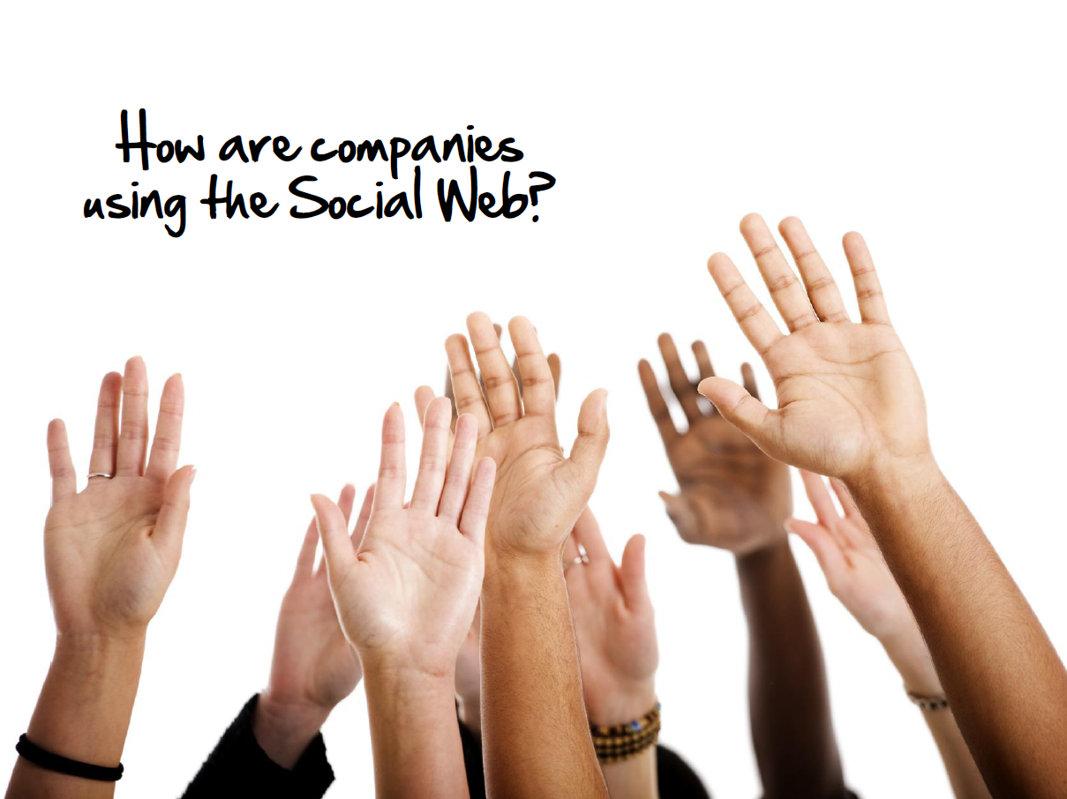
How many of you are using the Social Web?

Slide 4
What is Web 2.0?
LinkedIn
Facebook
Twitter
Vkontakte
Mail.ru

Slide 5

Social Media and Employee Engagement
Blogs and corporate social media pages are most effective
Excellent form of communication in some cases BETTER than email
Create more active employee participation and greater satisfaction
Current employees can be our best marketing/advertising tool.

Slide 6

Benefits of Recruiting Through Social Media
Attracts passive and other top quality candidates.
Builds a more personal relationship.
Improves corporate branding.
Improves the candidate experience.
Human contact element.
Increases traffic to the corporate website.
Reduces recruiting costs.

Slide 7
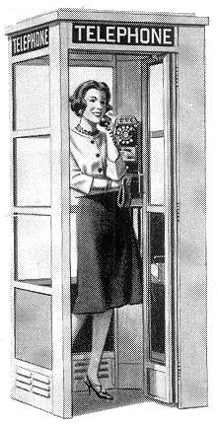
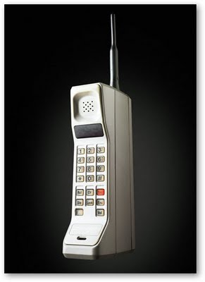
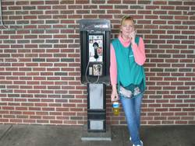

Do you Remember?

Slide 8
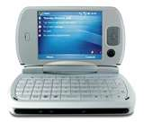
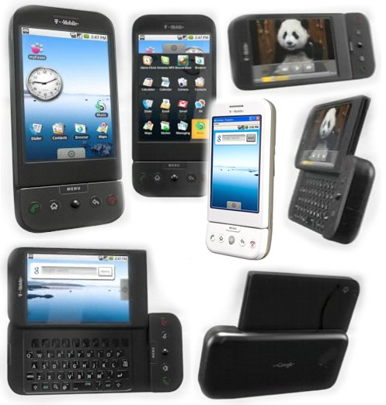
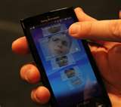
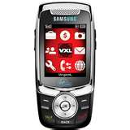
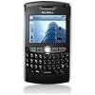
Mobile is not just a phone.
There’re text, email, video and web technology.

Slide 9
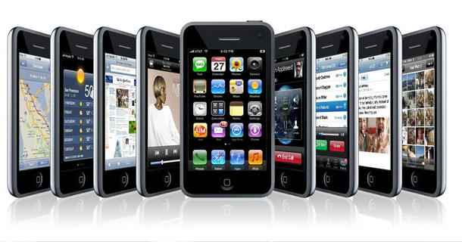
Why mobile?
Freedom
Anywhere / anytime access
Mobile web is on nearly everything.
Mobile phone usage outnumbers PC usage
Mobile access greater than PC access

Slide 10
Mobile Recruiting
Voice
Text - SMS
Web – corporate career site / blogs
Search – Autosearch / Profiler/ Indeed
Social networking – LinkedIn, Facebook, Apps!
Proximity marketing
Mobile email
Video / audio

Slide 11
Mobile Device Lineup
Smart phones…Laptops…Netbooks…Tablets / iPads
Recruiting apps
Construction apps
QA / QC
Safety apps
Various field apps

Slide 12

Social Media / Mobile Technology
The future is now.
The future is mobile.

