Slide 1

Christmas in Ukraine, England and USA

Slide 2
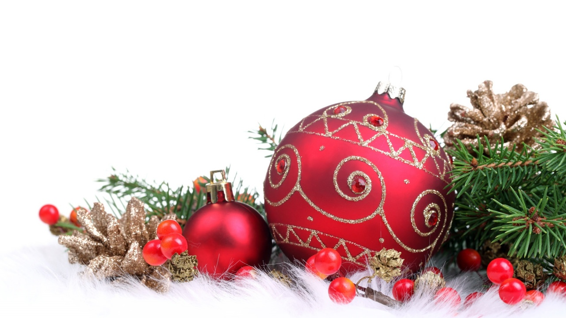
Christmas in England
In England, everything leads up to the 25th December because this is Christmas Day… the day everyone is waiting for.
Most people start decorating their homes in December, with lights, garlands and a Christmas tree. Some people get really excited and start preparing for Christmas in November!

Slide 3
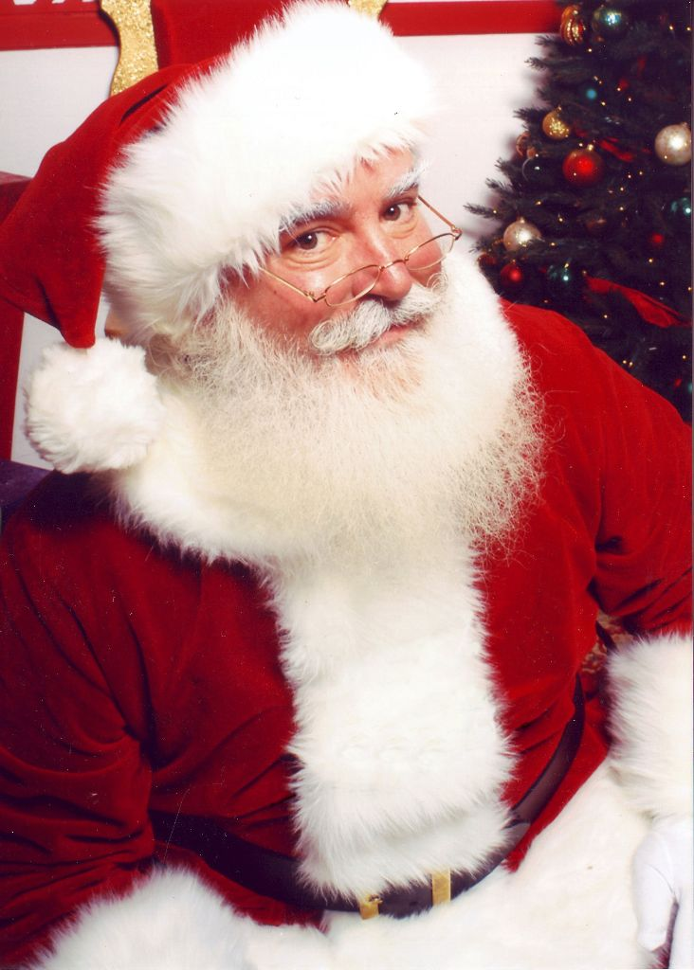
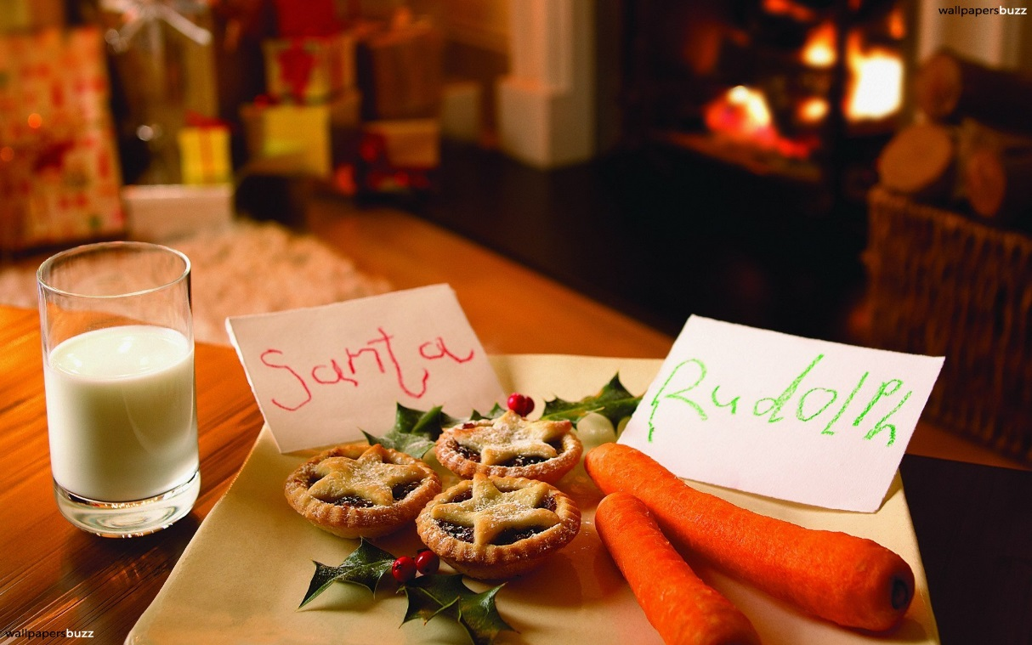
Father Christmas, or Santa Claus, comes on Christmas Eve and brings presents to all the children who have been good during the year.
He fills their Christmas stockings, and sometimes leaves presents under the tree too.
On Christmas Eve, lots of children leave something for Santa and his reindeer to snack on…
Mince pies and sherry for Santa. Carrots for the reindeer!

Slide 4
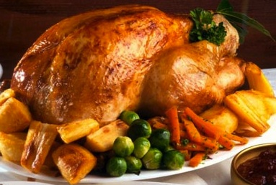
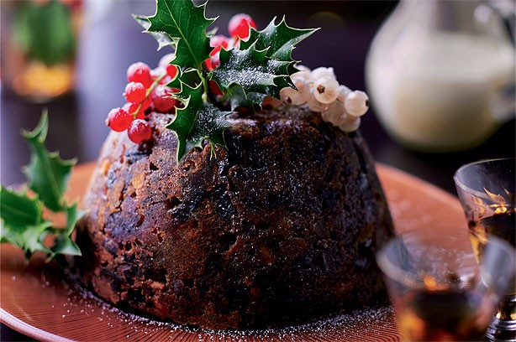
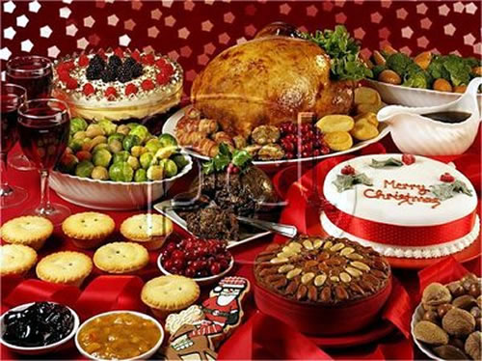
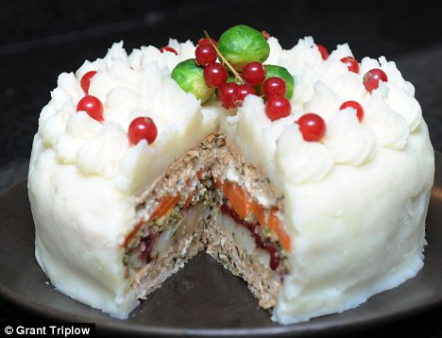
Christmas Dinner
The typical dinner consists of turkey with potatoes and other vegetables such as carrots and sprouts. In Britain this is followed by Christmas pudding - a sweet pudding containing a lot of dried fruit and often covered with burning brandy. Other traditional dish in Britain is a Christmas cake – a cake containing a lot of dried fruit and usually having a covering of icing .

Slide 5

Christmas in USA
Christmas is the most important holiday in the U.S. It is celebrating on December 25. American love Christmas and all the traditional cooking related. People like to decorate homes. Outwardly, they put figures that glow at night. These figures depict winter scenes with snowman, reindeer or biblical heroes.

Slide 6
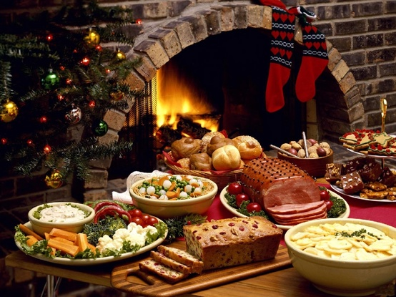
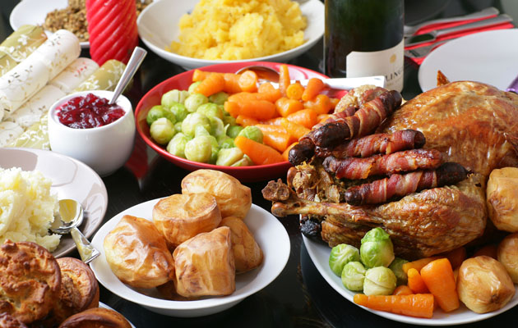
Christmas Eve
On Christmas Eve each family gathers at their parents house. Before sit down you should read a prayer. Then americans must eat the sacred bread. Then they drink red wine, eat sup with cabbage, homemade sausage with garlic and necessary fish. On the table also must be green peas and prunes. Stuffed turkey is the main dish of americans with scottish roots.

Slide 7
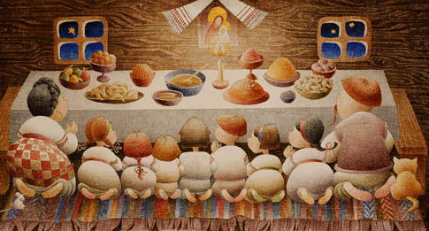
Christmas in Ukraine
Ukrainians selebrate Christmas in the 7th of January. Traditions of celebrating Christmas go back to the pre-Christian times and have many unique customs and rituals
The most important thing – it has always been a family holiday!

Slide 8
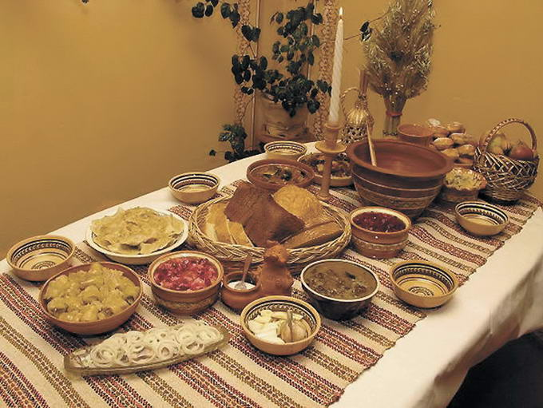
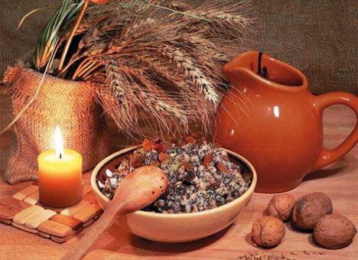
Holy Supper
Many families follow the old tradition to prepare 12 meatless dishes and to sit at the table when the first star appears in the sky.
The main dish of the Holy Supper is kutia. It is prepared of wheat and raisins, nuts, poppy seeds and fruit.

Slide 9
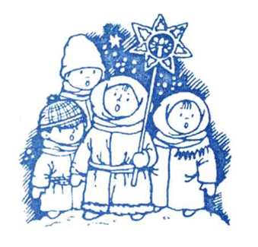
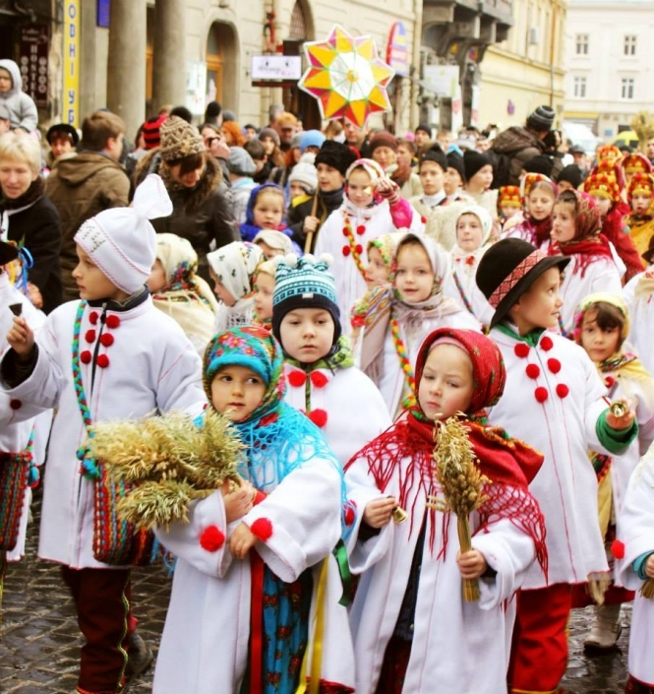
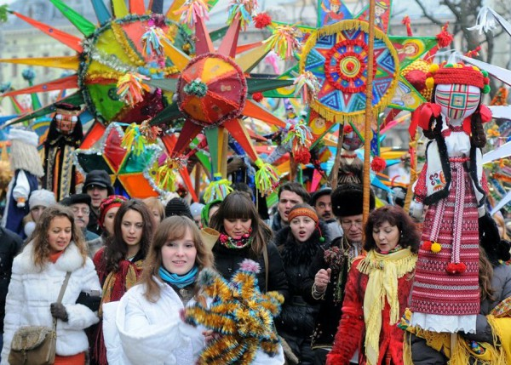
One of the most amazing traditions is singing Christmas carols. These are usually children who start caroling since early morning on the 6th of January
Children gather in groups and wear old clothes dramatizing the scenes from the Bible. These groups are called Vertep. Carols last till the 20th of January. They bring good mood and hope to every house…

