Slide 1


Taking a gap year in Ukraine
Designed by:Vitsinska Oksana and Melnyk Nastya

Slide 2
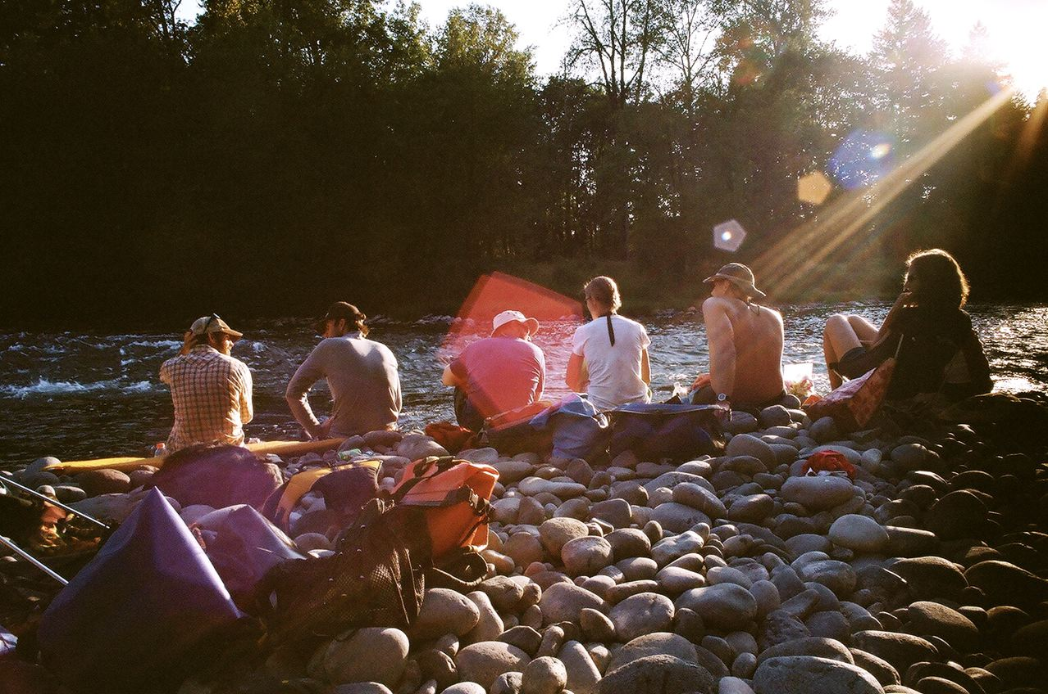
GAP YEAR- vacation, provided the student or senior secondary vocationals school for medical reasons and in other cases (disasters, family problems).

Slide 3
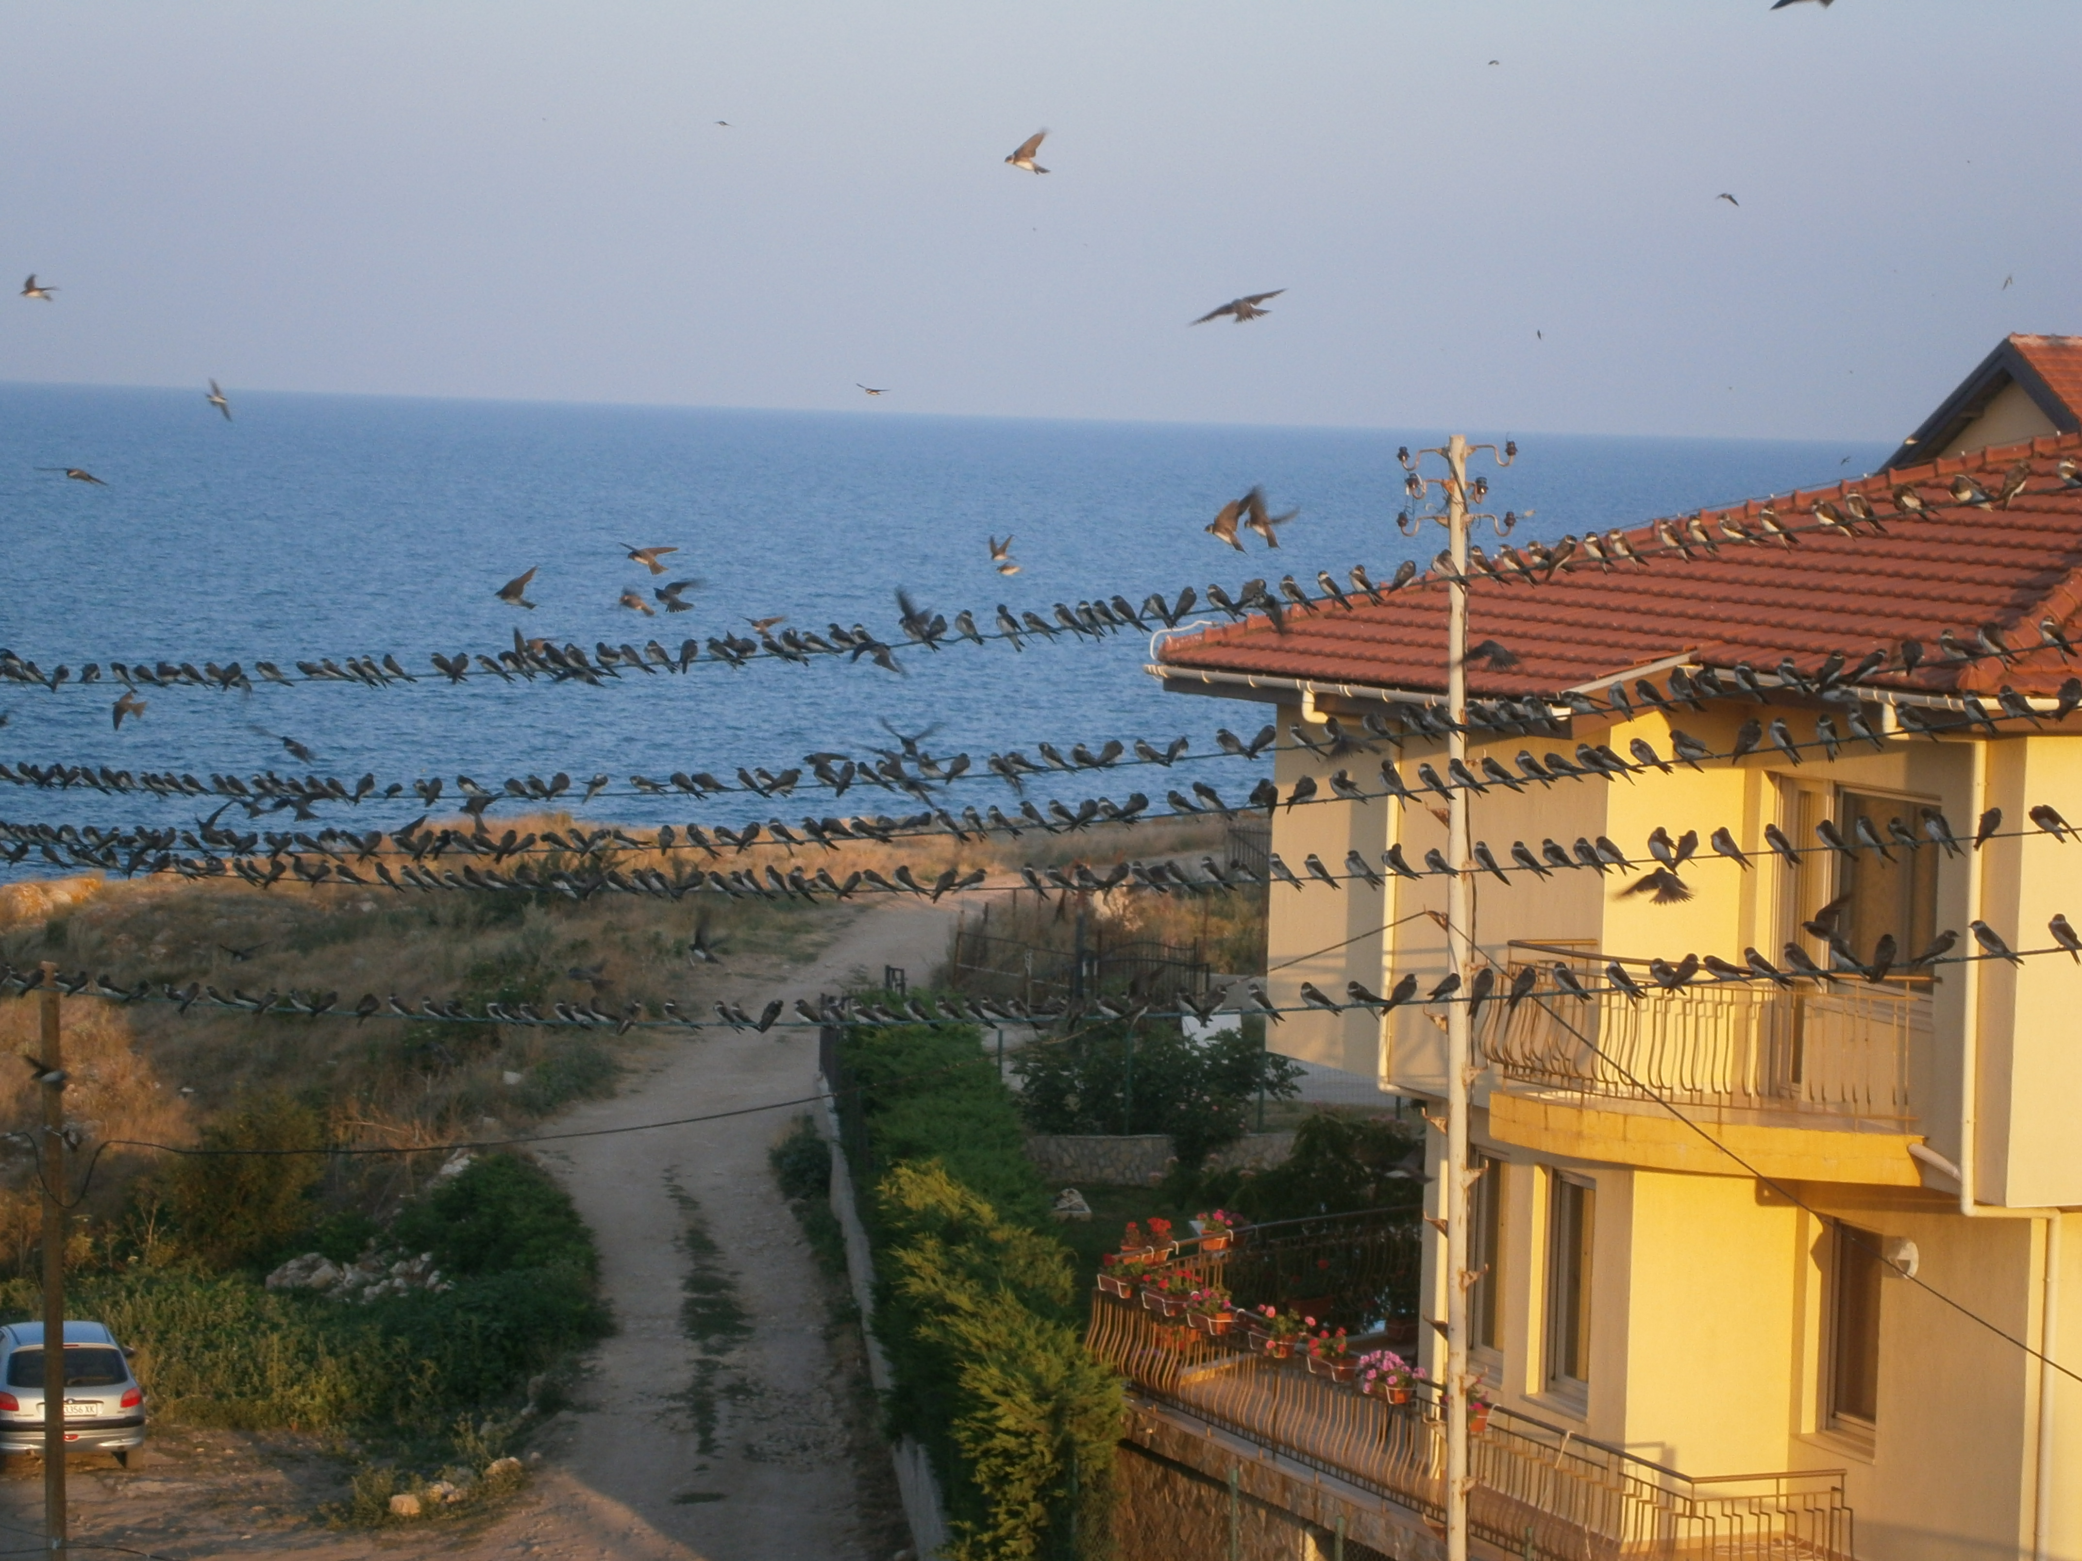
Taking a gap year will help improve your communication skills, your decision making and your ability to build relationships.
Taking a whole year out to do something amazing is anopportunity that most people will never have, so don’t take itlightly. Once you’re in a secure job with a mortgage and afamily you probably won’t be able to take a year out to dowhatever you want, so gap years are an ideal way to dosome traveling while you’re young and to ‘get it out of yoursystem’.

Slide 4

Here are 10 good reasons for you to go for a gap year.

Slide 5

1. Learn About the World
Although gap years don’t have to involve foreign travel, most gap year students seize the opportunity to travel abroad.
Young people are able to figure out who they are and what inspires them.
This firsthand experience of unfamiliar cultures offers profound lessons, especially for curious and motivated young people.
After all, engaged travel is one of the best forms of genuine education.

Slide 6

2. Learn About Yourself
For students who grew up in a structured environment with clearly defined social, athletic and academic goals, gap years offer valuable personal freedom.
Young people are able to figure out who they are and what inspires them. During the gap year, they begin to emerge as self-actualized adults.
3. Have Fun
You only live once. A gap year bursting with travel, adventure, exploration and self-discovery can be a life-changing and intensely memorable experience.

Slide 7
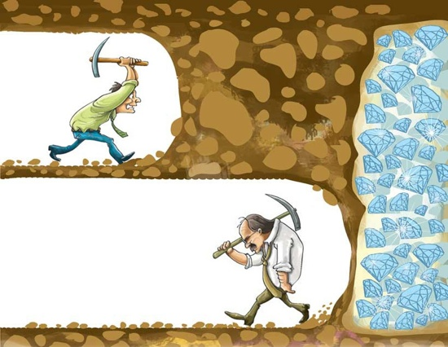
4. Overcome Challenges
Make no mistake – a gap year isn’t time to slack off or take a vacation.
Gap year students usually work, volunteer or undertake self-directed service projects.
For many students, especially those from sheltered backgrounds, the gap year is a time to learn how to get along in the real world. This process isn’t always easy, but it is an essential part of growing up.

Slide 8


5. Save Money
There’s a common perception that gap years are only for wealthy students.
However, taking a gap year can actually save you money in the long run. Gap year students often work part-time as they travel, or volunteer for organizations that cover their expenses.
At the other end of the spectrum, structured gap year programs often offer college credit and cost less than college tuition.
The kicker is that by taking a gap year, students are much more likely to know what they want to study in college. Clear academic and career goals keep students from aimlessly drifting through 4 years of college and 3 years of graduate school at upwards of $40,000 per year.

Slide 9

6. Learn A Foreign Language
Proficiency in a foreign language is an invaluable skill for young people in today’s interconnected world.
Living, working and traveling overseas is the best way to learn a foreign language, which means that gap year students who supplement their high-school Spanish with travel in Bolivia have a serious advantage over their peers.

Slide 10

Disadvantiges:
Time/year behind
Distraction
Cost/debts
Loss of momentum

Slide 11


