Slide 1

School
Design school ...

Slide 2
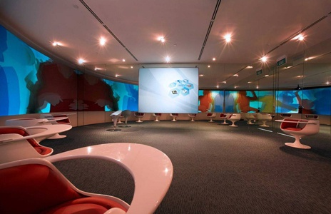
As you are such a class for us?)

Slide 3
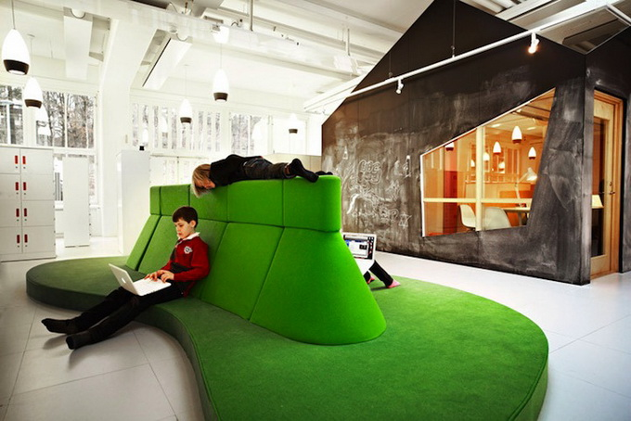
At the break to gain strength for the next lesson ... need all again, how is your lounge?
Personally, I like)

Slide 4
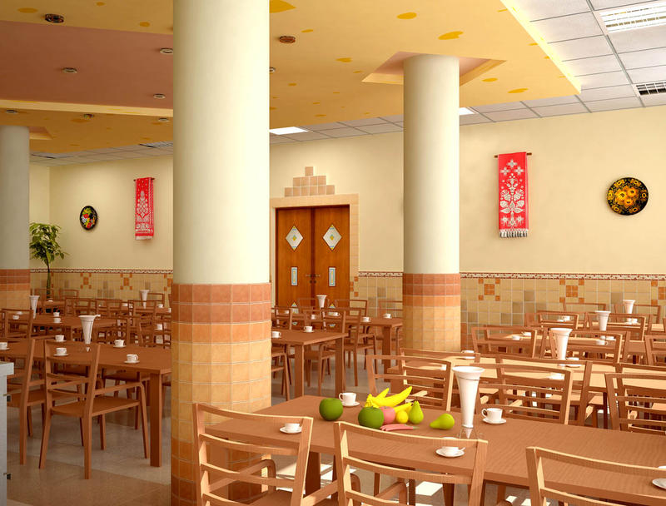
Here you can eat ...!

Slide 5
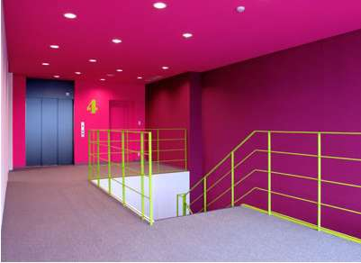
Elegant hallway ..)

Slide 6
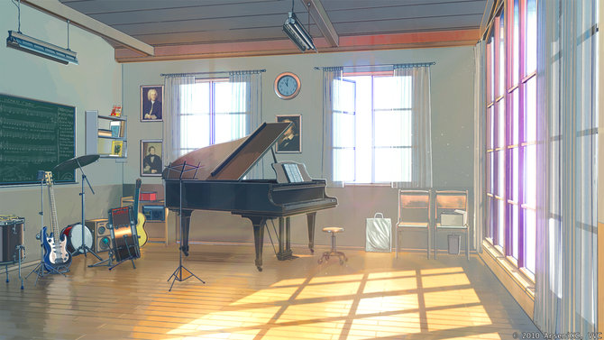
I want to at school was a music class! While in school, you can create bands After all, many have different talents!

Slide 7
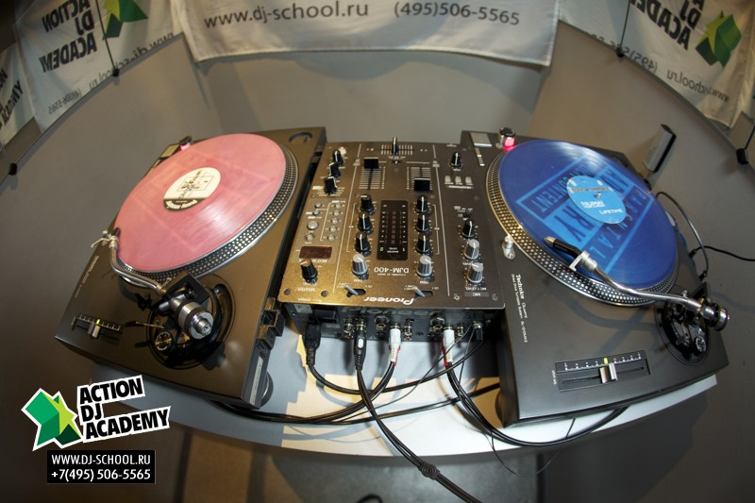
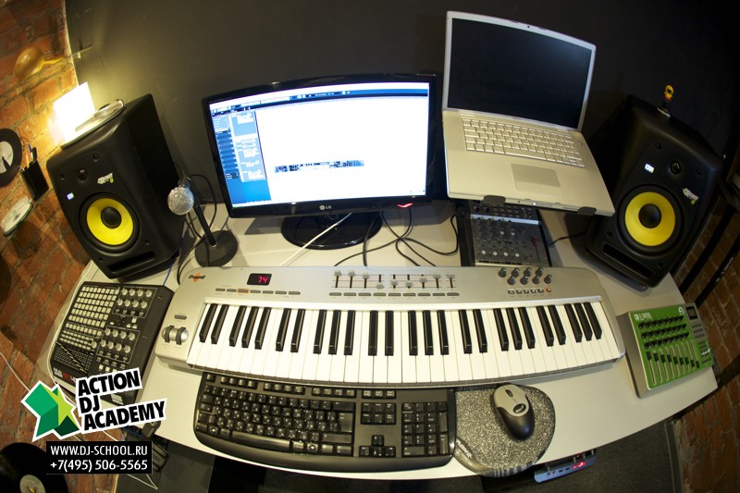
I love music ... music class is a good idea)

Slide 8
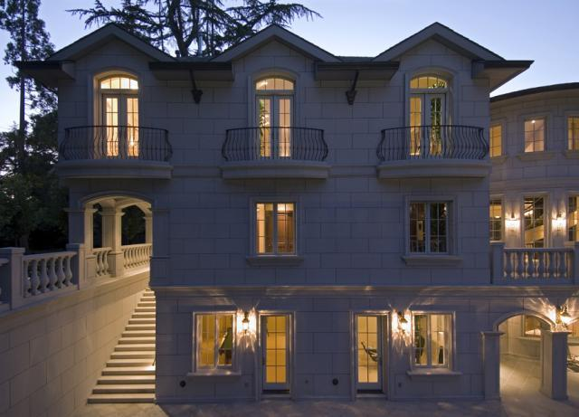
Junior corps will look like)

Slide 9
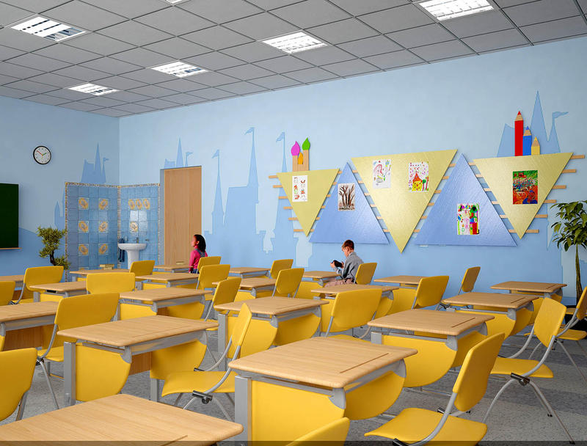
Smaller enjoy ...

Slide 10
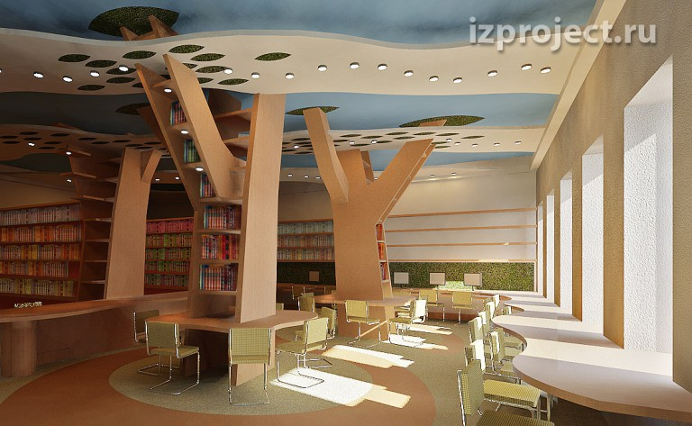
Dream Librarian ...

Slide 11
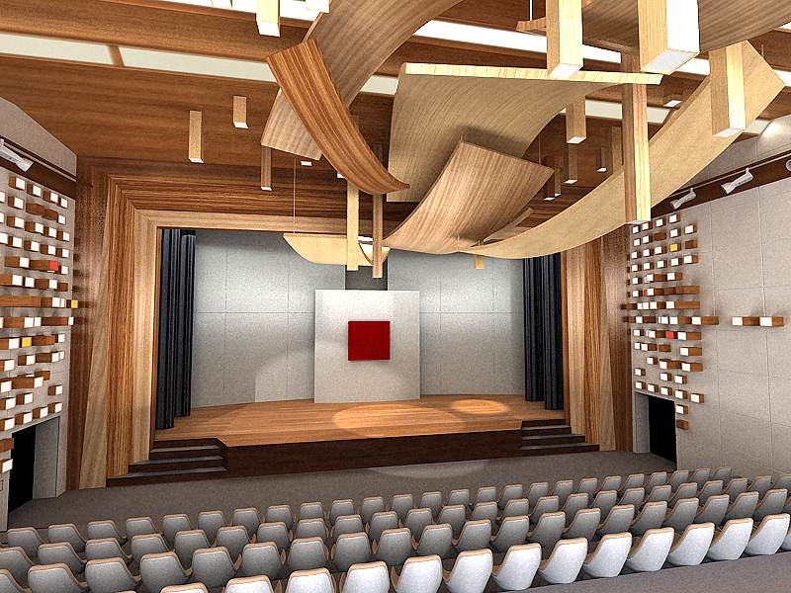
Assembly Hall ...! Entertainers podobatymetsya in such act ... and the audience to look at the artists!

Slide 12
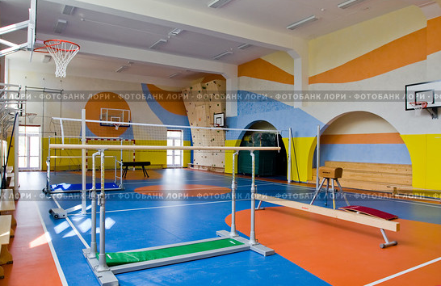
Gym ... for our athletes!

Slide 13
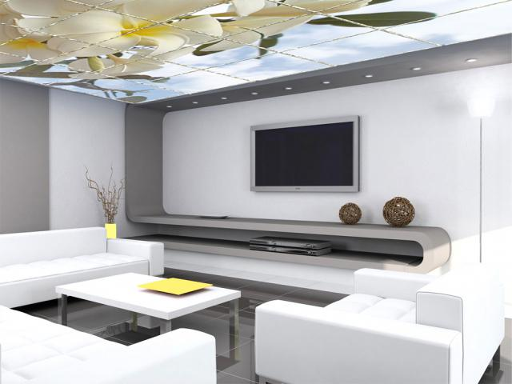
And of course never forget the teachers ... it is their lounge! Teacher ...!

