Slide 1
Famous Scientists And Inventors
Presentation:
Kuzmenko Halyna Form 11

Slide 2
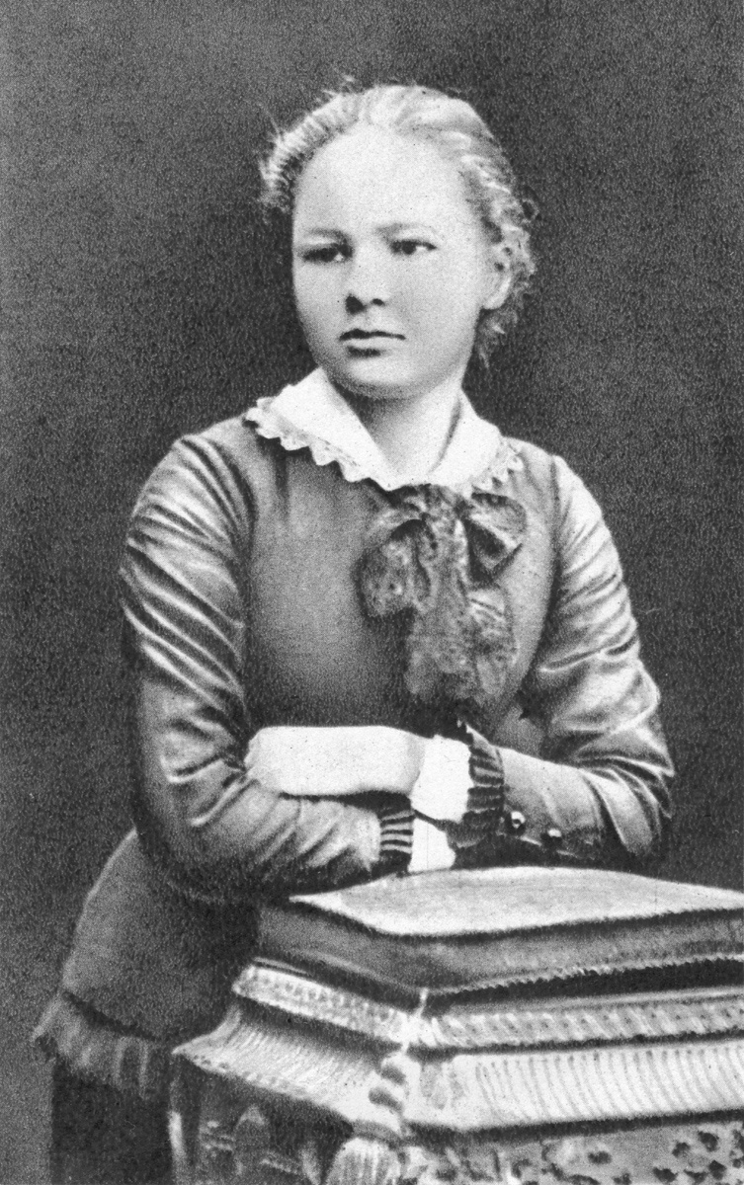
Maria Sklodowska
Famous scientist of physics and chemistry (1867-1934)

Slide 3
Maria Sklodowska was born in Warsaw,of Poland,on 7 November 1867,the fifth and youngest child of well-known teachers Bronislawa and Wladyslaw Sklodowski . Maria´s older siblings were Zofia (born 1862), Jozef (1863) , Bronislawa (1865) and Helena(1866). She was one of the first woman scientist to win worldwide fame , and indeed , one of the great scientist . She had degrees in mathematics and physics .

Slide 4
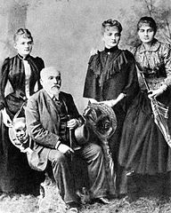
She studied at Warsaw’s clandestine Floating University and began her practical scientific training in Warsaw. In 1891 she studied in Paris, where she earned her higher degrees and conducted her subsequent scientific work. Her achievements included a theory of radioactivity, techniques for isolating radioactive isotopes , and the discovery of two elements , polonium and radium. She founded the Cure Institutes in Paris and Warsaw.
Wladyslaw Skladowski with daughters (from left)Maria,Bronislawa,Helena,1890

Slide 5
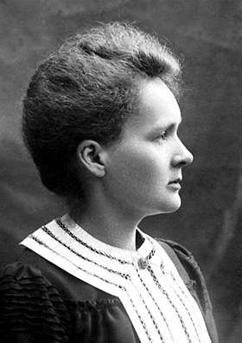
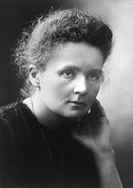
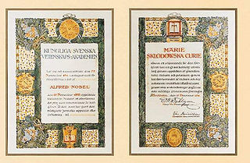
She won of two Nobel Prizes, for Physics in 1903 and for Chemistry in 1911,she performed ploneering studies with radium and polonium and contributed profondly to the understending of radioactivity.

Slide 6
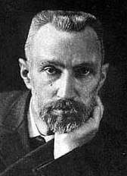
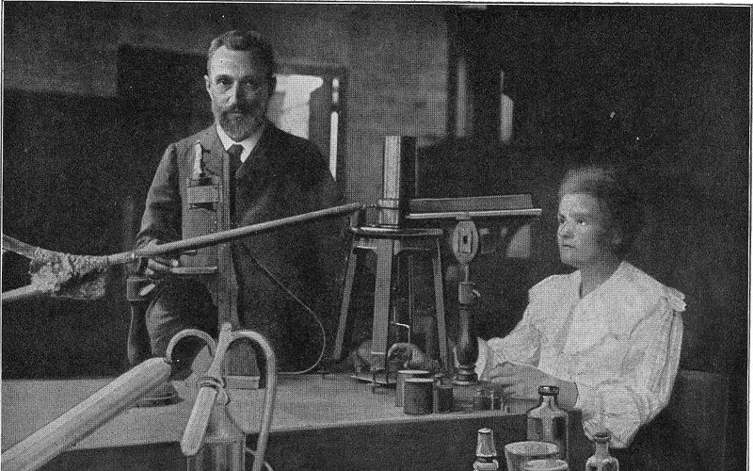
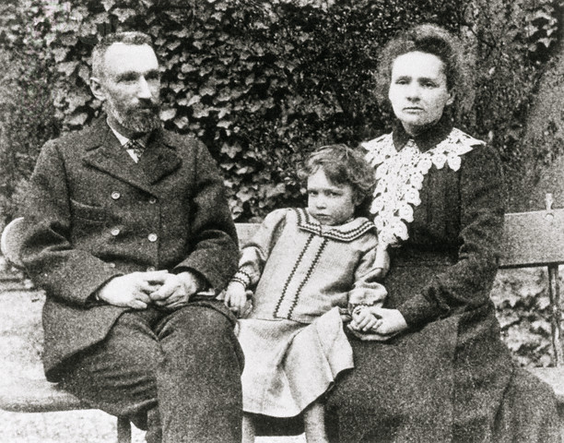
Pierre Curie was her husband. He was a instructor at the School of Physics and Chemistry. On 19 April 1906 Pierre was killed in a street accident. Maria Curie visited Poland for the last time on the spring of 1934, Curie died.

Slide 7
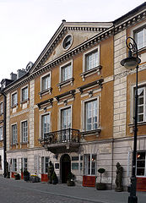
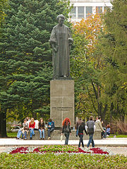

Slide 8
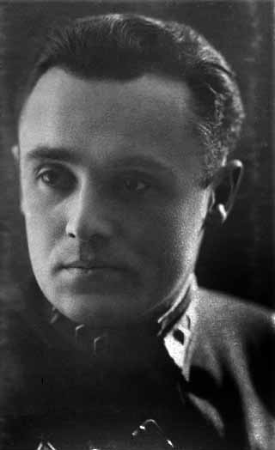
S. P. Korol’ov
Famous scientist and founder of practical cosmonautics (1906-1966)

Slide 9
Academician S.P. Korol’ov is a famous scientist and founder of practical cosmonautics. He was the chief constructor of the first Earth sputniks and space-ships. Korol’ov was born in 1906 in the small Ukrainian town of Zhitomyr into a family of teachers. He spend his childhood with his grendparents in the town of Nezhyn where he studied at home with a teacher.

Slide 10


In 1925 Korol’ov entered the Kyiv Politechnical Institute where he studied aviation and mathematics, but in the evening he had to work at the post-office and he played very small roles in films . After two years in Kyiv Korol’ov come to Moscow. At the Moscow Higher Technical School he learned about Tsiolkovskyi’s ideas on space travel and about his rocket.In 1930 Serhii Pavlovych graduated from the Moscow Higher Techical School and become an aviation engineer.

Slide 11
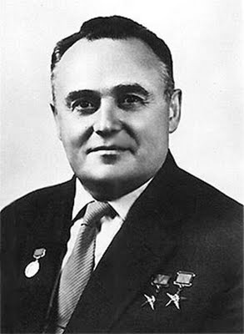
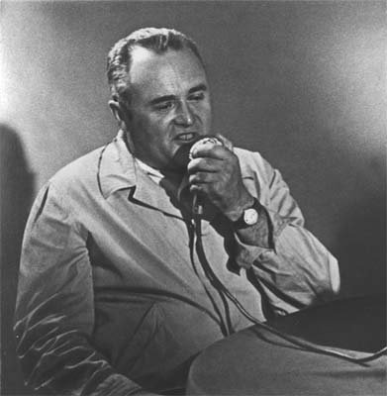
On October 4, 1957 the first man-made sputnik of the Earth was launched into space. It was the result of thirty years hard work and Chief Constructor was Korol’ov. For hes brilliant work in the name of science and progress he was awarded two Gold Stars of the Hero of Socialist labour. S.P. Korol’ov died in 1966.

Slide 12
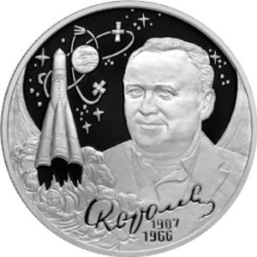
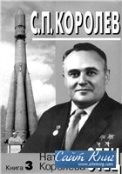
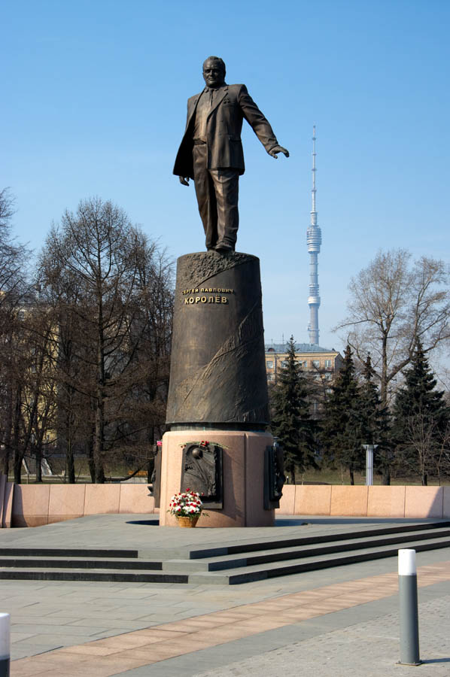

Slide 13
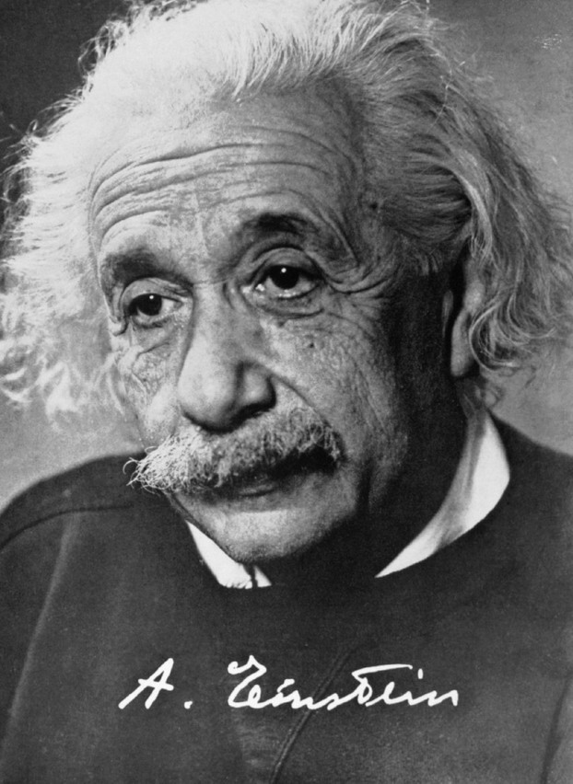
Albert Einstein
Famous scientist of physics (1879-1955)

Slide 14
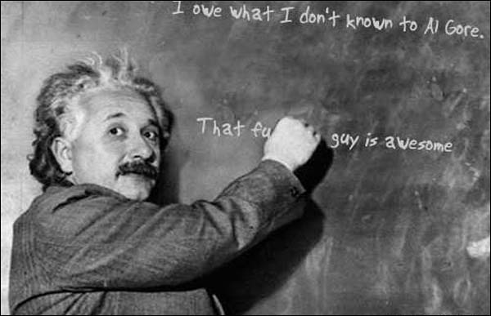
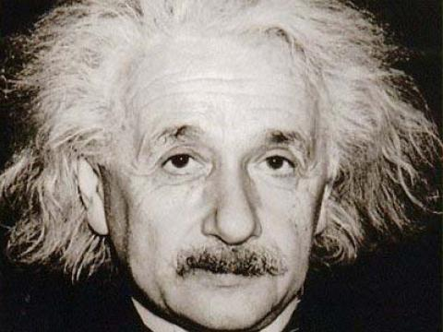
hildren
Albert Einstein was born in Ulm , Germany. He was an unusual child. He seemed to be very slow and dreamy and his parents were worried about him. He started to talk later then most children did. As a schoolboy , he thought a long time before answering questions. But he was far from being stupid. He learned mathematics and loved to use it in thinking about science. He studied physics in Switzerland where he got his first job. In his spare time, he wrote out some of his original ideas on physics. In 1905 he published an article on his special theory of relativity. In 1914 Einstein moved to Germany. He got a teaching job at the Royal Prussian Academy of Sciences. In 1921 he got the Nobel Prize in physics. In 1955, he died.

Slide 15
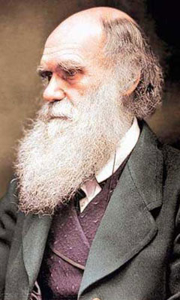
Charles Darwin
Famous scientist of biology (1802-1882)

Slide 16
About 120 years ago Charles Darwin published his famous book “On the Origin of Species”. In this book Darwin put forward his idea that species of animals and plants develop under the influence of the environment. At that time this idea met with strong opposition. Even today some people do not accept evolution as the major factor of formation of plants, animals- and even mankind.

Slide 17
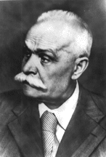
Eugene Paton
FaMOUS INVENTOR OF THE ELECTRIC WELDING(1870-1953)

Slide 18
Eugene Paton was born in the family of Russian Consul in Nice, France in 1870. He was a graduate of Dresden Polytechnic Institute, Germany. But when he came back to Petersburg as a famous engineer, he suddenly changed his mind as to his occupation. He became a student of Petersburg University being a famous engineer and having the project of the Dresden railway station to his credit. In a year , he passed all the exams and got a degree of a railway engineer. Paton was the first to found the Soviet school of bridge-building. He was awarded the title of the Honourable member of the Ukrainian Academy of Sciences. He decided to change his profession when he was 60. He became the founder of the first institute of the electric welding in the world. When he was 80, he headed the design and construction of the first boltless bridge in Kyiv. The bridge is 1150 metres long and is called after Paton.

