Slide 1
10 Most Unusual Jobs

Slide 2
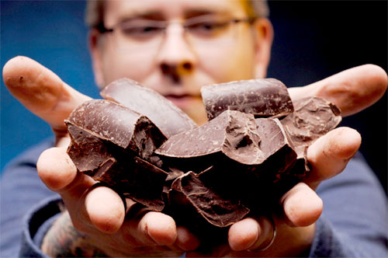
Chocolate Engineer

Slide 3

Island Caretaker

Slide 4
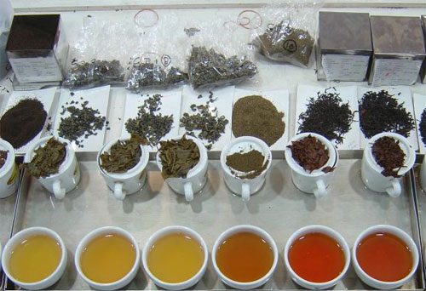
Tea Taster

Slide 5
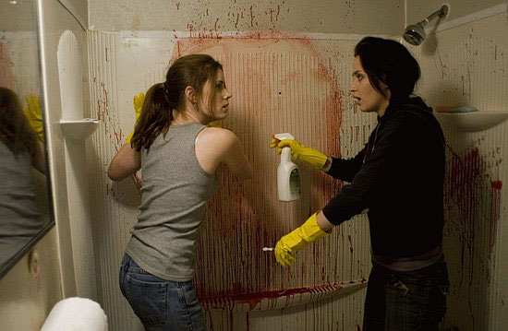
Crime Scene Cleaner

Slide 6
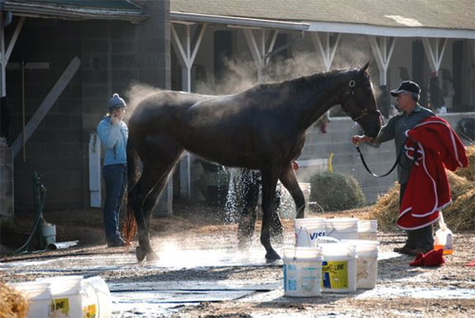
Hot Walker

Slide 7
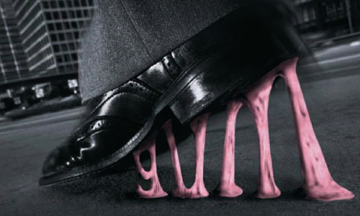
Gum Buster

Slide 8
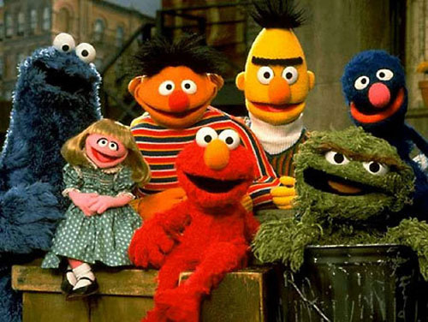
Cartoon Mascots

Slide 9
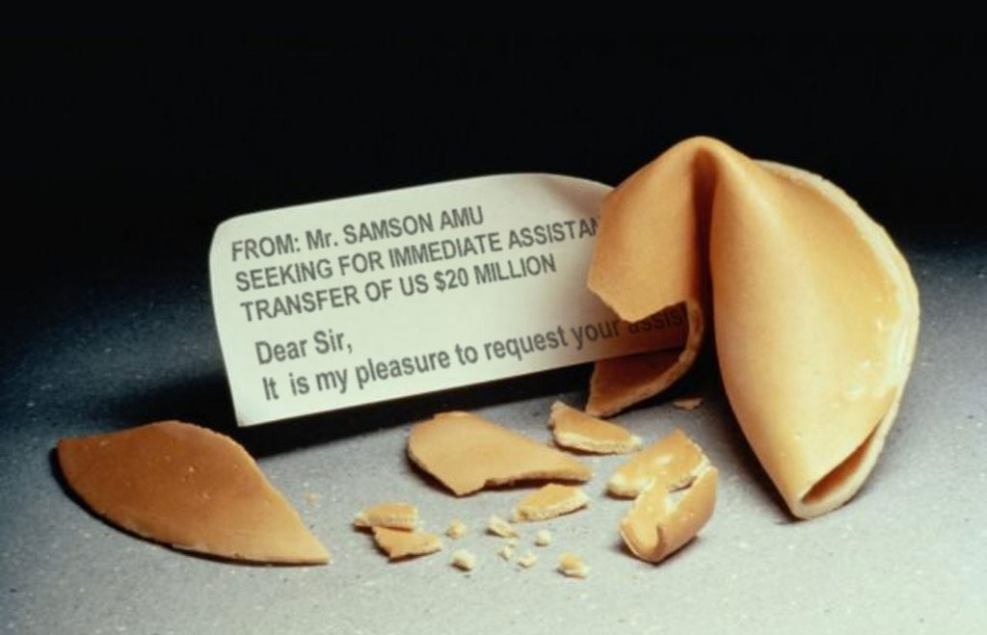
Fortune Cookies Writer

Slide 10
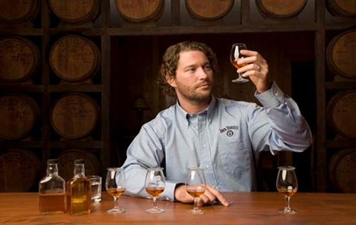
Whiskey Ambassador

Slide 11
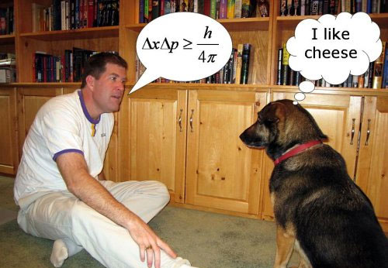
Pet Psychic

