Slide 1
group ABBA
Підготувала учениця 10-А класу:Скрипій Катерина

Slide 2
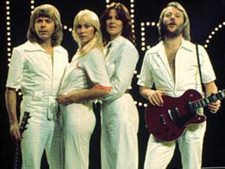
ABBA - Swedish musical quartet that existed in the years 1970-1982 and named for the first letters of the names of the performers. Is one of the most successful teams in the history of pop music. The most popular group established in Scandinavia. Quartet took first place in the world charts since the mid-1970s to the early 1980s.

Slide 3
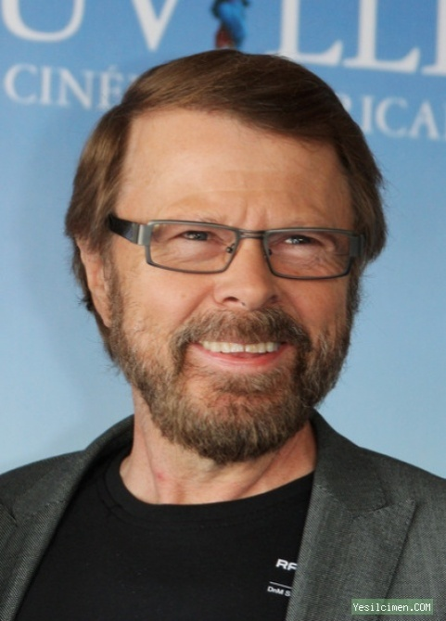
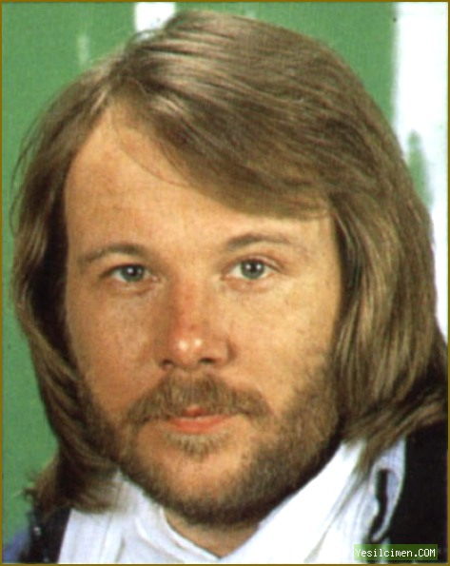
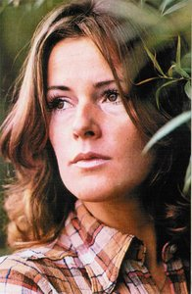
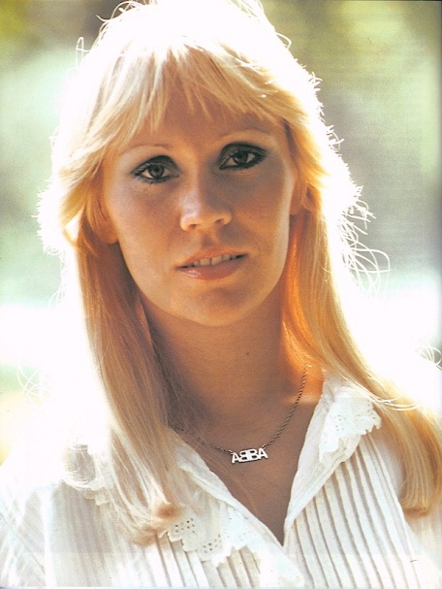
composition
Bjorn Ulvaeus - vocals, guitar (born April 25, 1945, Gothenburg, Sweden);
Benny Andersson - keyboards, vocals (born December 16, 1946, Stockholm, Sweden);
Anni-Frid Lyngstad - vocals (born November 15, 1945, Ballangen / Narvik, Norway).
Agneta Feltskog - vocals (born April 5, 1950, Jonkoping, Sweden);

Slide 4
Who they are: ABBA?

Slide 5
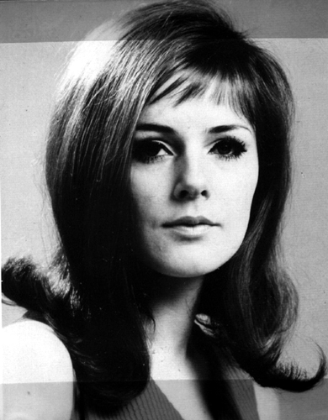
Anni-Frid Lyngstad 13 years singing with various groups working in the dance style. Later moved to jazz band . In 1969, she won a national talent contest . Her professional career began with the signing of the contract with the Swedish branch of EMI in 1967. about the shooting in the studio , she met Benny Andersson . A few weeks later , on a concert tour in southern Sweden , the second meeting . Soon they begin to live together , to with the same time he began producing his solo career Frida . Despite the growing popularity of the quartet ABBA, in late 1975 Frida completed its Swedish- solo album «Frida ensam». It is noteworthy that opened this record song «Fernando», one of the most successful in the history of the group, but in Swedish. Fearing idle speculation , Group Director Stig Anderson insisted on the continuation of joint efforts by the ensemble. Subsequent solo album, the dark-haired soloist ABBA, «Something's Going On», was released only in 1982.

Slide 6
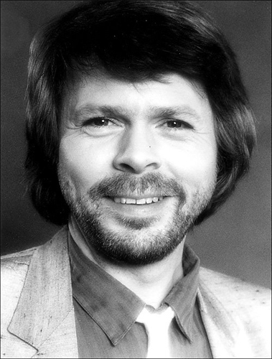
Bjorn Ulvaeus was a soloist of the popular folk group Hootenanny Singers. Andersson and he sometimes met and agreed on a joint record. Stig Anderson, manager Hootenanny Singers and founder of record company Polar Music, saw great potential in the joint work of Andersson and Ulvaeus and strongly supported any of their undertakings. He, like anyone else, believed that someday they became famous throughout the world.

Slide 7
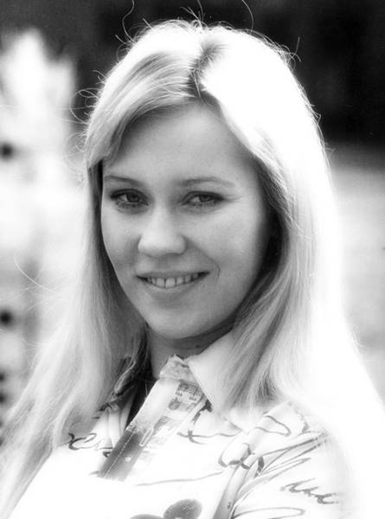
Agneta Feltskog - the youngest member of the group . When she was 17 , her performance in the song became number one in Sweden. Many critics felt that she was a talented composer , most of her songs were written in the style of popular music. Along with writing her own songs she also recorded cover versions of foreign hits and performed them on Swedish amateur competitions . As a result, she became the most popular pop singer of the time. In 1969, Agnetha met with Frida on the TV show , a few months later she met Bjorn at the concert. On the set of a TV show in 1969, they met again with Bjorn , met and married in 1971 . In 1972 Agnetha got the role of Mary Magdalene in the Swedish production of the musical "Jesus Christ - Superstar" . Critics praised her work on this project.

Slide 8
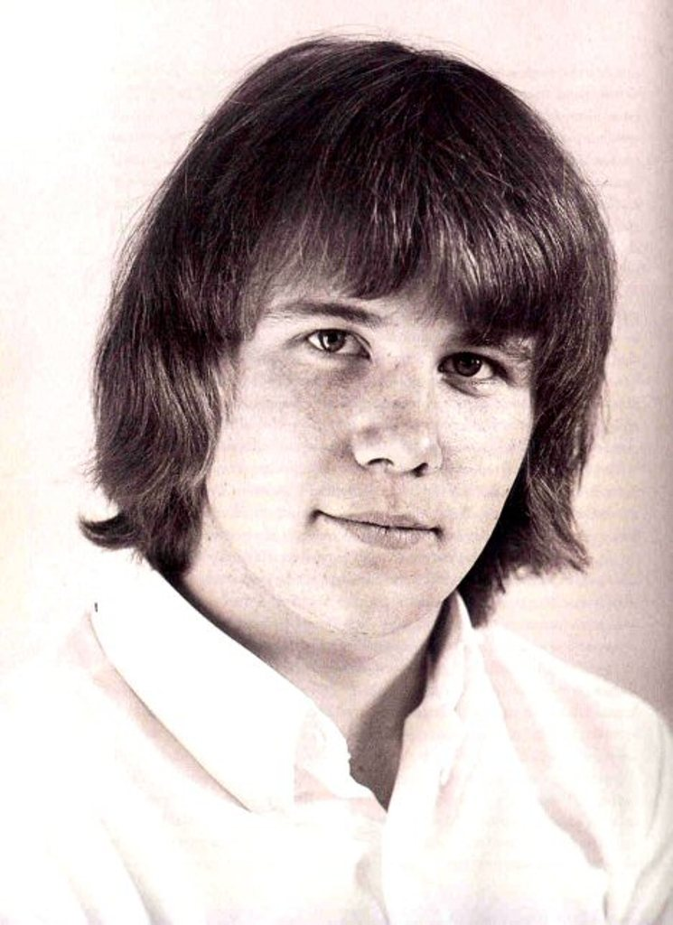
Benny Andersson was keyboardist popular in the second half of the 1960s, the Swedish pop group the Hep Stars. They performed remakes international hits. A strong party of the group were their live performances with a spectacular show. Their fans were mostly young girls. Rightfully called the Swedish «the Beatles». Andersson played on the keyboard and gradually began writing original compositions to the group, many of which have become hits.

Slide 9
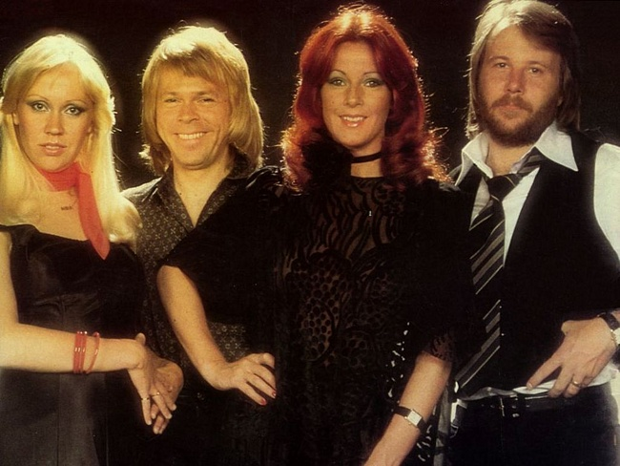
history

Slide 10
snovatelyami group were musicians , singers and songwriters Bjorn Ulvaeus and Benny Andersson. They first met at a party in Vastervik summer of 1966 , where they decided that they should write songs together
For the first time all four gathered to record a program in Stockholm, and started singing along with the November 1970. Simultaneously with the debut of the Quartet, one of the restaurants in Gothenburg
In November 1974 ABBA went on their first international tour to Germany, Denmark and Austria. Tour was so successful as hoped group, because many of the tickets were not sold and due to lack of demand ABBA were even forced to cancel several concerts, including pre-planned concert in Switzerland.

Slide 11
Release their 3 albums ABBA and 3 single SOS hit the top 10, the album reached number 13. The group no longer be treated as a one-hit group.
In November 1975, the band released a Greatest Hits compilation. It includes 6 songs that were in the Top 40 in the UK and the USA. He becomes the first album reached the first place in England, and includes the song Fernando
18 June 1976 ABBA performed before the king of Sweden, on the eve of the Royal wedding, presenting the audience is not a new song Dancing Queen. In February 1977 they made the first British tour
With winter 1981/1982 group activity noticeably slowed down. In December 1982 released the last recorded together single ABBA-Under Attack, although their last hit was Thank You For The Music.

Slide 12
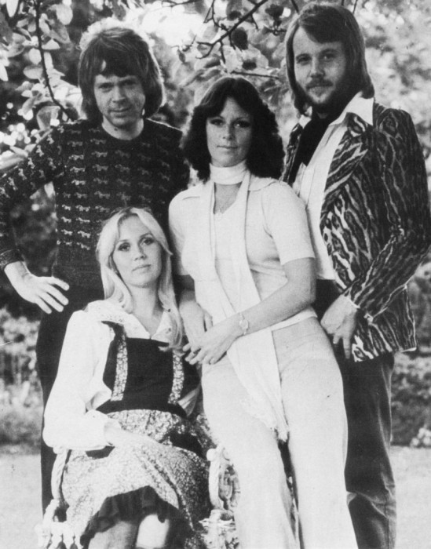
The name of ABBA

Slide 13
Stig spring of 1973, tired of the awkward name of the group, began to call her privately and publicly as ABBA. It originally was a joke, as "Abba" - a name widely known in Sweden seafood processing company. Agnetha on memoirs, "When we decided to call the A-B-B-A, we had to get permission from the company. There, we said, "We agree, just look, so we were not ashamed for you." I do not think they had to be ashamed of the group. "

Slide 14
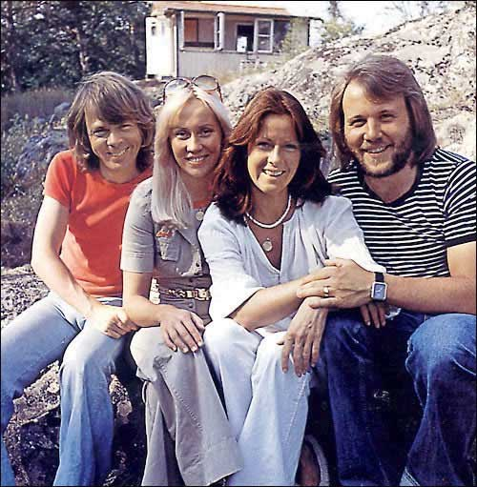
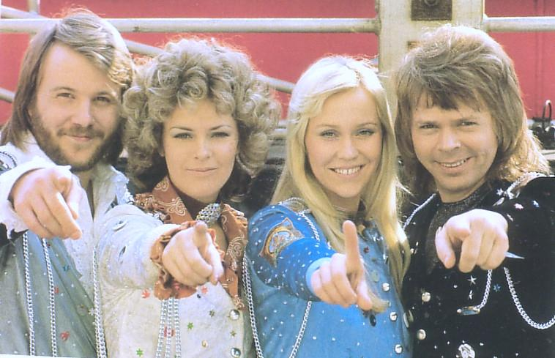
The very first time the name ABBA was found written on paper while recording studio Metronome Studio in Stockholm on 16 October 1973. The first single released under the name ABBA was Waterloo.
ABBA - an acronym formed from the first letters of the names of each member of the group: Agnetha, Bjorn, Benny and Anni-Frid (Frida). The first B in the title of the group was inverted in 1976, and formed a company logo.

Slide 15
the end

