Slide 1
Presentation
“ THE EARTH IS IN DANGER”
By Pupil 11 form
Karpenko Anastasia
The Teacher Klumyk L.V.

Slide 2
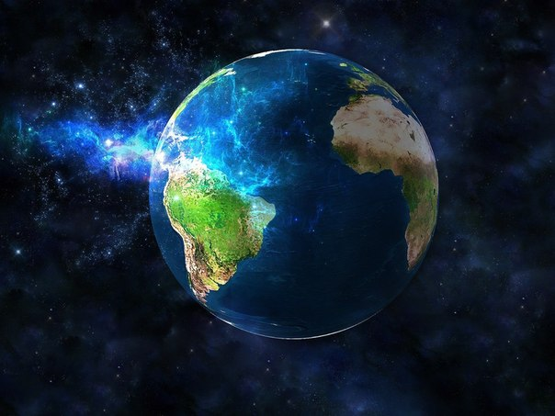
The Earth Is In Danger
The Earth is our home. It gives us everything: food, clothes and houses. But our earth is in danger because people don’t care of it. We want to see blue seas, green trees that are why we must protect our Earth.

Slide 3
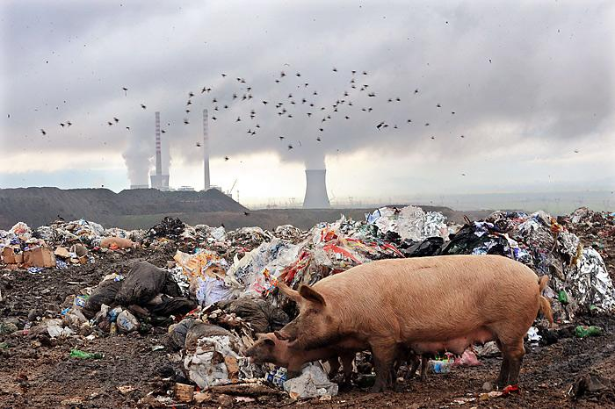
Big cities, towns and villages have many thousands of tons of garbage every week. Every day we throw away bottles, newspapers and food. Most of this garbage can be recycled: paper, glass, metal.

Slide 4
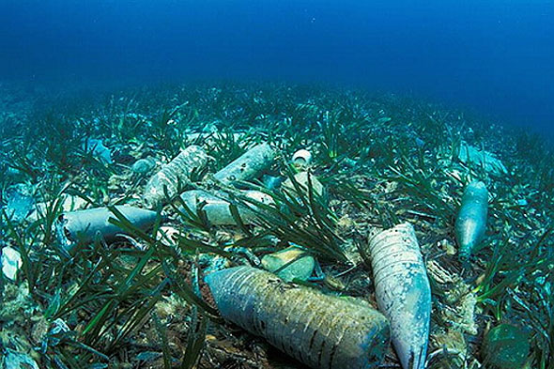
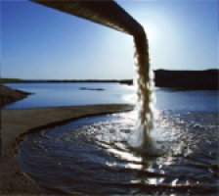
A lot of beaches are closed because of dirty water.

Slide 5
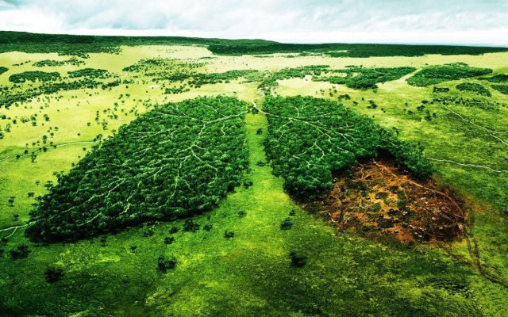
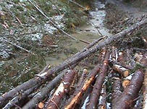
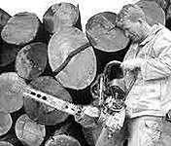
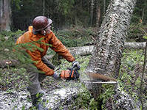
Trees are cut down by people.

Slide 6
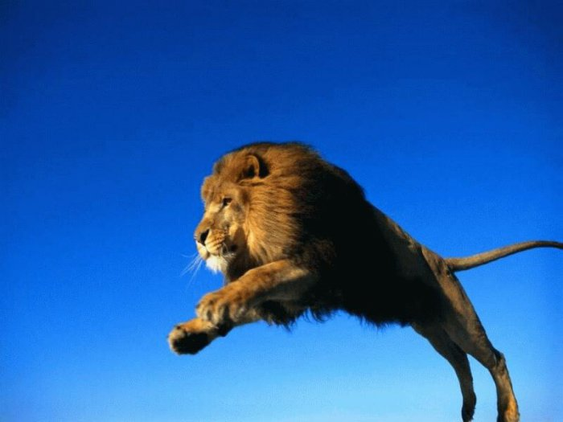
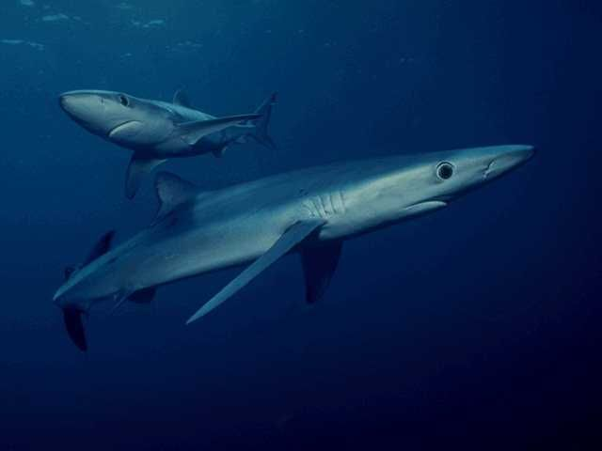
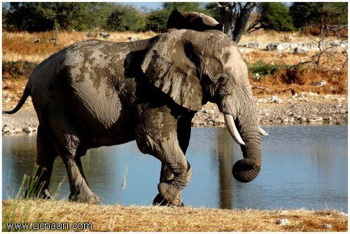
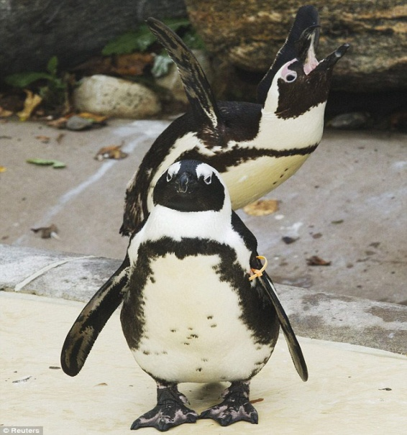
Almost all the animals and plants are in danger because of the pollution. Every day there are more and more animals and plants witch are in danger of becoming extinct. Their natural habitats are destroyed by human activity. Forests are cleared for farming or housing. Oceans and rivers are polluted. Animals are hunted for different reasons. The World Wide Fund for Nature has made a list of endangered species.

Slide 7
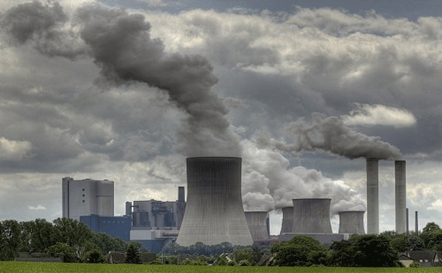
The air is polluted by factories. The cutting of the plants can kill animals that eat them too.

Slide 8
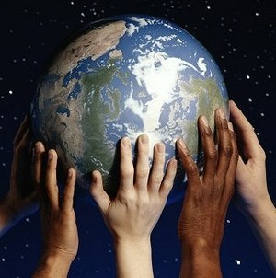
We can protect our Earth from air and water pollutions, killing animals. We must protect the nature because we love it. We must say to pollution “NO!”. The future is in our hands!

