Slide 1
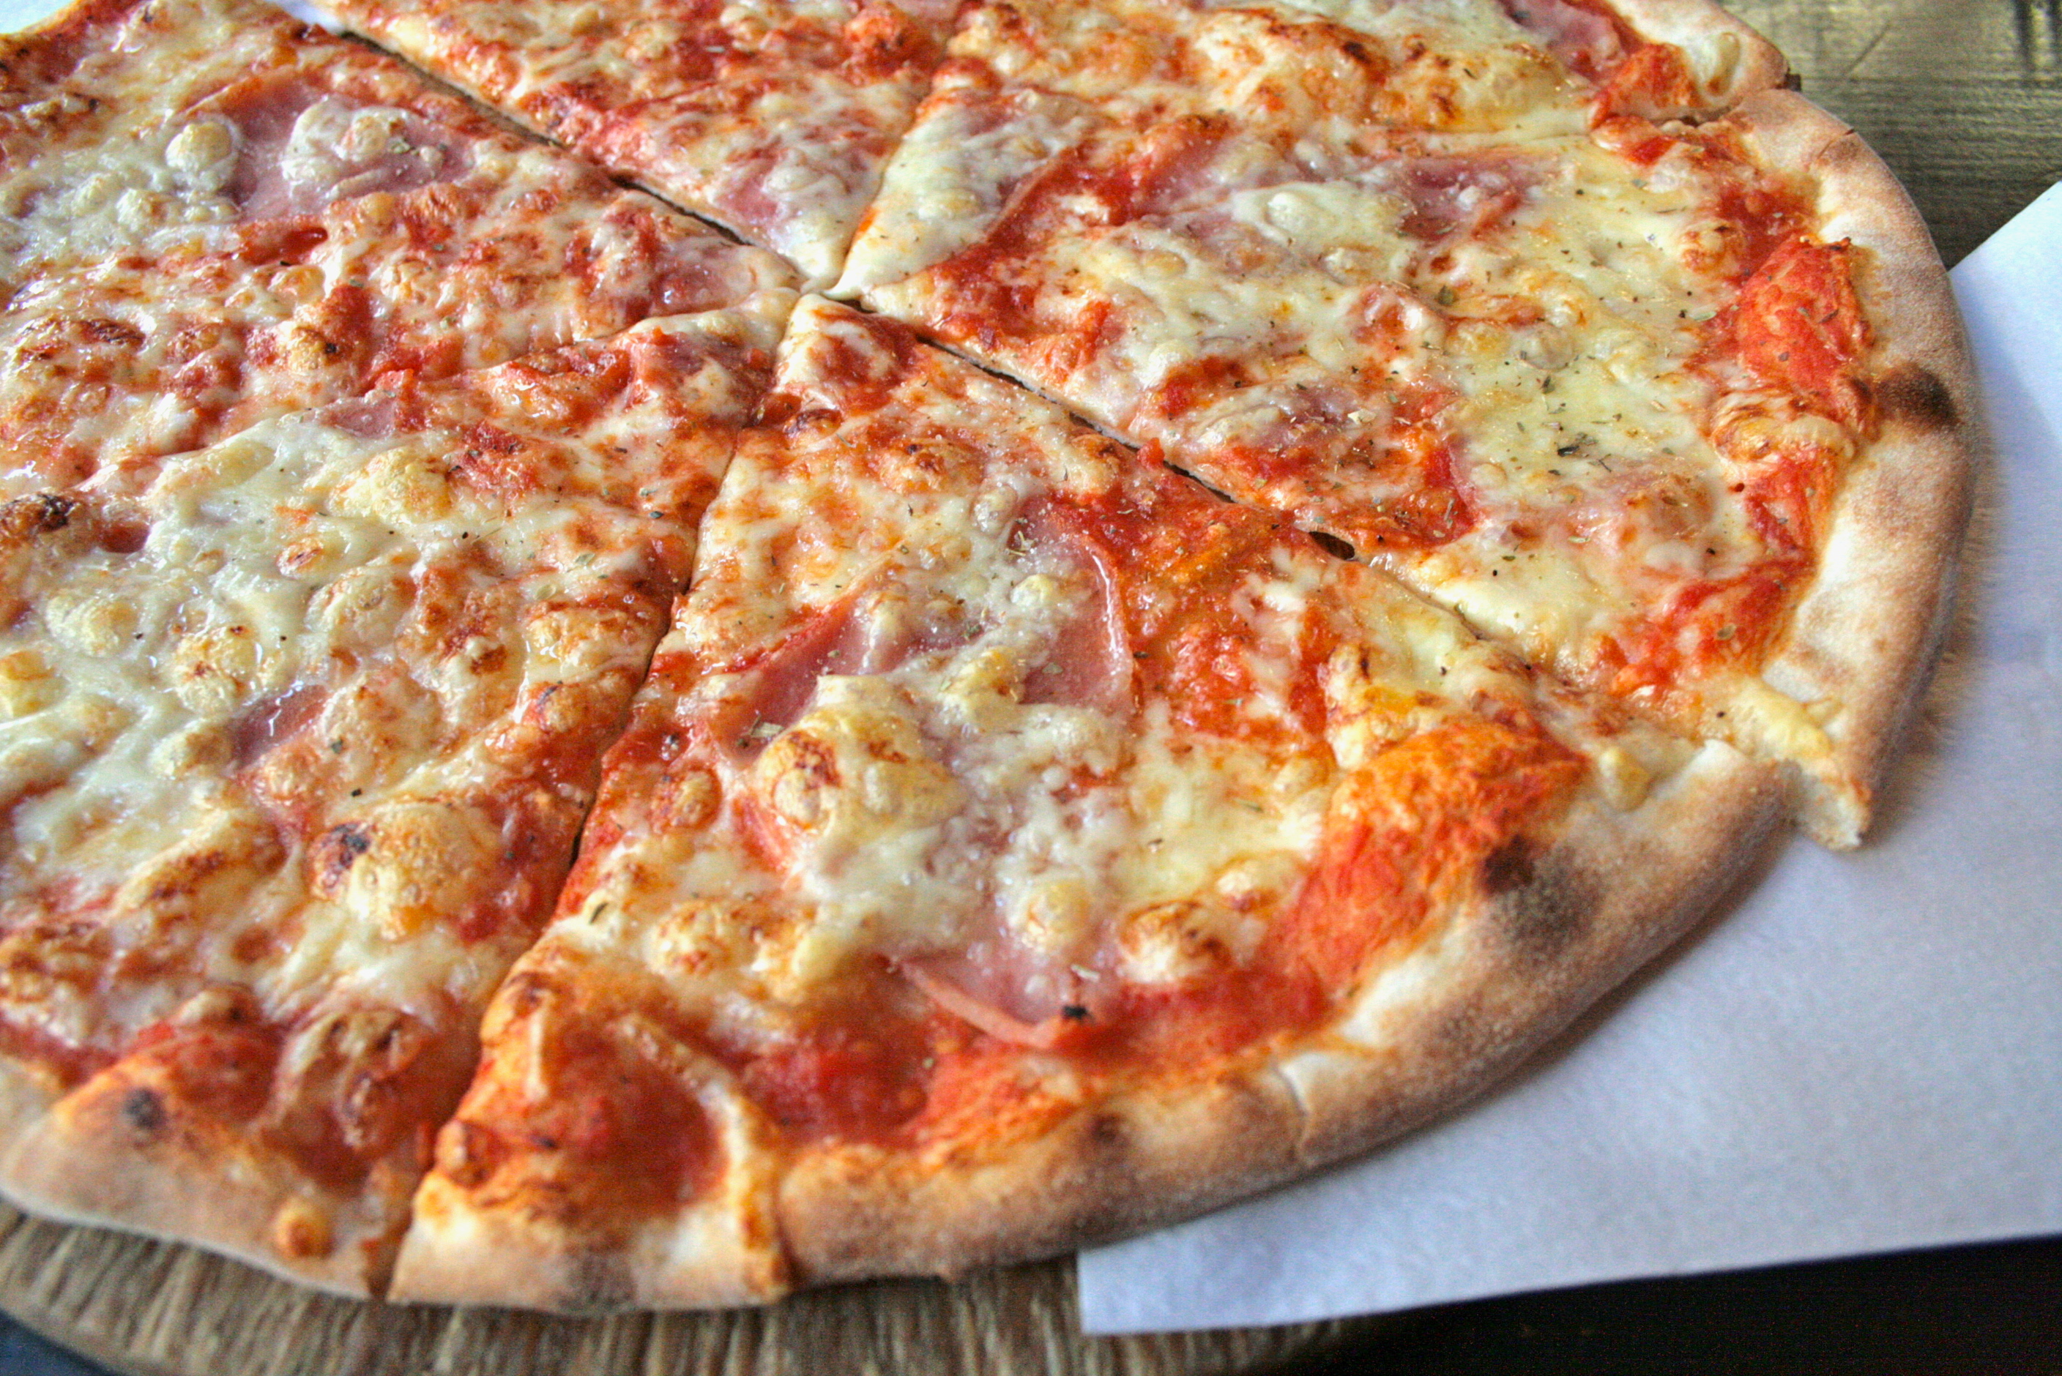
Junk Food

Slide 2


Slide 3
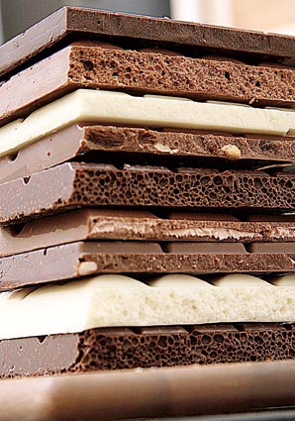
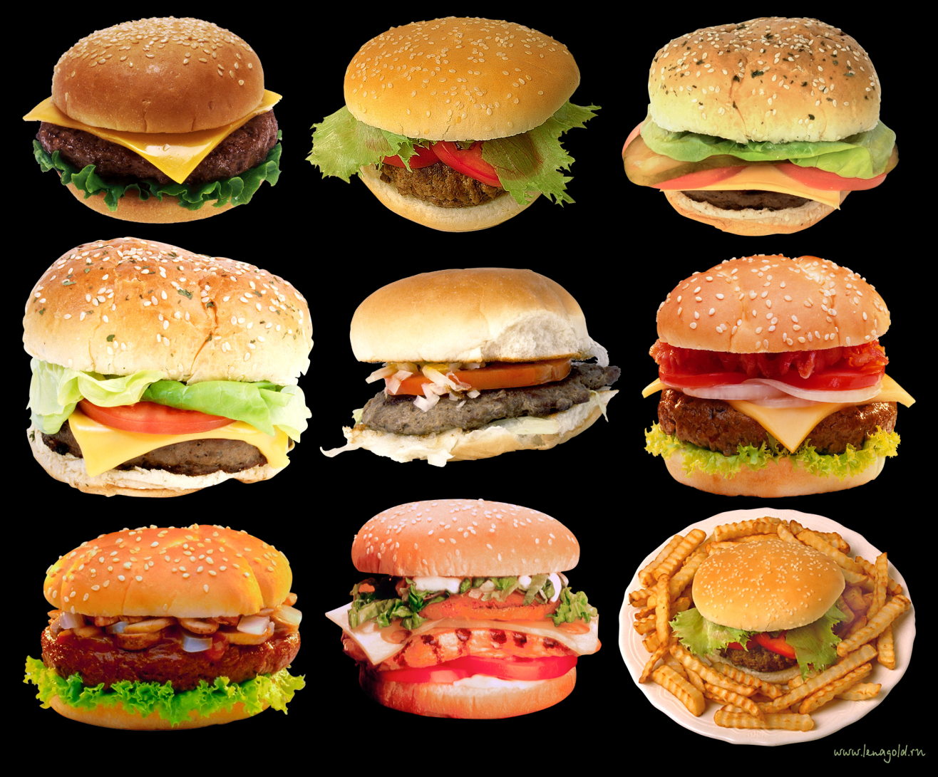
Basically, it is anything that is hight in calories but lacking in nutrition. Hamburgers, crips, chocolate bars and hot dogs fall into this category.

Slide 4


Slide 5
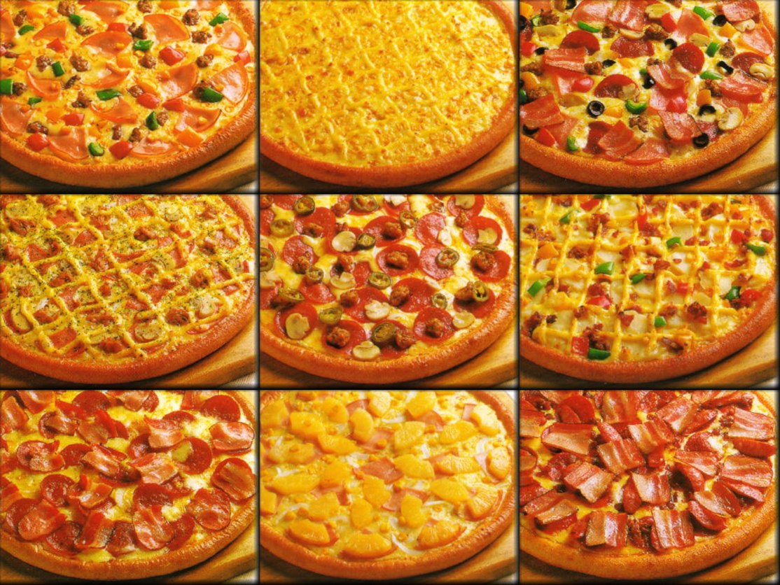
Pizzas, although they can have vegetable and cheese and toppings, are also included as they contain a lot of fat.

Slide 6
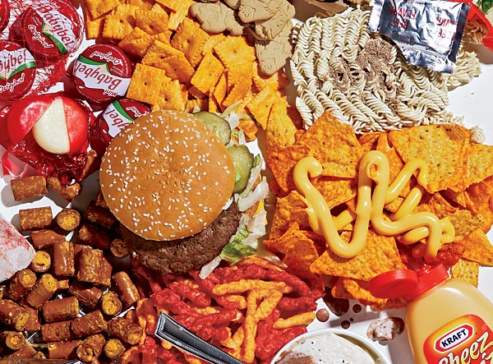
Obviusly, a diet of junk food is not the best thing for you health, particularly as it is high in saturated fat.

Slide 7


In 1993, the Journal of the National Cancer Institute reported this type of fat to be associated with a greater risk of cancer.

Slide 8
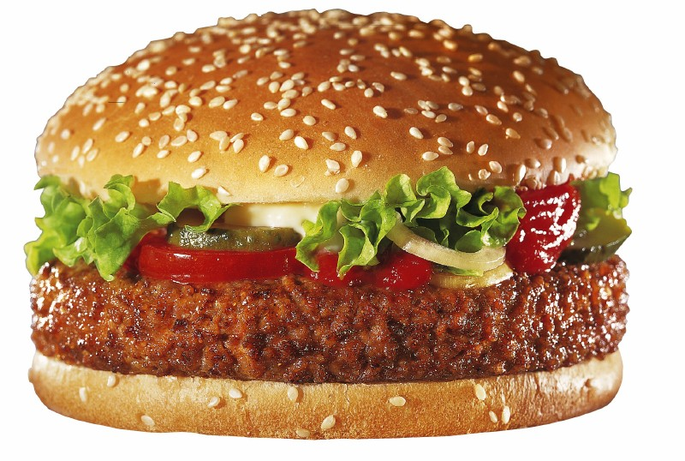
The best advice, then, for those who cannot live without their hamburgers or chocolate bars, is to limit the amount of junk food they eat.

Slide 9

A little now and then will probably do no harm.

Slide 10
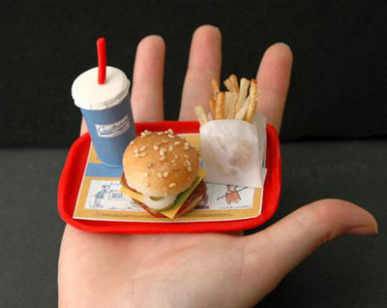

Slide 11

But why have out eating habits changed? “It’s lack of time and loss of tradition,” says one expert.

Slide 12


